Slide 1
Input
Governing Equations
Output
Anthropometric Data
Anthropometric Data
Kinematic Data
Kinematic Data
Kinetic Data
Kinetic Data

Slide 2
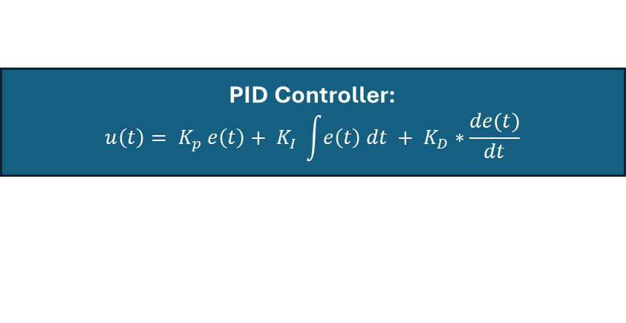
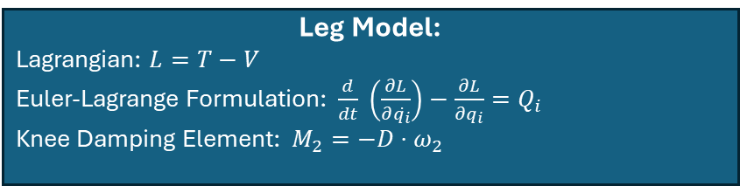

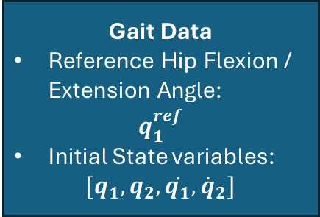
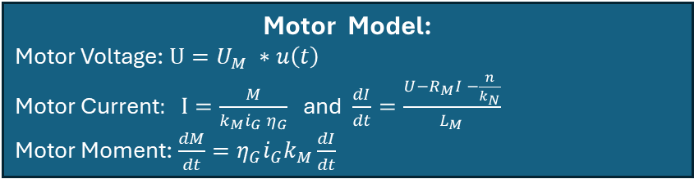

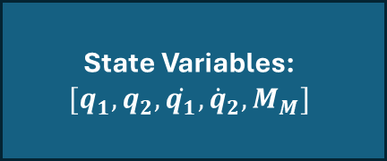

Input
Governing Equations
Output
Anthropometric Data
PID Controller:
$$u\left(t\right)= K_{p} e\left(t\right)+ K_{I} \int{e\left(t\right) dt} + K_{D}∗\frac{de(t)}{dt}$$
Gait Data
Reference Hip Flexion / Extension Angle:
$$q_{1}^{ref}$$
Initial State variables:
$[q_{1}, q_{2}, \dot{q_{1}}, {\dot{q}}_{2}]$
Motor Model:
Motor Voltage: $U=U_{M} ∗u\left(t\right)$
Motor Current$: I=\frac{M}{k_{M}i_{G} η_{G}}$ and $\frac{dI}{dt}=\frac{U−R_{M}I −\frac{n}{k_{N}}}{L_{M}}$
Motor Moment: $\frac{dM}{dt}=η_{G}i_{G}k_{M}\frac{dI}{dt}$
State Variables:
$$[q_{1}, q_{2}, \dot{q_{1}}, {\dot{q}}_{2}, M_{M}]$$
Leg Model:
Lagrangian: $L=T−V$
Euler-Lagrange Formulation: $\frac{d}{dt} \left(\frac{∂L}{∂\dot{q_{i}}}\right)−\frac{∂L}{∂q_{i}}=Q_{i}$
Knee Damping Element: $M_{2}=−D⋅ω_{2}$
Nominal Motor Voltage $$U_{M}$$
PID Controller Parameter
$$K_{p}, K_{i}, K_{d}$$
Ideal Angular Displacement Sensor:
$q_{i}^{sensor}=q_{i}^{actual}$ (no quantization)

Slide 3

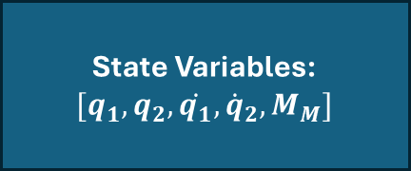

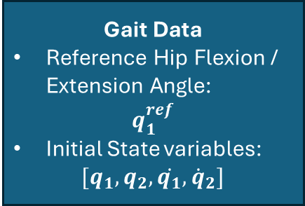
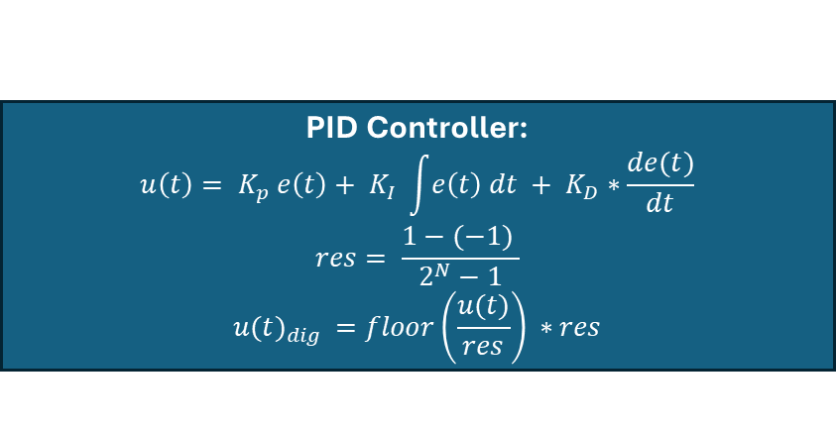



Input
Governing Equations
Output
Anthropometric Data
PID Controller:
$$u\left(t\right)= K_{p} e\left(t\right)+ K_{I} \int{e\left(t\right) dt} + K_{D}∗\frac{de(t)}{dt}$$
$$res= \frac{1−(−1) }{2^{N}−1}$$
$${u(t)}_{dig }=floor\left(\frac{u(t)}{res}\right) ∗res$$
Gait Data
Reference Hip Flexion / Extension Angle:
$$q_{1}^{ref}$$
Initial State variables:
$[q_{1}, q_{2}, \dot{q_{1}}, {\dot{q}}_{2}]$
Motor Model
State Variables:
$$[q_{1}, q_{2}, \dot{q_{1}}, {\dot{q}}_{2}, M_{M}]$$
Nominal Motor Voltage $$U_{M}$$
Leg Model
Real Angular Displacement Sensor:
$$α_{pot}=θ_{hip} −\frac{θ_{min}+ θ_{max}}{2}+\frac{α_{max}}{2}$$
${\tilde{U}}_{a}=U_{0}⋅\left(0.8 −\frac{α_{pot}}{α_{max}}\right)+σ$
$$res= \frac{U_{µC}}{2^{N}−1}$$
$$U_{dig }=floor\left(\frac{{\tilde{U}}_{a}}{res}\right) ∗res$$
Supply Voltage Potentiometer$U_{0}$
PID Controller Parameter
$$K_{p}, K_{i}, K_{d}$$
Noise $σ=0.01 mV$

