Slide 1
Database Design Project
Team Project: Bo Chen, Chong Guo
Source Code: GitHub-GTMRS

Slide 2
Project Introduce
Analyze，generalize， design， implement a simulation of new Georgia Tech Medical Records System
Using the Classical Methodology for Database Development .
Using a relational DBMS that supports standard SQL queries .

Slide 3
Design Process
Entity Relationship (EER) Diagram
Information Flow Diagram
Relational Schema Diagram
Create Table statements
SQL statements for each task
Using Java to implementing a functional application

Slide 4
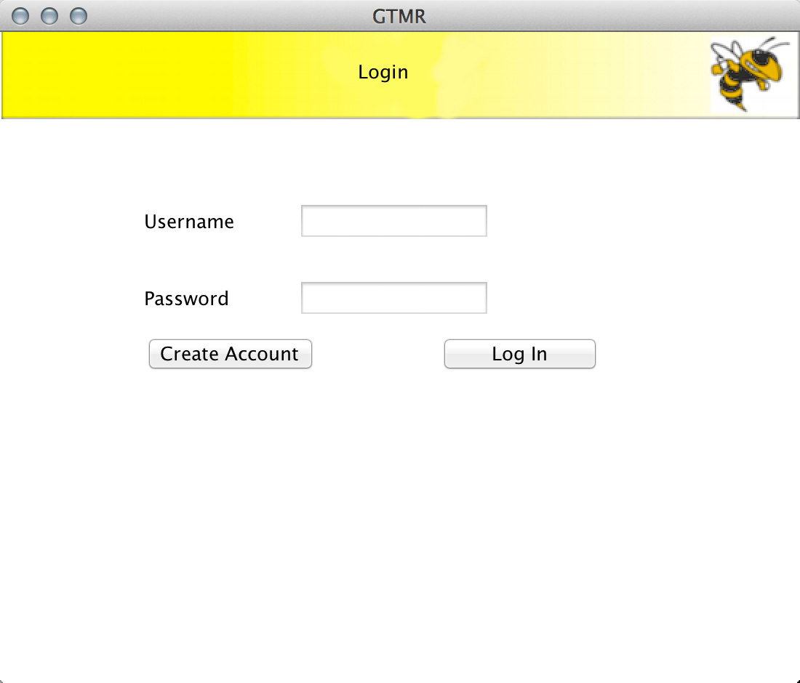
Login Page

Slide 5
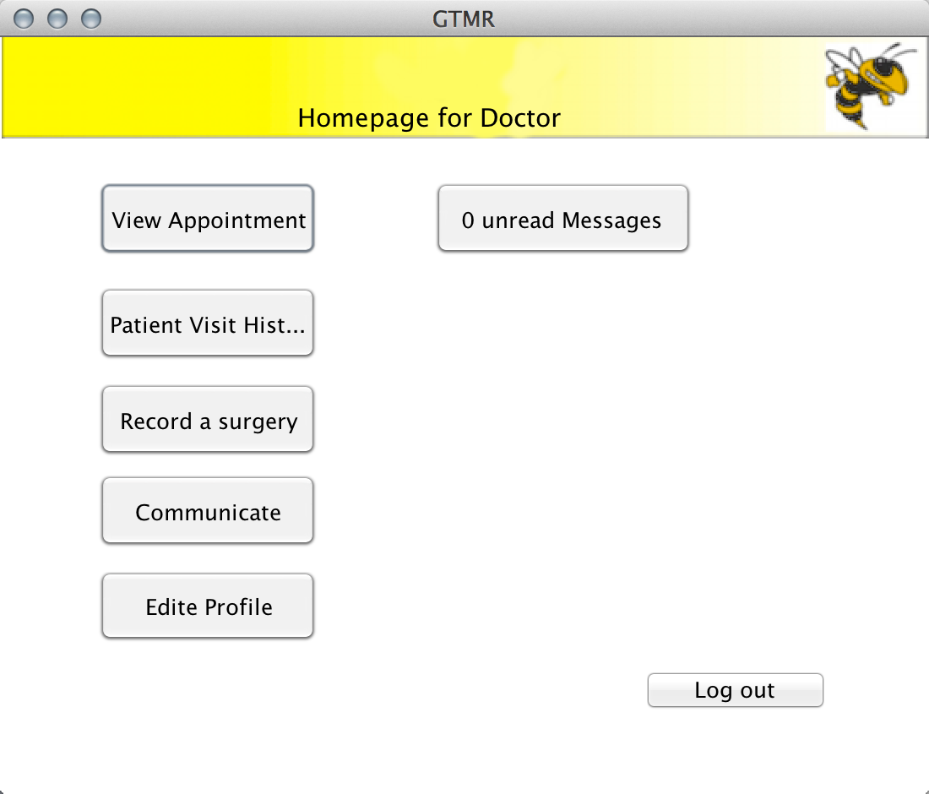
Doctor page

Slide 6
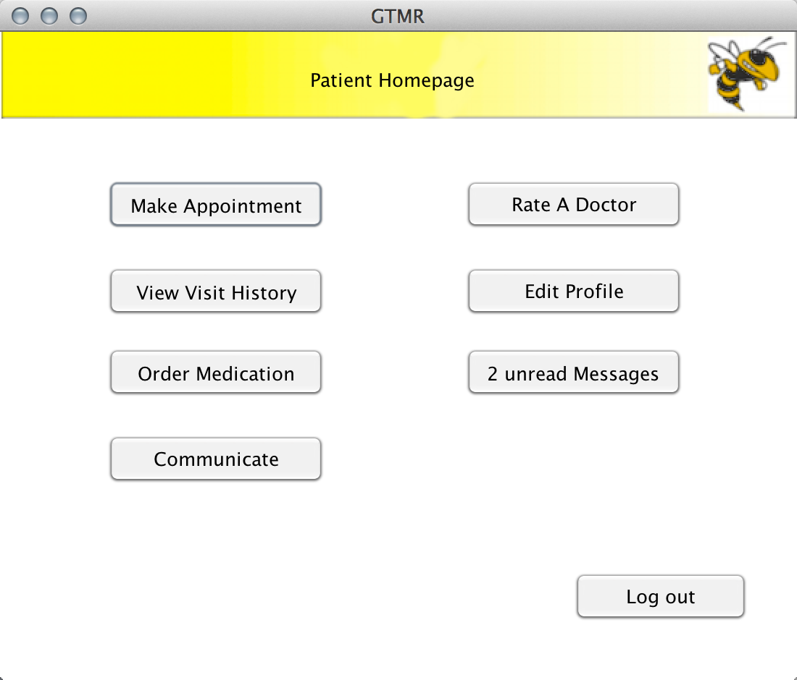
Patient Page

Slide 7
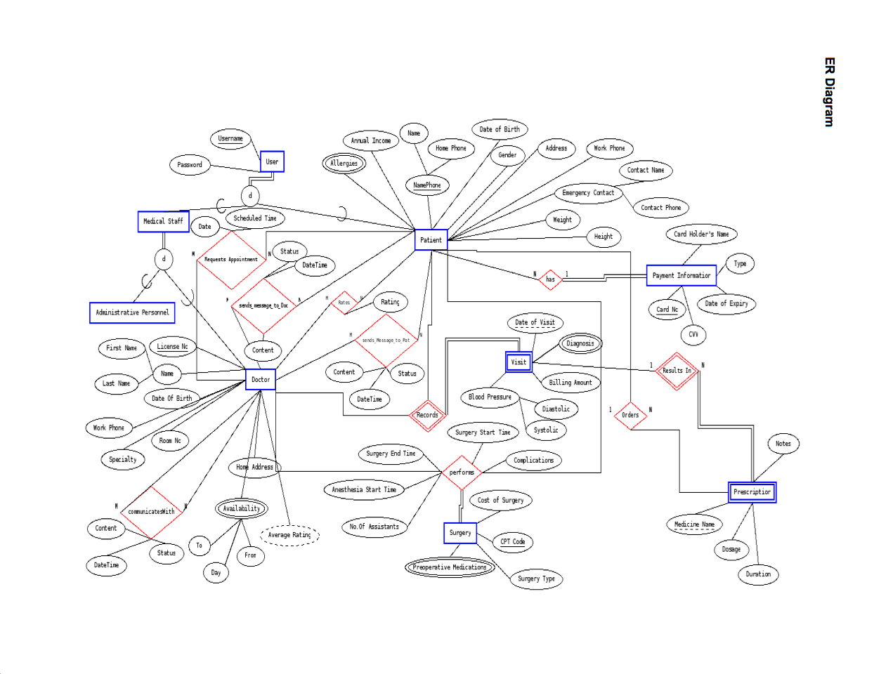
ER Diagram

Slide 8
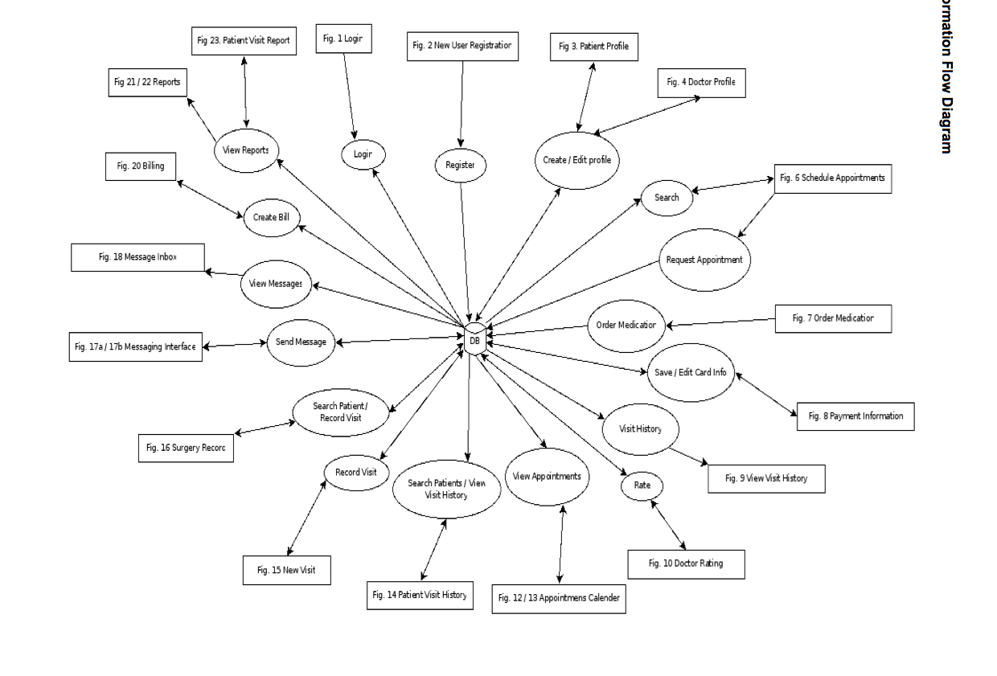
Information Flow Diagram

Slide 9
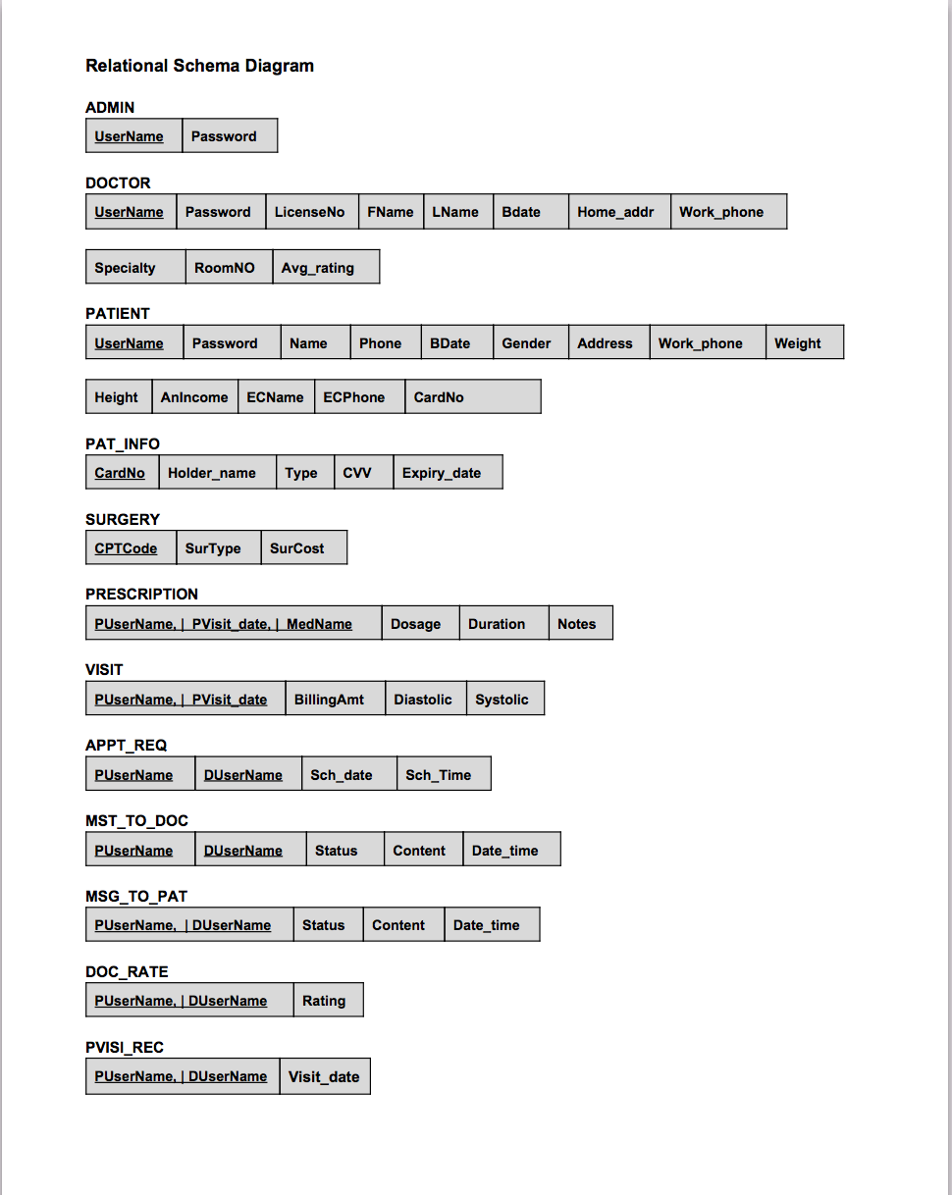
Relational Schema Diagram

