Slide 1
MEM

Slide 2
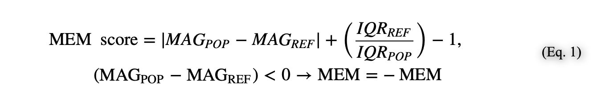
MEM score
MAG is feature magnitude (here, median protein expression detected by mass or fluorescence flow cytometry), and IQR indicates the interquartile range.
https://www.ncbi.nlm.nih.gov/pmc/articles/PMC5330853/

Slide 3
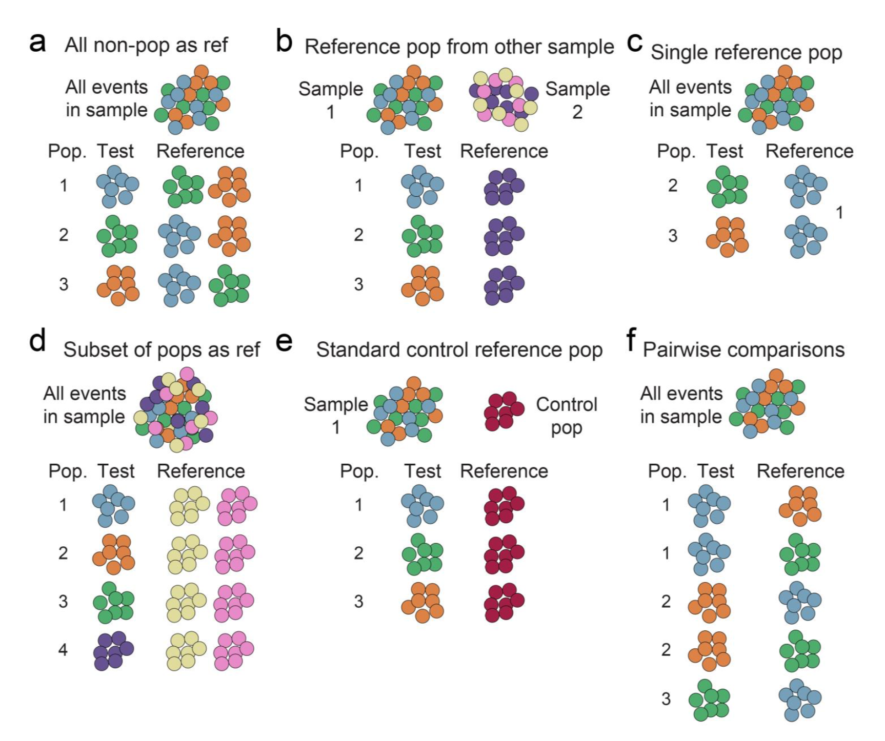
Method A, with all events in live single lymph - for each phenograph cluster

