Slide 1
MEM

Slide 2
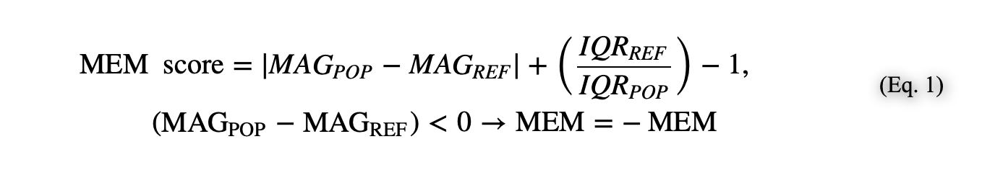
MEM score
MAG is feature magnitude (here, median protein expression detected by mass or fluorescence flow cytometry), and IQR indicates the interquartile range.
https://www.ncbi.nlm.nih.gov/pmc/articles/PMC5330853/

Slide 3
MEM scores are contextual; a population's MEM score depends on the reference population(s) to which it is compared. Selection of a reference population should be made deliberately depending on the biological question being addressed. When populations in a MEM analysis arise from different experimental sources, it may be necessary in some cases to normalize measurements prior to MEM analysis to avoid artifacts from experimental variation.
https://www.ncbi.nlm.nih.gov/pmc/articles/PMC5330853/

Slide 4
MEM score
The + or − value provided along with the marker name is converted to a −10 to +10 scale and rounded to the nearest integer. As implemented here, the maximum of the scale was set using the highest absolute value MEM score observed across all markers and populations. All values in the matrix are divided by this maximum value and multiplied by 10 to achieve the −10 to +10 scaling.
https://www.ncbi.nlm.nih.gov/pmc/articles/PMC5330853/

Slide 5
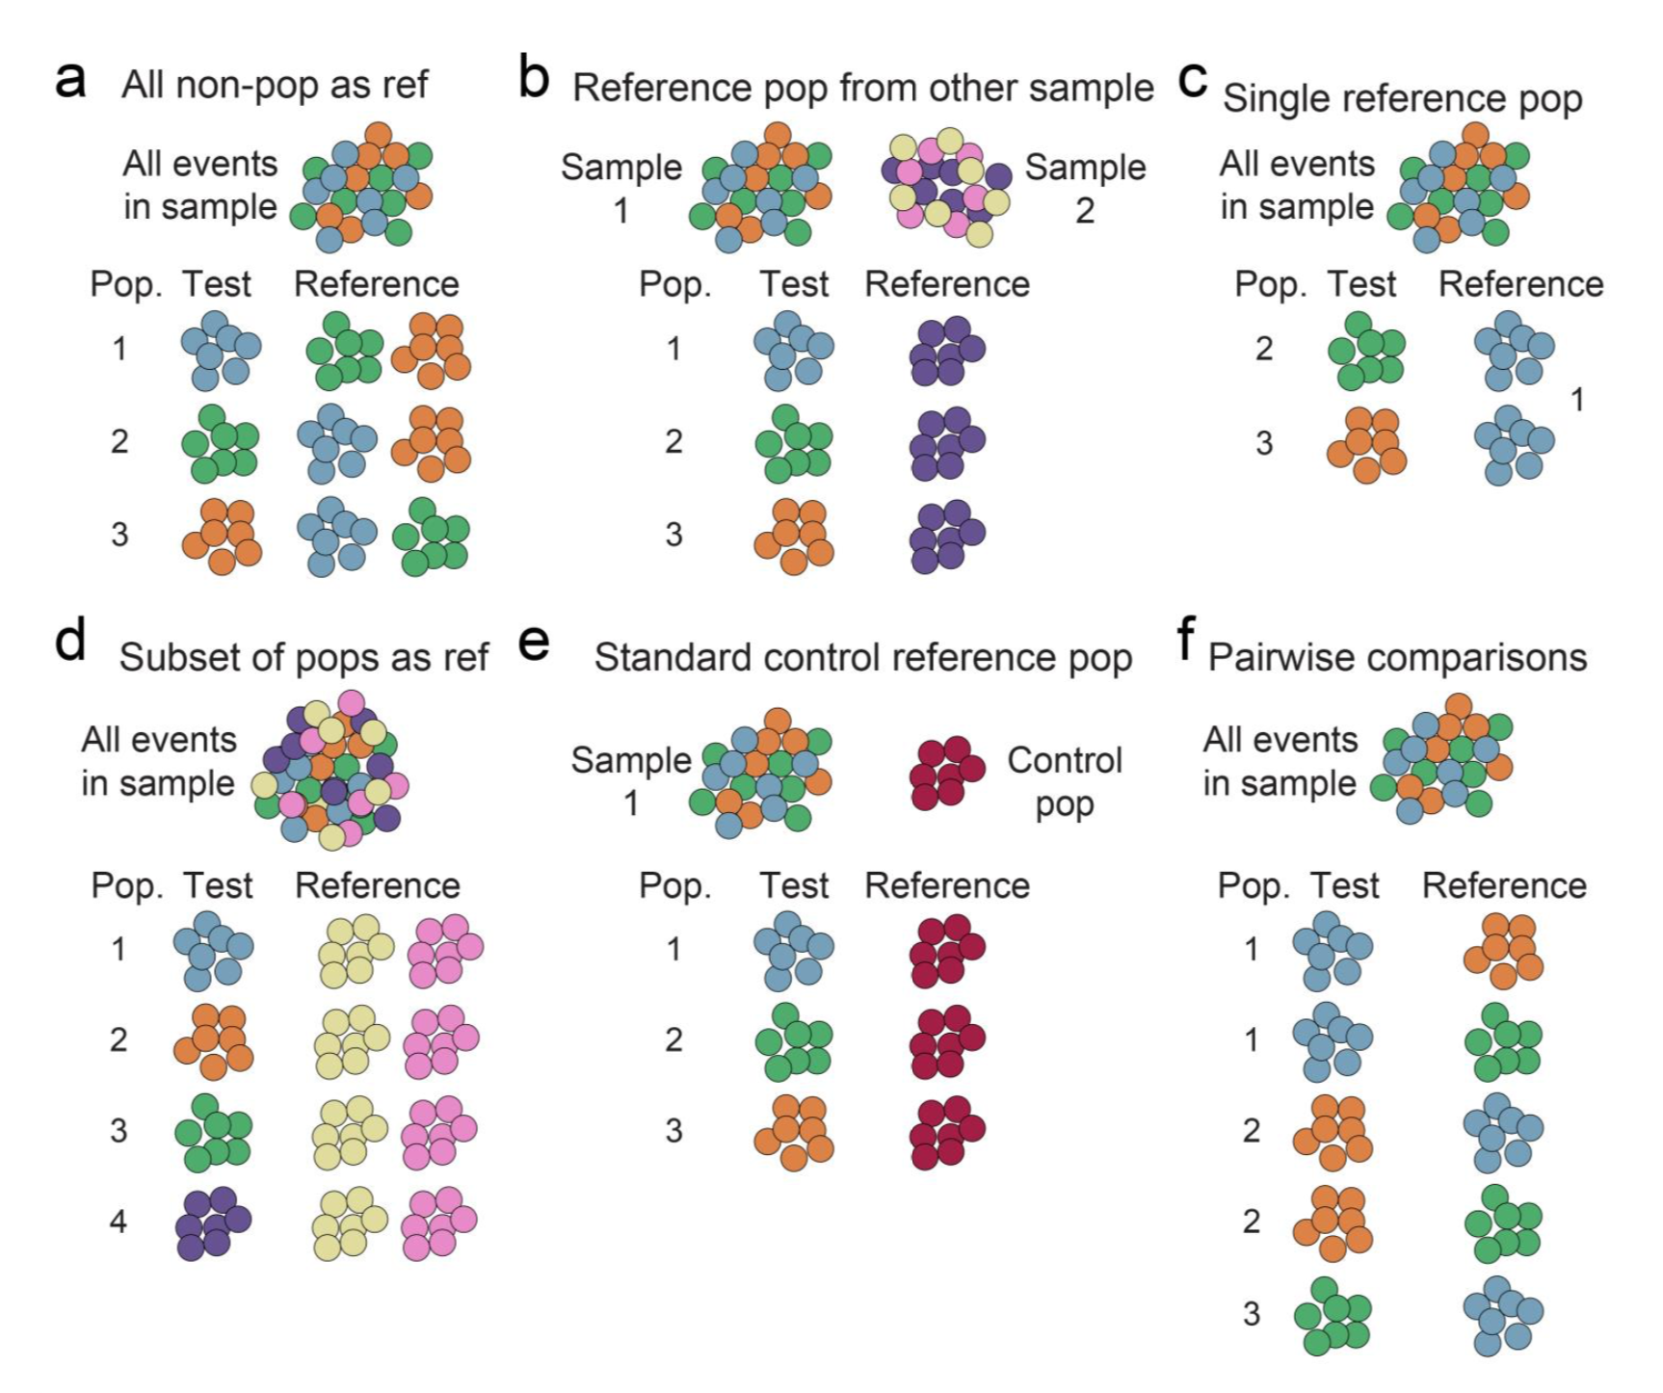
Method A, with all events in live single lymph - for each phenograph cluster

