Slide 1

Cruise Training
Preparation For CI

Slide 2
What You’ll learn
  Manage project using VCS
  Automate build using Ant
  Automate test using JUnit

Slide 3
Continuous Integration: best practices
  Get everything you need into source control
  Get the build automated
  Introduce some automated testing into you build

Slide 4
Version Control System (VCS )
  How do you use VCS?

Slide 5
Different types of VCS:
  Centralized VCS
  Distributed VCS

Slide 6

Centralized VCS

Slide 7

Distributed VCS

Slide 8
Centralized VCS vs Distributed VCS
  Commit locally
  Central control
  Distributed team

Slide 9
Workshop Using SVN
Setup svn server
Setup svn repository
Put a new project into svn
Edit existing files

Slide 10
Workshop Using HG
Setup hg repository
Put a new project into hg
Edit existing files

Slide 11
Build: Question:
How to make your build automated?

Slide 12
Build tools:
  Ant
  Nant / MSbuild
  Rake

Slide 13
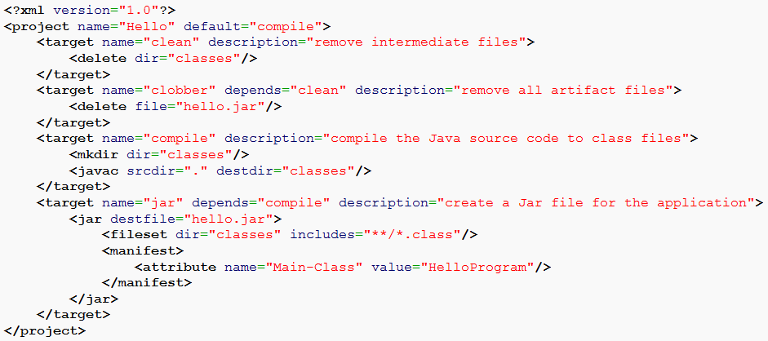
Basic format of Ant:

Slide 14
Automated test tools:
  JUnit
  NUnit
  xUnit family

Slide 15
Preparation: Let’s Go
  JDK
  Ant
  Subversion
  Setup a new repository
  Write the first ant build file and run it

Slide 16
Summary
  Version Control System
  Automated build tools
  Automated test tools

Slide 17
Questions

Slide 18
Cruise Training
Installation Of Cruise

Slide 19
What You’ll learn
  How to install cruise on Windows, Ubuntu, Mac, Redhat, Solaris and SUSE
  How Cruise server and agent work together
  How to add/remove agents
  How to upgrade

Slide 20
Installation
  Installer files for server and agent
    Windows: .exe installer
    Ubuntu: debian pkg file
    Mac: .app file
    Redhat/SUSE: rpm installer
    Solaris:
  Need to specify the server ip after installed agent

Slide 21
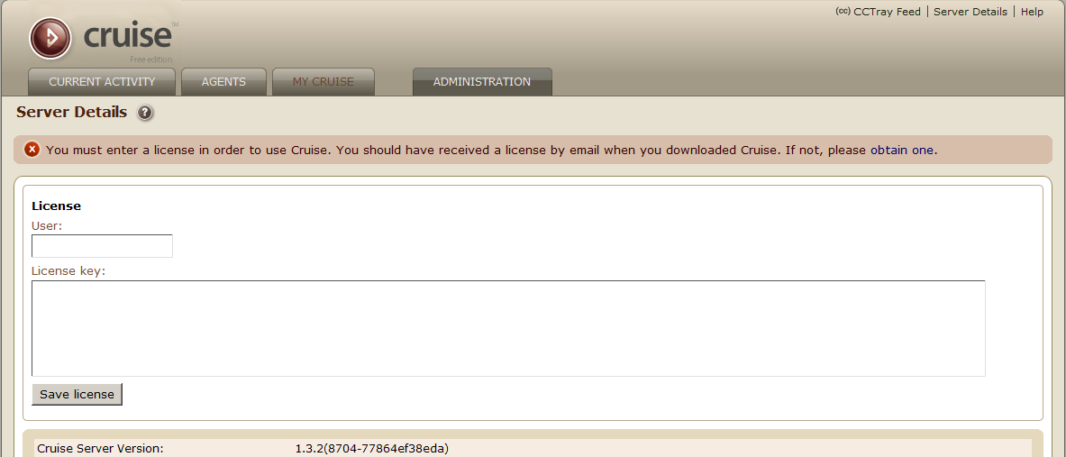
Cruise Server: after installed

Slide 22
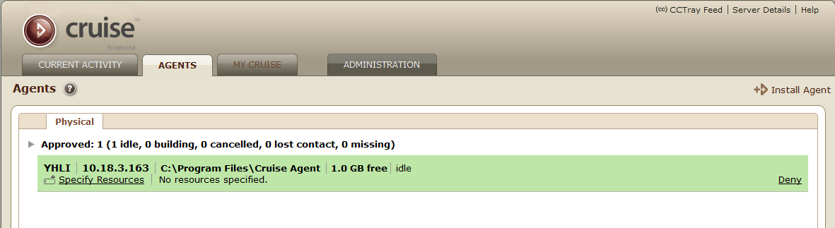
Cruise agent: after installed

Slide 23
How Cruise server and agent work together
VCS
Agent grid
Cruise Server
agent
agent
agent
agent
agent
agent
agent
agent
agent
Browser
http://cruise_server:8153

Slide 24
Installation: View status
  Check the server and agents works
    Access http://cruise_server:8153 to check if server works
    open Agents tab and you should see your agent is listed

Slide 25
Installation: Setup build cloud
  Install multiple agents on different machine
  approve it from server

Slide 26
Installation: Upgrade Server
  Backup database
  Backup config file
  Upgrade using installer

Slide 27
Installation: Upgrade Agent
  Cruise agent will be upgraded automatically

Slide 28
Questions

Slide 29
Thanks

