Slide 1

Cruise Training
Introduction of Cruise
Notes:
[Welcome]
Welcome to the Cruise training, this is the second lesson and we'll introduce the core features in Cruise.
If anyone lost during the presentation, please feel free to stop me directly. it would also help the others to understand it, and help me to do it better next time.

Slide 2
What you’ll learn
  Cruise Core Features
  Licensing and Pricing

Slide 3
Questions
List the things we want to get from continuous integration
Notes:
[Questions]
We introduced what is the CI and why we need it in last lesson. Before we start, we need to think about how it can help us on the software development.
* we know that the whole point of the CI is fast feedback
if the time of running the tests getting longer and longer, how can we make it fast
* If we use a cron job to do the CI, after it finished, we need to check the log file to see if the build succeed or failed?
* When we working on a cross-platform project, and need to support multiple databases, how can we run different tests on different environment?
* Have you worked on a project which doesn't allowed everyone to see it or operate it?

Slide 4
Things We Need To Do In CI
Fast Feedback
Run tests on specified environment
Artifacts
Easy to know the build result after commit
Security
Extensible

Slide 5
Fast Feedback:
Separate to different stages
Run tests parallel

Slide 6

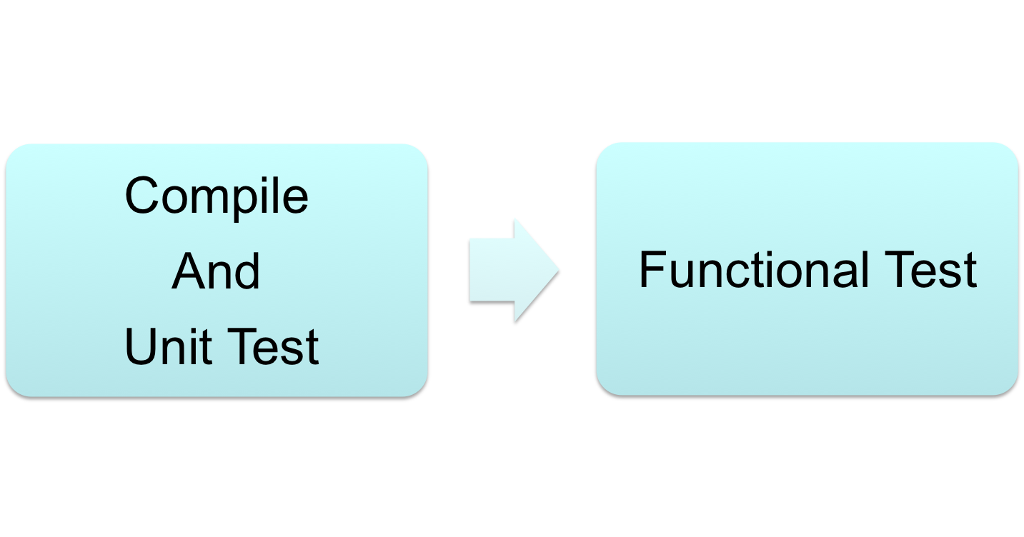
Basic Work Flow
Basic Steps In a Build
Compile
Unit Test
Functional Test
Disadvantages:
Slow to get feedback
Don’t know which part failed

Slide 7
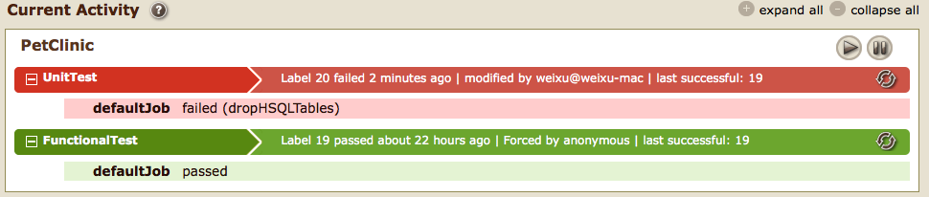
What Can We Get
Fast Feedback
Visibility
Customizable Stages

Slide 8
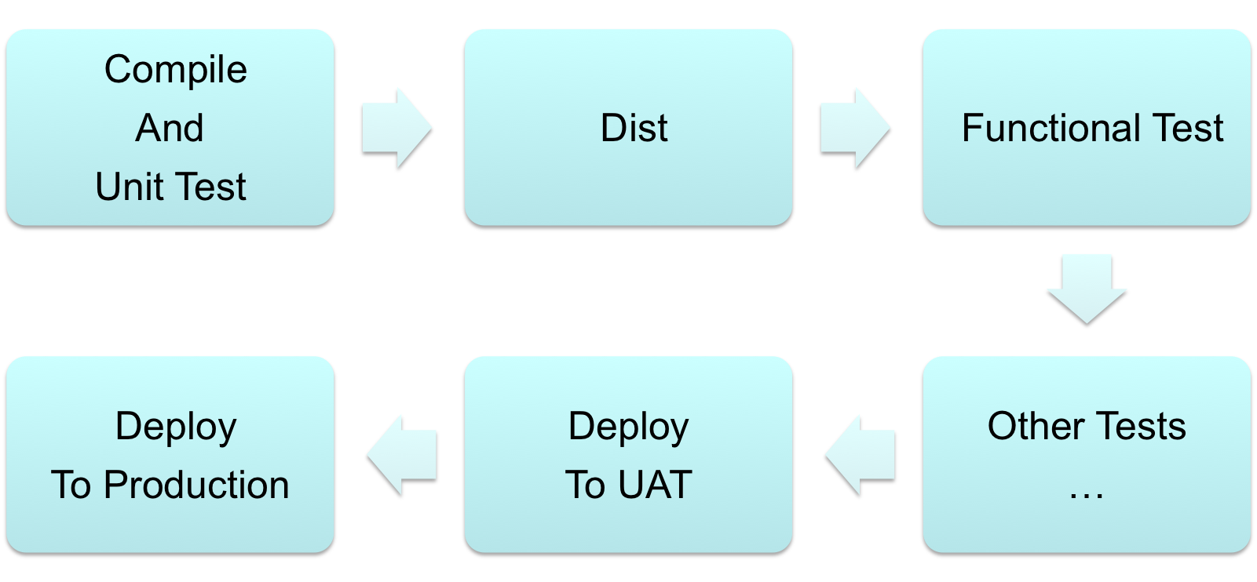
Example Of The Customized Work Flow

Slide 9
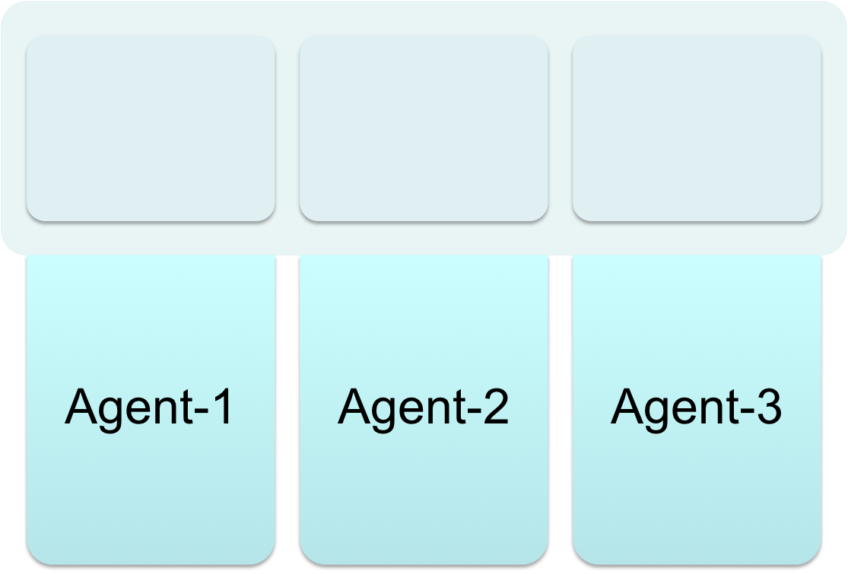
Cruise: Parallel Tests
Jobs
Tests -1
Tests -2
Tests -3

Slide 10
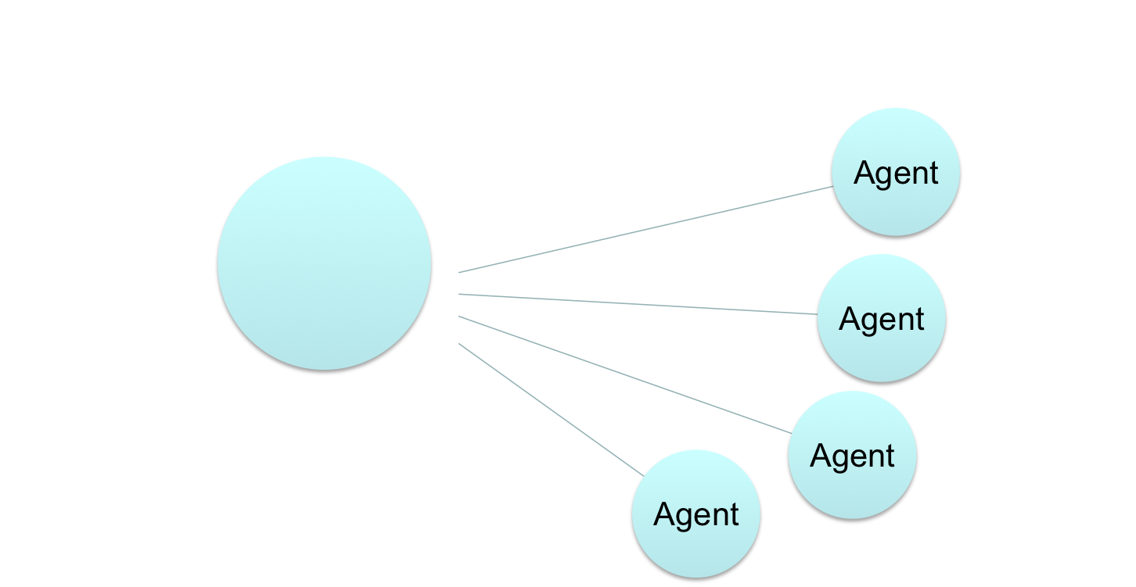
Cruise: Features of Build Grid
Handle Over 100 Agents
Auto Upgrade
Cruise
Server
Assign jobs which require resources: Linux,Mysql
Resources:
Linux,Mysql
Communicate
Using SSL
Notes:
Cruise’s build grid is the most scalable on the market.
The easiest to maintain. With one-step install, auto-upgrade and auto-configuration
handle over 100 agents
Match work to agents using tags
Secure. Agents require approval to join the grid, and all agent-server communication is secured with SSL

Slide 11
Cruise: Central Artifact Repository
Get Artifacts From Server
Publish Artifacts To Server
Cruise Server
Agent -1
Agent -3

Slide 12
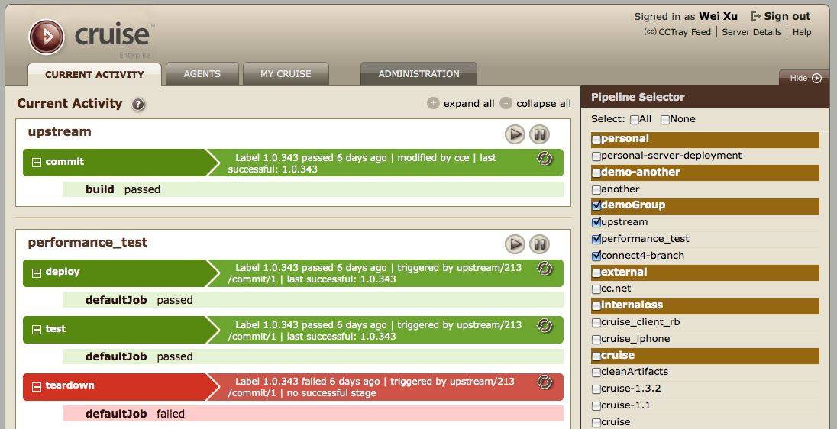
Cruise: Easy to Use Dashboard

Slide 13
Cruise: Complete security
Cruise Server
Ldap Server
No Access
View And Operate
Only View
Group Users

Slide 14
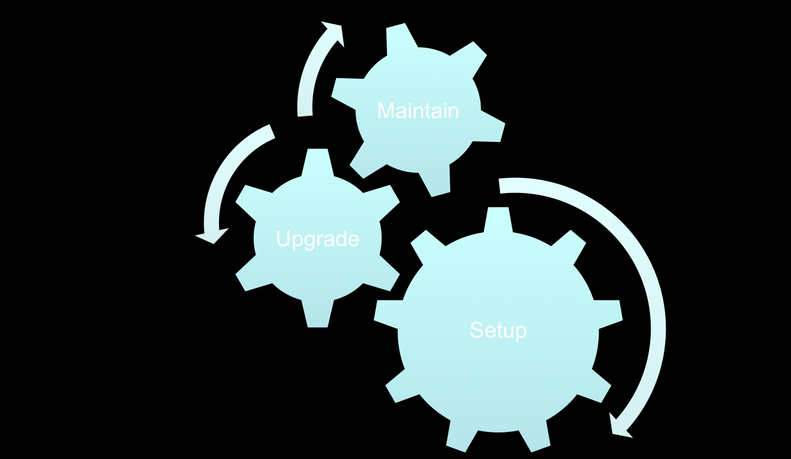
Cruise: Easy to Maintain
  Quick setup
  low maintenance
  extreme scalability

Slide 15
Cruise: Support Multiple Languages
Native support for Ant, Nant, Rake
Support any kind of build by using Exec

Slide 16
Cruise: Extensible
  Support restful API

Slide 17
Cruise: Licensing and Pricing
  Free Edition
    Up to 5 users
    Running agents on the same machine with the Cruise server
    Community support
  Professional Edition
    You can pay for as many users as you like
    Running agents on other machine
    Enhanced pipeline management with pipeline groups
    Improved security for pipeline groups
    Support for multiple source control blocks of different types in a pipeline.
    Phone, Email, Community support

Slide 18
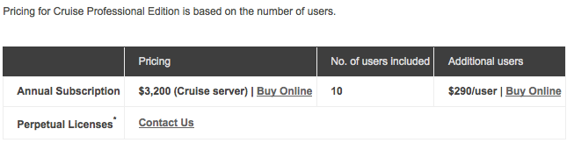
Cruise: Licensing and Pricing
Notes:
Cruise Professional includes 10 agents.
Additional agent packs can be purchased.
Cruise User means any individual who commits or checks in code
to any repository that Cruise accesses,
as well as any individual who accesses or uses Cruise through its user interface.

Slide 19
Summary
  Cruise Core Features:
    Workflows
    Parallelization
    Zero-configuration build grid
    Test multiple environments
    Easy to use dashboard
    Central artifact repository
    Complete security
    Easy to maintain
    Test multiple languages
  Licensing and Pricing

Slide 20
Questions

Slide 21
Thanks

