Slide 1

Cruise Training
Introduction of Continuous Integration

Slide 2
What you’ll learn
  History of Continuous Integration and problems it focuses on
  What is Continuous Integration and how it helps
  Key practices of CI
  Introduction of CruiseControl
  Why Cruise

Slide 3
Problems
  One of the most awkward and tense moment: integration
  Individual modules worked but the whole failed
  Late discovery of defects
  Lack of project visibility
  Low quality software

Slide 4
If you run into a painful activity, a good tip is to do it more often.

Slide 5
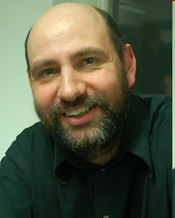
Continuous Integration: What it is
  a software development practice
  team members integrate their work frequently
  be verified by an automated build

Slide 6

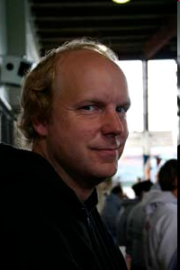
Continuous Integration: What it is

Slide 7
The Benefits
  Find problems faster
  Reduce risks
  Improve project visibility
  Solve the “last-mile” problem

Slide 8
Key practices
  Maintain a single source repository
  Automate the build
  Make you build self-testing
  Keep your build fast
  Automate the deployment

Slide 9
Maintain a single source repository
  Put everything into source repository
    Source codes
    Database schemas
    Test data/properties/scripts
    Build scripts/tools
    Deployment scripts/tools
  Targets
    Ability to build on any clean environment
    Traceability

Slide 10
Automate the build
  Automate every step you need to get a running system from sources
  Launch every process you need with a single command

Slide 11
Make your build self-testing
  Automated test is the key point to detect defects early and effectively
  You can not achieve effective CI without automated tests

Slide 12
Keep your build fast
  The whole point of CI is to provide fast feedback
  Staged build is a good way to balance fast feedback and test coverage

Slide 13
Automate the deployment
  Advanced use of CI requires automating the deployment and doing it frequently
  Solve the “last mile” problem

Slide 14


CruiseControl
  Started in 2000
  By ThoughtWorks
  Co-founders: Paul Julius & Jeffrey Fredrick

Slide 15

Cruise
  CruiseControl focused on development, but lacks features to support enterprise requirements
    Workflows
    Build Grid
    Parallelization
    Central Artifacts
    Security

Slide 16
Questions

Slide 17
Thanks

