Slide 1
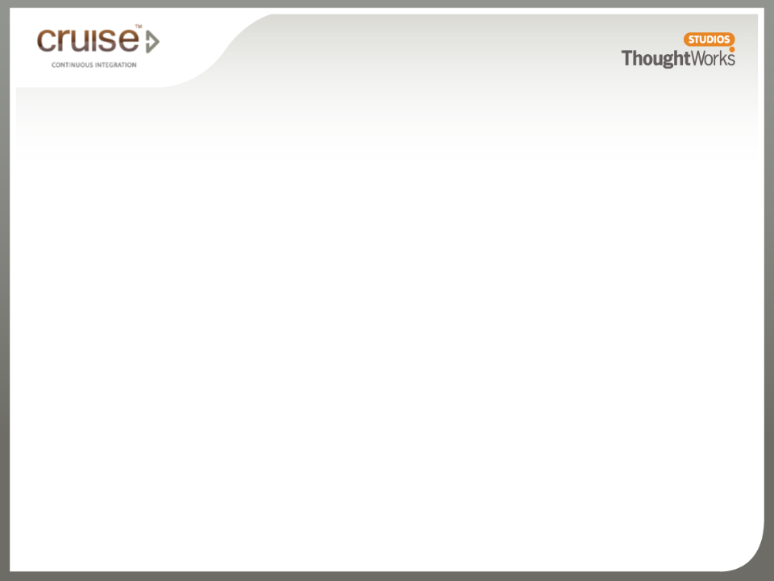
Continuous Integration
Installation of Cruise

Slide 2
What you’ll learn
  A brief idea about how to setup Cruise environment
  How Cruise server works with agents

Slide 3
Workshop: Install Cruise server and local agent
  Do this workshop individually
  Follow your instruction list to finish it

Slide 4
Workshop: Setup build grid
  Do this workshop in pair
  Pick a machine to act as remote agent
  Follow your instruction list to finish it

Slide 5
How Cruise server works with agents
VCS
Agent grid
Cruise Server
agent
agent
agent
agent
agent
agent
agent
agent
agent
Browser
http://cruise_server:8153
Notes:
Agents auto-configure and auto-upgrade
Agent-server communication is secured by SSL

