Slide 1

Continuous Integration
Preparation For CI

Slide 2
What You’ll learn
  Manage project using VCS
  Automate build using Ant
  Automate test using JUnit

Slide 3
Continuous Integration: best practices
  Put everything you need into source control
  Make the build automated
  Introduce some automated testing into you build

Slide 4
Version Control System (VCS )
  How do you use VCS?

Slide 5
Different types of VCS:
  Centralized VCS
  Distributed VCS

Slide 6

Centralized VCS

Slide 7

Distributed VCS

Slide 8
Centralized VCS vs Distributed VCS
  Commit locally
  Central control
  Distributed team

Slide 9
Workshop Using SVN
Setup svn server
Setup svn repository
Put a new project into svn
Edit existing files

Slide 10
Workshop Using HG
Setup hg repository
Put a new project into hg
Edit existing files

Slide 11
Build: Question:
How to make your build automated?

Slide 12
Build tools:
  Ant
  Nant / MSbuild
  Rake

Slide 13
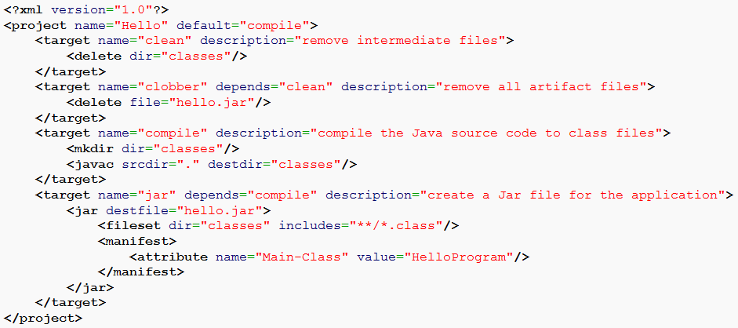
Basic format of Ant:

Slide 14
Automated test tools:
  JUnit
  NUnit
  xUnit family

Slide 15
Preparation: Let’s Go
  JDK
  Ant
  Subversion
  Setup a new repository
  Write the first ant build file and run it

