Slide 1

Continuous Integration
Setup first build in Cruise

Slide 2
What you’ll learn
  How to add a project into Cruise
  The concept of Pipeline, Stage, Job
  How to get test report of your build

Slide 3
Workshop: Setup first build in Cruise
  A sample web application is hosted in Svn repository
  Follow instruction list to add the project into Cruise

Slide 4
Question:
  How to find out which unit tests failed?

Slide 5
Workshop: Get junit report from Cruise
  The build script already generate junit report for you, but it’s on agent side
  Follow instruction list to upload it to Cruise’s server

Slide 6
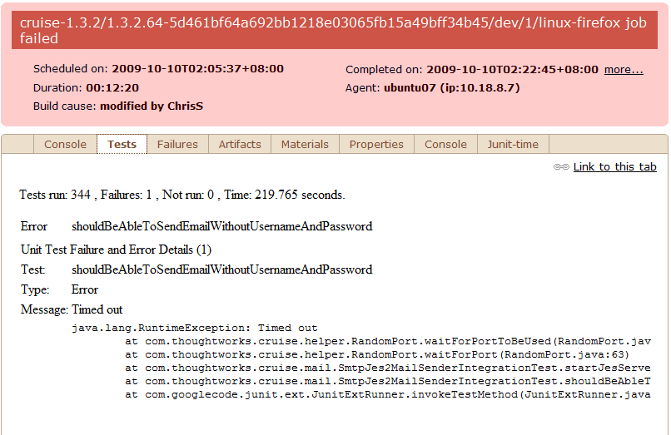
An example of tests report in Cruise

