Slide 1

Cruise Training
Introduction of Cruise

Slide 2
What you’ll learn
  Cruise features
    Pipeline workflows
    Zero-configuration build grid
    Parallelization
    Usability-driven dashboard
    Central artifact repository
    Secure and Auditable Deployments
    Lifecycle Management

Slide 3
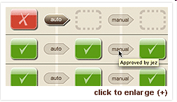
Pipeline workflows: Model and Control your Deployment Workflow
  Cruise's innovative concept of pipelines gives you and your team control into every aspect of your release.

Slide 4
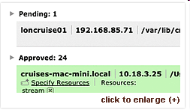
Zero-configuration build grid: fast setup, low maintenance, extreme scalability
  Cruise’s build grid is the most scalable on the market. It’s also the easiest to maintain. With one-step install, auto-upgrade and auto-configuration, Cruise gets up and running easily and stays that way.

Slide 5
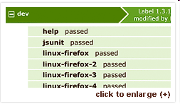
Parallelization: Reduce your feedback cycle, strengthen your confidence
  Cruise shortens your feedback cycle and makes it easy to detect defects on multiple platforms when they are introduced, not at release time.

Slide 6
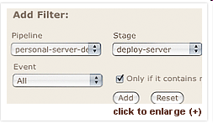
Usability-driven dashboard: Collaborative Releases
  Cruise is built with an emphasis on usability that enables collaboration between developers, testers, and operations. With all the features your team needs and an easy-to-use UI Cruise gives your entire team insight into the release.

Slide 7
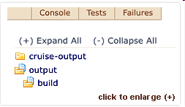
Central Artifact Repository: Collated Project Information and Metrics
  Cruise keeps your application's binaries, test data and log files in a central location so that you can get the information and metrics you need in a snap.

Slide 8
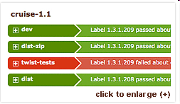
Secure and Auditable Deployments
  Cruise has LDAP and ActiveDirectory support built in, so you can control who has access to every operation in Cruise. With authentication switched on, Cruise records who triggered every promotion or deployment.

Slide 9
Lifecycle Management: No-fuss Integration Capabilities
  Cruise drops in to your current software ecosystem with the ability to talk to your existing tools and gather and aggregate reports. The power of Cruise can also be extended with Twist, Test Management platform and Mingle the Project Collaboration and Program Management tool for efficient application lifecycle management.

Slide 10
Questions

Slide 11
Thanks

