Slide 1
Active Object
By R. G. Lavender and D. C. Schmidt.
Presented by David Kemp
Melbourne Patterns Group

Slide 2
Active Object
R. G. Lavender and D. C. Schmidt, Active Object, Pattern Languages of Program Design 2, 1996
The Active Object design pattern decouples method execution from method invocation to enhance concurrency and simplify synchronized access to an object that resides in its own thread of control.

Slide 3
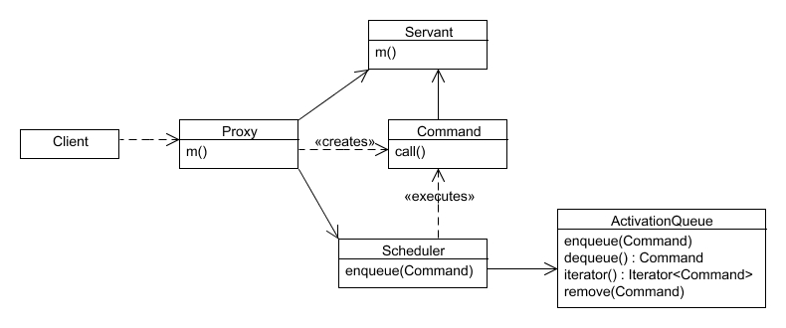
Object diagram

Slide 4
See code example
http://code.google.com/p/davidbkemp-activeobject/

Slide 5
Variants
Integrated Scheduler (combine proxy, scheduler, and servant).
Distributed Active Object (remote proxy).
Thread pool (multiple servants).

Slide 6
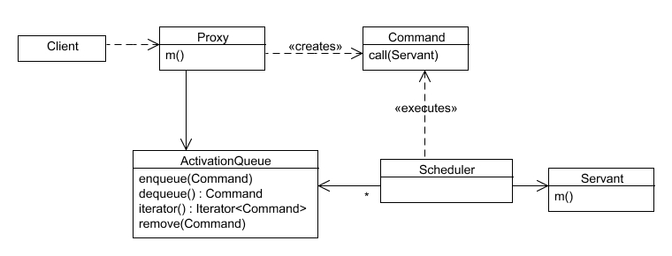
Example variation: multiple servants

Slide 7
Consequences
Enhance application concurrency and simplify synchronization complexity.
Transparently leverage available parallelism.
Method execution order can differ from method invocation order.
Performance overhead.
Complicated debugging.

Slide 8
Resources
http://en.wikipedia.org/wiki/Active_Object
R. Greg Lavender Douglas C. Schmidt, Active Object, Pattern Languages of Program Design 2, 1996.
http://www.cs.wustl.edu/~schmidt/PDF/Act-Obj.pdf
http://code.google.com/p/davidbkemp-activeobject

