Slide 1
Analysis of Poisson Ratio Data in Piezo Actuator Stacks
BY: Winnie Wang, undergraduate
Quantum Material Labs, University of Washington

Slide 2
What’s the Poisson Ratio? Why is it important?

Slide 3
Background
“Piezo-stack”: A highly incompressible material
Stretches very minimally under low temperatures
Poisson Ratio (“ν”): (Ratio of transverse strain):(ratio of axial strain)
Transverse = compressed; axial = tensile
Potentially useful for data analysis and comparison
Strain measurement experiments
Replace unstable data

Slide 4
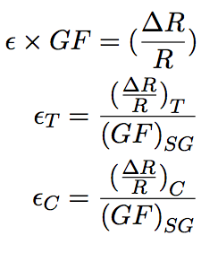
Background
Ratio of compressed and tensile strains
Tensile (‘T’) and compressed (‘C’) direction
‘GF’ = gauge factor
‘SG’ = strain gauge
‘ε’ =strain

Slide 5
Experimental Set-up
Piezo stack is glued with varnish on a small metal bar
Two strain gauges are glued with “stycast” onto the piezo-stack
The whole setup is then put in a cryostat
Piezo-stack is ramped with different voltages to induce change in resistance

Slide 6
1st Setup
0-130V
2 strain gauges
Piceramic
-40-40V
1 Cross Strain Gauge
Piezomechanik
2nd Setup

Slide 7
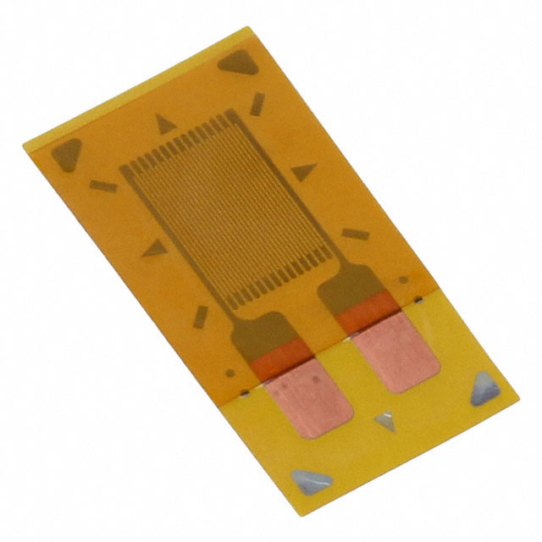
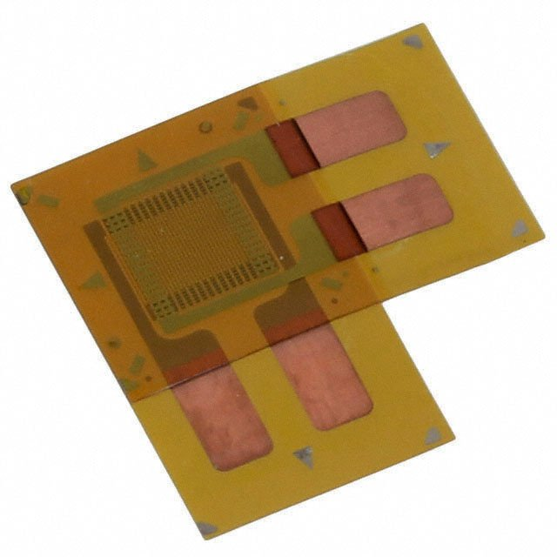
1st Setup
2nd Setup

Slide 8
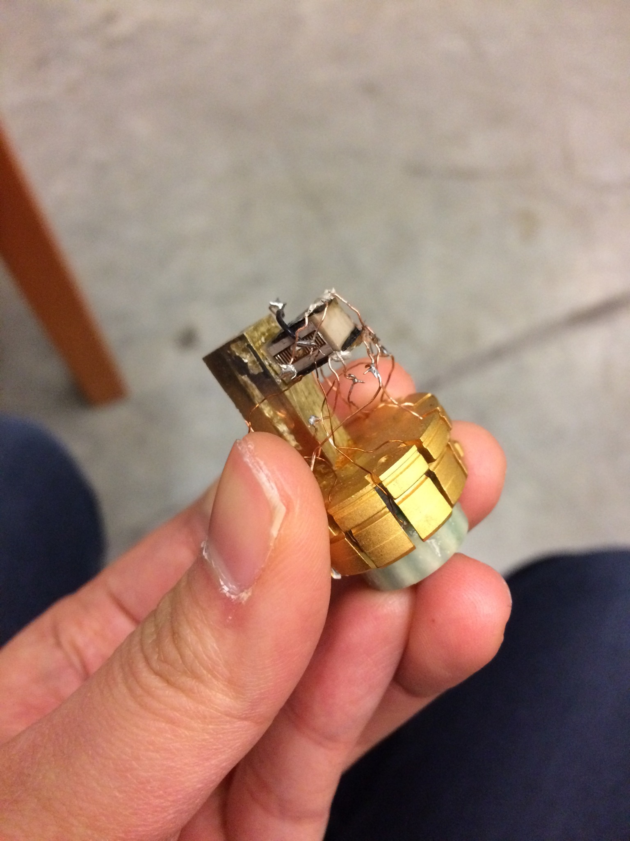
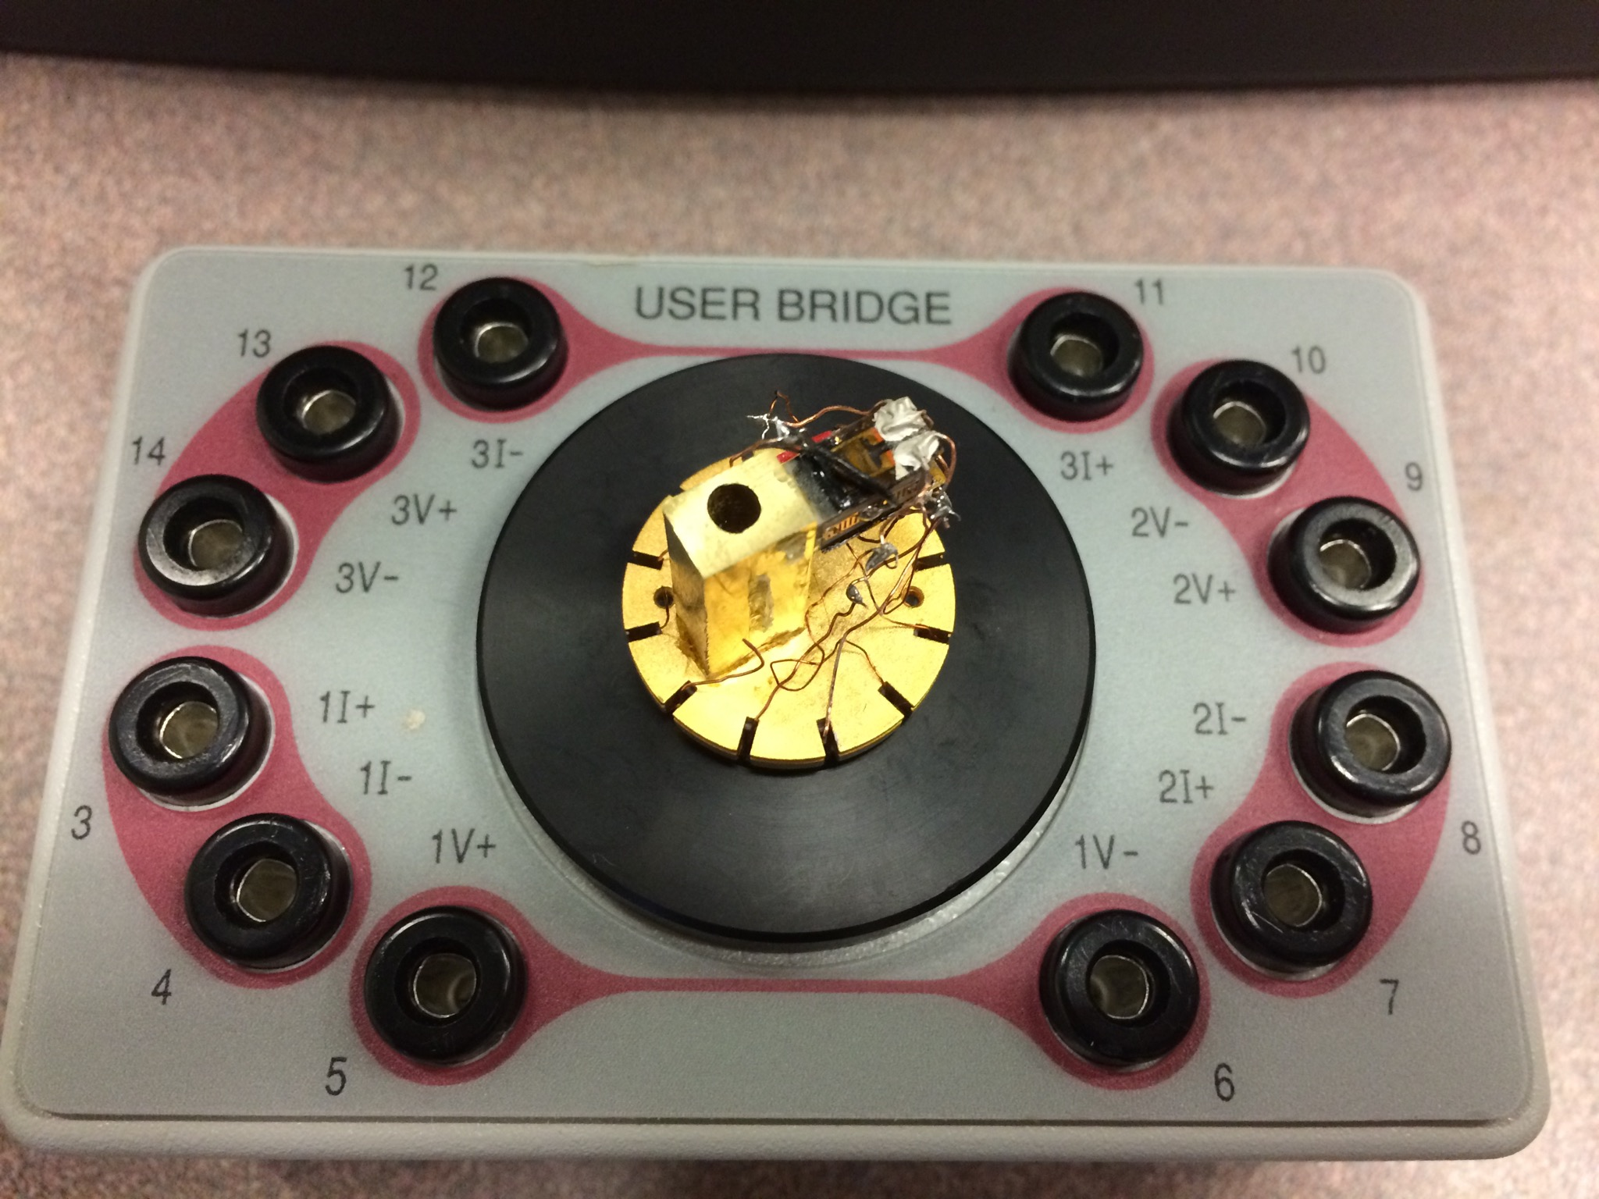
1st Setup

Slide 9
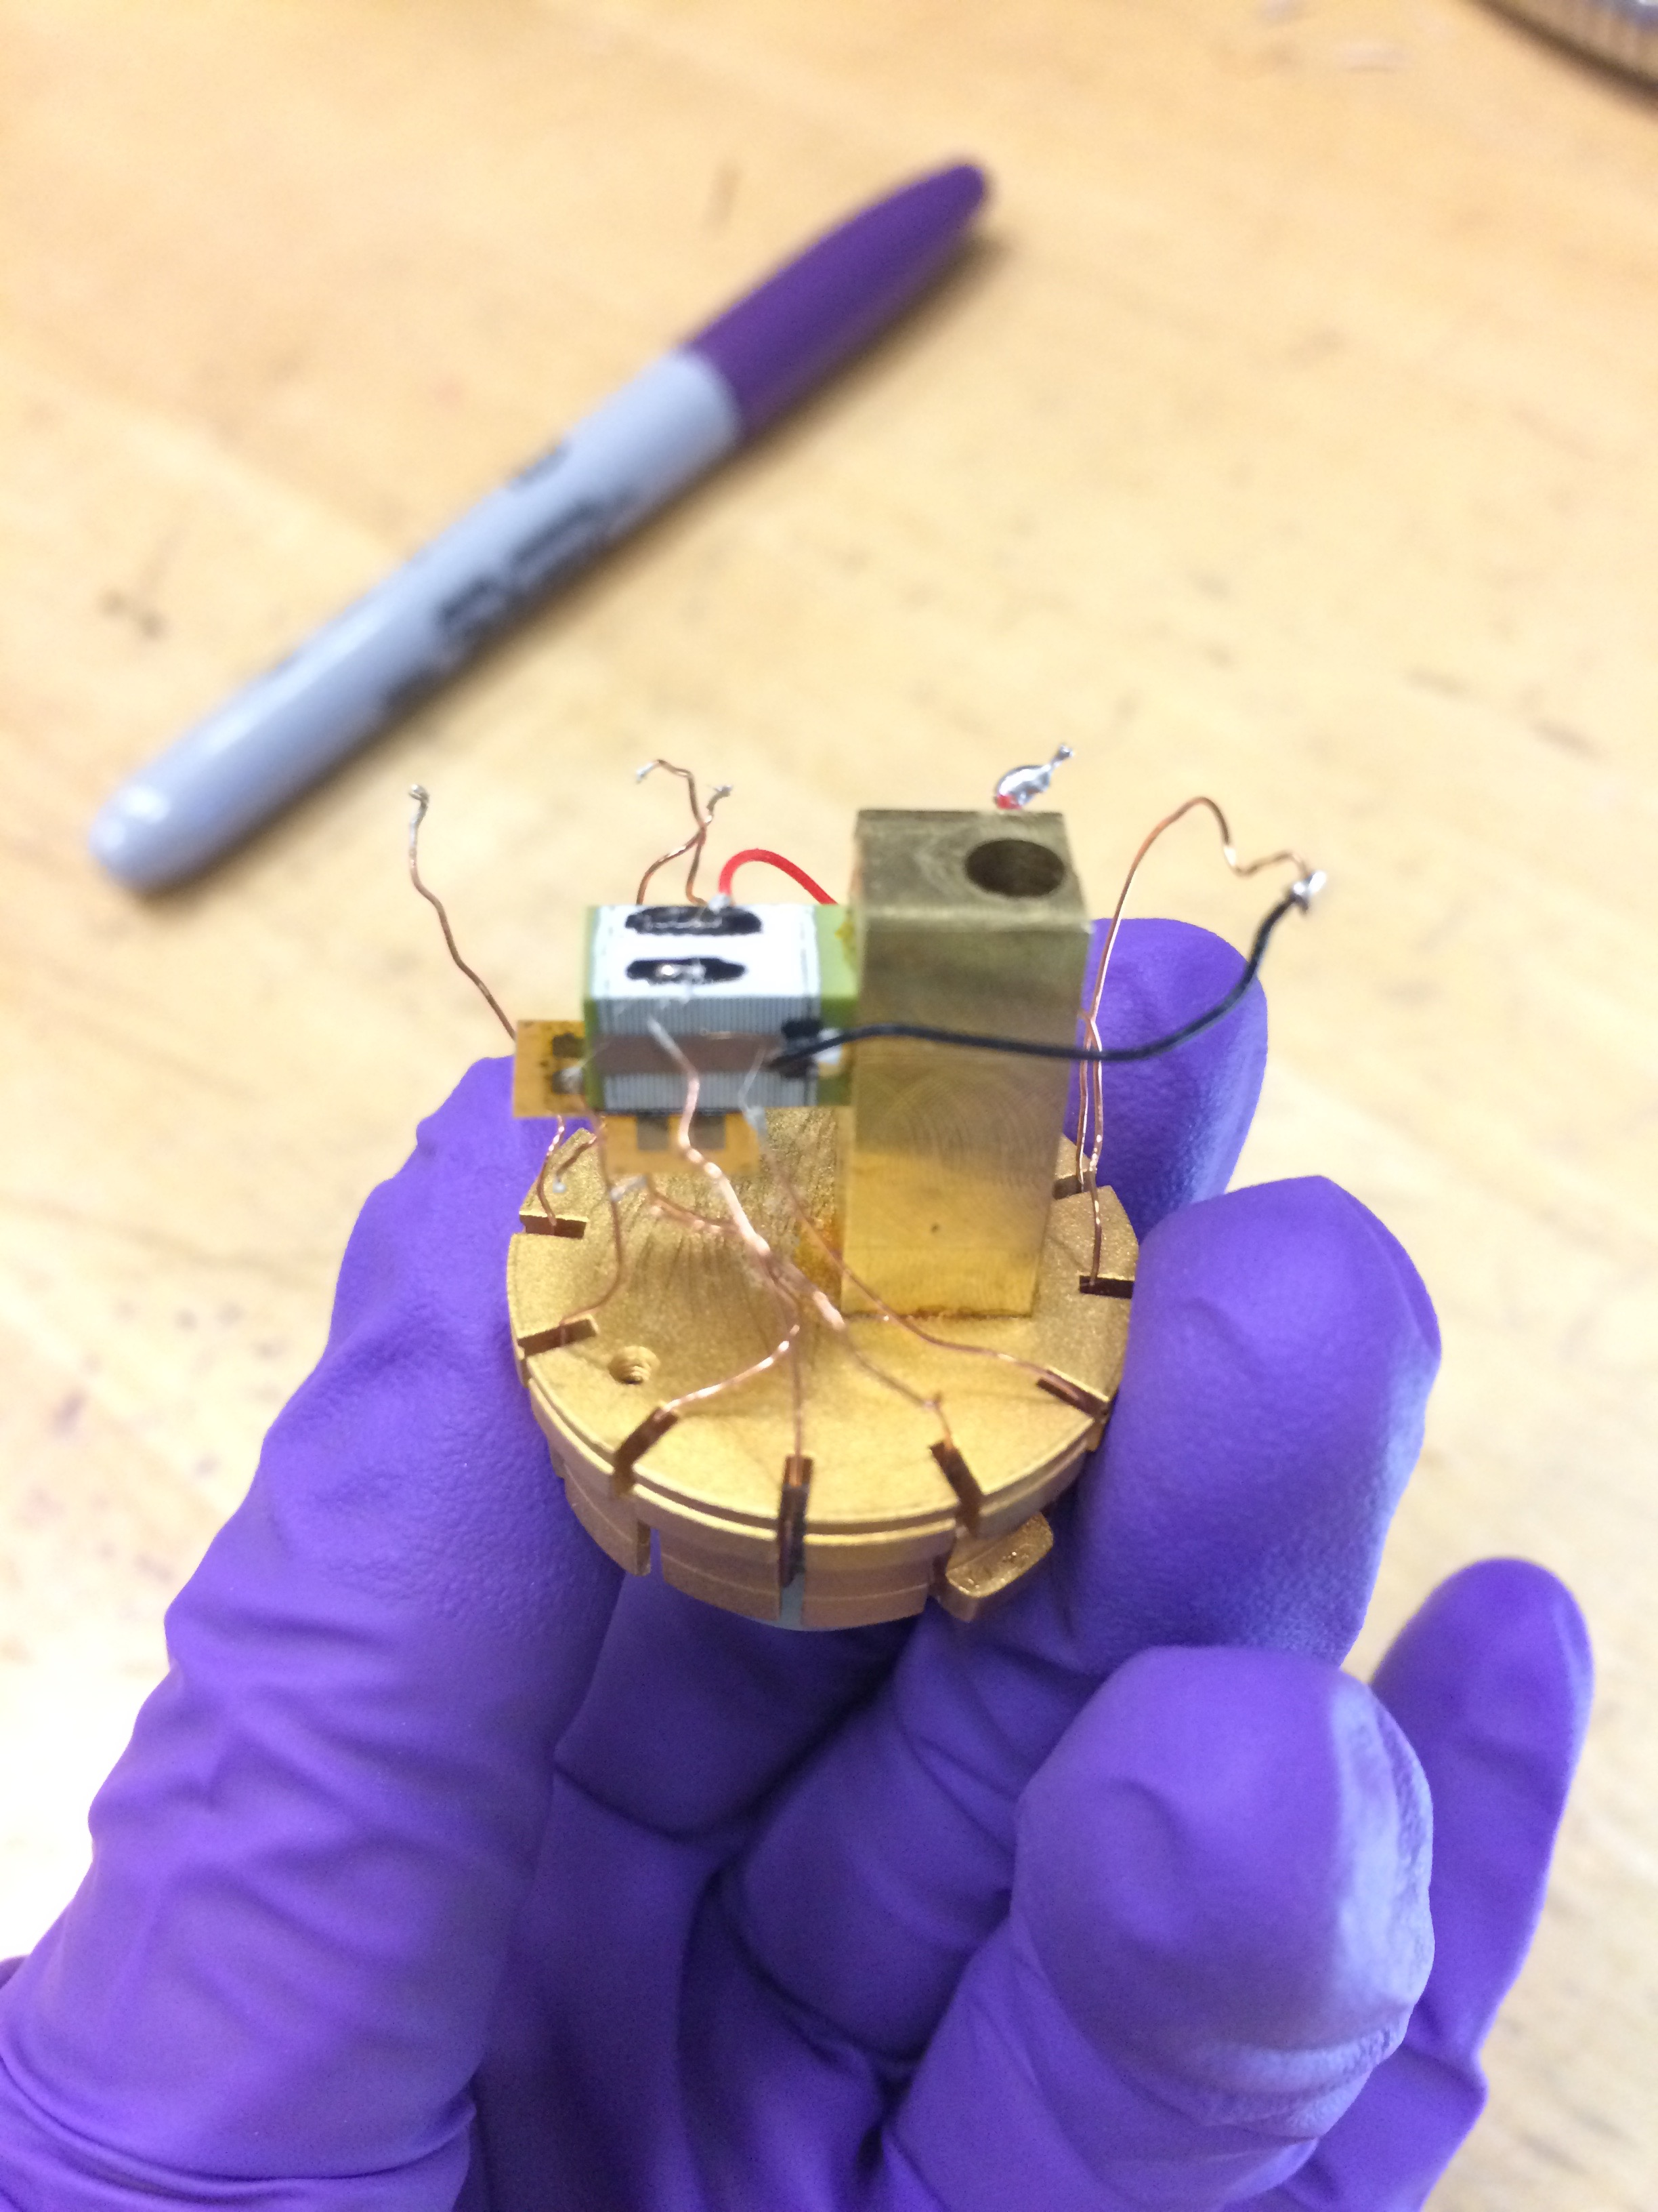
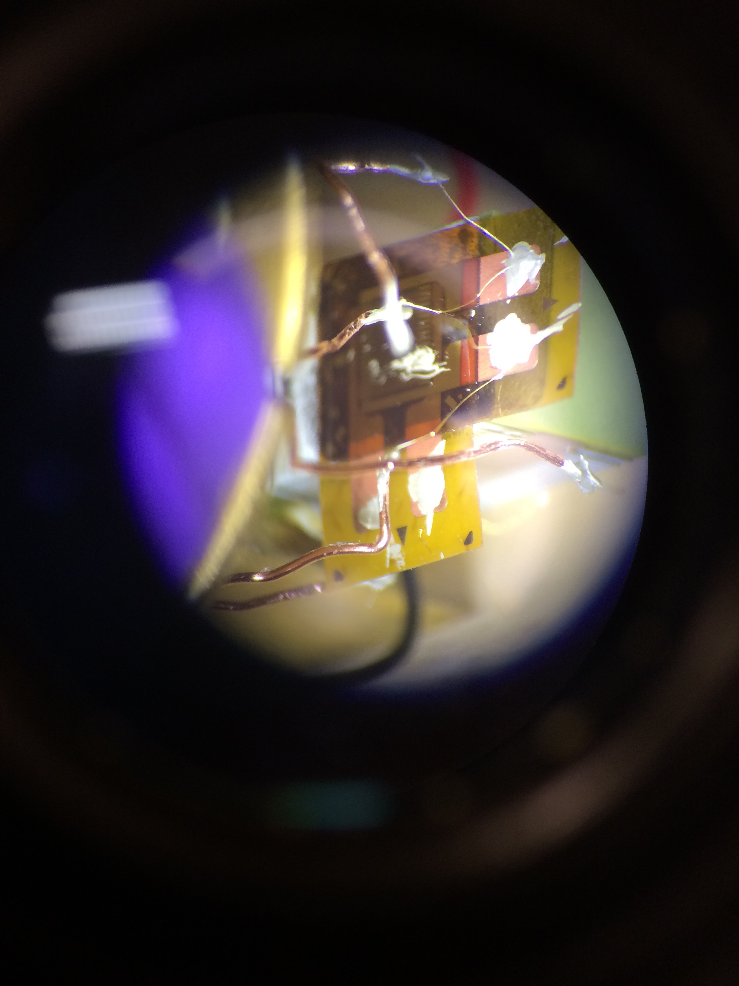
2nd Setup

Slide 10
Measurement Procedure
Poisson Ratios are analyzed from 2 piezo-stacks
Piceramic (Jan. 2017) and Piezomechanik (Mar. 2017)
Experiment starts at 300K
Goes down to 0K and back up at a regular temp. interval
System waits for about 200 seconds at each T (for equilibrium)
Voltage is ramped through the piezo-stack
A hysteresis graph is obtained at each temperature
Process repeats at the next temperature

Slide 11
Measurement Procedure
Data analysis process:
Best fit of all hysteresis is done at each temperature range
To obtain the average strain/volt at each temperature range
The fitted strain/volt at each temperature is then plotted
Poisson ratio is calculated from each fitted data point

Slide 12
Results

Slide 13
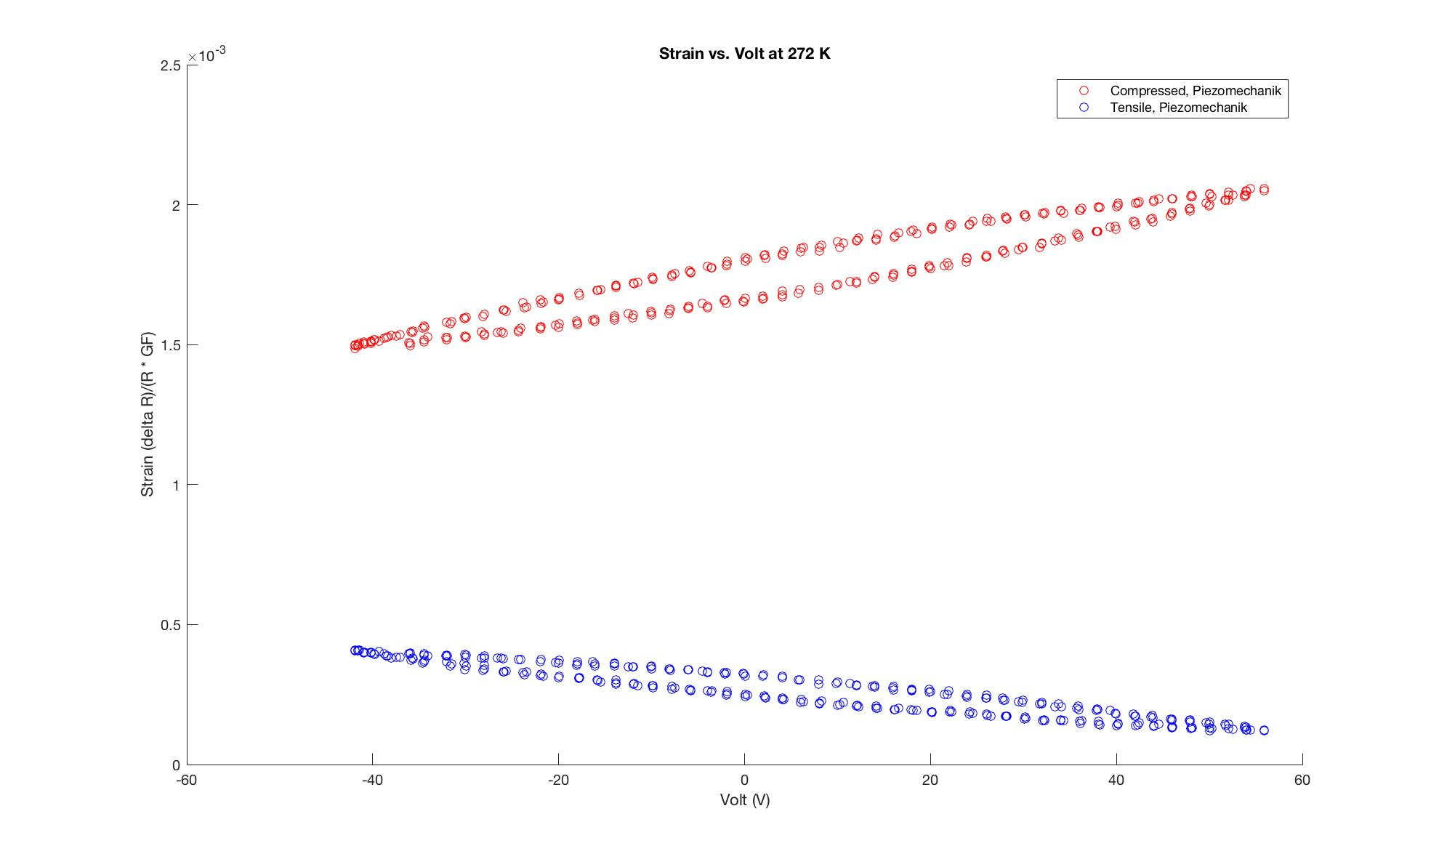

Slide 14
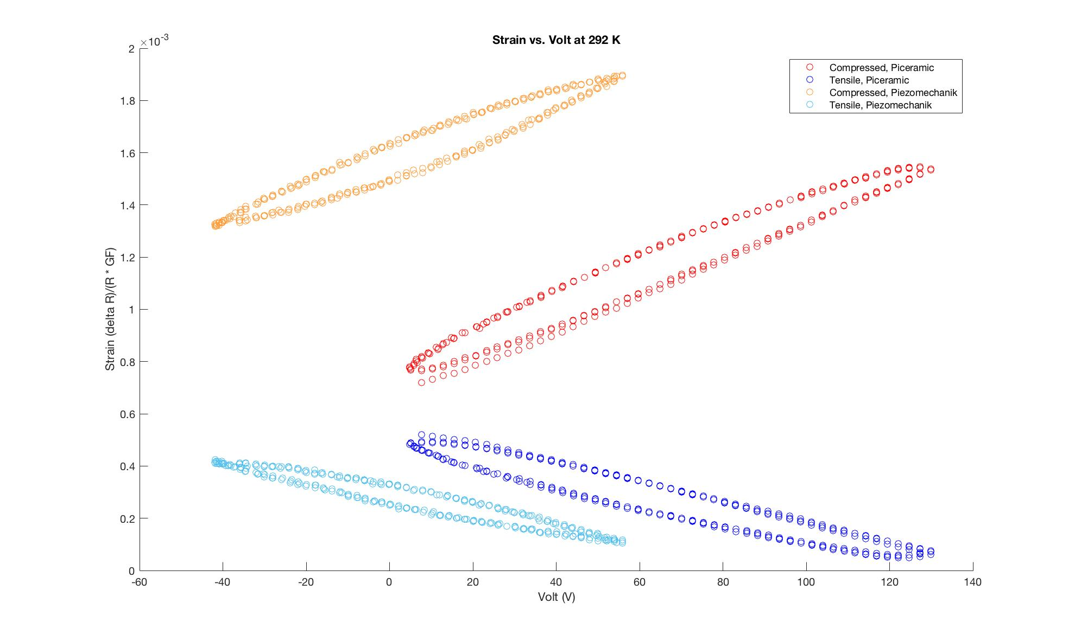

Slide 15
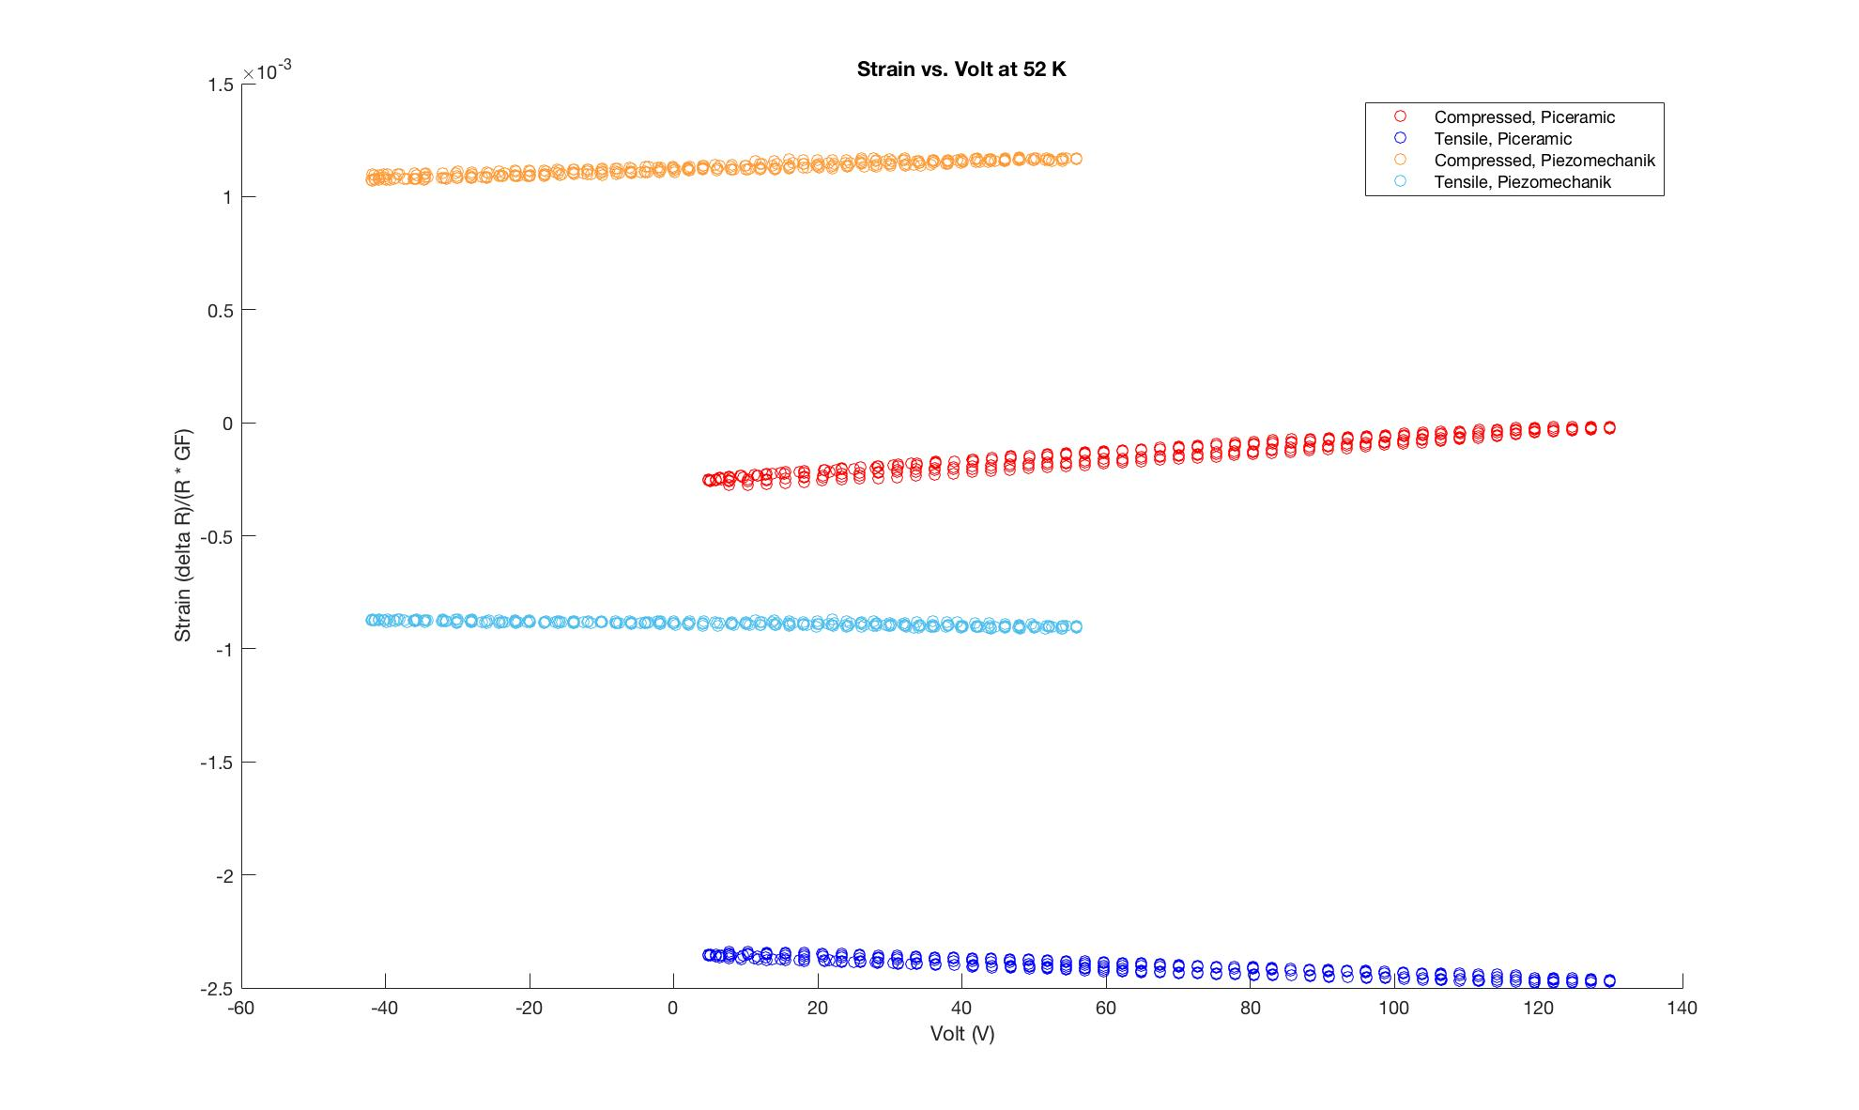

Slide 16
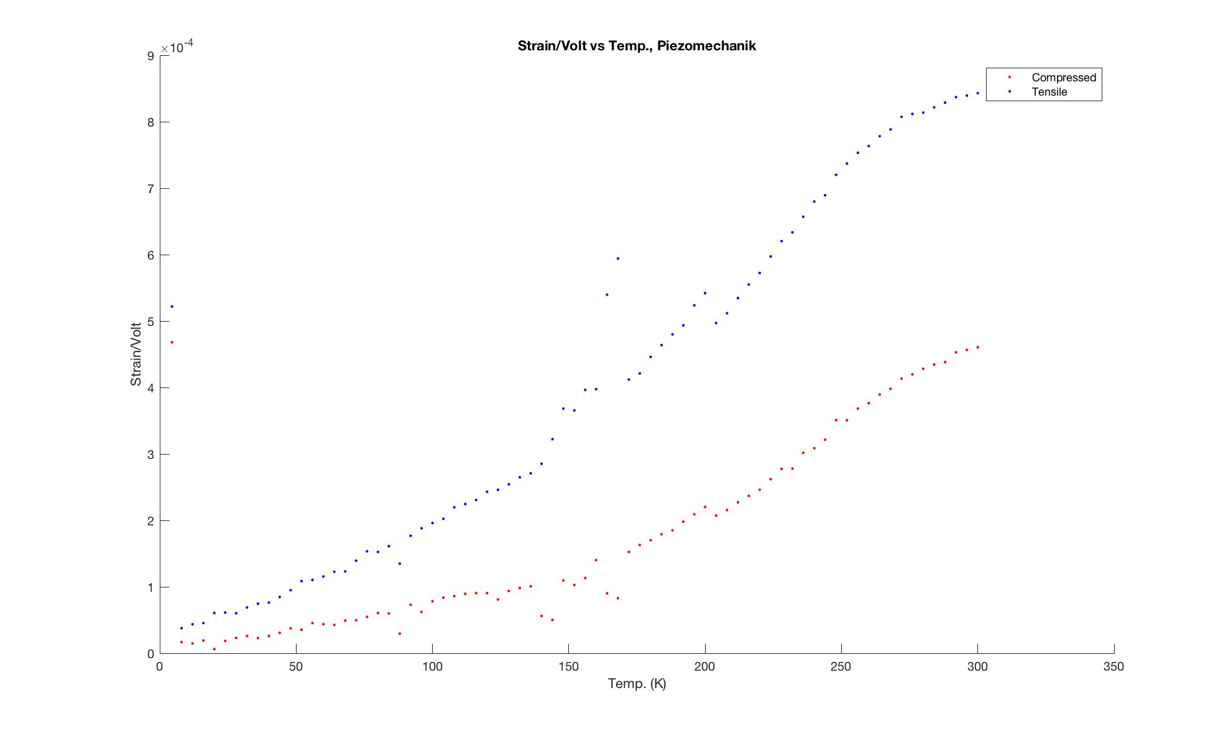

Slide 17
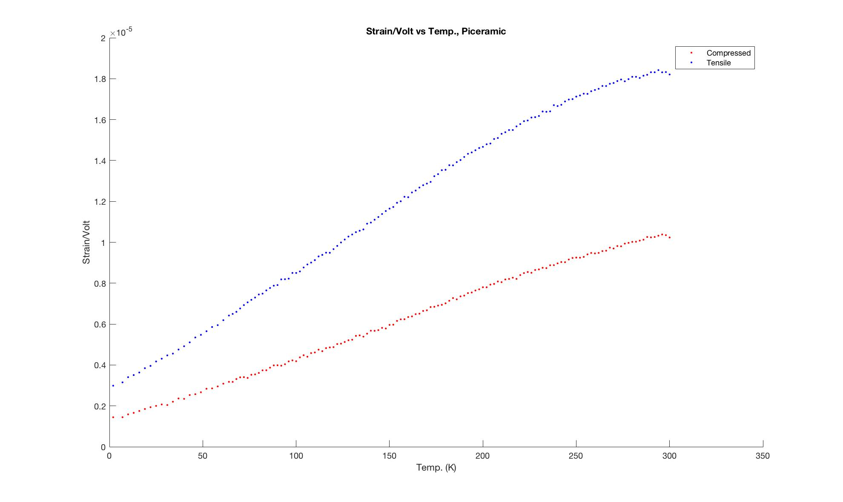

Slide 18
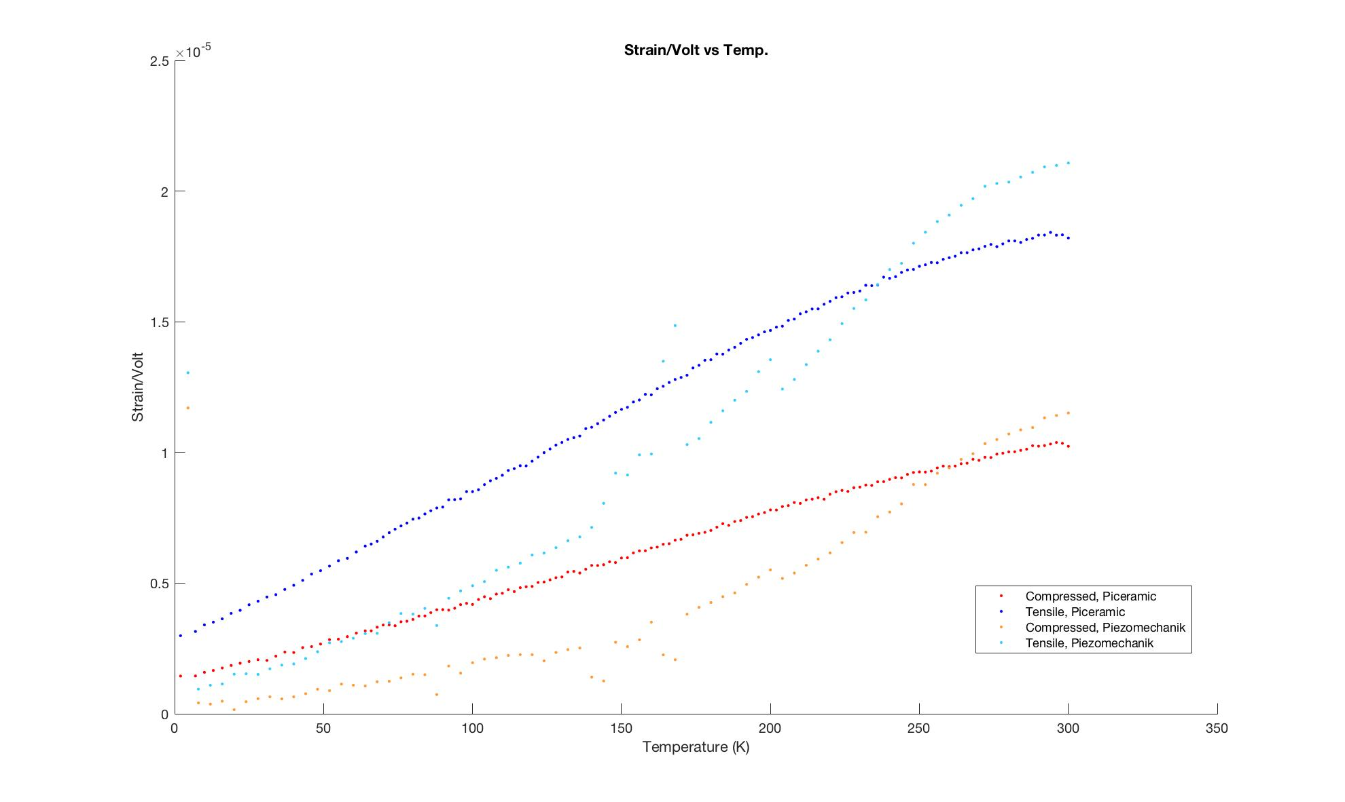

Slide 19
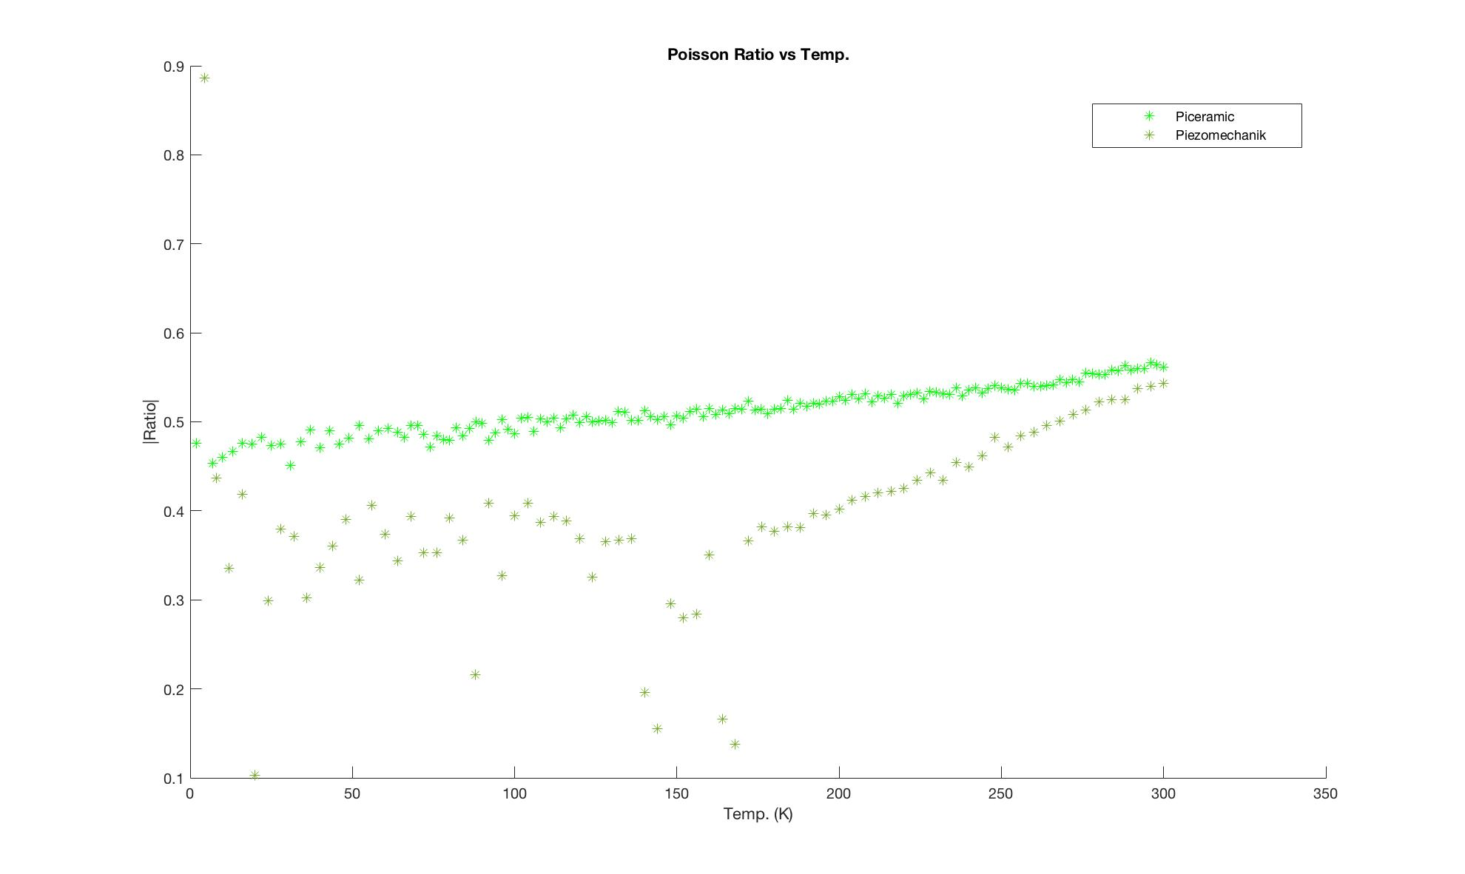

Slide 20
Discussion
New material (Piezomechanik) displayed poorer quality results
Than compared to one done in January (Piceramic)
Potential reasons:
Small voltage range?
Not enough stycast?
Different material?

Slide 21
Thank you for listening!

