Slide 1
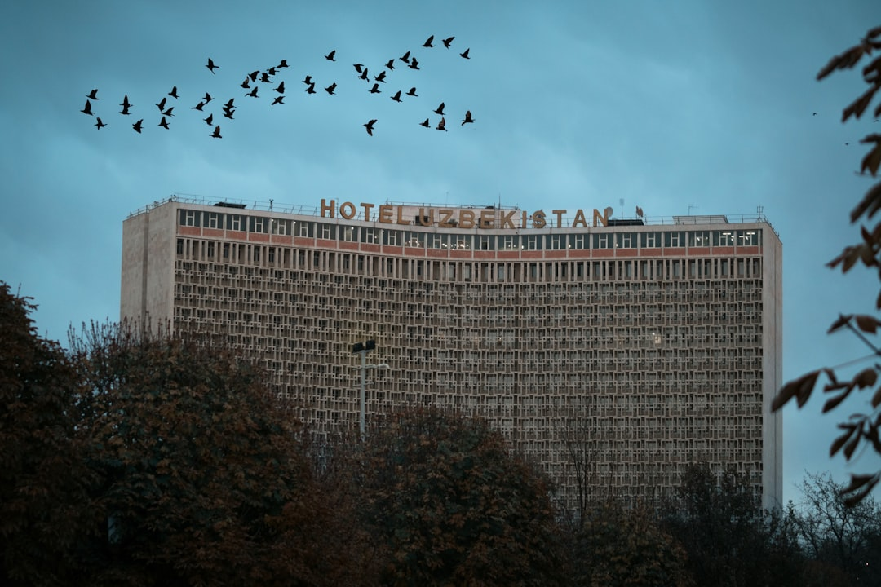
Hotel Translyvania

Slide 2
Overview
The franchise revolves around Count Dracula and his lavish resort.
Dracula's goal is to provide a safe haven for monsters away from humans.
The series combines humor, adventure, and themes of family and love.

Slide 3
Character Development
Dracula evolves from an overprotective father to a more open-minded character.
Supporting characters include iconic monsters like Frankenstein and Mavis.
The films explore relationships and personal growth within the monster community.

Slide 4
Cultural Impact
Popularized the concept of a monster resort in popular culture.
Encouraged family-friendly narratives in animated films.
Fostered a new generation's interest in classic monsters.

Slide 5
Box Office Success
The franchise has grossed over $1.3 billion worldwide.
Each film's release attracted significant audiences, contributing to its popularity.
Merchandising and spin-offs have expanded its reach and profitability.

Slide 6
Future Potential
Possibilities for new storylines and character arcs in future films.
Continued interest in animated features suggests franchise longevity.
Potential for further expansion into other media, such as television.

Slide 7
Conclusion
Hotel Transylvania is a successful franchise blending humor and heart.
Its unique take on monster mythology resonates with audiences.
The series has established itself as a beloved part of animated film history.

