Slide 1
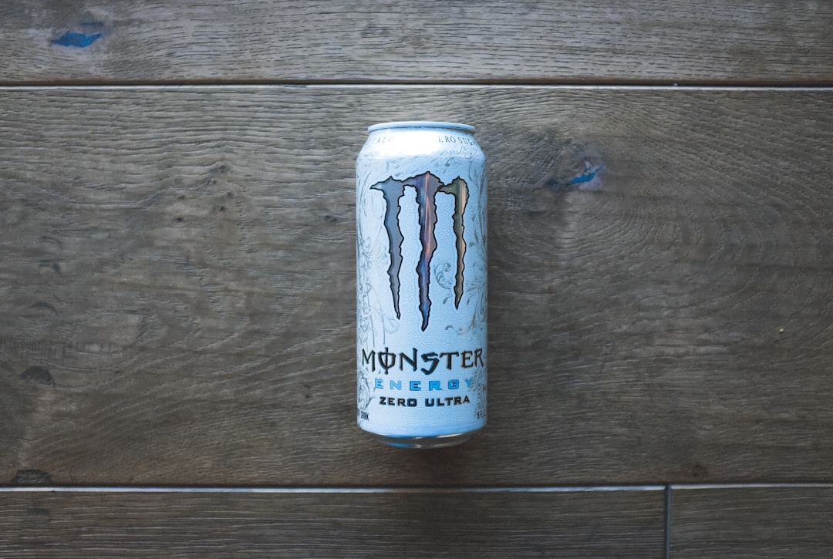
Monster Energy

Slide 2
Overview
Founded in April 2002 by Hansen Natural Company.
Produces a variety of energy drinks, coffee, teas, and juices.
Targeted towards athletes, musicians, and fans.

Slide 3
Product Range
Offers a diverse portfolio of energy drinks with unique flavors.
Includes brewed coffee and tea beverages.
Provides juices to cater to different consumer preferences.

Slide 4
Market Impact
Significant player in the global energy drink market.
Sponsorships in extreme sports and music events enhance brand presence.
Continues to innovate with new product lines and collaborations.

Slide 5
Cultural Influence
Strong association with youth culture and extreme sports.
Active social media engagement to connect with fans.
Promotion of lifestyle and community through events and sponsorships.

Slide 6
Health Considerations
Mixed opinions on health impacts of energy drinks.
Contains caffeine and sugar, raising concerns for some consumers.
Company promotes responsible consumption and awareness.

Slide 7
Conclusion
Monster Energy has established a strong brand presence.
Continues to evolve with diverse product offerings.
Maintains a significant cultural impact in sports and music.

