Slide 1
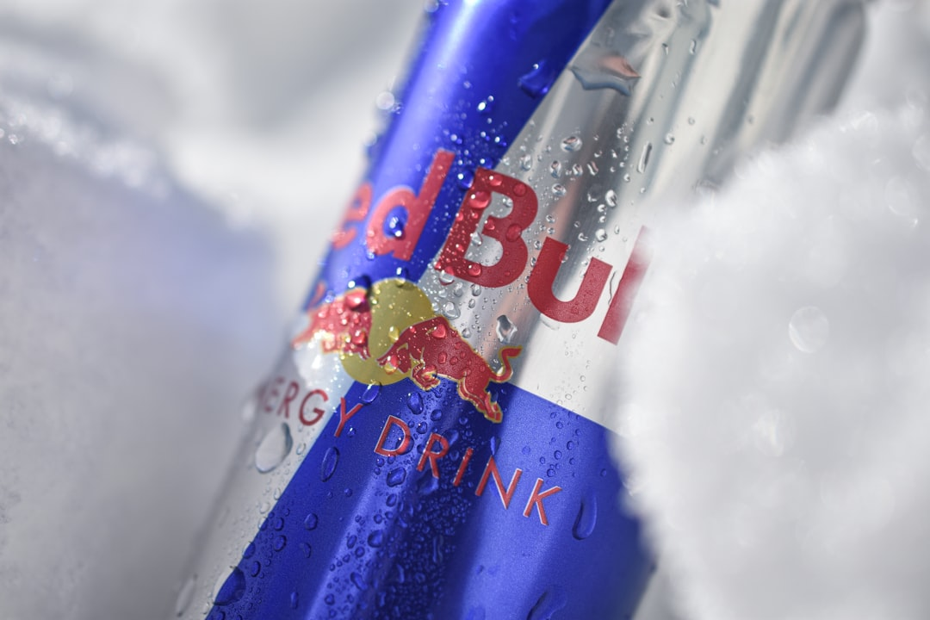
Red Bull

Slide 2
Overview
Red Bull is an energy drink brand owned by Red Bull GmbH.
It holds a 43% market share, making it the most popular energy drink globally.
The brand is known for its unique marketing strategies and sponsorships.

Slide 3
Product Variants
Offers various flavors, including seasonal editions like the Summer Edition with white peach.
Includes sugar-free and organic options to cater to different consumer preferences.
Constantly innovating with new flavors and limited-time offerings.

Slide 4
Sponsorship and Marketing
Heavily invests in sports sponsorships, particularly in motorsports and extreme sports.
Utilizes unique marketing campaigns that resonate with youth culture.
Engages fans through events, social media, and content creation.

Slide 5
Cultural Impact
Red Bull has become synonymous with energy and performance.
Influences lifestyle trends, especially among younger demographics.
Promotes a 'can-do' attitude through its branding and advertising.

Slide 6
Economic Impact
Contributes significantly to the beverage industry with substantial revenue generation.
Creates jobs and drives economic activity through its global operations.
Sets trends that impact competitors and the broader energy drink market.

Slide 7
Conclusion
Red Bull remains a leader in the energy drink market with innovative products and marketing.
Continues to shape cultural perceptions of energy drinks and active lifestyles.
Its impact on sports and youth culture underscores its brand strength and relevance.

