Slide 1
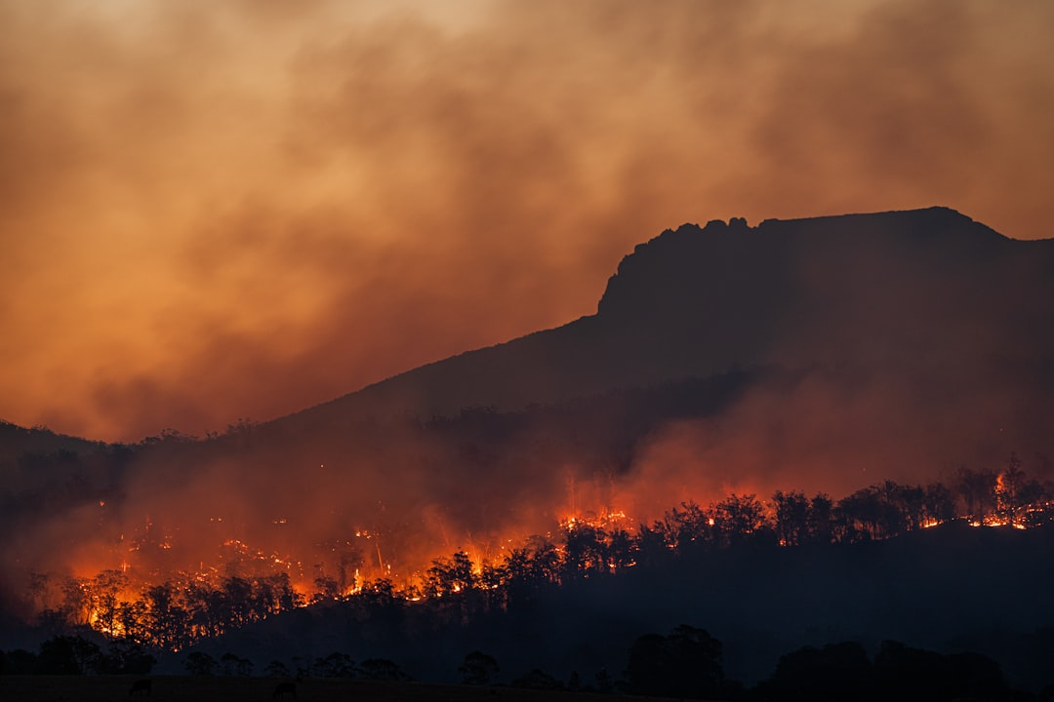
Climate Change

Slide 2
Overview
Climate change refers to long-term alterations in temperature, precipitation, wind patterns, and other elements of the Earth's climate system.
It is driven primarily by human activities, particularly the burning of fossil fuels and deforestation.
The effects of climate change are global, impacting ecosystems, economies, and communities.

Slide 3
Environmental Impact
Droughts can significantly harm food production, leading to food insecurity.
Increased flooding can cause infrastructure damage and spread diseases.
Ecosystems are shifting, resulting in loss of biodiversity and species extinction.

Slide 4
Economic Consequences
Climate change can disrupt agricultural productivity, leading to economic instability.
Damage from extreme weather events costs billions in recovery and rebuilding efforts.
Insurance rates may rise due to increased risk, affecting personal and business finances.

Slide 5
Health Risks
Climate change exacerbates respiratory issues through increased air pollution.
Heatwaves can lead to heat-related illnesses and fatalities.
Changing climates can expand the range of vector-borne diseases, affecting public health.

Slide 6
Social and Cultural Effects
Communities may face displacement due to rising sea levels and extreme weather.
Cultural heritage sites are at risk from climate-related damage.
Social inequalities can worsen as vulnerable populations are disproportionately affected.

Slide 7
Conclusion
Climate change is an urgent global challenge requiring immediate action.
Adaptation and mitigation strategies are essential to reduce its impacts.
Collaborative efforts at local, national, and global levels are critical for a sustainable future.

