Slide 1
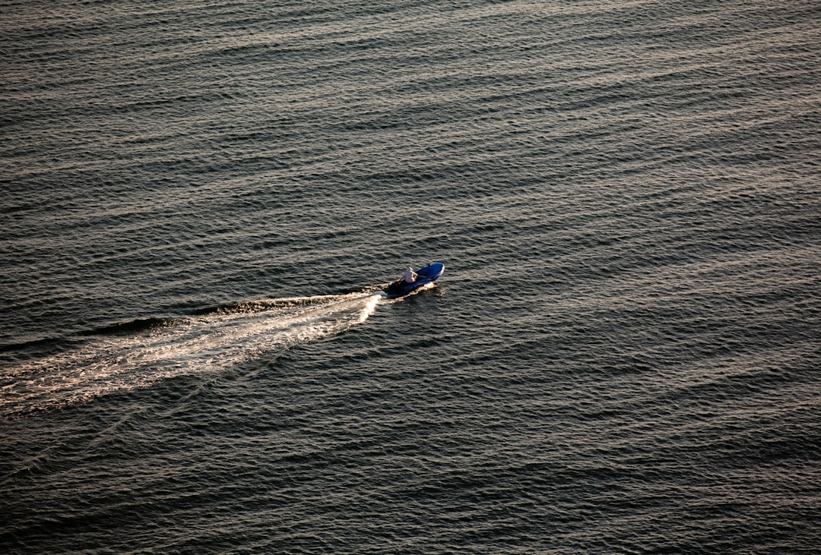
Chase Atlantic

Slide 2
Overview
Chase Atlantic is an Australian R&B band formed in 2014.
Originating from Cairns, Queensland, the band consists of three members.
They have gained significant popularity, amassing over 19 million monthly listeners on Spotify.

Slide 3
Musical Style
The band blends R&B, pop, and alternative music genres.
Their sound is characterized by atmospheric production and emotive lyrics.
They often explore themes of love, identity, and personal struggles in their music.

Slide 4
Live Performances
Chase Atlantic has performed at major festivals like Summer Sonic in Japan.
They are known for their engaging live shows and captivating stage presence.
Recent performances include 'DEMON TIME' and 'NIGHT CALLS' live from Sydney.

Slide 5
Merchandising and Brand
The band offers exclusive merchandise, including apparel like tees and hoodies.
Their merchandise is often tied to specific shows or themes from their music.
Items like the 'Lost In Heaven' tee are popular among fans.

Slide 6
Social Media Engagement
Chase Atlantic actively engages with fans through social media platforms.
They utilize platforms like Instagram and Twitter to announce shows and releases.
Their online presence helps maintain a strong connection with their fanbase.

Slide 7
Conclusion
Chase Atlantic continues to rise in the music industry with their unique sound.
Their live performances and engagement strategies enhance their popularity.
The band successfully combines artistry with effective branding and merchandising.

