Slide 1
Crawling and Analysing Python-questions on Stack-Overflow
Group B: Gu Chaowen
Hu Zijian
Niu Yunlu

Slide 2
Data Collection
Data Resource : Stack Overflow
Method : Scrapy
Storage : MongoDB

Slide 3
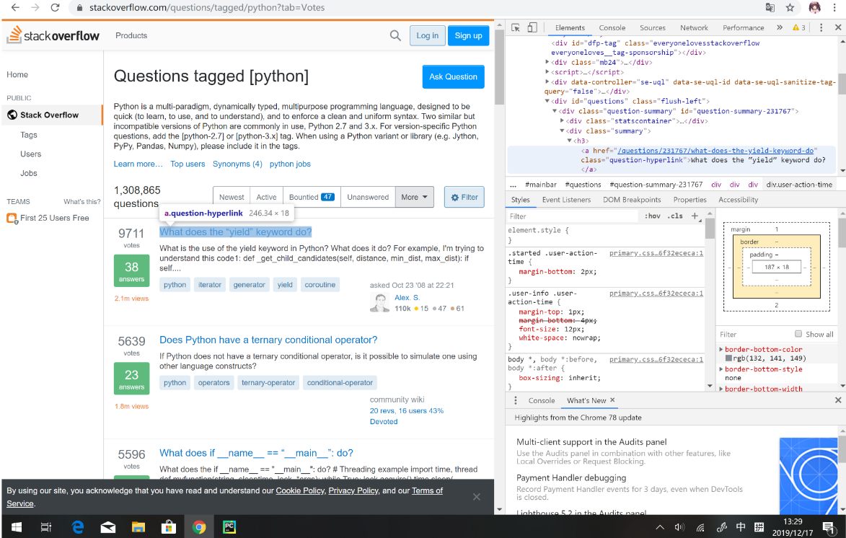
Data Collection: Scrapy
Why Scrapy not API?
We will get limiting quantity of datasets if we use API.
X-path to find the location of any element we want on the webpage.

Slide 4
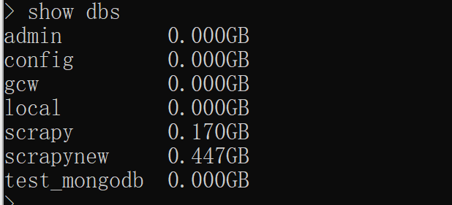
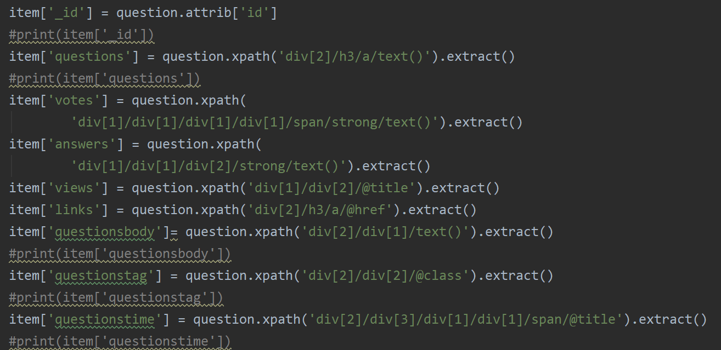
Data Collection: Storage
Why MongoDB not SQL?
MongoDB is python friendly（pymongo）.
447MB in our local MongoDB database
9 columns & Millions of rows

Slide 5
Data Cleaning&Processing

Slide 6
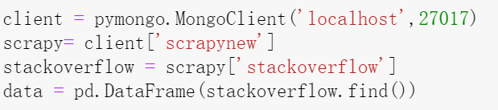
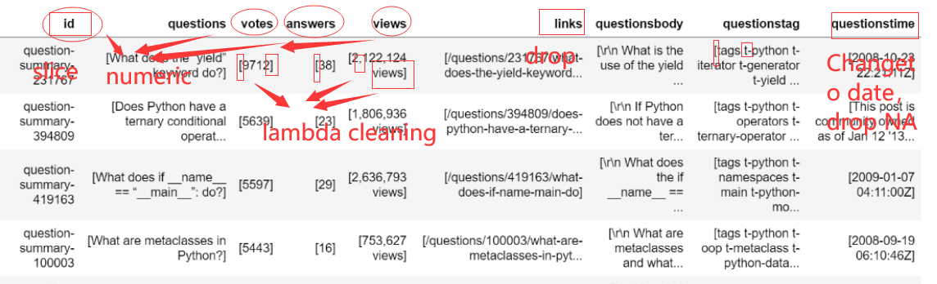
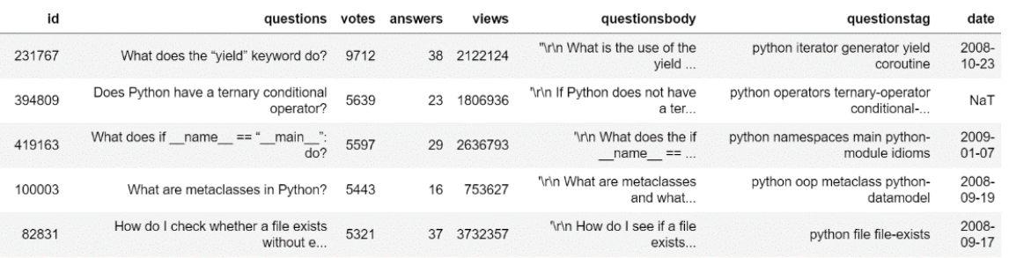
Loading Data
Original Data
Cleaned Data
Notes:
Remove Duplicate…

Slide 7
Data Analysis & Findings

Slide 8
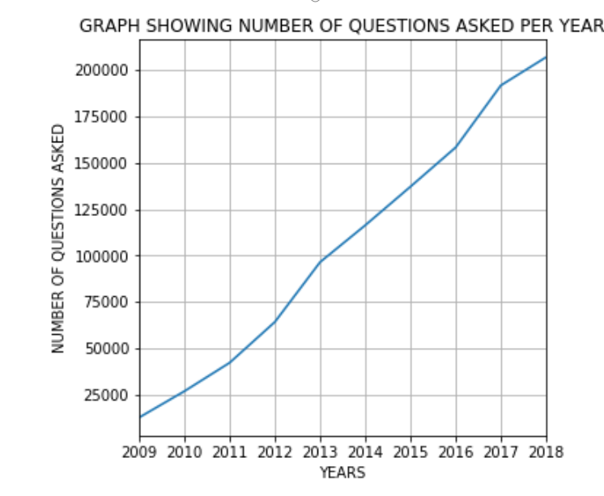
Analyze 1：To see the python questions asked by year
Our datasets start from 2008-08-02 to 2019-12-18 so we consider the 2008 and 2019 data is not complete. We set the date as index and select the only 2009-2018 data.
We can see that the questions of python raised by years and seems that python is more and more popular.

Slide 9
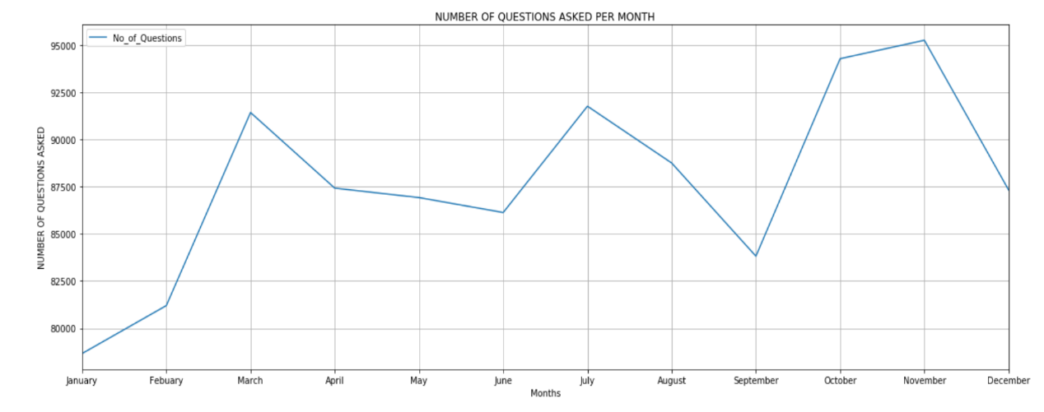
Analyze 2：To see the python questions asked per month
In March, July and November there are 3 peaks. We guess there maybe a lot of students users and these 3 month is usually when they do their project or related python homework.
January is the lowest maybe they go back home to celebrate the New Year Festival！！
Notes:
10.11

Slide 10
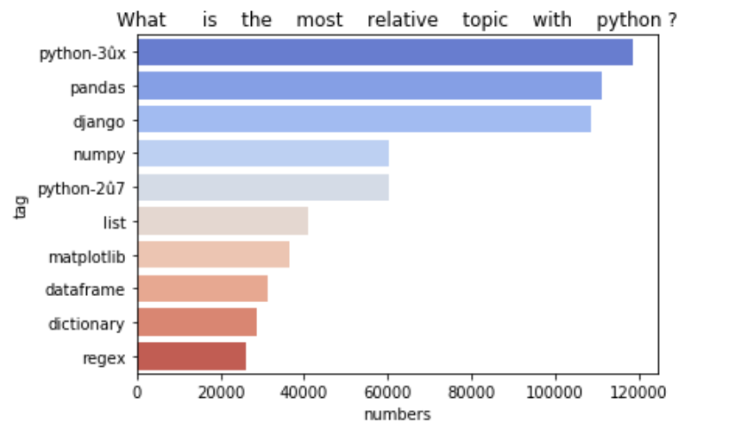
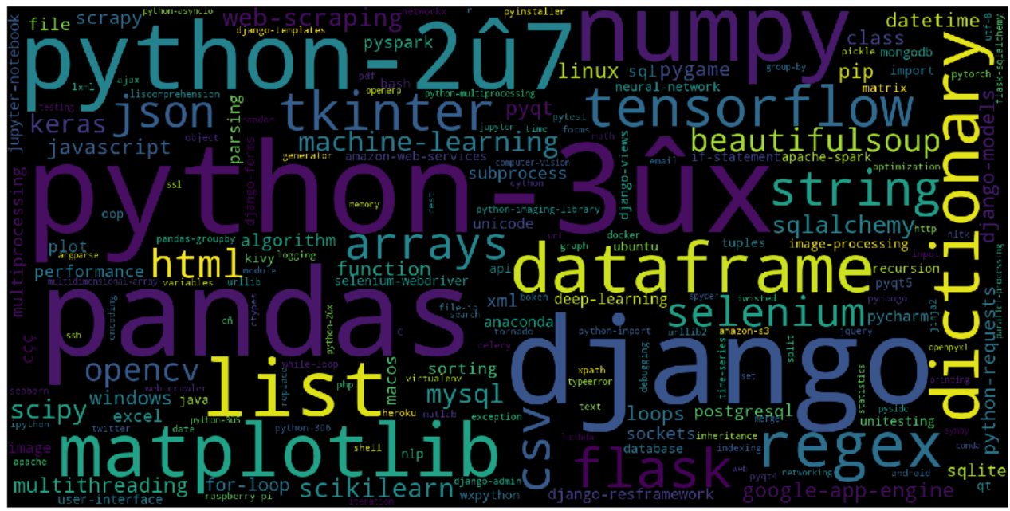
Analyze 3：Tags and python question, what is the most relative topic with python?
Use sns.barplot to show the top 10 related topic and select the top 200 related topic and show as wordcloud: as follow:
Notes:
Full-Stackframework Website Apps
Youtube, google , Yahoo Maps, Instagram、豆瓣、知乎

Slide 11
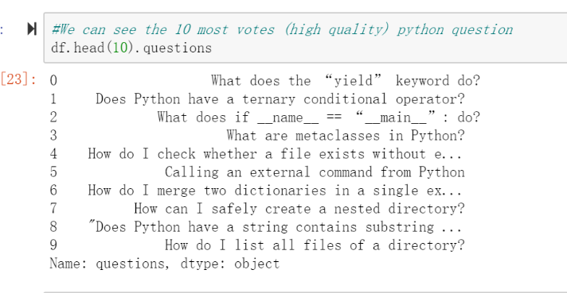
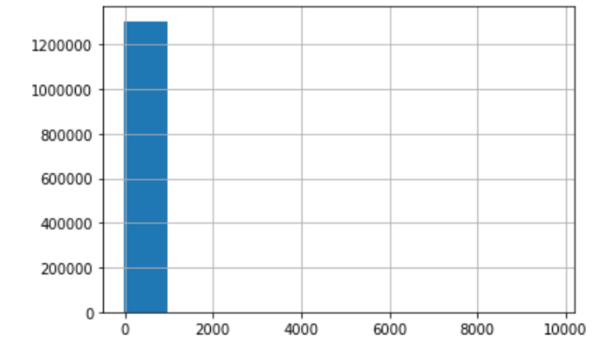
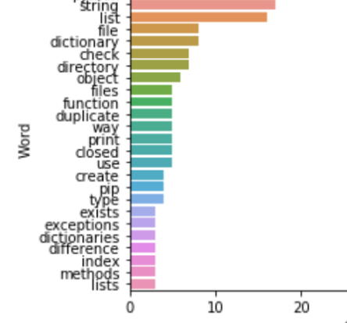
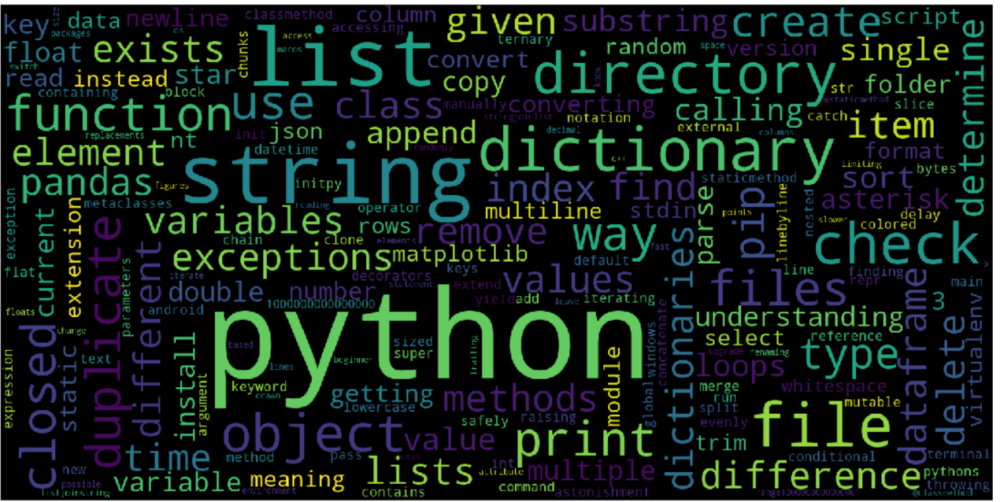
Analyze 4：Votes and python questions
top 10 votes questions
questions is less than 1k votes
most common 25 words in questions
most common words in the most votes questions

Slide 12
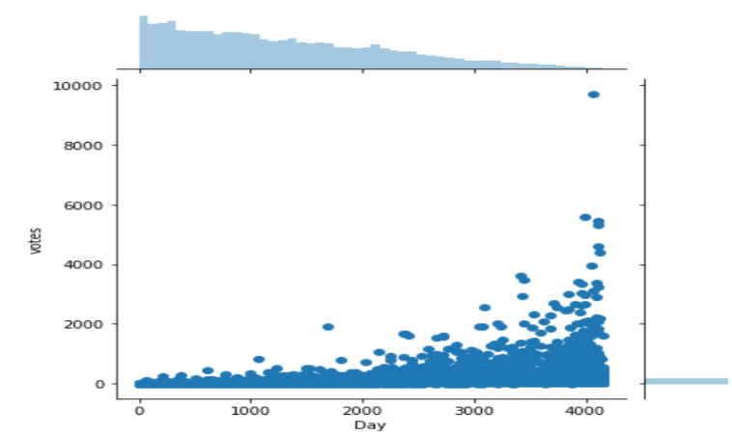
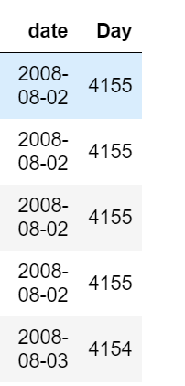
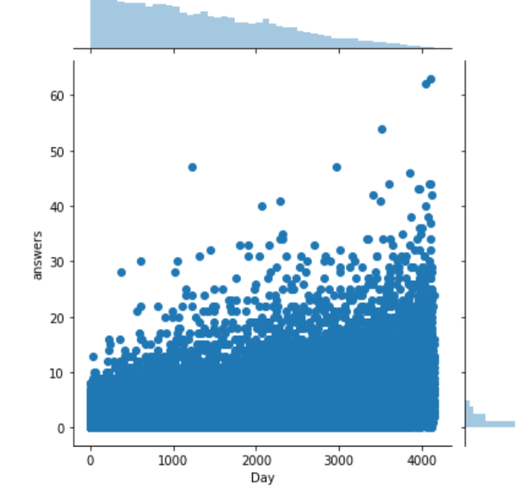
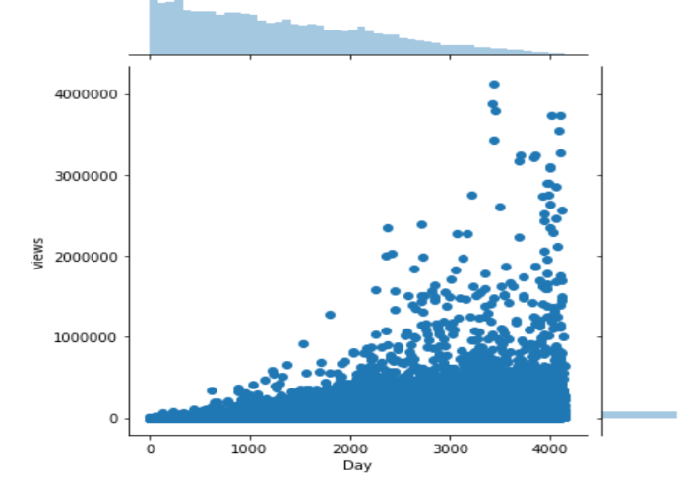
Analyze 5：Do older questions have more votes? And more views? And answers?
Days&Views
new column 'Day': the largest in data and minus the date
Days&Answers
Days&Votes

Slide 13
Thanks for Your Attention Q & A

