Slide 1
Unsupervised Feature Learning via Non-Parametric Instance Discrimination
Zhirong Wu Yuanjun Xiong Stella X. Yu Dahua Lin
UC Berkeley / ICSI Chinese University of Hong Kong Amazon Recognition
CVPR2018
Haozhe Feng
Oct 11, 2018
Notes:
Unsupervised Feature Learning via Non-Parametric Instance Discrimination

Slide 2
Outline
Which problem does the article focus on.
What is the main idea and the pipeline of the proposed approach.
What are the difficulties in the approach, and how to overcome them.
Which fields can the approach be applied to.

Slide 3
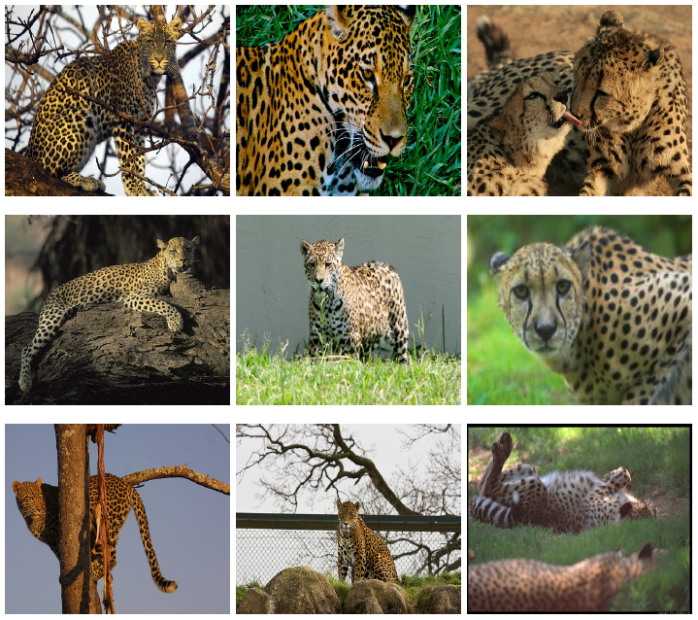
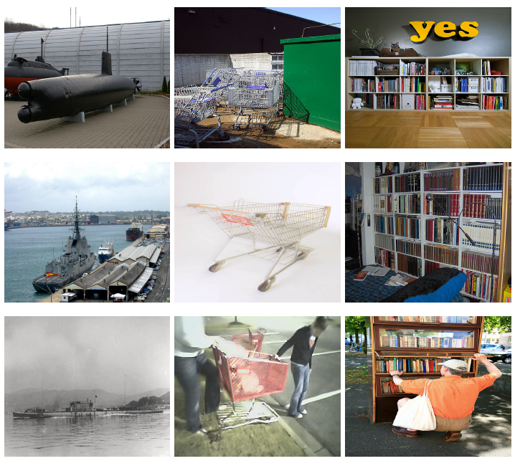
1. Which problem does the article focus on
Given an unannotated image dataset, how to formulate the similarity between images.
论文分享 Unsupervised Feature Learning

Slide 4
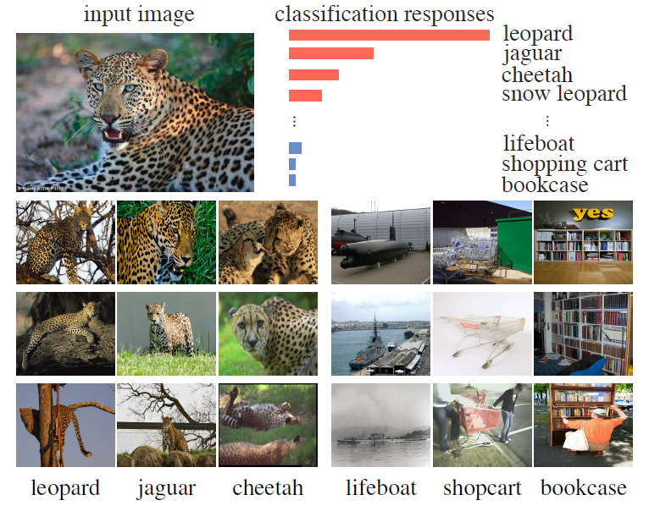
2.What is the main idea of the proposed approach
2.1 The background of the approach
A typical discriminative learning method can automatically discover apparent similarity among semantic categories, without being explicitly guided to do so.
Can we learn a meaningful metric that reflects apparent similarity among instances via pure discriminative learning?
If we learn to discriminate between individual instances, without any notion of semantic categories, we may end up with representation that captures apparent similarity among instances.
论文分享 Unsupervised Feature Learning

Slide 5
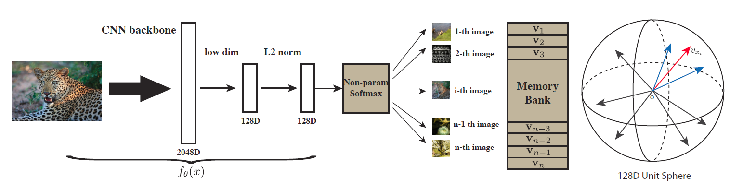
2.What is the main idea of the proposed approach
2.2 The pipline of the approach
Input. n images
Step1. encode each image as a k-dim feature vector
Step2. classify images into n classifications, each image represents a classification
Based on Step 2 we can build loss function
论文分享 Unsupervised Feature Learning

Slide 6
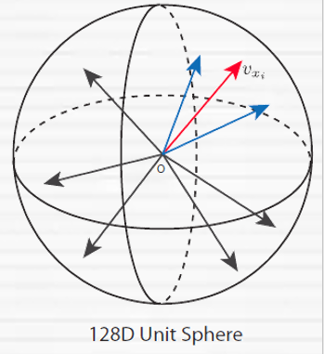

3. What are the difficulties in the approach, and how to overcome them.
3.1 How to do classify based on the k-dim feature vector
Suppose we get n k-dim feature vector $\left(v_{1},…,v_{n}\right),v_{i}=f\left(x_{i}\right),f(.)$ is encoder
Target function: maximize $Π_{i=1}^{n}P\left(i | v_{i}\right)$
Parametric Classifier :
Using fully connection layer to do classification
$P(i│v)=\frac{exp\left(w_{i}^{T}v\right)}{\sum_{j=1}^{n}{exp\left(w_{j}^{T}v\right)}}$
Problem: if $n→∞(e.g. n=10 million)$
Nonparametric Classifier :
$P\left(i | v\right)=\frac{\exp\left(v_{i}^{T}v/γ\right)}{\sum_{j=1}^{n}{exp\left(v_{j}^{T}v/τ\right)}}$
Advantage : build discriminative features
Problem: $v_{i},v$both have gradient
Memory Bank :
$P\left(i | v\right)=\frac{\exp\left(<v_{i}^{\left(t−1\right)},v^{\left(t\right)}>/τ\right)}{\sum_{j=1}^{n}{exp\left(<v_{j}^{\left(t−1\right)},v^{\left(t\right)}>/τ\right)}}$
$v_{i}^{0}$ is random initialized
论文分享 Unsupervised Feature Learning

Slide 7
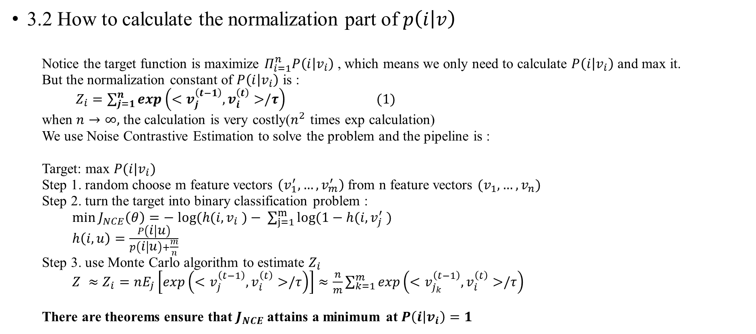
3. What are the difficulties in the approach, and how to overcome them.
3.2 How to calculate the normalization part of $p\left(i | v\right)$
Notice the target function is maximize $Π_{i=1}^{n}P\left(i | v_{i}\right)$, which means we only need to calculate $P\left(i | v_{i}\right)$ and max it.
But the normalization constant of $P\left(i | v_{i}\right)$ is :
$Z_{i}=\sum_{j=1}^{n}{exp\left(<v_{j}^{\left(t−1\right)},v_{i}^{\left(t\right)}>/τ\right)} (1)$
when $n→∞,$ the calculation is very costly($n^{2}$ times exp calculation)
We use Noise Contrastive Estimation to solve the problem and the pipeline is :
Target: max $P(i|v_{i})$
Step 1. random choose m feature vectors $\left(v_{1}^{′},…,v_{m}^{′}\right)$from n feature vectors $(v_{1},…,v_{n})$
Step 2. turn the target into binary classification problem :
$\min{J_{NCE}\left(θ\right)}=− log⁡(h(i,v_{i} )− \sum_{j=1}^{m}{log⁡(1−h(i,v_{j}^{′} ) }$
$h\left(i,u\right)=\frac{P\left(i | u\right)}{p\left(i | u\right)+\frac{m}{n}}$
Step 3. use Monte Carlo algorithm to estimate $Z_{i}$
$Z ≈Z_{i}=nE_{j}\left[exp\left(<v_{j}^{\left(t−1\right)},v_{i}^{\left(t\right)}>/τ\right)\right]≈\frac{n}{m}\sum_{k=1}^{m}{exp}\left(<v_{j_{k}}^{\left(t−1\right)},v_{i}^{\left(t\right)}>/τ\right)$
There are theorems ensure that $J_{NCE}$ attains a minimum at $P\left(i | v_{i}\right)=1$
论文分享 Unsupervised Feature Learning

Slide 8
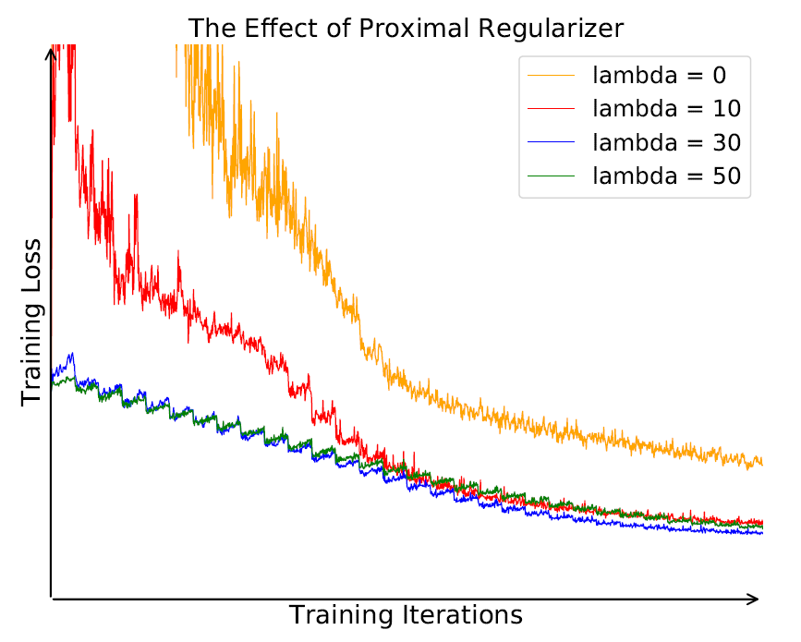

3. What are the difficulties in the approach, and how to overcome them.
3.3 How to handle the oscillation problem
Problem: only have one instance per class
Solution: using proximal optimization method, add
$$λ{\left|\left|v_{i}^{\left(t\right)}−v_{i}^{\left(t−1\right)}\right|\right|}_{2}^{2}$$
to the loss function.
论文分享 Unsupervised Feature Learning

Slide 9
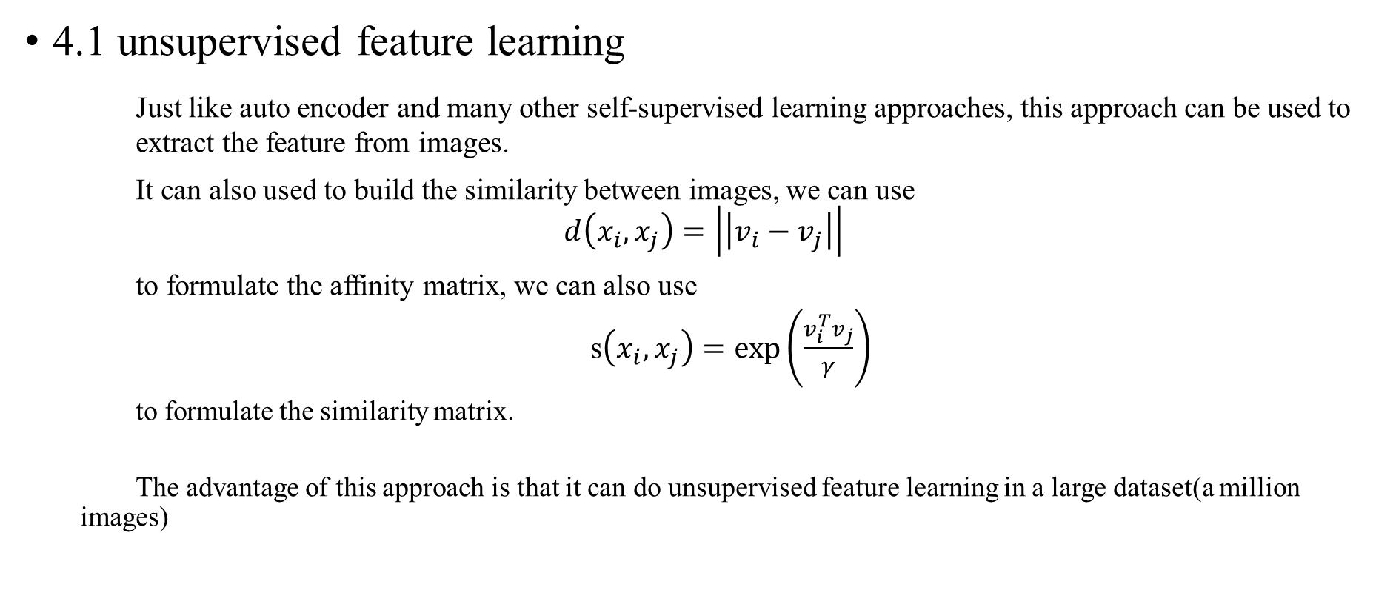
4. Which fields can the approach be applied to
4.1 unsupervised feature learning
Just like auto encoder and many other self-supervised learning approaches, this approach can be used to extract the feature from images.
It can also used to build the similarity between images, we can use
$$d\left(x_{i},x_{j}\right)=\left|\left|v_{i}−v_{j}\right|\right|$$
to formulate the affinity matrix, we can also use
s$\left(x_{i},x_{j}\right)=\exp\left(\frac{v_{i}^{T}v_{j}}{γ}\right)$
to formulate the similarity matrix.
The advantage of this approach is that it can do unsupervised feature learning in a large dataset(a million images)
论文分享 Unsupervised Feature Learning

Slide 10
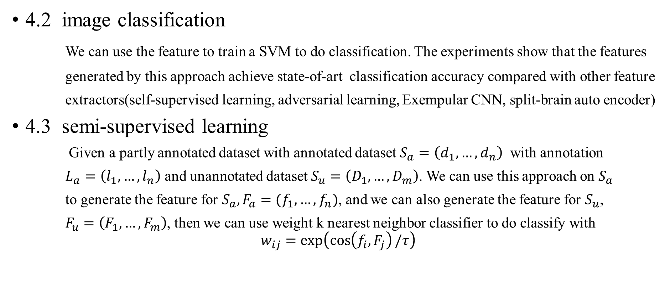
4. Which fields can the approach be applied to
4.2 image classification
We can use the feature to train a SVM to do classification. The experiments show that the features
generated by this approach achieve state-of-art classification accuracy compared with other feature
extractors(self-supervised learning, adversarial learning, Exempular CNN, split-brain auto encoder)
4.3 semi-supervised learning
Given a partly annotated dataset with annotated dataset $S_{a}=\left(d_{1},…,d_{n}\right)$ with annotation
$L_{a}=\left(l_{1},…,l_{n}\right)$ and unannotated dataset $S_{u}=\left(D_{1},…,D_{m}\right)$. We can use this approach on $S_{a}$
to generate the feature for $S_{a},F_{a}=(f_{1},…,f_{n})$, and we can also generate the feature for $S_{u}$,
$F_{u}=\left(F_{1},…,F_{m}\right)$, then we can use weight k nearest neighbor classifier to do classify with
$$w_{ij}=\exp\left(\cos\left(f_{i},F_{j}\right)/τ\right)$$
论文分享 Unsupervised Feature Learning

Slide 11
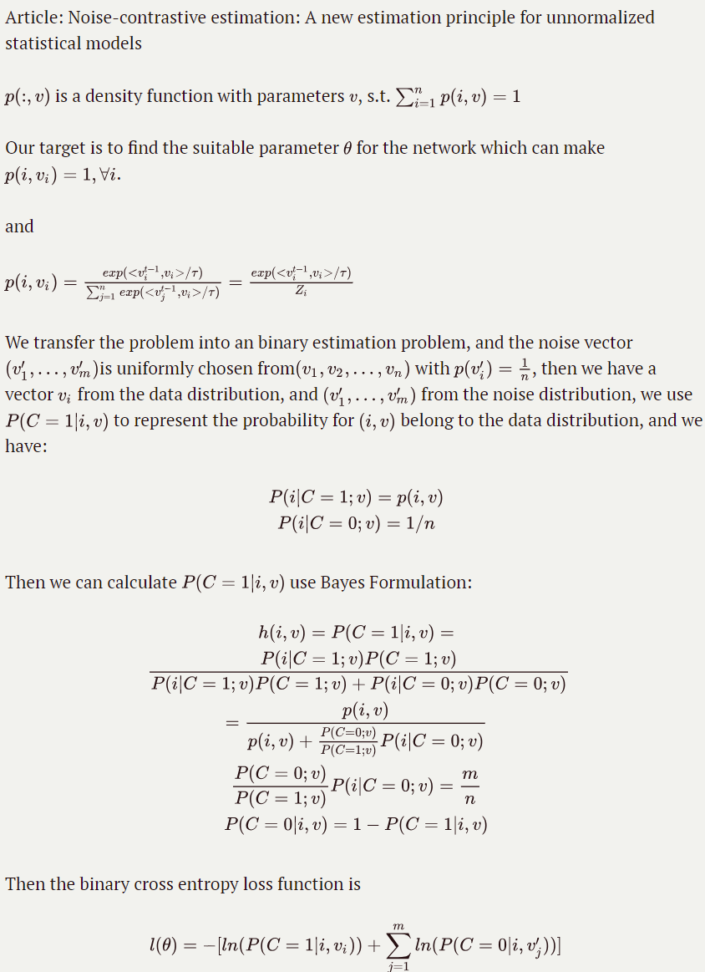
Appendix : the mathematic behind the NCE
论文分享 Unsupervised Feature Learning

Slide 12
Thanks!

