Slide 1
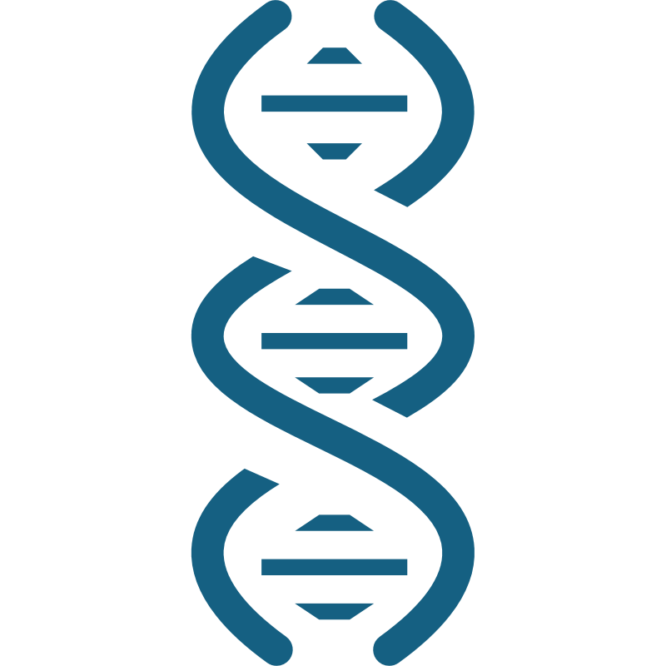
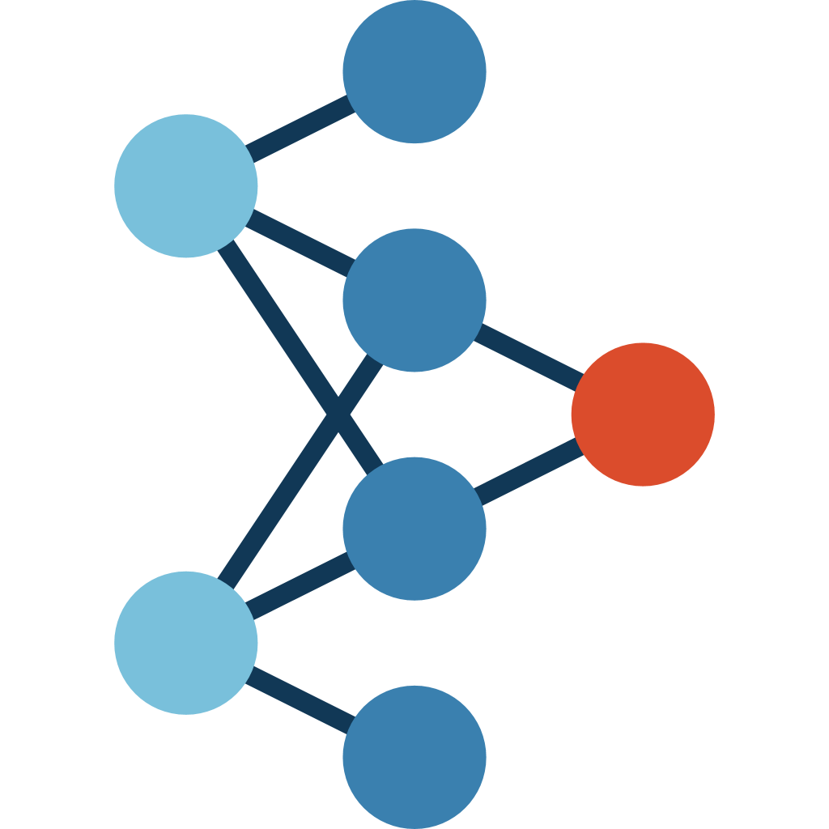




a
From static prediction at one time point ...
... to genotype-conditioned continuous-time developmental dynamics
Traditional genomic prediction (GP)
Kode: learn continuous developmental dynamics for each genotype
G → y_{t}
+
Genotype (G)
Trait value
at a single time point (y_{t})
Genotype (G)
Early phenotype
(state at t₁, y₁)
(unobserved future developmental trajectory)
(G, y₁) → developmental system → $\hat{y}$₁ ... $\hat{y}$_{t} ...$\hat{y}$_{T} (y_{t} to y_{T} is unobserved in traning data)
b
Kode model: trajectory-supervised learning of genotype-specific continuous dynamics
1. Inputs and conditioning
2. Hypernetwork:
individual operator generation
3. Continuous-time developmental dynamics
4. Output: developmental trajectory
Genomic relatedness
Hypernetwork
Latent state dynamics (ODE)
Predicted multivariate trajectories
GRM → PCA
bᵢ
(conditioned on c)
(P)
Trait 1
dh(t) /dt h(t)Aᵢᵀ bᵢ
Genotypes
=
+
Trait 2
Genotype-specific
low-rank dynamics
(Aᵢ = UᵢVᵢ)
Genotype-specific baseline shift
Trait value
Trait 3
Vᵢ
Trait P
(r × P)
…
Top D_{G} PCs
(z_{G})
Time (days after sowing)
Early phenotype at t₁
State propagation over actual elapsed intervals
(Δt can be irregular and unequal)
Uᵢ
…
(P × r)
Δt₁
Δt₂
Δt₃
Condition
vector
Aᵢ=UᵢVᵢ
(r × r)
t₁
t₂
t₃
…
t_{T}
P traits
(y₁)
c = [z_{G}; y₁]
Genotype-specific
low-rank dynamics parameters
$\hat{y}$₁
$\hat{y}$₂
$\hat{y}$₃
…
$\hat{y}$_{t}
Supports irregular observation schedules
c
Key advantages of Kode
1
Continuous-time formulation
2
End-to-end operator learning
3
Early-stage assisted forecasting
4
Genotype-specific dynamics
Δt₁
Δt₂
Δt₃
Directly learn dynamics from
trajectory-level prediction error
Only the first phenotype measurement is required
Genotype
early phenotype
Kode
(hypernetwork + ODE)
Predicted
trajectory
t₁
t₂
t₃
…
tₜ
Forecast the unobserved future developmental trajectory
Naturally handles irregular sampling
and missing observations
Trajectory loss (end-to-end)
y₁
y_{T}
Genotype 1
Genotype 2
Genotype 3

