Slide 1
Linux-1
Familiar with the environment and operating the terminal
113/12/03

Slide 2
Outline
Computer Terminal
Basic Instructions
help
advanced packaging tool
resource monitoring
file and directory
record commands
tips
Tree
nano text editor
Programming
Homework

Slide 3

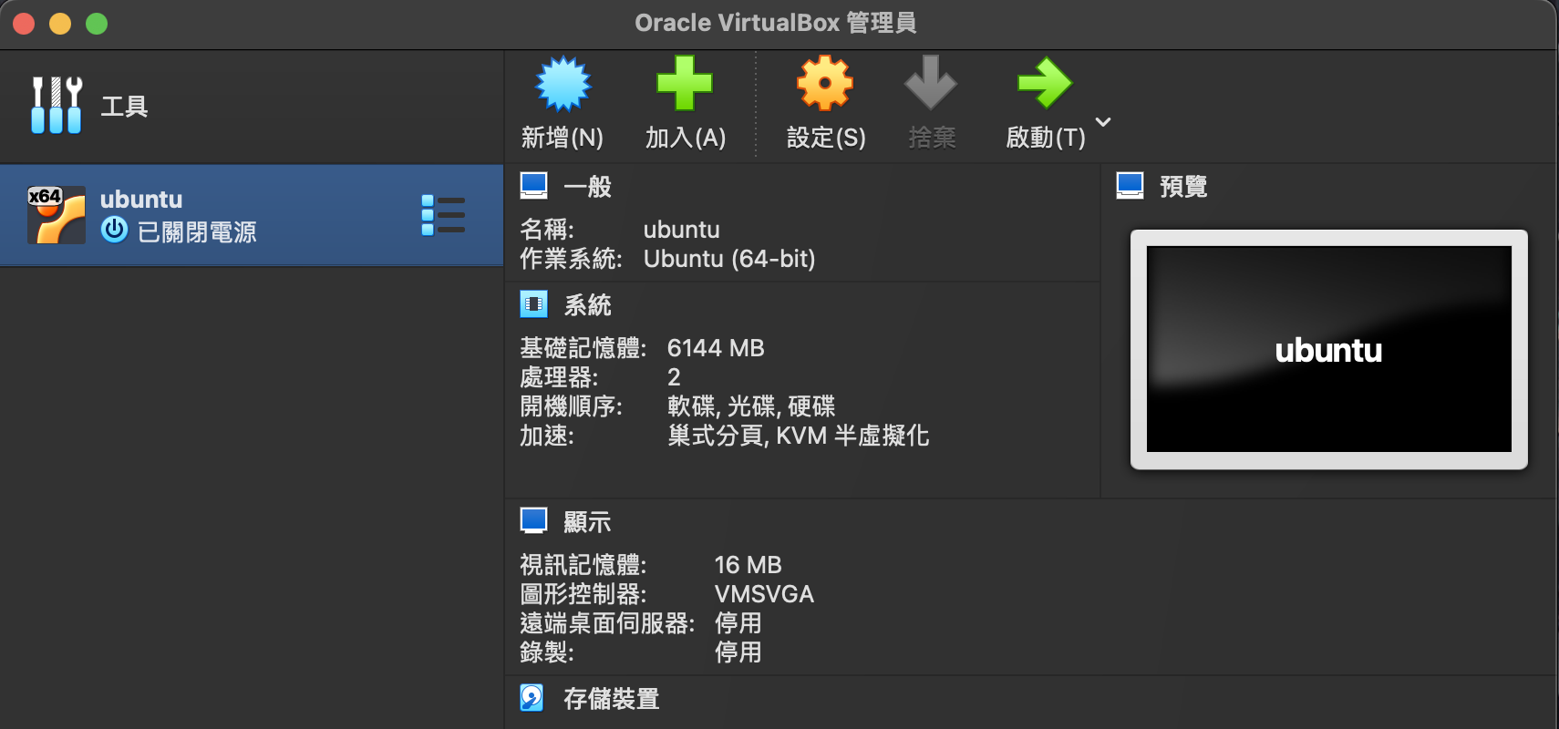
Log in Linux
password : 0000

Slide 4

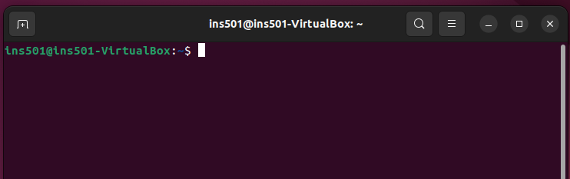
Terminal
An electronic or electromechanical hardware device that can be used for entering data into, and transcribing data from, a computer or a computing system.

Slide 5
Basic Instructions – help
help
see the shell command list
help name
find out more about the function ‘name’
man -k or info
find out more about commands not in the list
clear
clear the terminal screen
Notes:
while use ‘info’ to learn more about command, ‘Ctrl+C’ can escape the info page

Slide 6
Basic Instructions – advanced packaging tool (apt)
sudo apt install package_name
sudo apt update package_name
sudo apt remove package_name
apt list --installed
sudo apt show package_name

Slide 7
Basic Instructions – resource monitoringat
top
display linux processes
df (disk free)
report the amount of disk space used and available on file system
du (disk usage)
report the amount of disk space used by the set of specified files and for each subdirectory

Slide 8
Basic Instructions – file and directory
ls
list directory contents
pwd
print working directory, prints the name of the current directory
cd
change the shell working directory
~ : home directory
. : current directory
.. : upper directory

Slide 9
Basic Instructions – file and directory
mkdir folder_name
creates directories with the specified names
rmdir folder_name
remove empty directories
touch file_name
change the access and/or modification timestamps of the specified files
rm file_name
remove files

Slide 10
Basic Instructions – file and directory
cp src_file dest_path
copy source files to destination directory
cp src_file file_name
copy source files as a new file named file_name
mv src_file dest_path
move source file to destination directory
mv src_file file_name
rename source file as file_name

Slide 11
Basic Instructions – record commands
script file_name
make typescript of terminal session
end the script with exit command

Slide 12

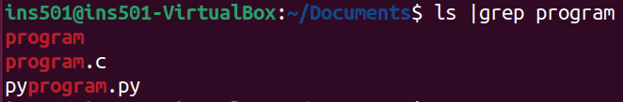
Basic Instructions – filter keyword
grep keyword file_name
command |grep keyword

Slide 13
Basic Instructions – Tips
‘up’ arrow key
use previously used command
ctrl+c
exit the executing command

Slide 14
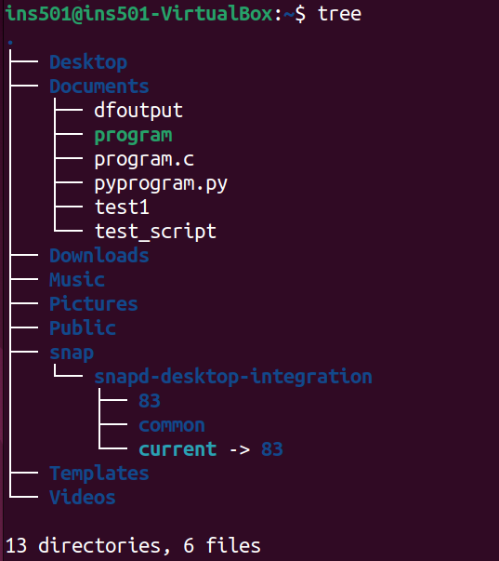
Tree
list content of directories in a tree-like format
sudo apt install tree

Slide 15
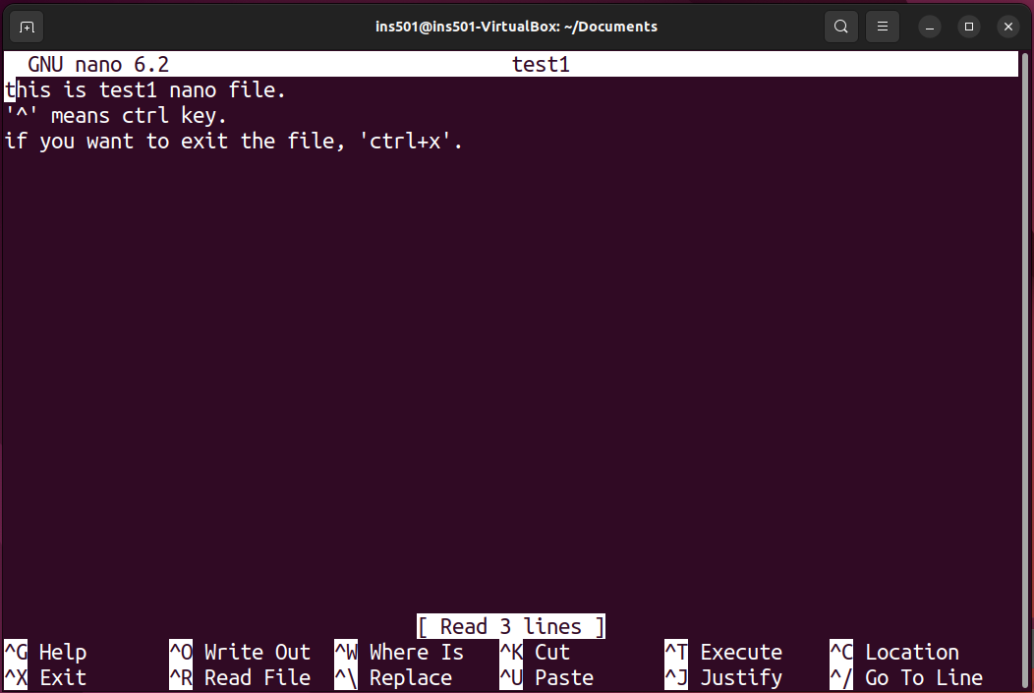
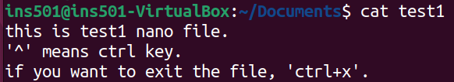
nano text editor
nano file_name
create a nano file named file_name
cat file_nam
output the file contents to the terminal

Slide 16
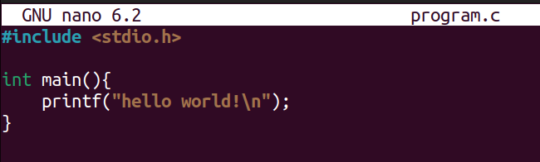


Programming (C program)
nano program_name.c
compile with gcc
gcc -o name program_name
sudo apt install gcc
execute C program
./name

Slide 17
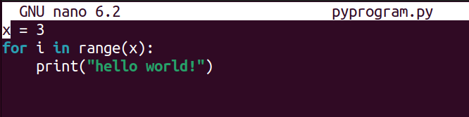
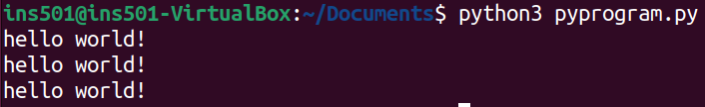
Programming (python)
nano program_pname.py
execute python program
python3 program_name.py

Slide 18
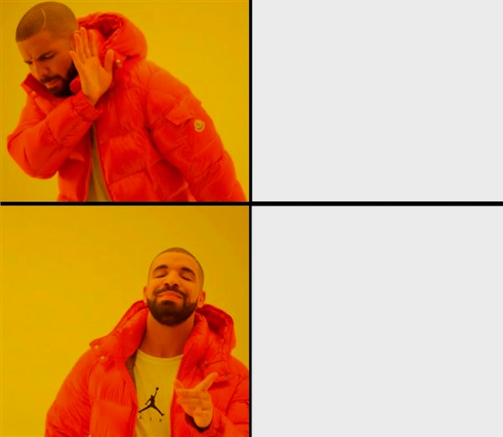

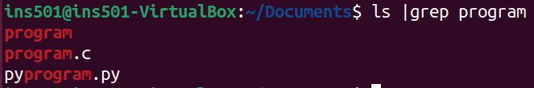
Homework
Please take screenshots of the commands used and the corresponding execution results for each sub-question in the assignment, paste them into a Word document, and convert the document into a PDF file.
請將作業每一小題使用到的指令與執行結果截圖貼在 Word 並轉成 PDF 檔 學號_1203.pdf

Slide 19
Homework
Create a directory named “main” under the home directory and create directory “file_1” and “file_2” inside. (10%)
Use cd command to move from file_1 to file_2 with “absolute path”, and move from file_2 to file_1 with “relative path”. (10%) (If you forget what ‘absolute path’ and ‘relative path’ mean, please refer to the slides from Week 10 HTML-2 in the course.)

Slide 20
Homework
Use script command to save disk free and disk usage output as “free.txt” in file_1. (20%)
Write a C program named “program_1.c” to find the prime numbers between 1 and 1000 and compile it using gcc. (25%)
Execute the program and redirect output to the file “primes.txt”. (25%)
After you have complete all the above questions, move to the home directory and use tree command to display the current directory structure of the system. (10%)

