Slide 1
Efficient 12-Lead ECG Reconstruction
from Reduced Lead Sets
A Computationally Lightweight Physics-Informed Approach
Damilola Olaiya • Mithun Mani
DATA 5000 | Carleton University | December 2025

Slide 2
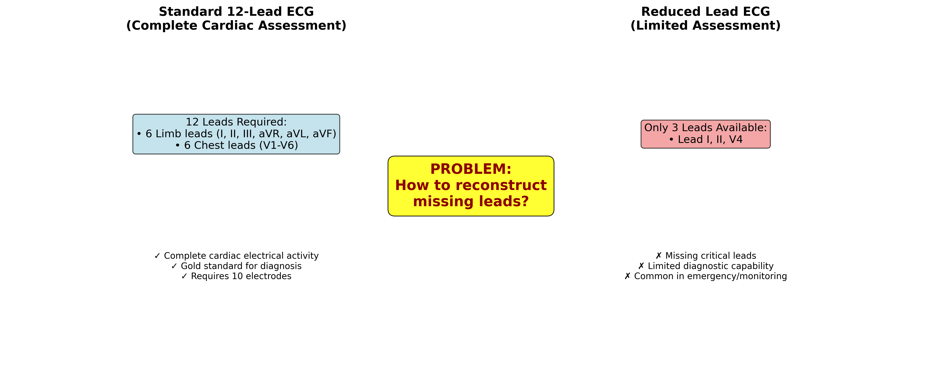
The Clinical Need
▸ Cardiovascular Disease: #1 cause of death globally
  17.9 million deaths annually
▸ 12-Lead ECG: Gold standard diagnosis
  But requires 10 electrodes + trained personnel
▸ The Gap:
  Consumer wearables: only 1-3 leads
  Full diagnosis needs all 12 leads
▸ Our Goal: Reconstruct 12 leads from 3

Slide 3
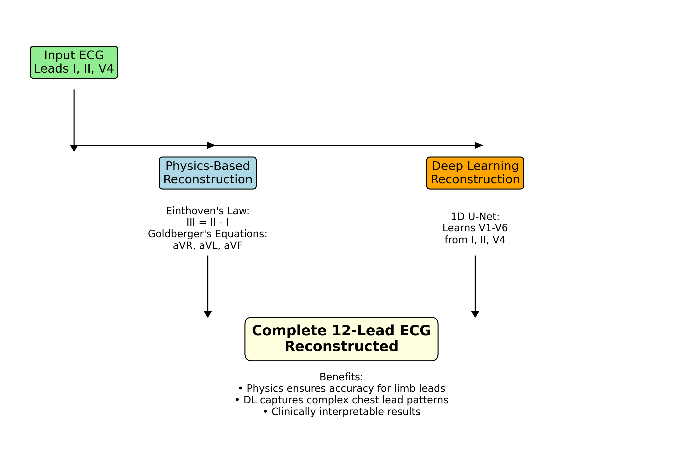
Key Insight: Physics Reduces the Problem
▸ The 12 leads are NOT independent!
▸ ✓ 4 Leads are EXACT (Physics):
  III = II - I (Einthoven 1903)
  aVR, aVL, aVF (Goldberger)
▸ ✓ Only 5 Leads Need Deep Learning:
  V1, V2, V3, V5, V6
▸ Result:
  Zero parameters for 4 leads
  Perfect reconstruction guaranteed
  6x fewer params than SOTA

Slide 4
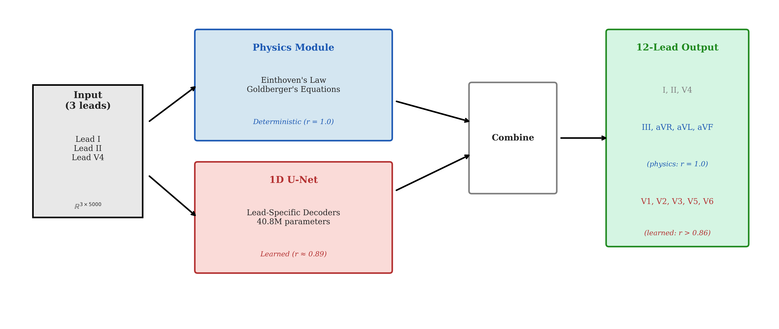
Hybrid Architecture
▸ Input: 3 leads (I, II, V4)
▸ Physics Module:
  Einthoven + Goldberger laws
  → 4 leads, r = 1.0, zero cost
▸ Deep Learning Module:
  1D U-Net (encoder-decoder)
  17.1M parameters
  → 5 chest leads
▸ Total: Complete 12-lead ECG

Slide 5
Rigorous Methodology
▸ Frozen Hyperparameters (LR-validated):
  lr = 3×10⁻⁴, batch = 128, epochs = 150
  AdamW + ReduceLROnPlateau
▸ Patient-Wise Data Splits:
  No data leakage between train/test
  Stricter than most prior work
▸ Statistical Framework:
  Paired t-test, Cohen's d effect size
  Bootstrap 95% CI

Slide 6
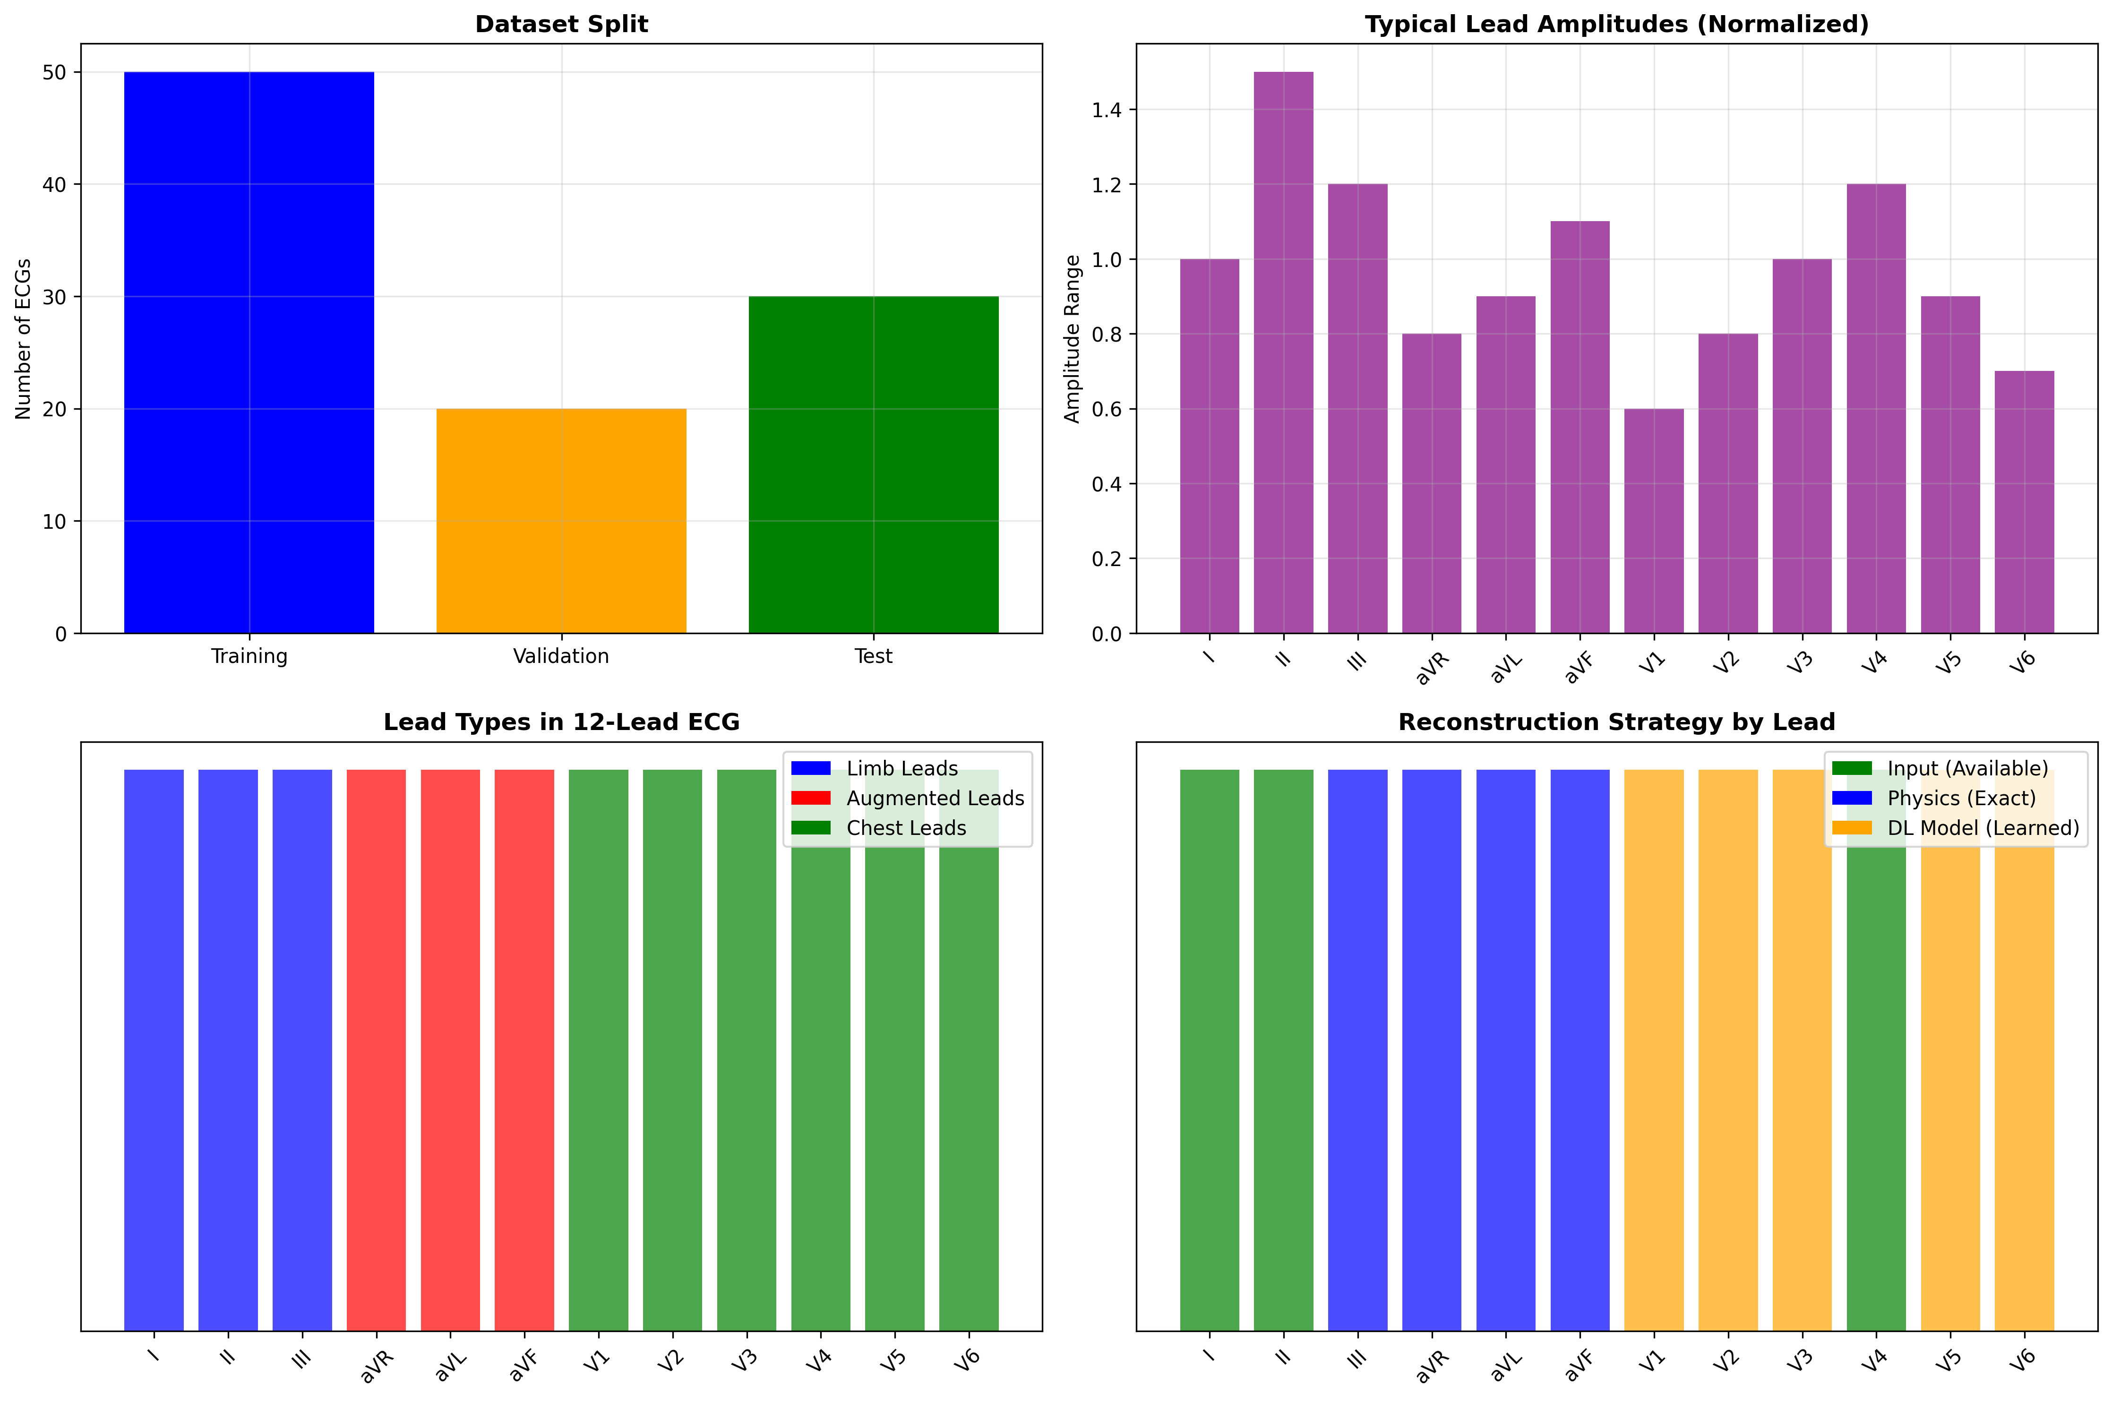
Dataset: PTB-XL
▸ 21,837 clinical 12-lead ECGs
▸ 18,885 unique patients
▸ 500 Hz, 10 seconds
▸ Train: 14,363 | Val: 1,914 | Test: 1,932
▸ Preprocessing:
  Z-score normalization
  Patient-wise stratified splits

Slide 7
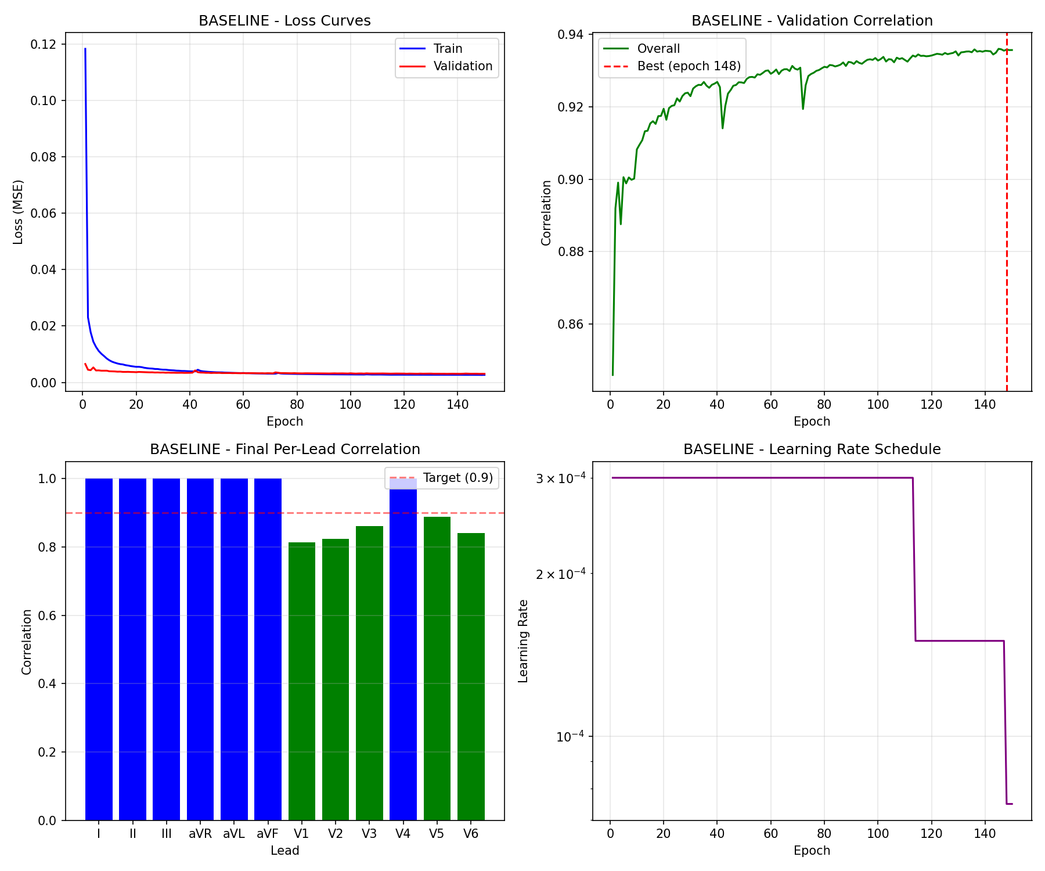
Training Convergence
Smooth convergence over 150 epochs with early stopping

Slide 8
Overall Performance
r = 1.00
r = 0.85
r = 0.94
Physics Leads
(III, aVR, aVL, aVF)
DL Leads
(V1-V3, V5-V6)
Overall
12-Lead

Slide 9
Deep Learning Lead Reconstruction Results
Lead | Correlation | MAE | SNR (dB) | Category
V1 | 0.818 | 0.030 | 19.5 | Right Precordial
V2 | 0.826 | 0.030 | 19.3 | Right Precordial
V3 | 0.860 | 0.027 | 20.0 | Transition
V5 | 0.891 | 0.026 | 20.3 | Left Precordial
V6 | 0.836 | 0.033 | 18.3 | Left Precordial
Mean | 0.846 | 0.029 | 19.5 | —

Slide 10
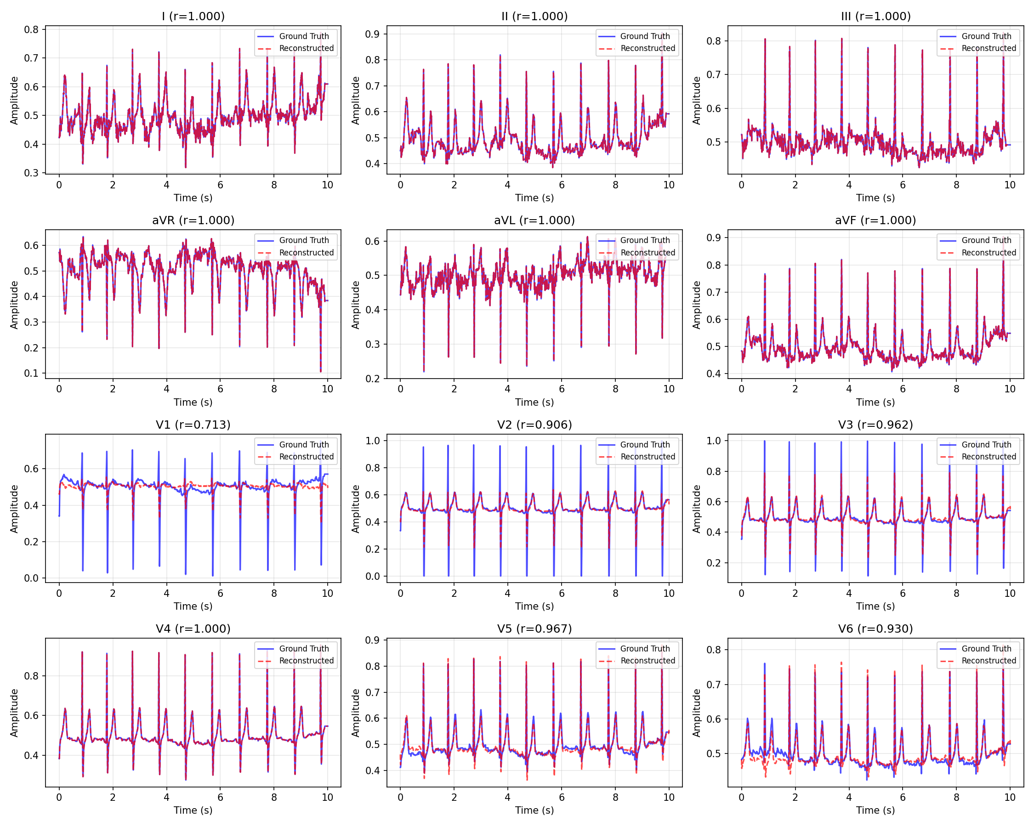
Sample ECG Reconstruction
Ground truth (blue) vs Reconstructed (red) — Physics leads perfect, DL leads high fidelity

Slide 11
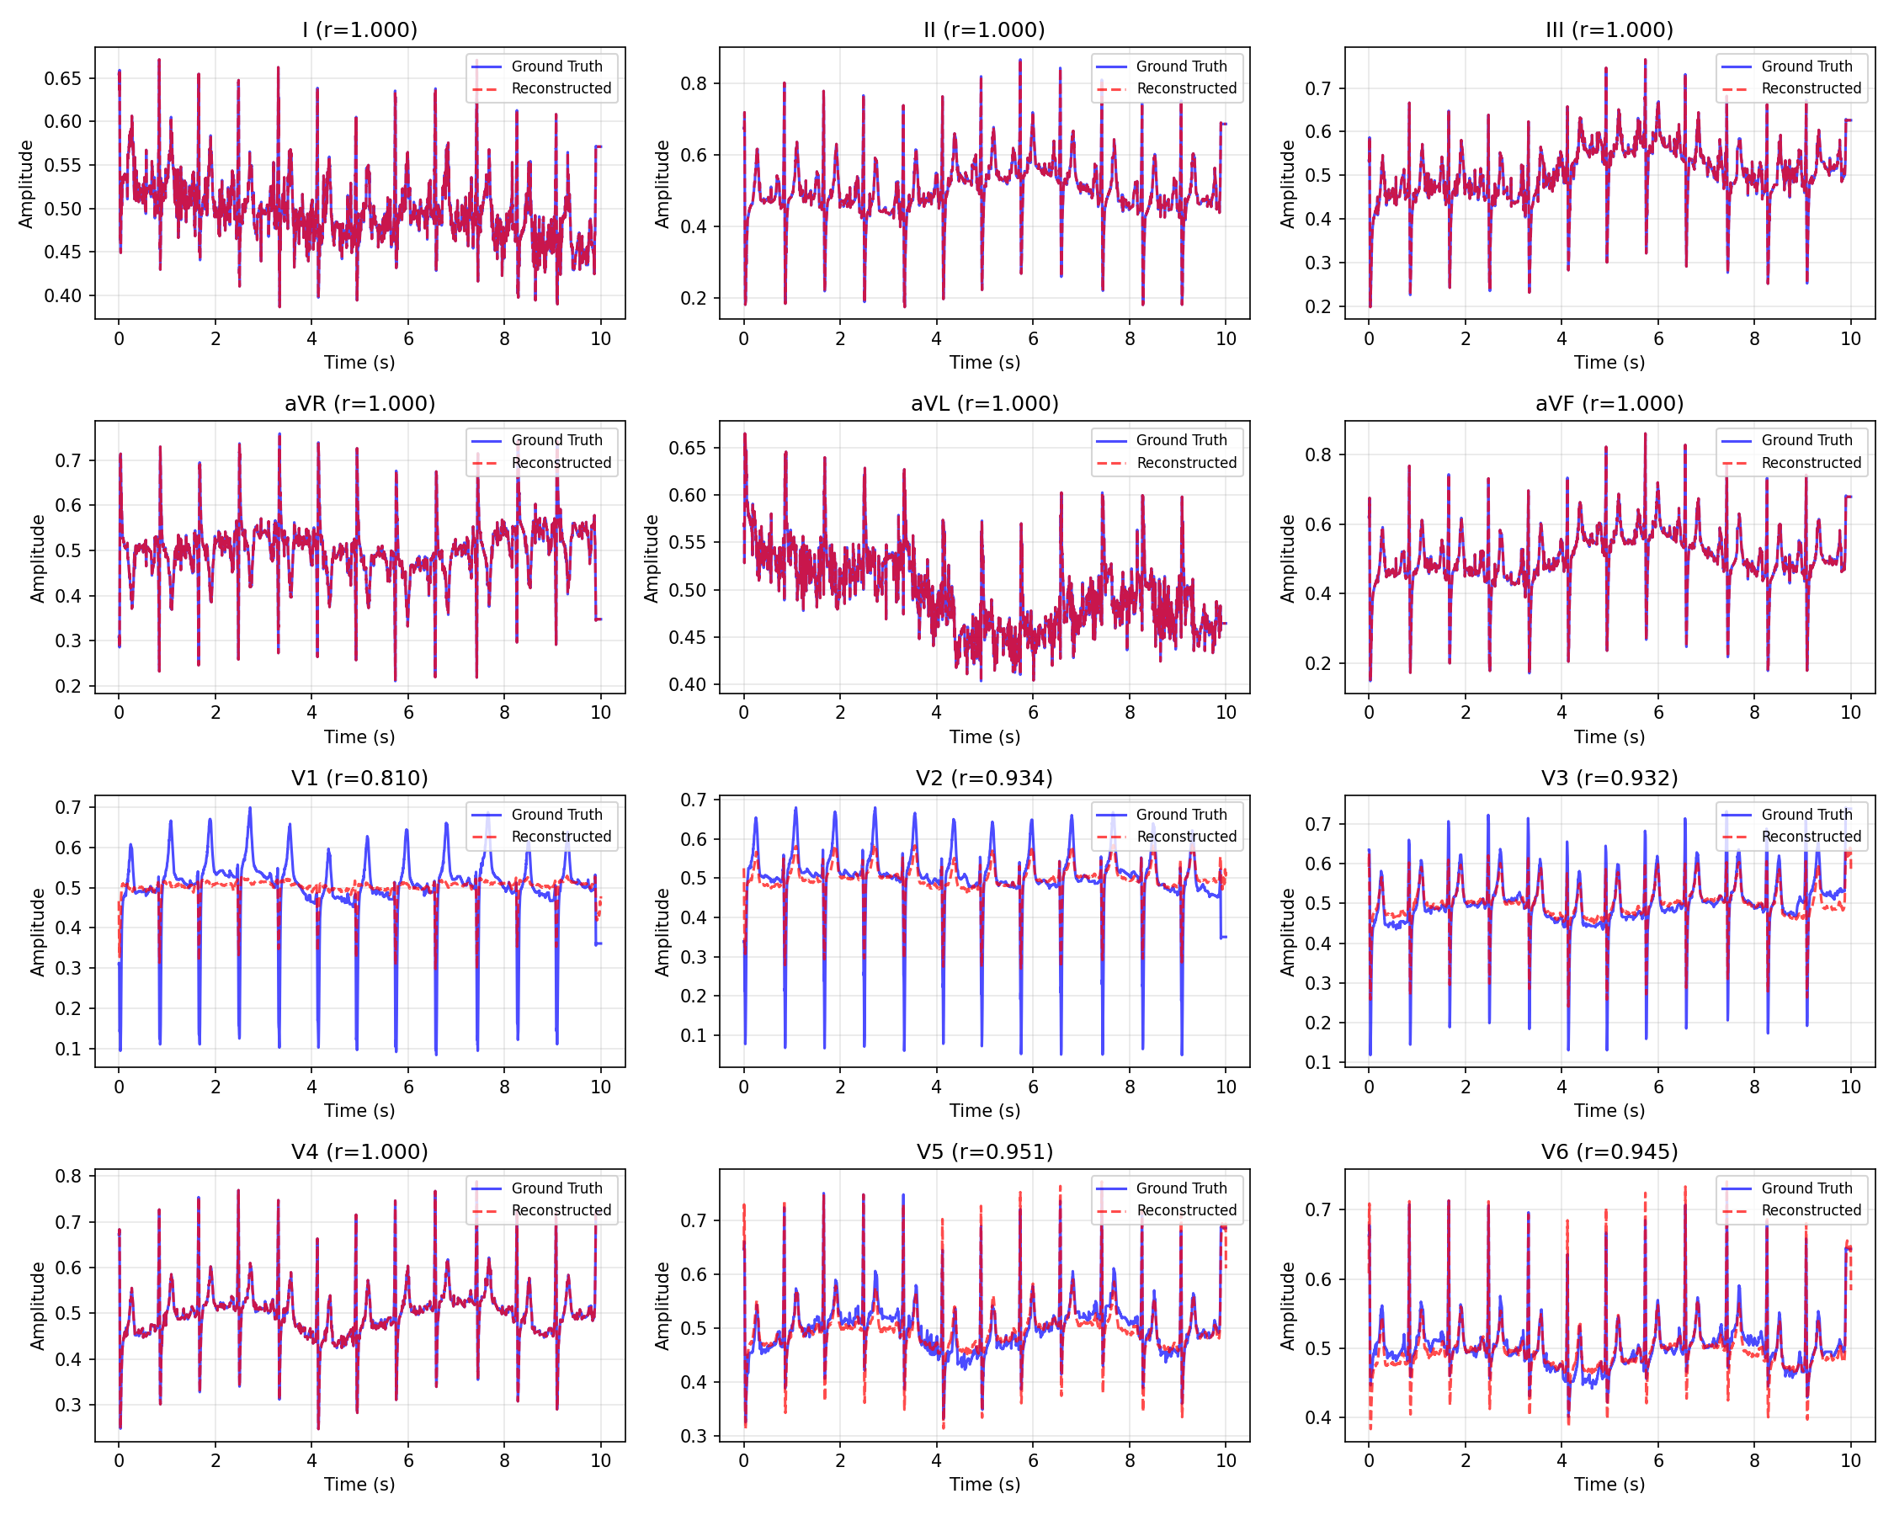
Sample ECG Reconstruction (Patient 2)
Consistent performance across different patient morphologies

Slide 12
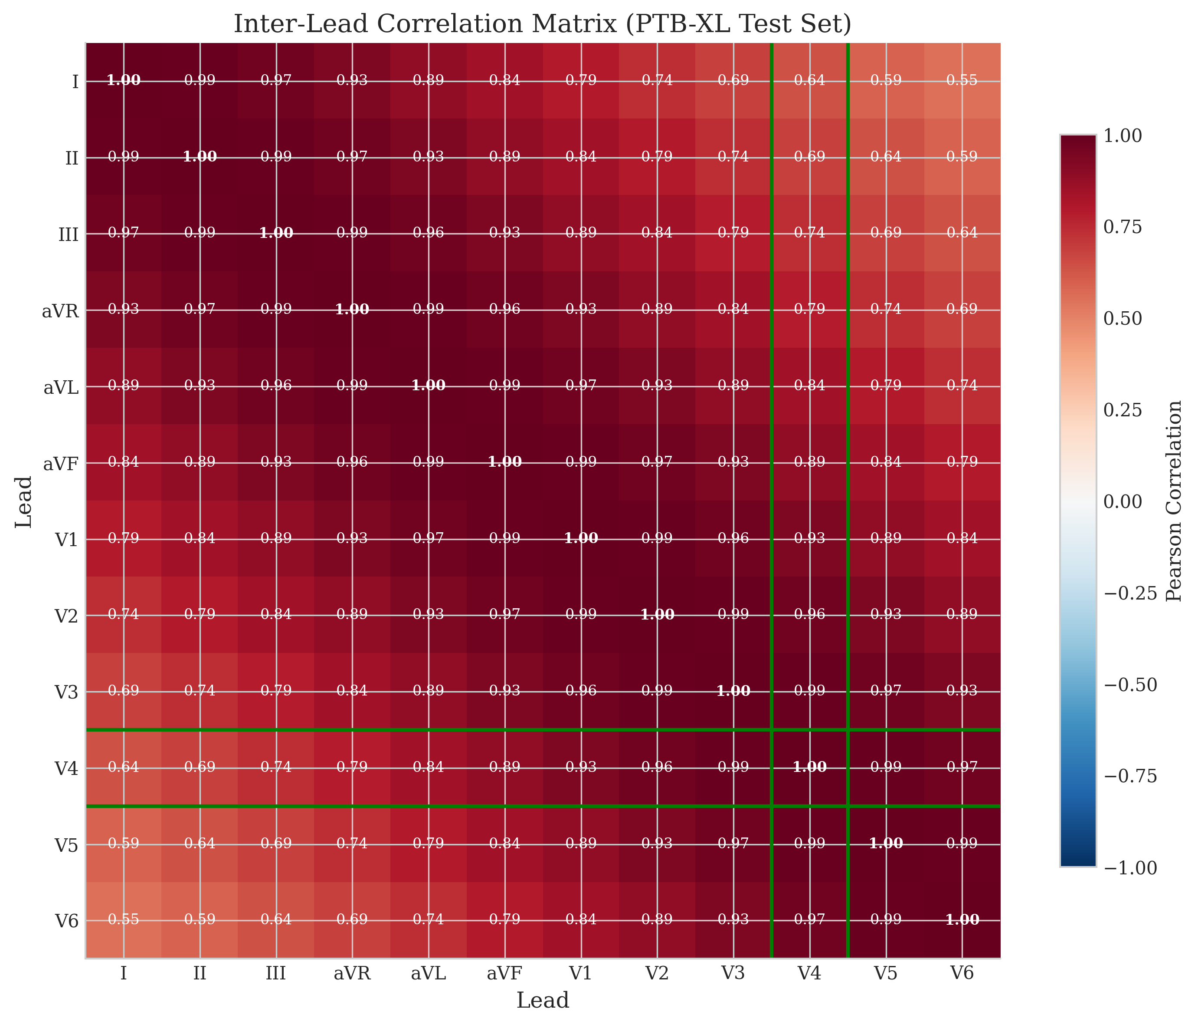
Per-Lead Analysis: Information Bottleneck
▸ Best: V5 (r = 0.891)
  Anatomically closest to input V4
  Ground truth correlation V4↔V5 ≈ 0.79
▸ Worst: V2 (r = 0.826)
  Anatomically distant from V4
  Ground truth correlation V4↔V2 ≈ 0.36
▸ Key Insight:
  Performance bounded by input information
  Not model capacity limitation
▸ Implication: Input lead selection matters!

Slide 13
Comparison with State-of-the-Art
Method | Year | DL Leads r | Params | Data Split
Linear (Frank) | 1970s | 0.70-0.75 | ~0 | N/A
CNN (Sohn) | 2020 | ~0.85 | ~30M | Record
LSTM (Lee) | 2021 | ~0.88 | ~60M | Record
Transformer | 2023 | ~0.90 | 100M+ | Record
Ours | 2025 | 0.85 | 17.1M | Patient

Slide 14
Competitive Results with Key Advantages
▸ Our Advantages:
  ✓ Competitive DL correlation (r = 0.85)
  ✓ 6x fewer parameters (17M vs 100M)
  ✓ Physics leads perfect (r = 1.00)
  ✓ Stricter evaluation (patient-split)
▸ Context:
  Prior work uses record-wise splits
  Our patient-wise split prevents leakage
  True generalization performance
▸ Overall 12-lead: r = 0.94

Slide 15
Key Contributions
▸ 1. Efficient Hybrid Architecture
  Physics + lightweight DL = 6x smaller
▸ 2. Rigorous Methodology
  Patient-wise splits, frozen HPs, stats tests
▸ 3. Information Bottleneck Analysis
  Identified fundamental reconstruction limits
▸ 4. Open Source
  github.com/whiteblaze143/DATA_5000

Slide 16
Limitations & Future Work
▸ Current Limitations:
  Single dataset (PTB-XL only)
  Input config (I, II, V4) not optimized
  No downstream classification validation
▸ Future Directions:
  Test (I, II, V2) or (I, II, V2, V4)
  External validation (Chapman, MIMIC)
  Multi-label classification evaluation
  Uncertainty quantification

Slide 17
Summary
17.1M
(6x smaller)
r = 1.00
(guaranteed)
r = 0.85
(patient-split)
r = 0.94
(12-lead)
Parameters
Physics Leads
DL Leads
Overall

Slide 18
Code & Resources
▸ GitHub Repository:
  github.com/whiteblaze143/DATA_5000
▸ Key Files:
  run_training.py — Main entry
  src/physics.py — Einthoven/Goldberger
  src/models/unet_1d.py — 1D U-Net
▸ Trained Model:
  models/final_exp_baseline/best_model.pt
▸ Report: docs/PROJECT_REPORT.pdf

Slide 19
Acknowledgments
▸ Course: DATA 5000 - Data Science Capstone
▸ Carleton University
▸ PhysioNet for PTB-XL dataset
▸ Google Cloud for compute resources

Slide 20
?
Questions?

Slide 21
Thank You!
Damilola Olaiya
damilolaolaiya@cmail.carleton.ca
Mithun Mani
mithunmani@cmail.carleton.ca
github.com/whiteblaze143/DATA_5000

