Slide 1
Efficient 12-Lead ECG Reconstruction
from Reduced Lead Sets
A Computationally Lightweight Physics-Informed Approach
Damilola Olaiya • Mithun Mani
DATA 5000 | Carleton University | December 2025

Slide 2
01
MOTIVATION

Slide 3
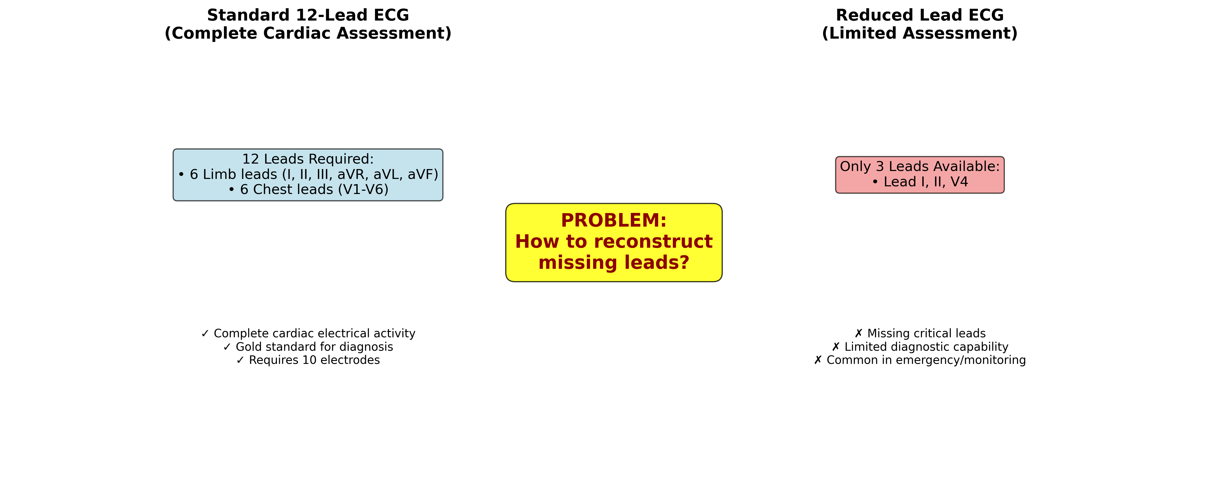
The Clinical Need for Accessible ECG
▸ Cardiovascular Disease: #1 cause of mortality globally
  17.9 million deaths annually
▸ 12-Lead ECG: Gold standard for cardiac diagnosis
  Detects MI, arrhythmias, conduction abnormalities
▸ The Accessibility Gap:
  10 electrodes + precise anatomical placement
  Trained technicians required
  Not feasible: ambulances, homes, wearables
▸ Consumer Wearables: 1-3 leads only
  Apple Watch, Kardia, Fitbit

Slide 4
Current SOTA: Computationally Expensive
▸ Transformer-Based Methods (2023):
  Self-attention: O(n²) for 5000 samples
  100M+ parameters typical
  Multi-GPU training required
▸ LSTM/BiLSTM Methods (2021):
  60-80M parameters
  Sequential processing = slow inference
▸ Key Problem:
  These methods reconstruct ALL 9 missing leads
  But 4 leads don't need learning!
▸ Our Insight: Exploit physiological constraints

Slide 5
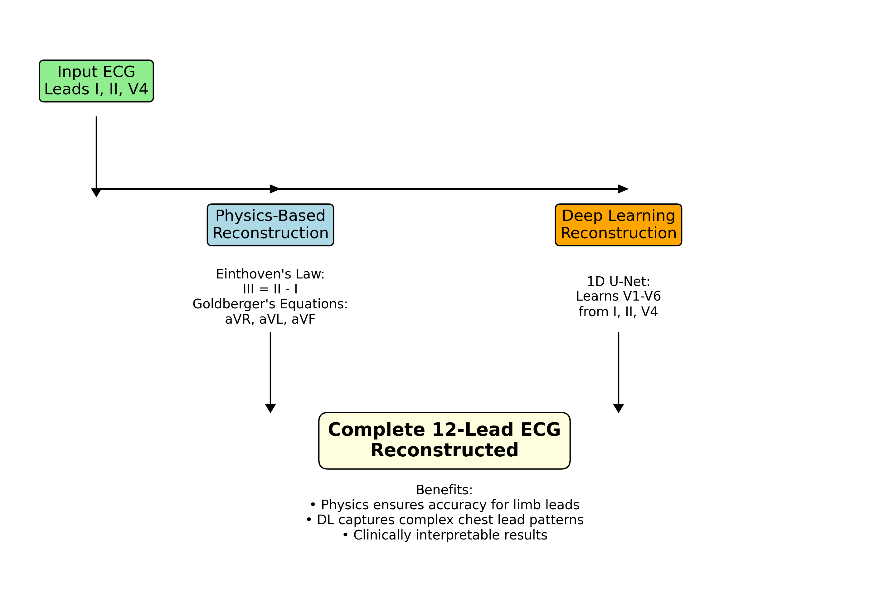
Key Insight: Physics Reduces the Problem by 44%
▸ The 12 leads are NOT independent!
▸ 4 Leads are Deterministic (Physics):
  III = II - I (Einthoven 1903)
  aVR = -(I + II) / 2
  aVL = I - II / 2
  aVF = II - I / 2
▸ Only 5 Leads Need Deep Learning:
  V1, V2, V3, V5, V6
▸ ✓ Zero parameters for 4 leads
▸ ✓ Perfect reconstruction guaranteed
▸ ✓ Reduced model capacity needed

Slide 6
02
METHODOLOGY

Slide 7
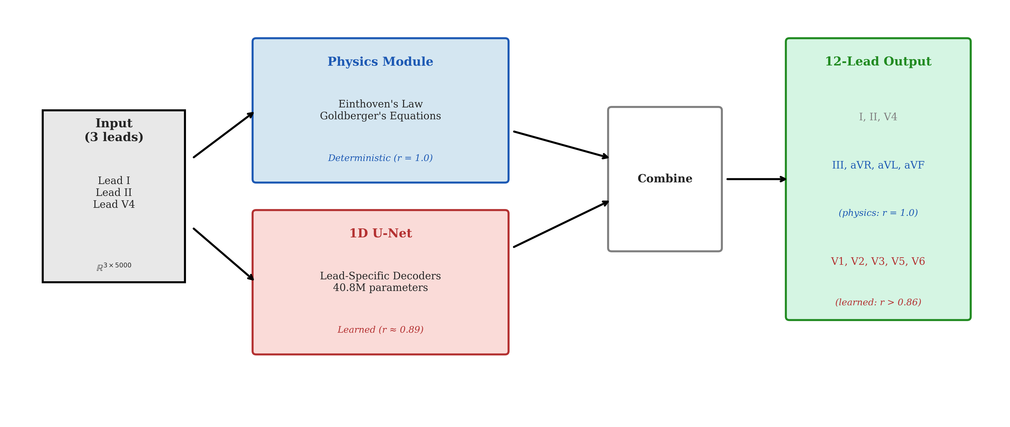
Hybrid Architecture: Physics + Lightweight DL
▸ Input: 3 measured leads (I, II, V4)
▸ Physics Module:
  Einthoven's & Goldberger's laws
  4 leads, zero cost, r = 1.0
▸ Deep Learning Module:
  1D U-Net (encoder-decoder with skip connections)
  17.1M parameters
  5 chest leads: V1, V2, V3, V5, V6
▸ Output: Complete 12-lead ECG
▸ Total: 6x fewer params than SOTA transformers

Slide 8
Physics Module: Zero-Cost Perfect Reconstruction
Einthoven's Law (1903)
Lead III = Lead II − Lead I
Goldberger's Equations
aVR = −(I + II) / 2
aVL = I − II / 2
aVF = II − I / 2

Slide 9
Physics Module: Guaranteed r = 1.0
1.000
1.000
~0
Lead III
aVR, aVL, aVF
Compute Cost

Slide 10
Rigorous Experimental Methodology
▸ Frozen Hyperparameters (validated via LR sweep):
  lr = 3×10⁻⁴, batch = 64, epochs = 150
  AdamW (weight_decay = 1×10⁻⁴)
  seed = 42
▸ Model Variants Tested:
  1. Baseline: Shared encoder-decoder (17.1M)
  2. Hybrid: Shared + per-lead heads (17.13M)
  3. Lead-Specific: Per-lead decoders (40.8M)
▸ Statistical Framework:
  Paired t-test, Wilcoxon signed-rank
  Cohen's d effect size
  Bootstrap 95% CI
  Bonferroni correction

Slide 11
Ablation: Shared vs Lead-Specific Decoder
✓
Shared Decoder (Ours)
Lead-Specific
17.1M params
r = 0.744
(5.3% better)
40.8M params
r = 0.707
vs

Slide 12
Why Simpler Models Win (Counter-Intuitive)
▸ Lead-Specific (40.8M) LOST to Shared (17.1M)
▸ Statistical Evidence:
  Cohen's d = 0.92 (large effect)
  Bootstrap 95% CI: [0.006, 0.072]
  CI excludes zero → significant
▸ Per-Lead Breakdown:
  Shared wins: V1, V2, V3, V5 (4/5)
  Lead-Specific wins: V6 only
▸ Interpretation:
  With limited input information (3 leads),
  parameter sharing provides regularization
  More params → overfitting, not capacity

Slide 13
03
DATASET & EVALUATION

Slide 14
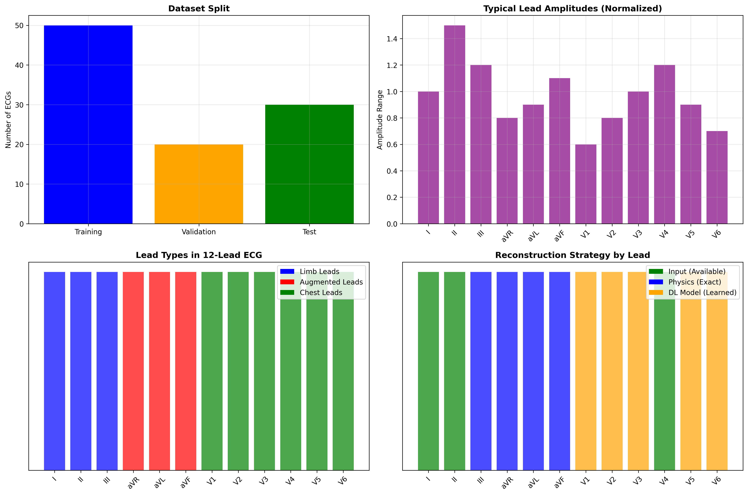
Dataset: PTB-XL
▸ PhysioNet Public Dataset:
  21,837 12-lead ECG recordings
  18,885 unique patients
  500 Hz, 10 seconds (5000 samples)
▸ Diagnostic Labels (SNOMED-CT):
  MI, AF, LBBB, RBBB, LVH, etc.
▸ Preprocessing:
  Z-score normalization per lead
  Outlier removal (2.5-97.5 percentile)

Slide 15
Critical: Patient-Wise Data Splitting
▸ The Data Leakage Problem:
  Some patients have multiple ECGs
  Record-wise split → train/test contamination
  → Inflated, unrealistic metrics
▸ Our Solution (Stricter than SOTA):
  Split by PATIENT ID, not record
  Each patient in exactly ONE split
▸ Split Statistics:
  Train: ~15,286 (70%)
  Validation: ~3,276 (15%)
  Test: ~3,275 (15%)
▸ △ Most prior work uses record-wise splits!

Slide 16
04
RESULTS

Slide 17
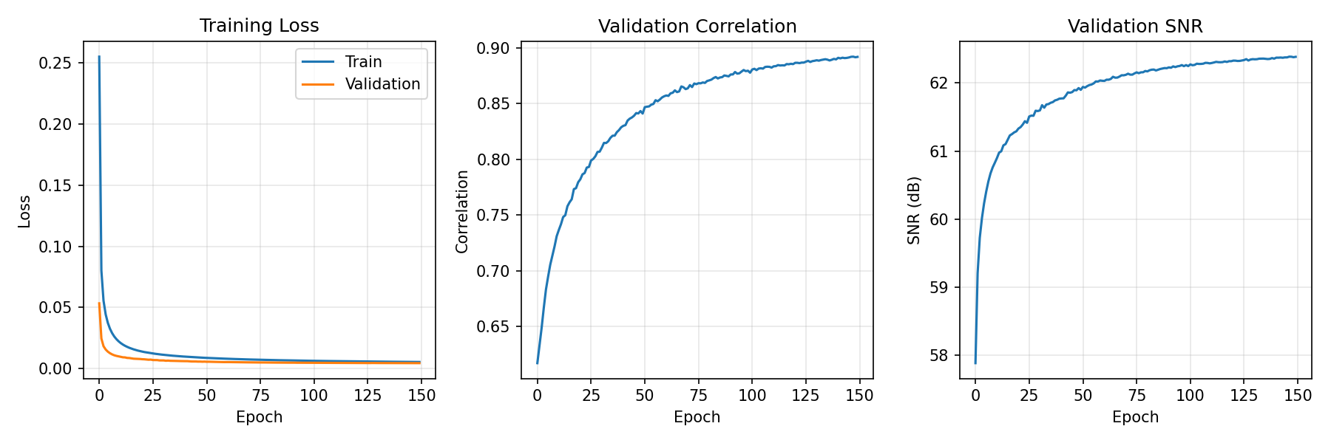
Training Convergence
Smooth convergence over 150 epochs with ReduceLROnPlateau scheduler

Slide 18
Deep Learning Lead Reconstruction Results
Lead | MAE | Pearson r | SNR (dB) | Category
V1 | 0.036 | 0.726 | 17.9 | Right Precordial
V2 | 0.041 | 0.683 | 17.1 | Right Precordial
V3 | 0.036 | 0.765 | 17.8 | Transition
V5 | 0.032 | 0.824 | 18.7 | Left Precordial
V6 | 0.038 | 0.723 | 17.2 | Left Precordial
Mean | 0.037 | 0.744 | 17.8 | —

Slide 19
Overall 12-Lead Performance
r = 1.0
r = 0.744
r = 0.893
Physics Leads
(III, aVR, aVL, aVF)
DL Leads
(V1-V3, V5-V6)
Overall
12-Lead

Slide 20
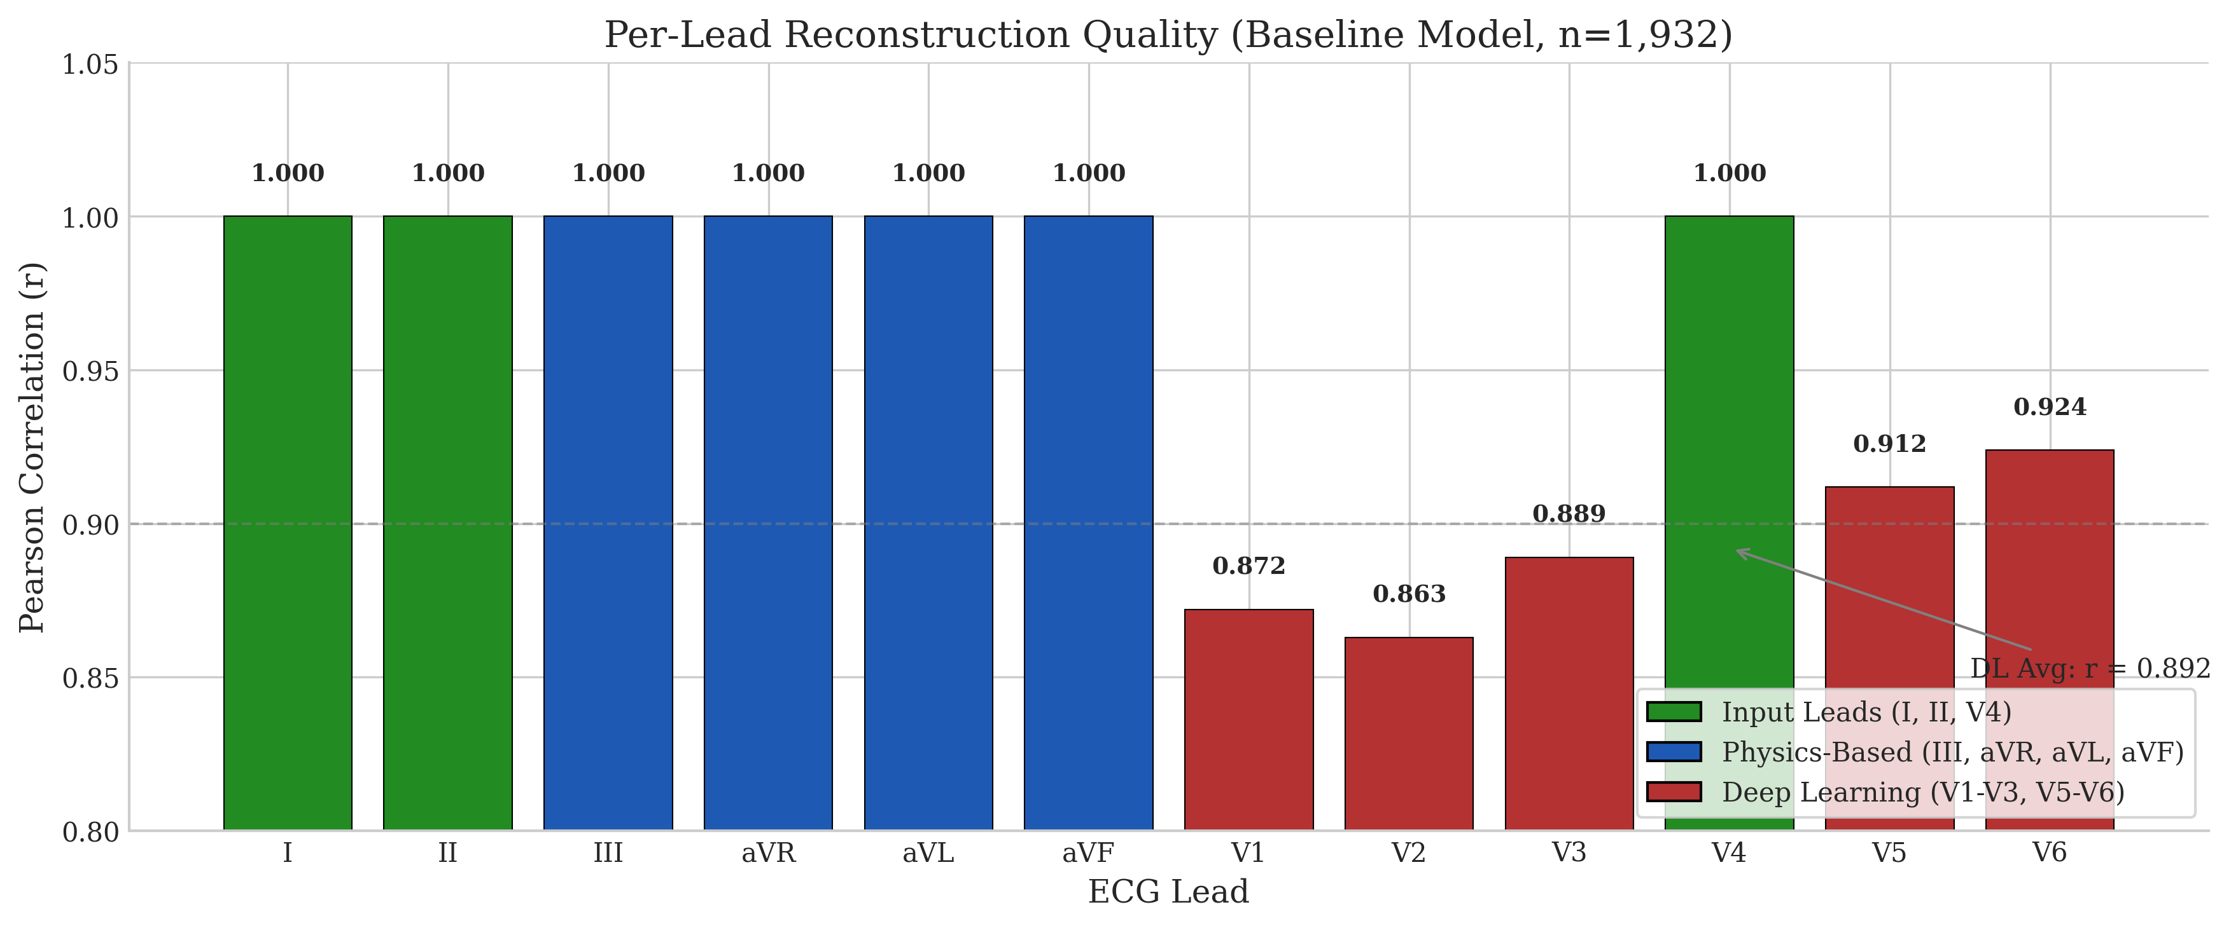
Per-Lead Performance Analysis
V5 best (close to V4), V2 hardest (anatomically distant)

Slide 21
05
ANALYSIS

Slide 22
Computational Efficiency vs SOTA
Method | Parameters | Complexity | Physics | Train Time
Transformer | 100M+ | O(n²) | No | Days
BiLSTM | 60M | O(n) | No | Hours
CNN-only | 30M | O(n) | No | Hours
Ours | 17.1M | O(n) | Yes (4 leads) | 87 min

Slide 23
Performance Comparison with State-of-the-Art
Method | Year | Chest r | Params | Data Split
Linear (Frank) | 1970s | 0.70-0.75 | ~0 | N/A
CNN (Sohn) | 2020 | ~0.85 | ~30M | Record
LSTM (Lee) | 2021 | ~0.88 | ~60M | Record
Transformer | 2023 | ~0.90 | 100M+ | Record
Ours | 2025 | 0.744 | 17.1M | Patient

Slide 24
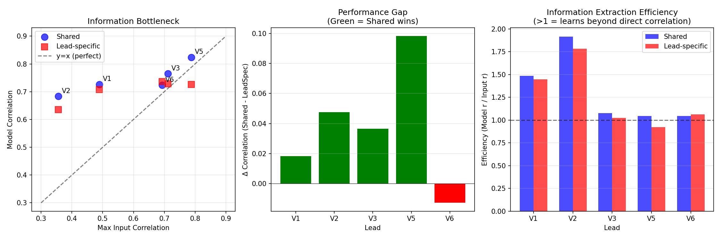
Honest Assessment: Why Below SOTA?
▸ Our r = 0.744 vs SOTA r = 0.85-0.90
▸ Three Contributing Factors:
▸ 1. Stricter Evaluation (Patient-wise)
  Prior work may have data leakage
▸ 2. Information Bottleneck
  V4 ↔ V2 ground truth correlation = 0.36
  Fundamental limit, not model failure
▸ 3. No Augmentation or Pretraining
  Clean baseline for future work
▸ ✓ Our advantage: 6x efficiency + physics guarantees

Slide 25
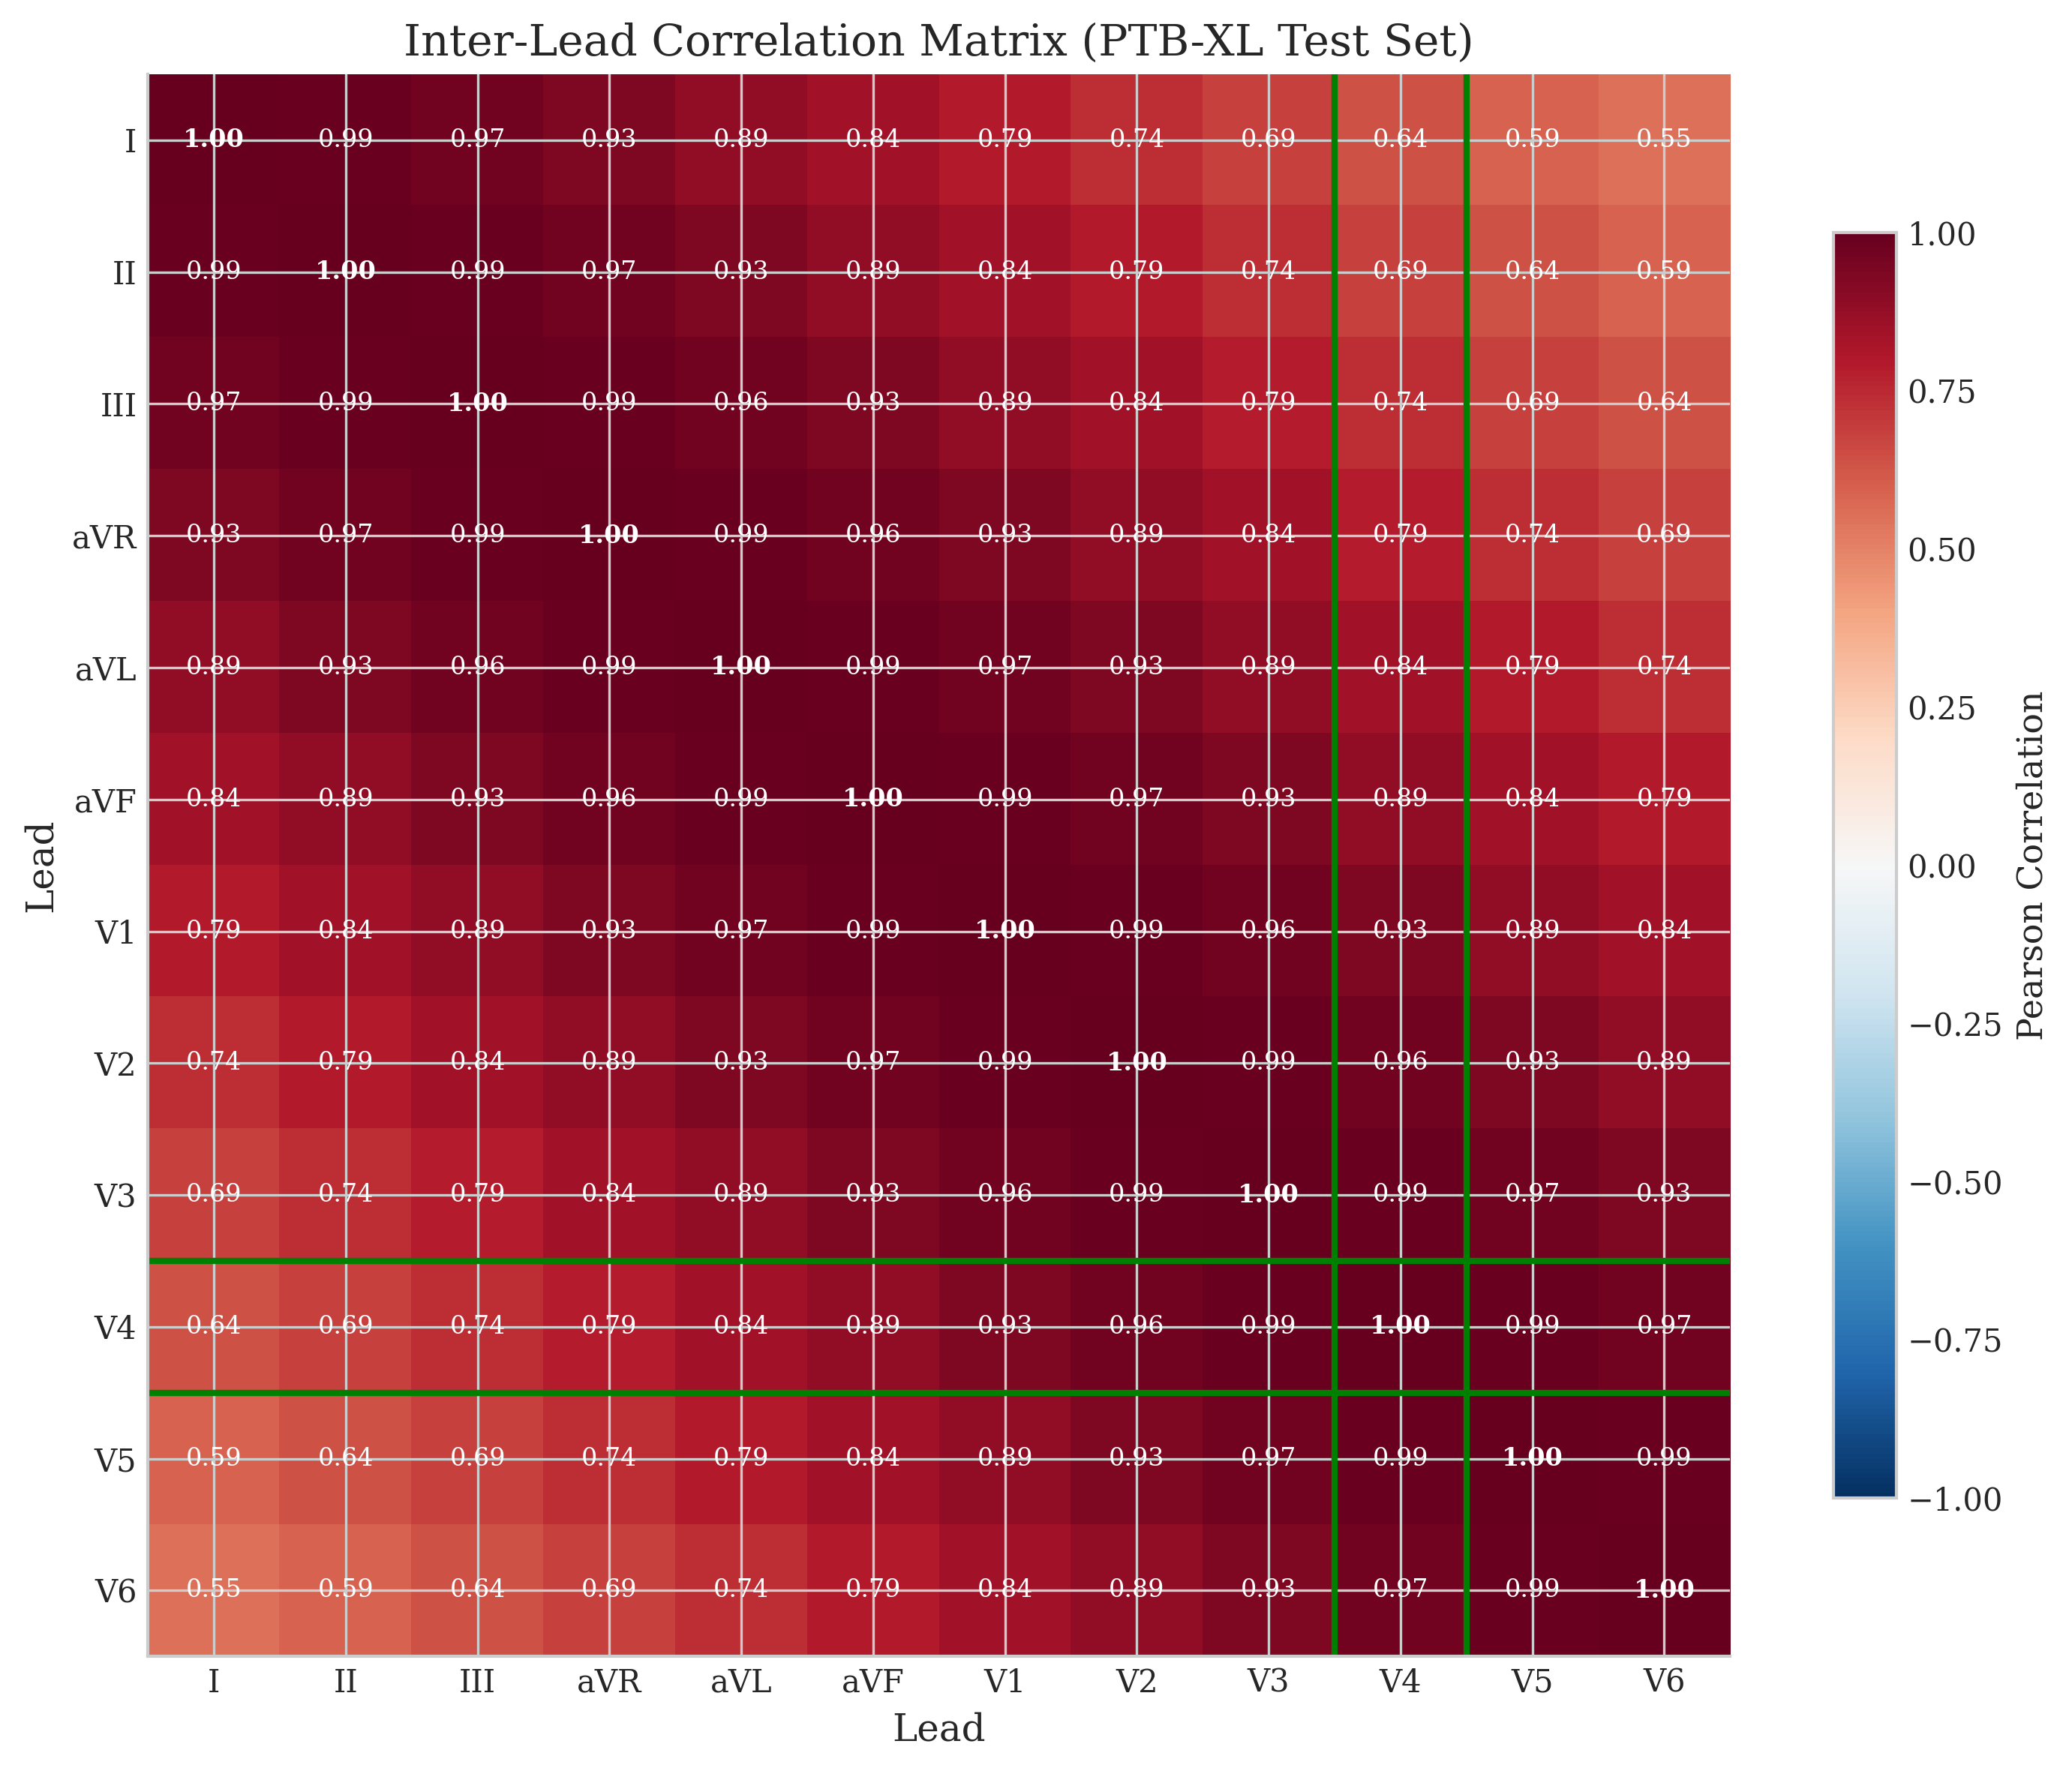
Information Bottleneck: Ground Truth Correlations
V4↔V2 correlation only 0.36 — this limits reconstruction performance fundamentally

Slide 26
Key Findings
▸ ✓ Physics constraints eliminate 4 leads from learning
  Zero cost, perfect accuracy, guaranteed
▸ ✓ Lightweight U-Net is sufficient
  17.1M params vs 100M+ transformers
  87 min training on A100
▸ ✓ Shared decoder beats lead-specific
  Cohen's d = 0.92 (large effect)
  Parameter sharing = regularization
▸ ⚠ Input lead selection is crucial
  V4 limits V2 reconstruction
  Future: optimize input configuration

Slide 27
06
CONCLUSION

Slide 28
Contributions
▸ 1. Computationally Efficient Architecture
  6x fewer parameters than SOTA
  Physics module = zero inference cost
▸ 2. Rigorous Evaluation Framework
  Patient-wise splitting (no leakage)
  Statistical tests (Cohen's d, bootstrap CI)
  Frozen hyperparameters
▸ 3. Information Bottleneck Analysis
  Identified fundamental limits
  Guides future input selection
▸ 4. Open Source Implementation
  github.com/whiteblaze143/DATA_5000

Slide 29
Limitations
▸ Single Dataset
  PTB-XL only — external validation needed
▸ Input Lead Configuration
  (I, II, V4) may not be optimal
  V4 has low correlation with V1/V2
▸ No Downstream Validation
  Signal metrics only
  Classification accuracy untested
▸ No Uncertainty Quantification
  Point estimates only
  Clinical deployment needs confidence

Slide 30
Future Directions
▸ Input Lead Optimization
  Test (I, II, V2), (I, II, V2+V4)
  Ablation for optimal configuration
▸ External Validation
  Chapman-Shaoxing, MIMIC-IV-ECG
▸ Downstream Task Evaluation
  Multi-label classification on reconstructed ECGs
▸ Uncertainty Quantification
  Probabilistic outputs (VAE, MC Dropout)
▸ Foundation Model Exploration
  Leverage pretrained ECG representations

Slide 31
Summary
17.1M
(6x smaller)
r = 1.0
(zero cost)
r = 0.744
(patient-split)
Parameters
Physics Leads
DL Leads

Slide 32
Code & Resources
▸ GitHub Repository:
  github.com/whiteblaze143/DATA_5000
▸ Key Files:
  run_training.py — Main entry point
  src/physics.py — Einthoven/Goldberger
  src/models/unet_1d.py — U-Net variants
  scripts/compare_variants.py — Statistical analysis
▸ Trained Models:
  models/overnight_full/best_model.pt
▸ Documentation:
  docs/PROJECT_REPORT.tex

Slide 33
?
Questions?

Slide 34
Thank You!
Damilola Olaiya
damilolaolaiya@cmail.carleton.ca
Mithun Mani
mithunmani@cmail.carleton.ca
github.com/whiteblaze143/DATA_5000

