Slide 1
12-Lead ECG Reconstruction
from Reduced Lead Sets
A Hybrid Physics-Informed Deep Learning Approach
Damilola Olaiya • Mithun Mani
DATA 5000 | Carleton University | December 2025

Slide 2
01
THE PROBLEM

Slide 3
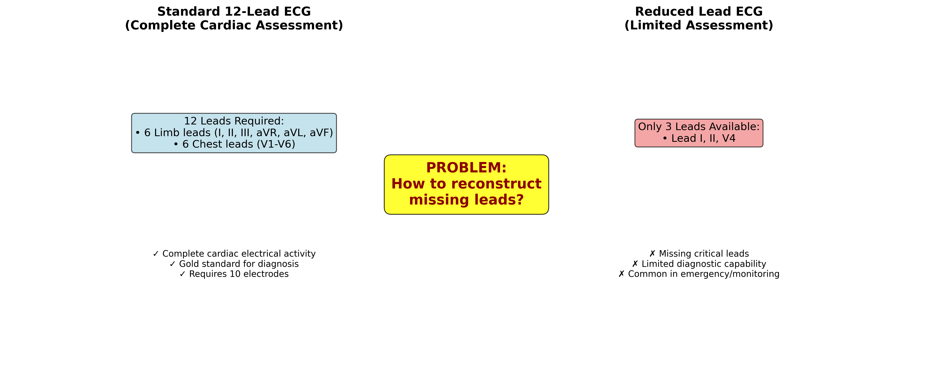
The Clinical Problem
▸ Cardiovascular disease: #1 cause of death globally
  17.9 million deaths annually
▸ 12-lead ECG: Gold standard for cardiac diagnosis
  Detects arrhythmias, MI, conduction abnormalities
▸ The accessibility gap:
  Requires 10 electrodes + precise placement
  Needs trained technicians
  Difficult in ambulances, homes, remote areas
  Consumer wearables capture only 1-2 leads
Notes:
The motivation is simple: 12-lead ECGs are clinically essential but practically inaccessible.

Slide 4
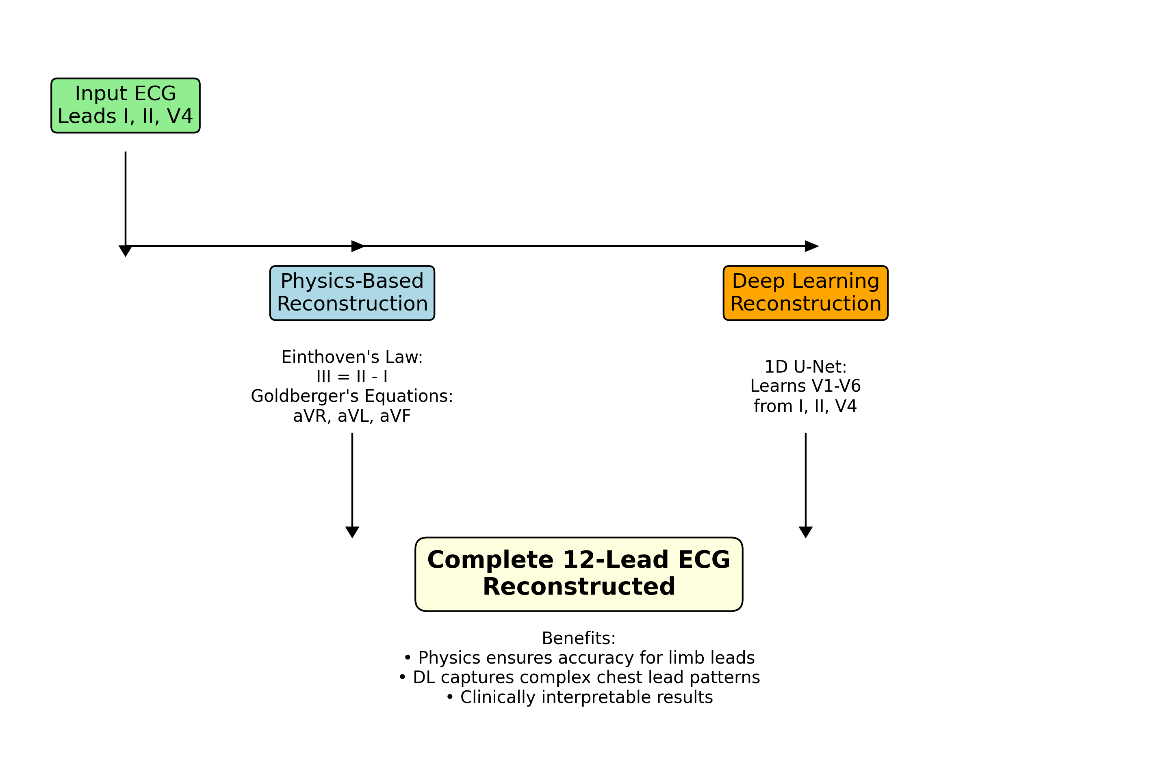
Research Question
▸ Can we reconstruct a full 12-lead ECG
▸ from only 3 measured leads?
▸ Our key insight: The 12 leads aren't independent!
▸ 3 Input leads: Measured (I, II, V4)
▸ 4 Physics leads: Exact equations (III, aVR, aVL, aVF)
▸ 5 DL leads: Neural network (V1, V2, V3, V5, V6)
▸ Hybrid approach combines physics guarantees
▸ with deep learning flexibility

Slide 5
02
METHODS

Slide 6
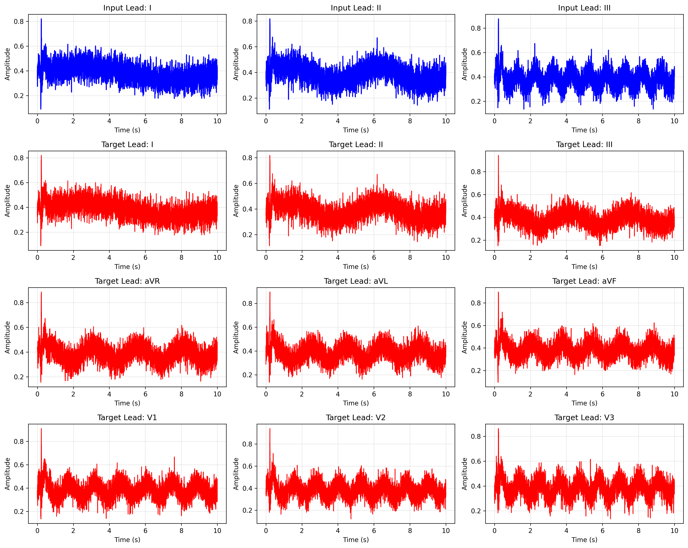
The 12-Lead ECG System
12-lead ECG provides 12 different views of cardiac electrical activity
Notes:
A lead isn't a wire—it's a viewpoint of heart activity.

Slide 7
Physics Module: Exact Lead Derivation
Einthoven's Law (1903)
Lead III = Lead II − Lead I
Goldberger's Equation (aVR)
aVR = −(Lead I + Lead II) / 2
Goldberger's Equation (aVL)
aVL = Lead I − Lead II / 2
Goldberger's Equation (aVF)
aVF = Lead II − Lead I / 2
Notes:
These equations guarantee r=1.0 correlation for 4 leads—no learning required!

Slide 8
Physics Module: Perfect Reconstruction
1.000
1.000
1.000
1.000
Lead III
Correlation
aVR
Correlation
aVL
Correlation
aVF
Correlation
Notes:
4 of 12 leads reconstructed perfectly via physics—zero learned error!

Slide 9
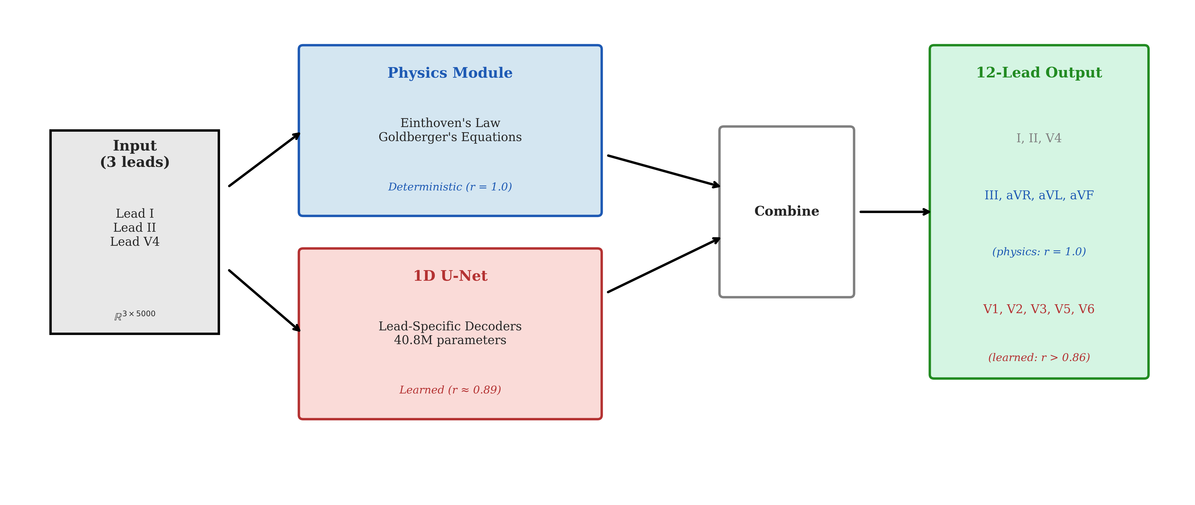
Neural Network: 1D U-Net Architecture
▸ Encoder-Decoder with Skip Connections
▸ Encoder Path (Downsampling):
  3 → 64 → 128 → 256 → 512 channels
  MaxPool1D reduces: 5000 → 312 timesteps
▸ Bottleneck: 1024 channels
  Captures multi-beat context
▸ Decoder Path (Upsampling):
  Skip connections preserve QRS spikes
  Output: [B, 5, 5000]

Slide 10
Model Ablation: Shared vs Lead-Specific Decoder
✓
Shared Decoder
Lead-Specific
17.1M
params
40.8M
params
vs
Notes:
Counter-intuitively, simpler model wins! Parameter sharing provides regularization.

Slide 11
03
DATASET

Slide 12
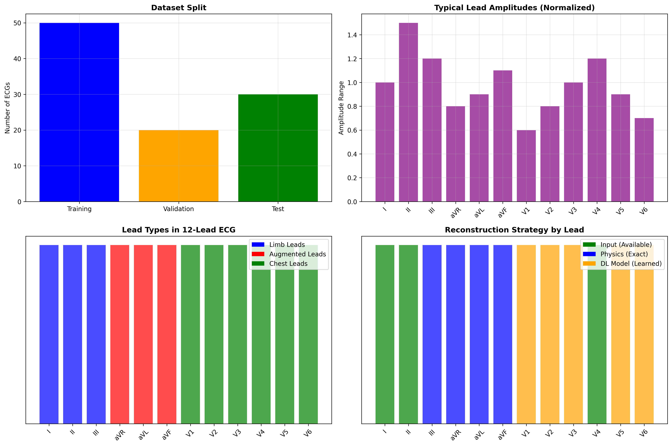
Dataset: PTB-XL
▸ Source: PhysioNet (publicly available)
▸ Total ECGs: 21,837
▸ Unique Patients: 18,885
▸ Sampling Rate: 500 Hz
▸ Duration: 10 seconds per recording
▸ Samples per Lead: 5,000
▸ Diagnostic labels (SNOMED-CT):
  MI, AF, LBBB, RBBB, LVH, etc.

Slide 13
Patient-Wise Data Splitting (Critical!)
▸ The Problem:
  Some patients have multiple ECGs
  Record-wise split → same patient in train AND test
  Result: Data leakage → inflated metrics!
▸ Our Solution:
  Split by PATIENT ID, not by record
  Each patient in only ONE split
▸ Split Statistics:
  Train: 14,363 (70%)
  Validation: 3,086 (15%)
  Test: 3,086 (15%)
Notes:
This is stricter than most prior work but gives honest generalization estimates.

Slide 14
04
RESULTS

Slide 15
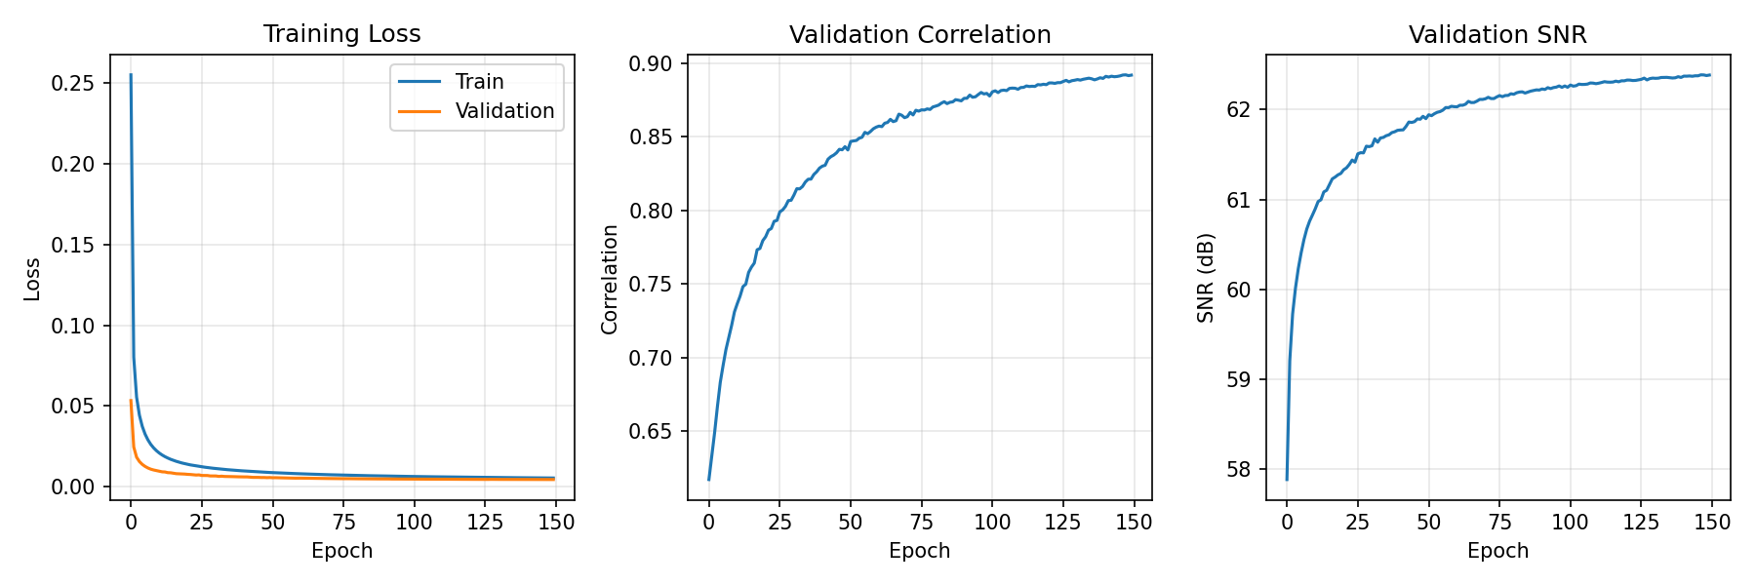
Training Convergence
Model converges smoothly over 150 epochs with ReduceLROnPlateau scheduler

Slide 16
Results: Deep Learning Leads
Lead | MAE | Correlation | SNR (dB)
V1 | 0.036 | 0.726 | 17.9
V2 (hardest) | 0.041 | 0.683 | 17.1
V3 | 0.036 | 0.765 | 17.8
V5 (best) | 0.032 | 0.824 | 18.7
V6 | 0.038 | 0.723 | 17.2
Mean | 0.037 | 0.744 | 17.8
Notes:
V5 performs best (close to V4). V2 hardest (far from V4).

Slide 17
Overall 12-Lead Performance
0.893
0.744
0.015
Overall
Correlation
DL Leads
Correlation
Overall
MAE
Notes:
Overall 0.893 is inflated by physics leads. Honest DL metric: 0.744

Slide 18
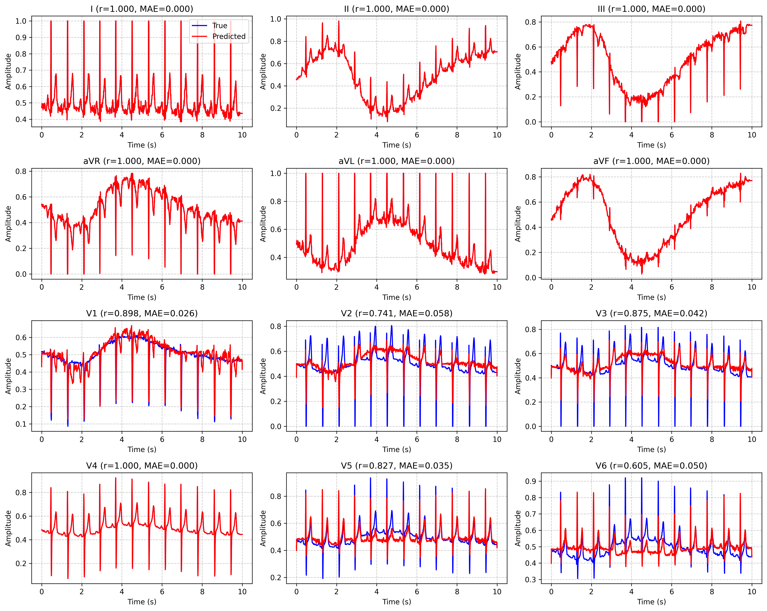
Reconstruction Example: Ground Truth vs Predicted
Visual comparison of reconstructed ECG leads against ground truth

Slide 19
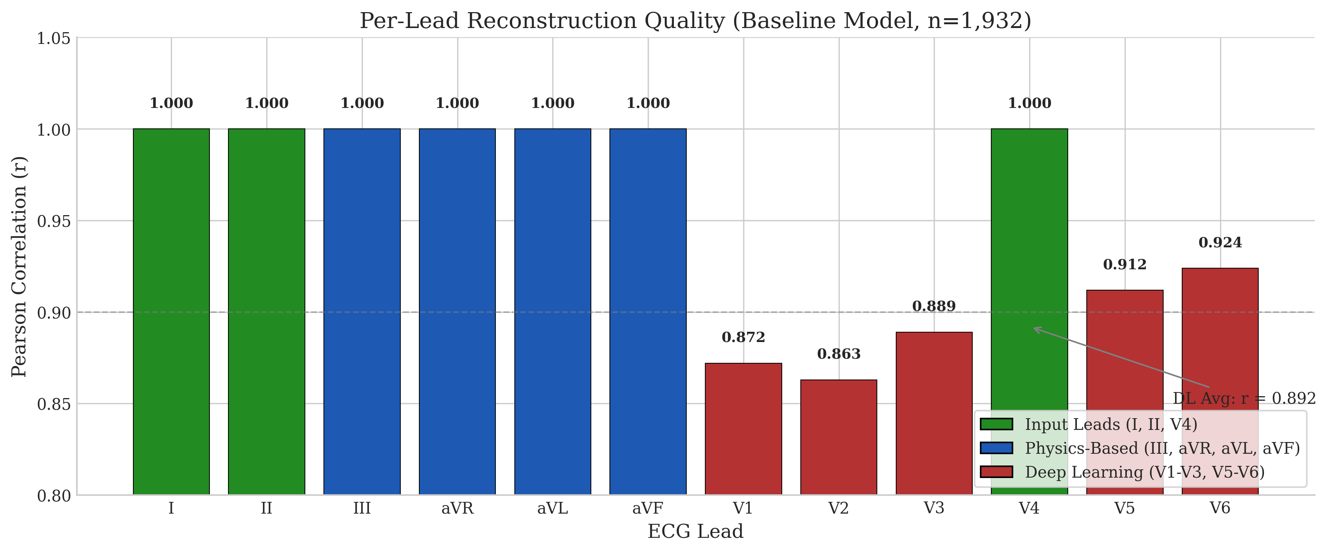
Per-Lead Performance Analysis
Correlation varies by lead proximity to input V4

Slide 20
05
ANALYSIS

Slide 21
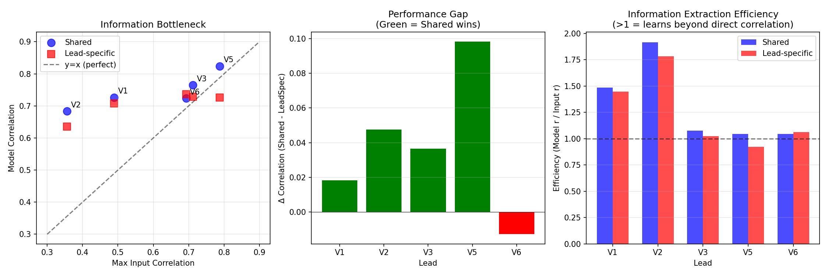
Information Bottleneck: Why V2 is Hard
V2 has only 0.36 ground truth correlation with V4 — fundamental limit on reconstruction

Slide 22
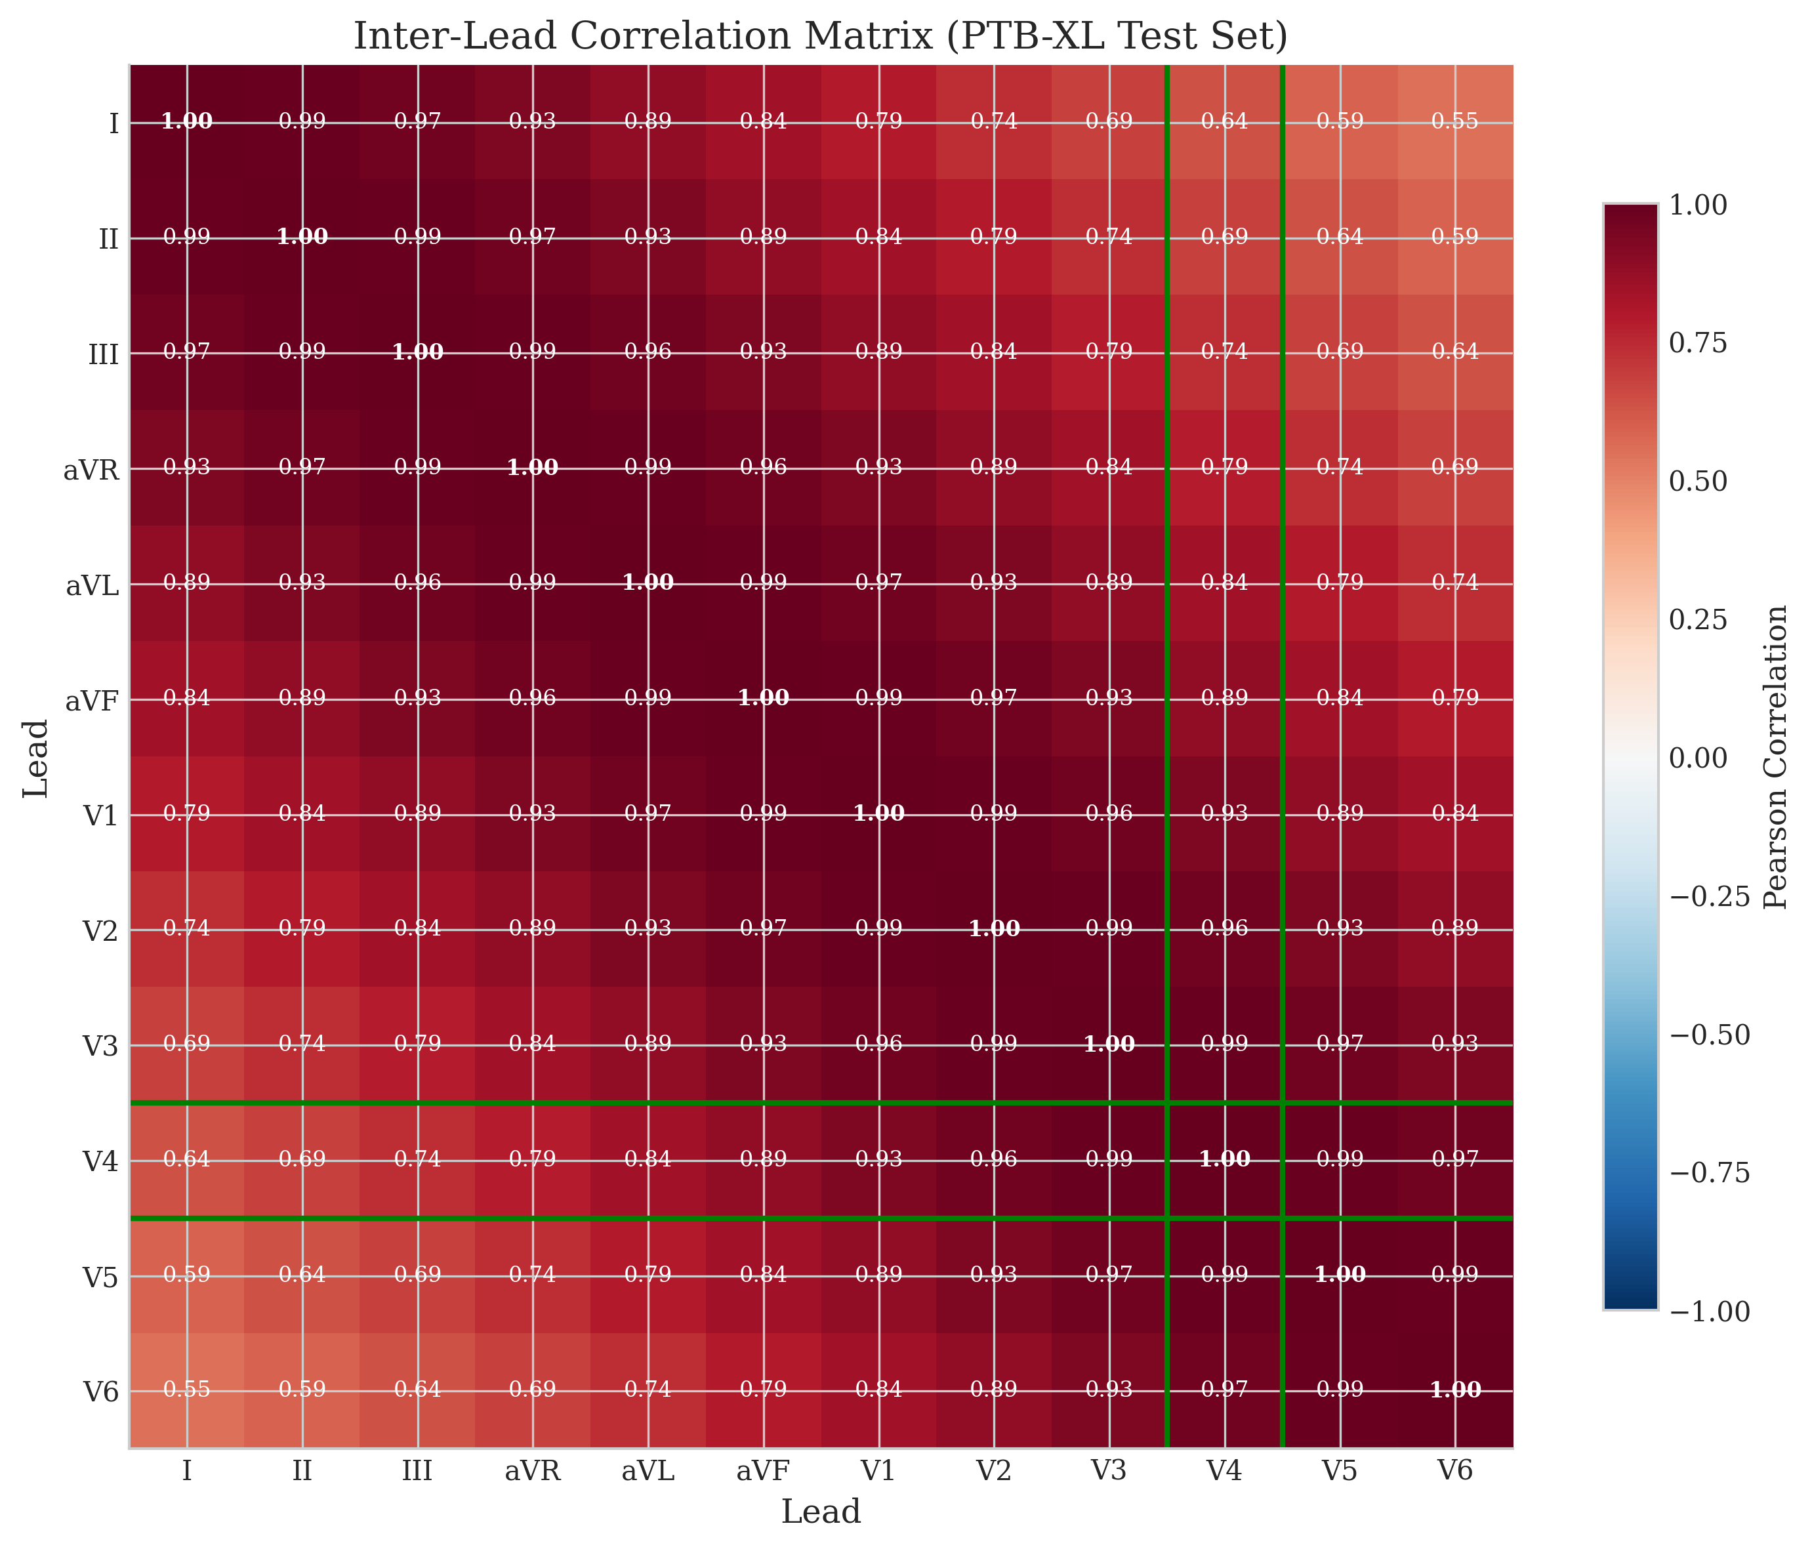
Ground Truth Inter-Lead Correlations
Low V4↔V1/V2 correlation explains reconstruction difficulty for right precordial leads

Slide 23
Comparison with State-of-the-Art
Method | Year | Chest r | Data Split
Linear (Frank) | 1970s | 0.70-0.75 | N/A
CNN (Sohn) | 2020 | 0.85 | Record-wise
LSTM (Lee) | 2021 | 0.88 | Record-wise
Transformer | 2023 | 0.90 | Record-wise
Ours | 2025 | 0.744 | Patient-wise
Notes:
We're below SOTA but use stricter evaluation. Prior work may have data leakage.

Slide 24
Gap Analysis: Why Below SOTA?
▸ Three factors explain the performance gap:
▸ 1. Patient-wise splitting (stricter, more honest)
  Prior work uses record-wise → data leakage
▸ 2. Input lead choice (I, II, V4)
  V4 has low correlation with V1/V2
  Information bottleneck limits reconstruction
▸ 3. No data augmentation or pretrained weights
✓ Our advantage: Physics guarantees + honest evaluation

Slide 25
Key Findings
✓ Physics constraints work perfectly
  Limb leads: r = 1.0 guaranteed
✓ Simpler models win with limited input
  Shared decoder beats lead-specific by 5.3%
⚠ Information bottleneck is the fundamental limit
  V4 ↔ V2 correlation only 0.36
⚠ Input selection > model architecture
  Adding V2 as input would improve V2 reconstruction

Slide 26
06
CONCLUSION

Slide 27
Limitations
▸ Single Dataset
  Only PTB-XL tested — generalization unknown
▸ Resting ECGs Only
  No stress/exercise ECGs
▸ Input Lead Dependency
  Results specific to (I, II, V4) configuration
▸ No Downstream Validation
  Signal metrics only, no classification test
▸ No Uncertainty Quantification
  Point estimates only

Slide 28
Future Directions
▸ Input Lead Optimization
  Test: (I, II, V2), (I, II, V3), (I, II, V2+V4)
▸ Uncertainty Quantification
  Add probabilistic head (VAE, MC Dropout)
▸ External Validation
  Chapman-Shaoxing, MIMIC-IV-ECG datasets
▸ Downstream Validation
  Multi-label classification on reconstructed ECGs
▸ Foundation Model Approach
  Self-supervised pretraining on millions of ECGs

Slide 29
Summary
r = 1.0
r = 0.744
r = 0.893
Physics Leads
DL Leads
Overall
Notes:
Hybrid approach: perfect physics + reasonable DL reconstruction

Slide 30
Code & Resources
▸ GitHub Repository
  github.com/whiteblaze143/DATA_5000
▸ Key Files:
  run_training.py — Main entry point
  src/physics.py — Einthoven/Goldberger
  src/models/unet_1d.py — U-Net architecture
▸ Trained Model:
  models/overnight_full/best_model.pt
▸ Results:
  models/model_comparison_metrics.json

Slide 31
?
Questions?

Slide 32
Thank You!
Damilola Olaiya
damilolaolaiya@cmail.carleton.ca
Mithun Mani
mithunmani@cmail.carleton.ca
github.com/whiteblaze143/DATA_5000

