Slide 1


2026 CARNEGIE MELLON FORUM ON BIOMEDICAL ENGINEERING • ABSTRACT #194
Can We Reconstruct a Diagnostic 12-Lead ECG from Only a Few Measured Leads?
Discrete Latent Sequence Generation for Limited-Lead ECG Reconstruction
Mithun Manivannan, BSc¹'² • Alex Mariakakis, PhD¹ • Christopher Cheung, MD²
¹Department of Computer Science, University of Toronto | ²Division of Cardiology, Sunnybrook Health Sciences Centre
Contact: mithun.manivannan@sri.utoronto.ca
Notes:
Hello everyone. I’m Mithun Manivannan from the University of Toronto and Sunnybrook Health Sciences Centre. Today I am presenting our work asking a fundamental question: can we reconstruct a full diagnostic twelve-lead electrocardiogram from only a few measured wearable leads?

Slide 2
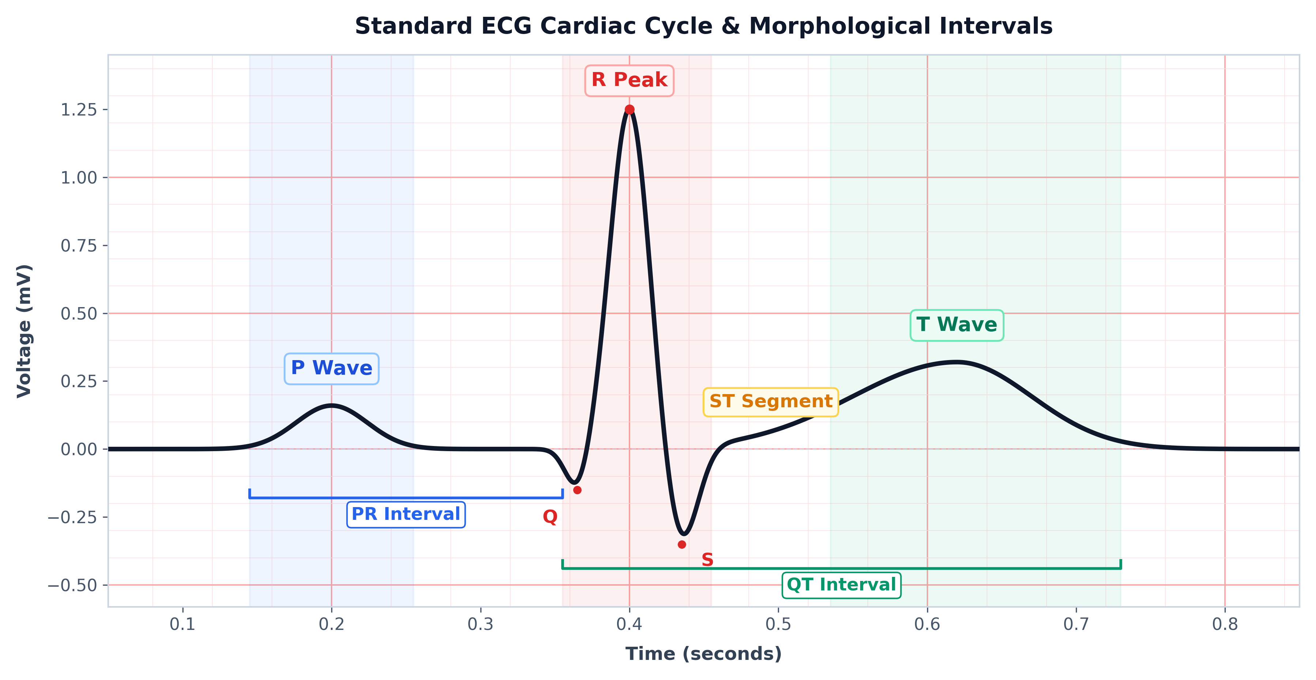
CLINICAL CONTEXT
12 Leads vs. One Wearable Lead
Comparing full hospital diagnostic fields against consumer wearable monitoring
Clinical 12-Lead ECG
12 Spatial Views
• Frontal (I–aVF) + Precordial (V1–V6) planes • Comprehensive 3D cardiac vector field
Smartwatch ECG
1 Measured Projection
• Single wrist transverse vector (Lead I) • Completely blind to vertical & chest planes
Most spatial information is unobserved.
Electrophysiological Fiducials
P wave (atria) → QRS complex (ventricles) → ST–T (repolarization)
Ref: Perez et al., Apple Heart Study, N Engl J Med 2019; Cheung et al., Heart Rhythm 2023.
Carnegie Mellon Forum on Biomedical Engineering 2026 • Abstract #194 • Discrete Latent ECG Reconstruction
Slide 2 of 8
Notes:
Standard clinical care relies on a twelve-lead ECG, using ten electrodes to capture twelve spatial projections across frontal and horizontal planes. Consumer smartwatches, by contrast, measure only a single projection—Lead I across the wrists. While great for rhythm screening, most spatial information remains completely unobserved.

Slide 3
MATHEMATICAL FORMULATION
The Reconstruction Challenge
Inferring unobserved 3D fields without statistical mean collapse
One Observed Lead ⟶ [ ? ] ⟶ 12-Lead ECG
Spatial Ambiguity
Different cardiac electrical states can produce similar single-lead measurements.
Generative Inference
The model therefore has to infer plausible missing morphology without simply smoothing it away.
Ref: Frank, Circulation 1956; Atoui et al., IEEE TBME 2010.
Carnegie Mellon Forum on Biomedical Engineering 2026 • Abstract #194 • Discrete Latent ECG Reconstruction
Slide 3 of 8
Notes:
This creates a fundamental reconstruction challenge: because multiple distinct cardiac electrical states project onto very similar single-lead signals, the problem is underdetermined. Rather than performing simple pointwise regression that averages away critical spikes, the model must infer plausible missing morphology while preserving sharp physiological features.

Slide 4
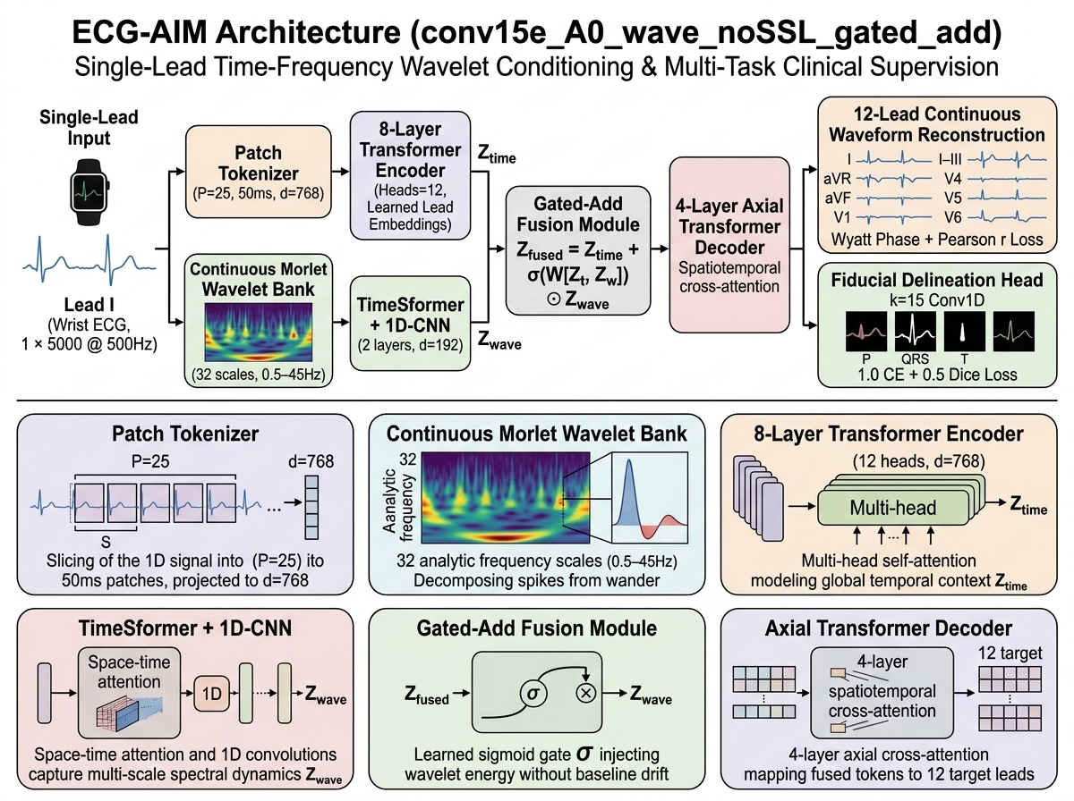
METHODOLOGICAL CONTRIBUTION
ECG-AIM Model Architecture
Disentangled time-frequency conditioning with axial transformer cross-attention
Ref: van den Oord et al., VQ-VAE, NeurIPS 2017; Ho et al., Axial Attention, ECCV 2020.
Carnegie Mellon Forum on Biomedical Engineering 2026 • Abstract #194 • Discrete Latent ECG Reconstruction
Slide 4 of 8
Notes:
To address this, we developed ECG-AIM. ECG-AIM combines the raw temporal signal with a multiscale wavelet representation, maps these features into a compact latent representation, and jointly reconstructs the missing leads.

Slide 5
BENCHMARK SETUP
Experimental Setup
Rigorous multi-cohort evaluation across diverse clinical populations
~175k ECGs
Trained and benchmarked across diverse cohorts from PTB-XL and MIMIC-IV-ECG
Competitive Baselines
Direct head-to-head comparison against continuous 1D U-Net and MultiScale-VAE
1 to 3 Observed Leads
Evaluated from single wearable Lead I up to 3 complementary leads (I, II, V2)
Comprehensive Evaluation
Evaluated on waveform correlation, QRS timing, and downstream clinical preservation
Ref: Wagner et al., PTB-XL, Sci Data 2020; Gow et al., MIMIC-IV-ECG, PhysioNet 2023.
Carnegie Mellon Forum on Biomedical Engineering 2026 • Abstract #194 • Discrete Latent ECG Reconstruction
Slide 5 of 8
Notes:
We evaluated our framework across 175,000 hospital ECGs from PTB-XL and MIMIC-IV. We tested configurations ranging from one to three observed leads, compared directly against standard continuous 1D U-Net and MultiScale-VAE baselines, and evaluated both raw waveform fidelity and downstream clinical preservation.

Slide 6
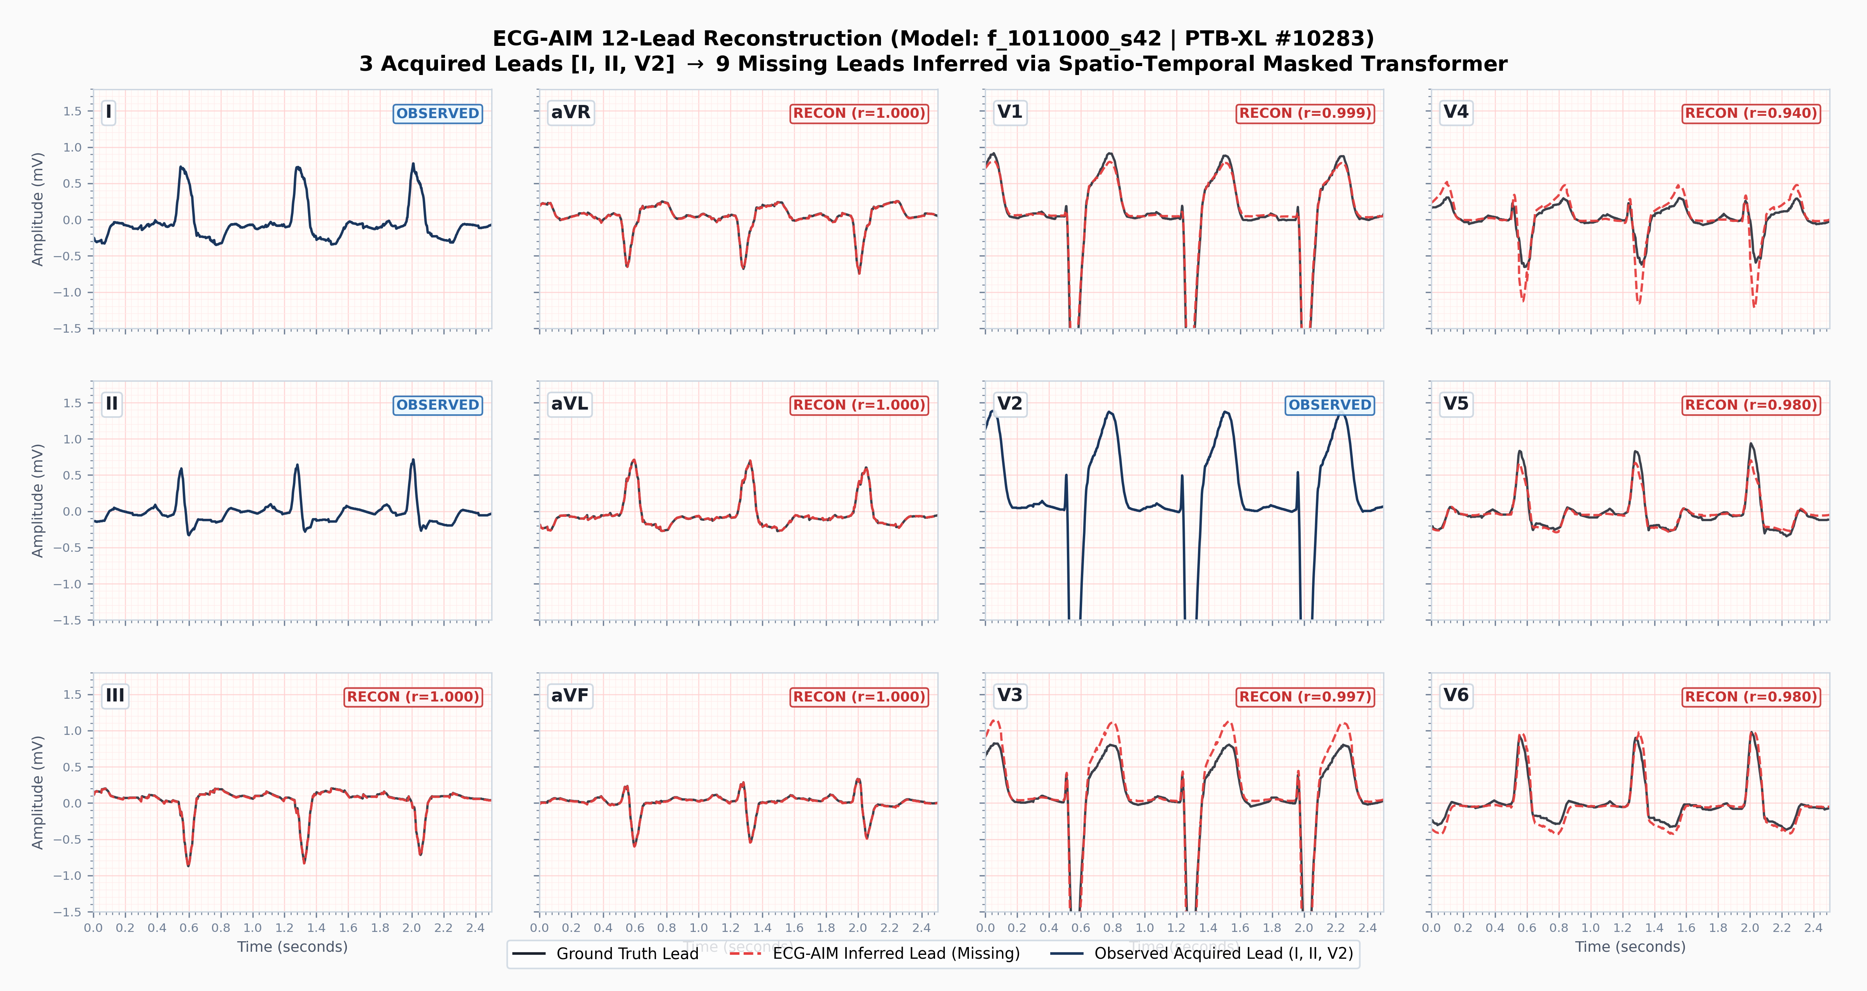
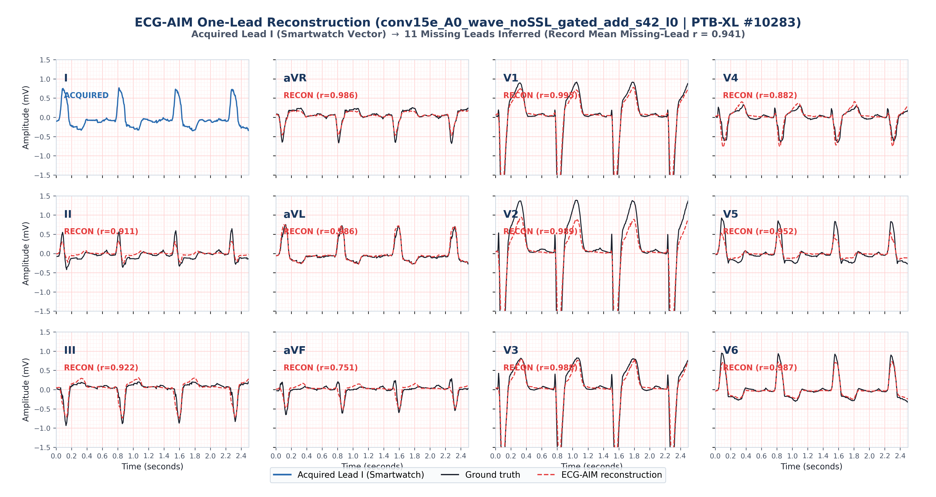
RECONSTRUCTION BENCHMARK
Spatial Information Determines Reconstruction Quality
Reconstruction quality scales sharply with complementary spatial measurements
3 Leads Acquired (I, II, V2): r > 0.98
1 Lead Acquired (Smartwatch Lead I): r = 0.776
Adding complementary spatial measurements sharply improves reconstruction.
Spatially complementary leads provide substantially more information for reconstruction.
Ref: Frank, Circulation 1956; Atoui et al., IEEE TBME 2010.
Carnegie Mellon Forum on Biomedical Engineering 2026 • Abstract #194 • Discrete Latent ECG Reconstruction
Slide 6 of 8
Notes:
With three complementary leads, reconstruction approaches the measured signal. With a single wearable-like Lead I, substantial morphology remains recoverable, but performance falls because the missing spatial information cannot be directly observed.

Slide 7
CLINICAL UTILITY
Preservation of Clinically Relevant Structure
Validating beyond Euclidean waveform similarity
Morphology
0.776
Precordial Lead r
(vs. 0.571 U-Net, 0.684 MS-VAE)
Timing
8.0 ms
QRS Timing Error
(Meets < 10.0 ms Clinical Gate)
Downstream Task
0.775
EchoNext Structural AUROC
(Ground Truth = 0.803)
The reconstruction preserved more than waveform similarity.
Ref: Holste et al., EchoNext Structural Prediction, JACC Adv 2024; Surawicz et al., JACC 2009.
Carnegie Mellon Forum on Biomedical Engineering 2026 • Abstract #194 • Discrete Latent ECG Reconstruction
Slide 7 of 8
Notes:
Crucially, the reconstruction preserved more than waveform similarity. On precordial morphology, ECG-AIM reaches a correlation of 0.776. For clinical timing, it achieves a QRS duration error of 8.0 milliseconds, meeting the clinical gate. And on downstream tasks, EchoNext structural AUROC reaches 0.775, closely tracking the 0.803 ground truth.

Slide 8
CONCLUSIONS & FUTURE WORK
Conclusions and Translational Next Steps
Core insights and prospective clinical validation roadmap
1. Reconstruction is limited by the spatial information observed.
Single wearable Lead I recovers useful morphology (r = 0.78); 3 complementary leads unlock near-lossless recovery (r > 0.98).
2. ECG-AIM preserves substantial morphology and timing from limited leads.
Reconstructed signals meet clinical timing gates (8.0 ms QRS error) and retain downstream diagnostic utility (0.775 EchoNext AUROC).
3. Prospective paired smartwatch–12-lead validation is the next test.
Translating from retrospective archives to live clinical deployment requires validating across live hardware factors.
Sunnybrook paired validation protocol in preparation • PI: Dr. Christopher Cheung
Mithun Manivannan • mithun.manivannan@sri.utoronto.ca • Abstract #194
Carnegie Mellon Forum on Biomedical Engineering 2026 • Abstract #194 • Discrete Latent ECG Reconstruction
Slide 8 of 8
Notes:
In conclusion: first, reconstruction is limited by the spatial information observed. Second, ECG-AIM preserves substantial morphology and timing from limited leads. Third, prospective paired smartwatch to twelve-lead validation is our next test. Thank you very much for your attention, and I look forward to your questions.

