Slide 1

Care
Buddy
From the WhiteCoat Innovation Team
Less to remember.
More room
to care.
HEALTHCARE · LONG-TERM SELF-CARE
Tencent Cloud AI CAN DO IT Hackathon Singapore 2026
Alex Lew · Shao Quan Chew · Yau Boon Tan
01
Notes:
CareBuddy-Launch.pdf, page 1

Slide 2

THE WORLD AROUND US
AI everywhere.
Life at
full speed.
More messages. More screens.
More competing for our attention.
02
Notes:
CareBuddy-Launch.pdf, page 2

Slide 3

THE CARE GAP
Care can slip
through
a busy day.
Our routines. Our health.
The people we mean to check on.
03
Notes:
CareBuddy-Launch.pdf, page 3

Slide 4

INTRODUCING
Your everyday
health buddy.
A little more attention to your health.
A little more care for the people you love.
HEALTHCARE · LONG-TERM SELF-CARE
04
Notes:
CareBuddy-Launch.pdf, page 4

Slide 5
A DELIBERATE FOCUS
Care has its
own space.
01
Daily routines & medication
02
Dental & screening reminders
03
Sleep & health information
04
Health chat & your care circle
Designed around everyday health
and the people you care for.
Product vision
05
Notes:
CareBuddy-Launch.pdf, page 5

Slide 6
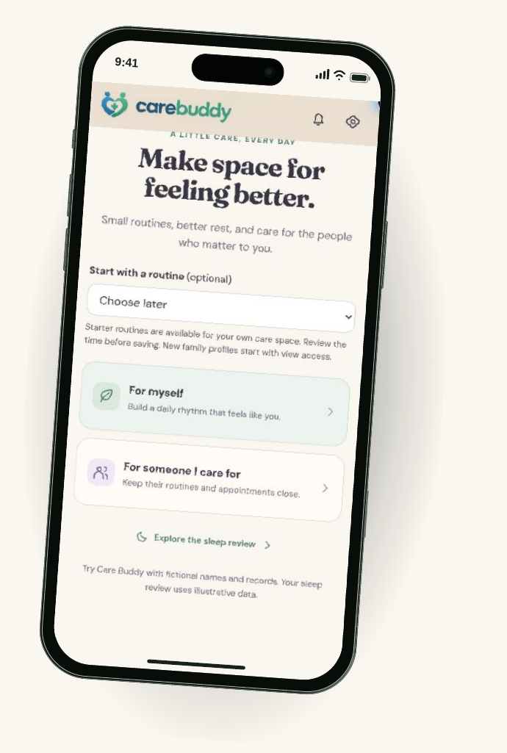
THE PROTOTYPE, UP CLOSE
Start with
your care.
For yourself.
For someone you care for.
Choose a routine.
Make room for a small first step.
Mobile prototype walkthrough · Fictional data
06
Notes:
CareBuddy-Launch.pdf, page 6

Slide 7
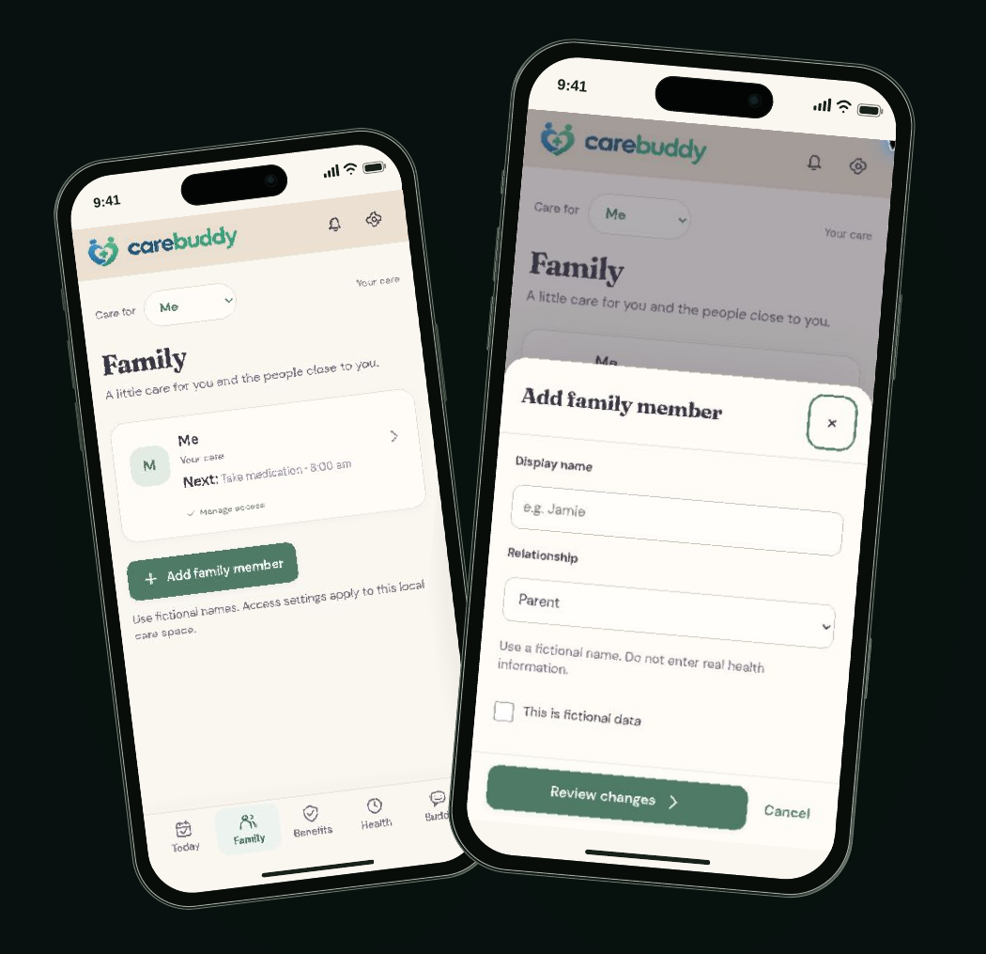
YOUR CARE CIRCLE
Your people.
In view.
Keep a loved one’s routines
and appointments close.
A personal care space,
with permission-aware access
as the intended model.
Mobile prototype walkthrough · Fictional profiles; production sharing to be validated
07
Notes:
CareBuddy-Launch.pdf, page 7

Slide 8
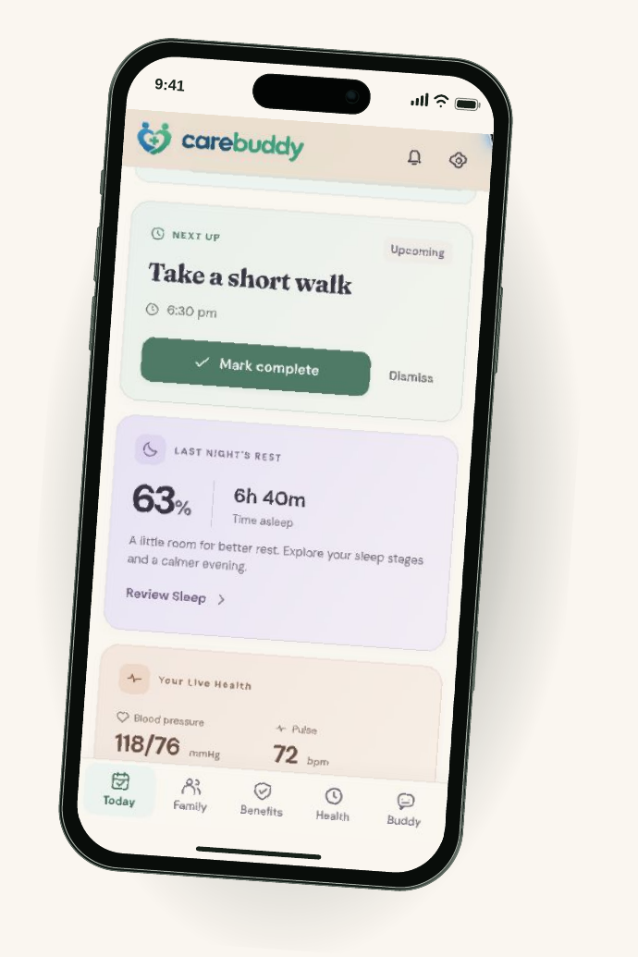
Your day.
A little lighter.
One place to see the next care task
and keep everyday routines in view.
Routines
Rest
Readings
Mobile prototype walkthrough · Fictional data
08
Notes:
CareBuddy-Launch.pdf, page 8

Slide 9
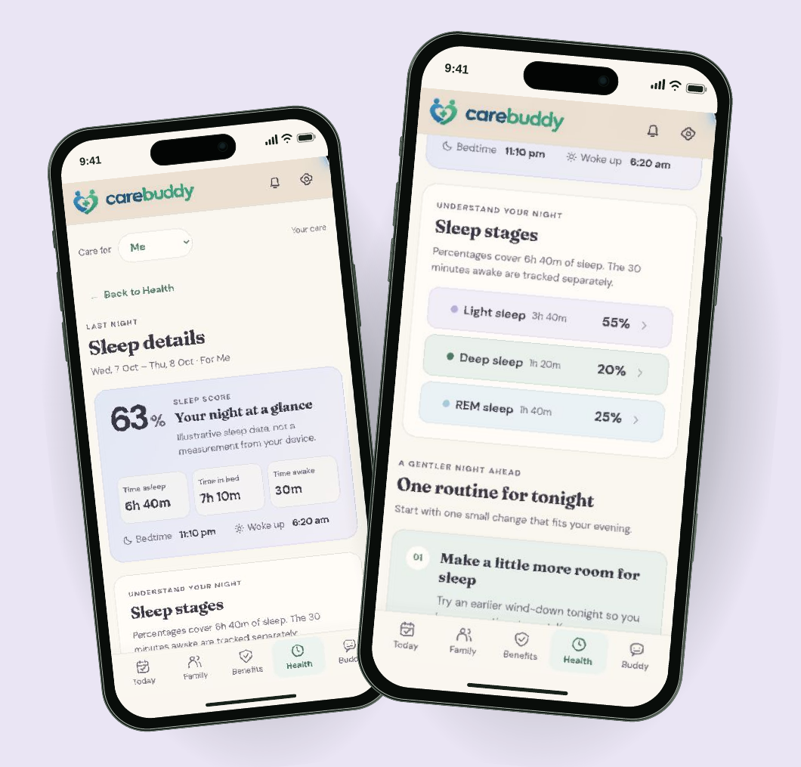
SLEEP
Make room
for a
better night.
Review rest.
Choose a wind-down routine.
Illustrative sleep data.
Wearable connection is planned.
Mobile prototype walkthrough · Sleep is not measured from a device
09
Notes:
CareBuddy-Launch.pdf, page 9

Slide 10
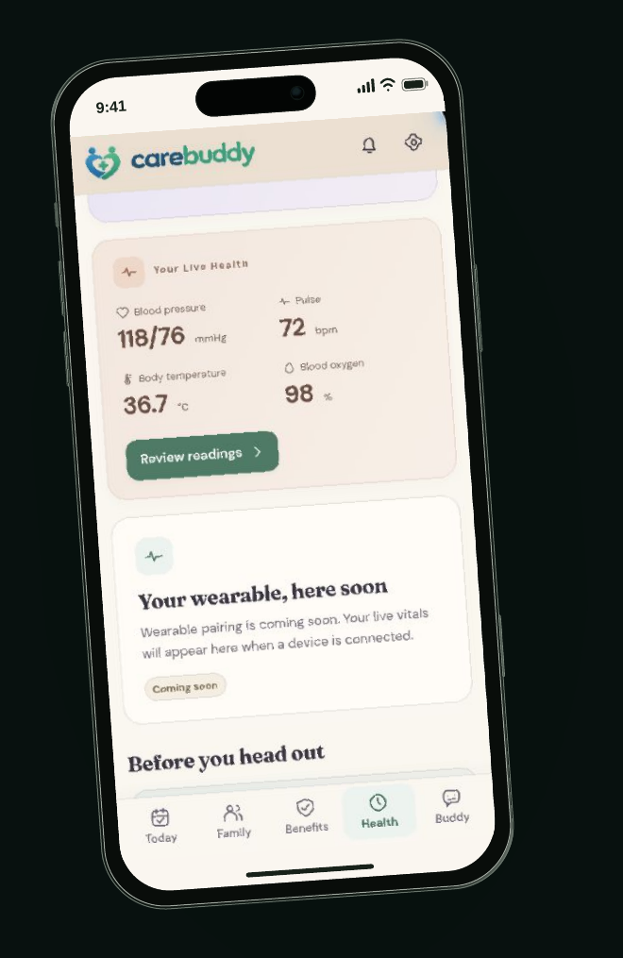
HEALTH INFORMATION
Your health,
at a glance.
Rest, routines and recorded readings.
A place to notice what deserves attention.
Mobile prototype walkthrough · Illustrative readings; no live wearable data
10
Notes:
CareBuddy-Launch.pdf, page 10

Slide 11
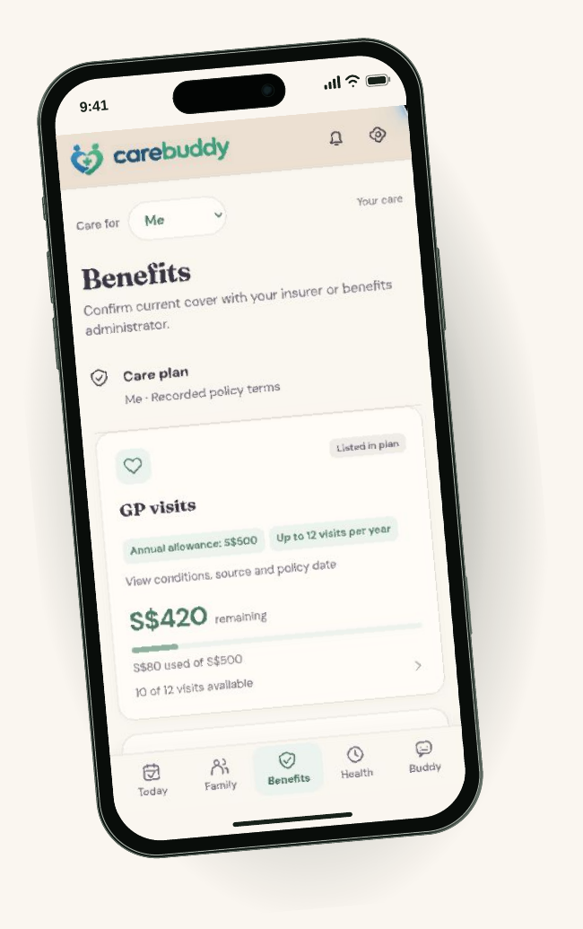
BENEFITS
Keep the details
close.
Bring important plan notes
into your care space.
Confirm cover with the insurer.
Less searching.
More clarity.
Mobile prototype walkthrough · Plan notes, not a live insurance check
11
Notes:
CareBuddy-Launch.pdf, page 11

Slide 12
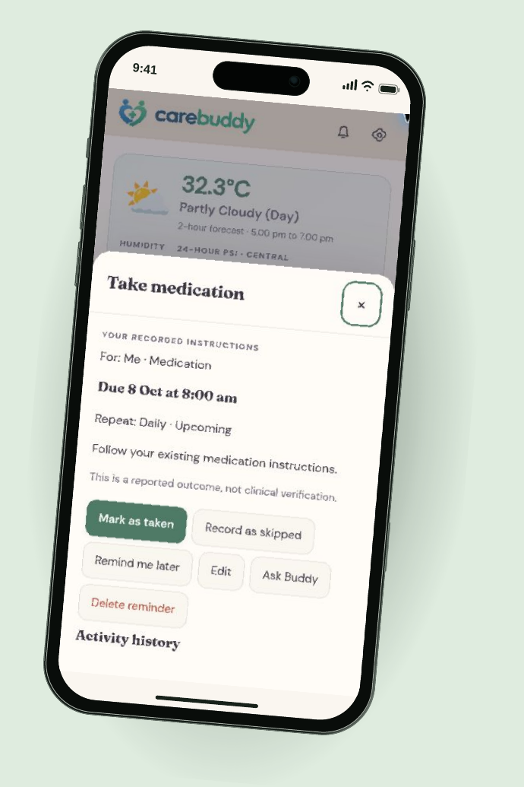
ROUTINES & MEDICATION
A small nudge.
A clear
next step.
See what’s due.
Mark it taken, skipped or later.
Follow existing medication instructions.
Responses are self-reported.
Mobile prototype walkthrough · In-app reminder; push delivery is not live
12
Notes:
CareBuddy-Launch.pdf, page 12

Slide 13
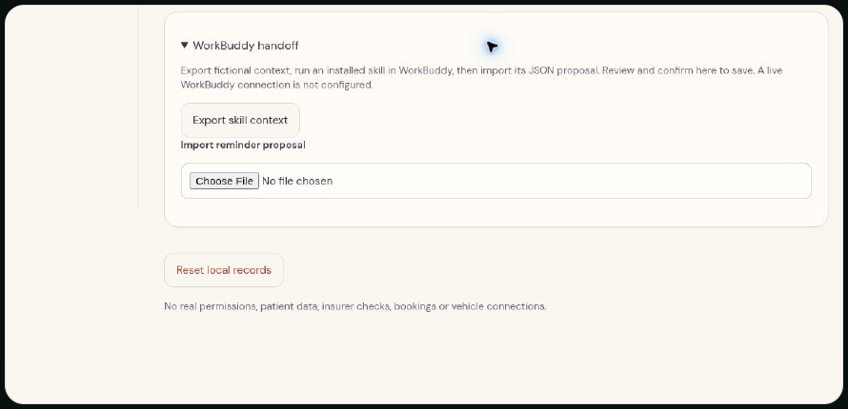
CARE, WHERE YOU ALREADY ARE
A reminder beyond
the care app.
“Remind me to drink water
while I’m working.”
CareBuddy plugin concept
Codex experience planned
Current prototype: manual WorkBuddy handoff.
Export context, import a proposal, review before saving.
Early concept · Implemented scoped Codex/Claude export appears in the architecture appendix
13
Notes:
CareBuddy-Launch.pdf, page 13
UPDATE, 9 October 2026: the supplied submission architecture and Project-Description.txt supersede earlier implementation-status notes. The prototype now uses server-owned SQLite care state, saved transaction receipts, scoped private MCP for Buddy, revocable public MCP exports for Codex/Claude notifications, and a WhiteCoat redirect. Verified human identity, consent-verified sharing, production tenant isolation, real device feeds and managed high-availability storage remain production work. The new personal anecdotes are separately attributed accounts supplied by the user, and do not establish clinical outcomes.

Slide 14
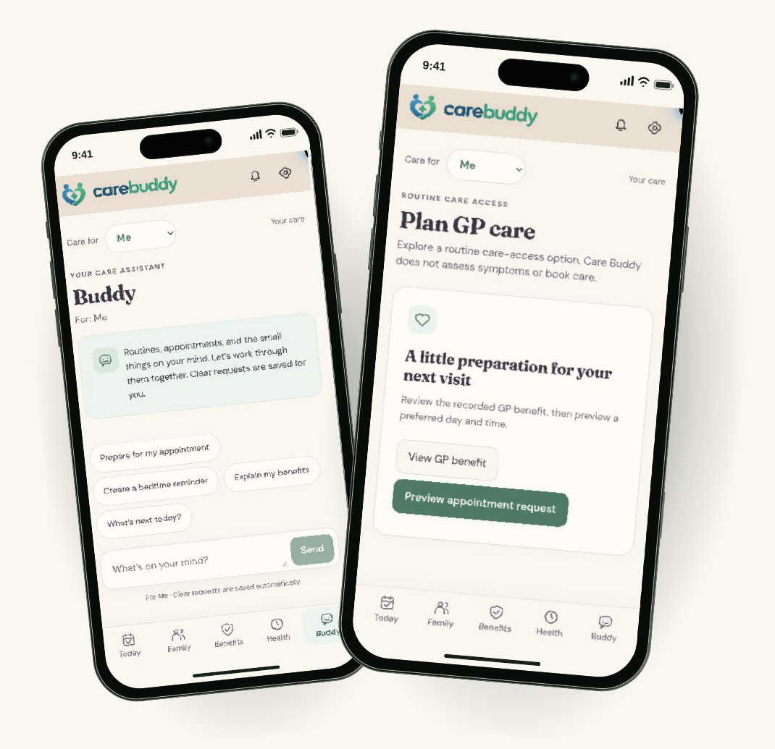
BUDDY & CARE ACCESS
Talk through
the next step.
Routines and appointment
preparation today.
WhiteCoat teleconsult connection
is a next step.
Mobile prototype walkthrough · GP planning only; no verified WhiteCoat redirect or booking
14
Notes:
CareBuddy-Launch.pdf, page 14

Slide 15

KEEPING CARE IN VIEW
Notice.
Remember.
Follow through.
Make the next care step easier
to see, discuss and remember.
Intended value · Clinical outcomes have not been evaluated
15
Notes:
CareBuddy-Launch.pdf, page 15

Slide 16
TEAM ARCHITECTURE
Built around
Tencent.
TENCENT CLOUD · INTENDED APPLICATION BOUNDARY
USER DEVICE
CareBuddy
CareBuddy services
Tencent TokenHub
→
Identity, care records
→
Model inference
Care circle · Routines · Health
and action validation
for Buddy
views
Built with CodeBuddy
Review before execution
External care providers
Development workflow
AI proposals pass application checks
Separate boundary; explicit handoff
Early architecture view. The submission architecture appendix provides the 9 October 2026 implementation details.
16
Notes:
CareBuddy-Launch.pdf, page 16
UPDATE, 9 October 2026: the supplied submission architecture and Project-Description.txt supersede earlier implementation-status notes. The prototype now uses server-owned SQLite care state, saved transaction receipts, scoped private MCP for Buddy, revocable public MCP exports for Codex/Claude notifications, and a WhiteCoat redirect. Verified human identity, consent-verified sharing, production tenant isolation, real device feeds and managed high-availability storage remain production work. The new personal anecdotes are separately attributed accounts supplied by the user, and do not establish clinical outcomes.

Slide 17
TRUST BY DESIGN
Care needs
Permissioned care
clear boundaries.
Family visibility should follow explicit access choices.
Visible actions
Let people review consequential proposals before saving or sharing.
Clinical limits
Support routines and preparation. Refer clinical decisions to
qualified care.
THE TRADE-OFF
Less silent
automation.
More human control.
Production design requirements · Validation remains ahead
17
Notes:
CareBuddy-Launch.pdf, page 17

Slide 18
WHAT COMES NEXT
01
Benefits, connected
More ways
Insurance information and clearer benefit guidance
to care.
02
A more useful day
Relevant news, weather and timely routines
03
Care within reach
Doctor discovery and WhiteCoat teleconsult access
04
CareBuddy, alongside you
A plugin experience, including hydration prompts in Codex
Roadmap · Integrations and clinical workflows are not live
18
Notes:
CareBuddy-Launch.pdf, page 18

Slide 19

Less to remember.
More room to care.
carebuddy.life ↗
Alex Lew · Shao Quan Chew · Yau Boon Tan
Tencent Cloud AI CAN DO IT Hackathon Singapore 2026
19
Notes:
CareBuddy-Launch.pdf, page 19
https://carebuddy.life/

Slide 20
PROTOTYPE SCOPE
What the demo
shows today.
Visible in the prototype
Onboarding and care profiles
Daily routines and medication actions
Illustrative sleep and health readings
Benefits and saved Buddy actions
GP planning and WhiteCoat redirect
Scoped Codex / Claude assistant export
Still ahead
Verified sign-up and authentication
Connected wearable measurements
Live insurance eligibility checks
Durable hosted notification scheduling
Consent-verified family sharing
WhiteCoat teleconsult booking
Screens are captured from carebuddy.life. Fictional records and illustrative flows are used throughout the demo.
Updated 9 October 2026
20
Notes:
CareBuddy-Launch.pdf, page 20
UPDATE, 9 October 2026: the supplied submission architecture and Project-Description.txt supersede earlier implementation-status notes. The prototype now uses server-owned SQLite care state, saved transaction receipts, scoped private MCP for Buddy, revocable public MCP exports for Codex/Claude notifications, and a WhiteCoat redirect. Verified human identity, consent-verified sharing, production tenant isolation, real device feeds and managed high-availability storage remain production work. The new personal anecdotes are separately attributed accounts supplied by the user, and do not establish clinical outcomes.

Slide 21
REFERENCES & DEMONSTRATION
See it for yourself.
01
CareBuddy product & brand ↗
Current slogan, visual identity and public prototype.
02
CareBuddy demo ↗
Original screens: Today, Family, Health, Sleep, Benefits, Buddy and Settings.
03
Tencent TokenHub ↗
Architecture names are supplied by the team; deployment evidence is separate.
Product screenshots captured 8 October 2026. Team: Alex Lew, Shao Quan Chew and Yau Boon Tan.
Human imagery is illustrative. Additional source detail and presenter notes are included with the HTML source.
21
Notes:
CareBuddy-Launch.pdf, page 21
https://carebuddy.life/
https://carebuddy.life/today
https://intl.cloud.tencent.com/document/product/1300/78933?lang=en

Slide 22
STRATEGY & PRODUCTION APPENDIX
High availability architecture
Proposed Tencent Cloud deployment in Singapore
SINGAPORE REGION · SAME VPC, TWO AVAILABILITY ZONES
SINGAPORE ZONE 1
Stateless API
Tencent TokenHub
Replica + worker
External model inference
CareBuddy PWA
WAF + regional CLB
Managed SQL
Family & caregivers
Healthy replicas only
SINGAPORE ZONE 2
Primary, standby
Timeout + circuit breaker
Across zones
Stateless API
Manual actions still work
Replica + worker
Review model data-processing
locations before the pilot
Durable outbox + retries · encrypted backups · probes & alerts
Targets to validate
99.9% core availability · restore ≤30 min · data loss ≤15 min
Regional disaster recovery needs a separate approved location and recovery plan.
Proposed design; deployment choices and failover/restore drills still required. Source: Tencent Cloud Regions and Zones.
22
Notes:
PROPOSED PRODUCTION ARCHITECTURE, not a claim about current deployment.
Stateless Express APIs run on separate CVM instances across Singapore Zone 1 and Zone 2; a regional CLB removes unhealthy replicas. Select a managed SQL configuration with primary/standby across zones and validate service/zone availability with Tencent. Durable outbox, idempotent workers, bounded retries, encrypted backups, health probes and an on-call runbook are proposed controls. Database connections must handle failover.
AI failures must not block manual routines, appointments or records. Only selected, authorised circle context may be sent to TokenHub; model provider processing locations/terms require review. The AI request is illustrated from one replica; both replicas use the same bounded adapter.
99.9% is a proposed monthly end-to-end SLO for core care flows, excluding external AI inference. It allows about 43.2 minutes of unavailability in a 30-day month. RTO ≤30 minutes and RPO ≤15 minutes are proposed backup/restore drill targets, not measured guarantees. Same-region availability does not cover a region-wide outage; separate DR design is needed.
Source: Tencent Cloud, Regions and Zones, last updated 18 September 2026. Supports cross-zone VPC isolation and regional CLB routing. https://www.tencentcloud.com/document/product/213/6091
Current prototype context: local docs/tokenhub.md (7 October 2026); account authentication and server CRUD migration remain separate.
UPDATE, 9 October 2026: the supplied submission architecture and Project-Description.txt supersede earlier implementation-status notes. The prototype now uses server-owned SQLite care state, saved transaction receipts, scoped private MCP for Buddy, revocable public MCP exports for Codex/Claude notifications, and a WhiteCoat redirect. Verified human identity, consent-verified sharing, production tenant isolation, real device feeds and managed high-availability storage remain production work. The new personal anecdotes are separately attributed accounts supplied by the user, and do not establish clinical outcomes.

Slide 23
STRATEGY & PRODUCTION APPENDIX
Multi-tenancy
One platform; organisation boundaries and consent within each care circle
TENANT = ORGANISATION OR DIRECT FAMILY ACCOUNT
Access within a circle
Partner A
Partner B
Direct family
The family owner grants view or edit rights.
Care circles A1, A2
Care circles B1, B2
Private care circle
Sponsor access follows explicit consent.
Isolation across tenants
Validate tenant and circle scope on every
Shared application + access policy
query, object path, job and AI request.
Verified identity → tenant membership → circle permission
Operations at scale
Separate quotas, audit logs and billing.
Test denied access across tenant boundaries.
Tenant-scoped records, files and AI context
Enterprise option
tenant_id + care_circle_id on every operation
Offer a dedicated database when contracts
require stronger physical separation.
Proposed model; production identity, consent enforcement and server-side tenant storage remain implementation work.
23
Notes:
PROPOSED MULTI-TENANT MODEL.
A tenant is an organisation-sponsored account or a direct family account. Care circles have separate membership and consent grants within the tenant. A person can belong to multiple tenants, but the active tenant and circle must be explicitly authorised by the server. Organisation membership alone does not grant access to personal health records. Sponsor reporting should use agreed aggregate metrics unless a person explicitly grants specific access.
Every database operation must include verified tenant_id and care_circle_id scope. Use composite identifiers/constraints, tenant-scoped storage paths, scoped queue payloads and scoped AI retrieval. Reject missing or mismatched scope. Use database-enforced isolation where supported by the selected engine; do not assume MySQL provides native row-level security. A dedicated database is an optional enterprise tier.
Negative tests must attempt access using another tenant's identifiers, revoked circle roles, stale invitations and background jobs with mismatched scope. Tenant quotas and metering prevent one organisation from exhausting shared capacity.
Source context: CareBuddy-Launch.pdf, pages 6–14 and 20; local docs/tokenhub.md, dated 7 October 2026, describes selected-profile AI context and confirmation requirements but says authentication and server CRUD migration are separate. This slide proposes the production design, not implemented isolation.
UPDATE, 9 October 2026: the supplied submission architecture and Project-Description.txt supersede earlier implementation-status notes. The prototype now uses server-owned SQLite care state, saved transaction receipts, scoped private MCP for Buddy, revocable public MCP exports for Codex/Claude notifications, and a WhiteCoat redirect. Verified human identity, consent-verified sharing, production tenant isolation, real device feeds and managed high-availability storage remain production work. The new personal anecdotes are separately attributed accounts supplied by the user, and do not establish clinical outcomes.

Slide 24
STRATEGY & PRODUCTION APPENDIX
Singapore TAM, SAM & SOM
Illustrative annual revenue potential at S$120 per care circle
TAM · Total market | SAM · Initial segment | SOM · Year-3 scenario
S$178.8m | S$53.6m | S$0.60m
1.49m care circles | 447,000 care circles | 5,000 funded care circles
All resident households Upper bound, before need or adoption | Assumed 30% of households Have a need and can use the service | Target through partner distribution About 1.1% of modelled SAM
1.49m × S$120 per year | 1.49m × 30% × S$120 per year | 5 partners × 5,000 eligible circles × 20% funded conversion × S$120 per year
Assumptions: one circle per household; S$10/month; 30% SAM eligibility; partner reach and conversion are unvalidated.
TAM and SAM are potential revenue, not current spend. SOM is a target scenario, not a forecast.
Demographic base: 1.49m resident households in 2025, SingStat Population Trends 2026. All commercial inputs are assumptions.
24
Notes:
SINGAPORE-FIRST BOTTOM-UP MARKET MODEL.
Observed input: 1.49 million Singapore resident households in 2025, as reported in Population Trends 2026 (published 25 September 2026). No claim is made that every household needs or will pay for CareBuddy.
Assumptions: one revenue-bearing care circle per household and S$10 per month (S$120 annually). A sponsor may pay on behalf of the family. TAM = 1,490,000 × 120 = S$178,800,000 annually, a theoretical upper bound for Singapore.
SAM eligibility is an explicit, unvalidated scenario assumption of 30% of households with a coordination need and ability to use the service. It is NOT an observed count of households with elderly members. SAM = 1,490,000 × 0.30 = 447,000 circles; annual potential = S$53,640,000 (rounded on slide to S$53.6m). Validate this eligibility share with research before using it as a forecast.
SOM is a year-3 distribution scenario: 5 partners × 5,000 unique eligible households each × 20% funded/paid conversion = 5,000 funded circles. De-duplicate households across partners. 5,000 × S$120 = S$600,000 annual recurring revenue at year-3 steady state, about 1.12% of SAM. Partner counts, reach, conversion and price are unvalidated, not current traction. Regional markets are excluded.
Sensitivity: at S$5/month all revenue values halve; at S$15/month they increase by 50%. At 20%/40% SAM eligibility, SAM becomes 298,000/596,000 circles, or S$35.76m/S$71.52m at the base price.
Source: Singapore Department of Statistics, Population Trends 2026, Households and Housing. https://www.singstat.gov.sg/publication-resources/population-trends-2026

Slide 25
STRATEGY & PRODUCTION APPENDIX
SWOT analysis
Prototype strengths, production gaps and the conditions for adoption
Strengths Working mobile care-circle prototype Confirmable actions with scoped AI context Clear routine and coordination use case | Weaknesses Production identity and tenant storage pending Retention and willingness to pay untested Clinical and wearable integrations limited
Opportunities Singapore’s ageing population Caregiver pilots via community or clinical partners Tencent Cloud and NTU collaboration potential | Threats Trusted care platforms and existing reminder tools Low repeat use or limited digital confidence Trust failures and AI/provider cost dependence
Near-term priority
Validate repeat use and a paying sponsor while closing identity and tenant-isolation gaps.
Strategic assessment; no clinical outcome, adoption or partner commitment is claimed. Prototype context: 7–8 October 2026.
25
Notes:
SWOT is an assessment, not a statistical ranking or established competitive analysis.
Strengths are grounded in CareBuddy-Launch.pdf and local docs/tokenhub.md, dated 7 October 2026, which records a real TokenHub completion and confirmable domain-validated proposals. Weaknesses reflect the documented absence of production authentication/server CRUD and the original deck's limited wearable/clinical integration scope. No commercial retention, willingness-to-pay or clinical outcome data was supplied.
Opportunities are hypotheses for caregiver-led care coordination, community/clinical pilots and potential Tencent/NTU collaboration. Singapore resident population ageing is supported by SingStat: 19.5% aged 65+ in 2026, from 12.4% in 2016. https://www.singstat.gov.sg/publication-resources/population-trends-2026
Threats are plausible adoption and execution risks: existing care/reminder alternatives, repeat-use difficulty, trust failures and external AI/provider economics. They do not assert competitor market shares.
Priority: establish production identity/tenant controls, then test repeat use, support costs and paid sponsor demand before deeper clinical integration or regional expansion.
UPDATE, 9 October 2026: the supplied submission architecture and Project-Description.txt supersede earlier implementation-status notes. The prototype now uses server-owned SQLite care state, saved transaction receipts, scoped private MCP for Buddy, revocable public MCP exports for Codex/Claude notifications, and a WhiteCoat redirect. Verified human identity, consent-verified sharing, production tenant isolation, real device feeds and managed high-availability storage remain production work. The new personal anecdotes are separately attributed accounts supplied by the user, and do not establish clinical outcomes.

Slide 26
STRATEGY & PRODUCTION APPENDIX
Go-to-market strategy
Singapore caregiver pilots first; sponsor-funded distribution after validation
Months 0–3 | Months 4–6 | Months 7–12
Caregiver pilot | Paid cohort | Partner rollout
100 circles through one community or clinical partner | Pilot sponsor, then employers with caregiver benefits | Employer or insurer distribution; regional partner discovery later
Daily routines and shared tasks Guided onboarding and support | Annual sponsor plan: S$120/circle Test pricing and service levels | Repeatable onboarding and support Expand integrations when needed
Gate: ≥80% activation in 7 days ≥50% active in usage week 8 | Gate: signed paid extension Manageable cost per active circle | Gate: 2–3 paying partners Repeatable retention and economics
Business model hypothesis: partners fund care circles; family access is included.
The timeline starts after production readiness. All milestones and pricing are proposed targets.
Proposed GTM plan. Clinical effectiveness, acquisition cost and willingness to pay need evidence from the pilot.
26
Notes:
PROPOSED GO-TO-MARKET PLAN, with time measured from a production-ready pilot start rather than a committed calendar launch.
Initial user: an adult caregiver coordinating a family member's routines and appointments. Initial value proposition: fewer coordination gaps and a clearer daily task view; do not claim diagnosis, clinical triage or proven health outcomes. Recruit an initial cohort through an agreed community or clinical partner; no such partner commitment is claimed.
Activation definition: a circle creates a first routine and invites another authorised member within 7 days. The proposed activation target is ≥80% of enrolled circles. Weekly active at week 8 means at least one confirmed routine/care action during that week; denominator is all enrolled circles, with a proposed target of ≥50%. Targets are unvalidated. Capture qualitative caregiver feedback and onboarding barriers.
Business-model hypothesis: a sponsor pays S$120/circle/year, including family access. Validate price, support effort, AI unit costs and sponsor procurement cycle before a paid extension. A signed paid cohort, positive contribution after direct costs and sustained repeat use are gates to expansion.
In months 7–12, aim for 2–3 paying partners and repeatable onboarding. The market slide's five-partner SOM is a later year-3 scenario. Regional discovery starts after Singapore evidence; no regional revenue is included in this deck.
Source context: CareBuddy-Launch.pdf, especially pages 12–14 and 18–20. The channel priorities and commercial targets on this slide are strategic proposals, not external factual claims.

Slide 27
PARTNERSHIP OPPORTUNITIES
Tencent
01
Cloud architecture & pilot support
Review availability and data boundaries.
partnership
Request cloud support for a defined pilot
budget, with a deployment and recovery review.
opportunities
02
AI quality & cost
Compare models on caregiver tasks and language
Production readiness and distribution
coverage. Track latency, cost and confirmed
for a Singapore care-coordination pilot.
actions before increasing usage.
Potential value to Tencent: a reference
03
Commercial distribution
workload for cloud and AI services.
Explore Development Partner eligibility and
Initial ask
introductions to suitable channels. Publish a
A technical workshop and a defined
reference case only with participant consent.
cloud/model support package.
Proposed collaboration; participation, support and programme eligibility are subject to agreement. Sources in speaker notes.
27
Notes:
PROPOSED TENCENT COLLABORATION, not an existing or committed partnership.
The first opportunity is a Tencent Cloud architecture workshop covering a Singapore deployment, multi-zone failover, data boundaries and AI model processing. Request pilot credits/support only against an agreed budget; this deck does not assume credits have been awarded or guaranteed.
The second is an evaluation of TokenHub models on caregiver coordination tasks and supported languages, with latency, per-circle cost and confirmation/error behaviour measured. Existing local docs/tokenhub.md, dated 7 October 2026, report a real completion via TokenHub; this does not establish a commercial partnership.
The third is to explore the Development Partner route and introductions to channels relevant to Singapore caregivers. Tencent's published partner programme lists Development Partners for software/SaaS built on Tencent Cloud. Eligibility and any joint marketing or distribution must be agreed. Regional/WeChat distribution could be assessed later after Singapore evidence; no access to Tencent users or guaranteed reach is claimed.
Potential reciprocal value: a consented reference workload demonstrating care-coordination demand for cloud and AI services. Any case study would require organisational agreement and participant consent; do not publish identifiable care information.
Sources: Tencent Cloud Partner Ecosystem Program. https://www.tencentcloud.com/partners
Tencent Cloud Regions and Zones. https://www.tencentcloud.com/document/product/213/6091
CareBuddy local docs/tokenhub.md (7 October 2026).

Slide 28
PARTNERSHIP OPPORTUNITIES
NTU
01
ARISE: ageing & caregiver design
Co-design with caregivers and older adults.
partnership
Evaluate ease of use and weekly engagement;
explore a fit with health-coaching work.
opportunities
02
LKCMedicine: evaluation design
Seek Primary Care & Family Medicine input
Nanyang Technological University
on content and evaluation design. Measure
Caregiver research and commercial validation.
feasibility before testing clinical outcomes.
Potential value: a platform for applied
03
NTUitive: commercial validation
ageing and implementation research.
Explore venture-building advice, pricing
Initial ask
validation and partner introductions, subject
A joint scoping session with an ageing
to programme eligibility and agreed IP terms.
research lead and a venture adviser.
Proposed collaboration; participation, support and programme eligibility are subject to agreement. Sources in speaker notes.
28
Notes:
PROPOSED NTU COLLABORATION. NTU means Nanyang Technological University, confirmed by the user. No NTU participation, research approval, patient recruitment access or funding is claimed.
ARISE (Ageing Research Institute for Society and Education) describes gerontechnology and health coaching among its focus areas. This makes caregiver/older-adult co-design and behavioural usability work a plausible opportunity; the specific CareBuddy project is a proposal. https://www.ntu.edu.sg/arise/home
LKCMedicine's Primary Care & Family Medicine programme describes co-developing interventions and research with GPs/community and its SPARK primary-care research network. Seek content/evaluation input and a feasibility protocol; do not imply clinical efficacy or guaranteed clinic access. https://www.ntu.edu.sg/pcfm
NTU Innovation and Entrepreneurship's Startup Pathway lists NTUitive venture-building guidance and support for field work on problem/market/business-model fit. Commercial advice, eligibility, partner introductions and IP ownership/publication rights require agreement. No grant eligibility or award is assumed. https://www.ntu.edu.sg/innovates/startup-pathway
An evaluation involving research participants requires an agreed protocol, appropriate institutional ethics review where applicable, and informed consent before recruitment. The initial aim is feasibility/usability and caregiver task coordination. Clinical outcome claims would require a separate, adequately designed study.

Slide 29
TENCENT + NTU + CAREBUDDY
Joint pilot proposal
100 care circles · 12 weeks · Singapore
Weeks 1–2 | Co-design, consent and onboarding
Weeks 3–10 | Caregiver use with weekly feedback
Weeks 11–12 | Evaluate use, cost and paid extension
Proposed success measures
80%
Activate within 7 days
First routine + member invited
50%
Weekly active in usage week 8
At least one confirmed care action
Both measures use all enrolled circles as the denominator.
Tencent | NTU | CareBuddy
Architecture and model review Defined pilot support request | Co-design and feasibility study Ethics/research oversight as needed | Product, onboarding and support Metering and incident response
Continue if repeat use and delivery cost support a funded next cohort.
Proposed pilot; starts after production identity/access controls, partner agreement, participant consent and relevant study approvals.
29
Notes:
PROPOSED JOINT PILOT, contingent on Tencent/NTU agreement. 100 care circles are an illustrative initial cohort size, not a recruited cohort or a statistical power calculation. The 12-week participant programme starts only after production identity, consent/access controls, tenant storage and an agreed evaluation protocol are ready. Institutional ethics approval is required where the project is research and applicable; this schedule does not include approval lead time.
Weeks 1–2: caregiver/older-adult co-design feedback, consent and supported onboarding. Weeks 3–10: eight weeks of ordinary coordination use and weekly qualitative feedback. Weeks 11–12: evaluate engagement, usability, support effort, AI/hosting costs and sponsor willingness to fund a next cohort.
Activation target: at least 80 of 100 enrolled circles create a first routine and invite another authorised member within 7 days. Week-8 activity target: at least 50 of 100 enrolled circles perform one confirmed care action during the eighth usage week (calendar weeks 3–10 are the eight usage weeks). Measure active use at circle level, de-duplicate members and do not treat self-reported actions as verified medication adherence.
Proposed roles: Tencent supplies architecture/model evaluation advice and considers a defined support request; NTU collaborates on co-design and feasibility/evaluation oversight; CareBuddy builds and operates the product, handles participant support and tracks costs/incidents. The study protocol must define roles, data access, ownership, publication rights and withdrawal procedures.
Decision gate: sufficient sustained use, manageable direct delivery costs and a credible funded next cohort. No clinical-effectiveness claim is proposed for this feasibility pilot.
Institutional fit sources: https://www.ntu.edu.sg/arise/home ; https://www.ntu.edu.sg/pcfm ; https://www.tencentcloud.com/partners .

Slide 30
PILOT USER ANECDOTE
Mick Chew
“
Daily medicines
As a thyroid cancer survivor, I have to take medicines
and specialist reviews
everyday and have regular specialist reviews with my
doctor. The app helps me to keep track all these so I
don't have to. It works great!
Personal account supplied by the team
30
Notes:
Pilot-user anecdote supplied by the user on 9 October 2026. The user requested that the anecdote be used as supplied.
Mick Chew
As a thyroid cancer survivor, I have to take medicines everyday and have regular specialist reviews with my doctor. The app helps me to keep track all these so I don't have to. It works great!
This is an individual account, not a measured clinical or adoption outcome. The architecture section describes the separate submission demo snapshot. No interview date or independently measured results were supplied.

Slide 31
PILOT USER ANECDOTE
Ken Sim
“
Exercise routines
I suffered from a leg muscle injury a couple of years
where I already work
back and I have to do regular exercises. The app is
easy to use and lets me customise the right cycles
and reminders. The integration into Claude is great, it
prompts me directly in Claude to remind me to do my
exercises
Personal account supplied by the team
31
Notes:
Pilot-user anecdote supplied by the user on 9 October 2026. The user requested that the anecdote be used as supplied.
Ken Sim
I suffered from a leg muscle injury a couple of years back and I have to do regular exercises. The app is easy to use and lets me customise the right cycles and reminders. The integration into Claude is great, it prompts me directly in Claude to remind me to do my exercises
This is an individual account, not a measured clinical or adoption outcome. The architecture section describes the separate submission demo snapshot. No interview date or independently measured results were supplied.

Slide 32
PILOT USER ANECDOTE
Seb Tan
“
A little peace of mind
My dad has a heart condition. I paired my CareBuddy
while caring for Dad
with his Fitbit to keep track of his health metrics. It
works great and it pings me every time there is an
anomaly in his metrics. My dad is amazed and was
wondering how I can know in real time his status
without being next to him. It feels great to know that I
got my dad covered despite my busy work schedule
Personal account supplied by the team
32
Notes:
Pilot-user anecdote supplied by the user on 9 October 2026. The user requested that the anecdote be used as supplied.
Seb Tan
My dad has a heart condition. I paired my CareBuddy with his Fitbit to keep track of his health metrics. It works great and it pings me every time there is an anomaly in his metrics. My dad is amazed and was wondering how I can know in real time his status without being next to him. It feels great to know that I got my dad covered despite my busy work schedule
This is an individual account, not a measured clinical or adoption outcome. The architecture section describes the separate submission demo snapshot. No interview date or independently measured results were supplied.

Slide 33
Care Buddy architecture
Healthcare Track · Case Study 2: AI Healthier Every Day
People
Daily care view
Buddy
Next step
Adults and family
caregivers
Routines, readings
and appointments
Grounded answers
and care changes
A saved action or
professional care
Me, Mom and Dad
Care records with context
The selected person and
view/manage permission
shape each care action.
Saved receipts, appointment confirmation status
and benefit sources make the next step clear.
WhiteCoat
Opens GP link
No booking
Fictional care records. Live weather and validated AI actions in the prototype.
33
Notes:
Implementation: https://github.com/whitecoatglobal/carebuddy/tree/main, reference commit 63f19f6e291159b01338a56eaed2fb7edbf98ee6. Relevant files: backend/src/app.ts, buddyMcp.ts, buddyPrompt.ts, interpret.ts, persistence.ts, commands.ts, notificationMcp.ts, notificationFeed.ts, notificationConnections.ts, pluginBundle.ts, weather.ts; shared/src/domain.ts. Mobile production behaviour captured 9 October 2026. Hackathon case study: https://drive.google.com/file/d/1W894c8ISZvOD4tYsAtQyTFypV5N5HDbS/view, Healthcare Track, case study 2. No clinical effectiveness or pilot outcome claims. Business model shown is the current care journey, not a contracted provider or insurer integration. WhiteCoat link: https://link.whitecoat.com.sg/dXEf/nnq8g6r9. The app does not transfer chat or reading payloads to that link. Family access is local care-space permission, not consent-verified patient sharing.

Slide 34
System architecture
The server owns care state and keeps AI credentials out of the browser
Server application boundary
React PWA
Express API
Private MCP
TokenHub
Care screens
Browser API
HTTPS / Nginx
Owned care state
Selected records
Allowed tools
Tencent Cloud AI
Reply + tools
data.gov.sg
SQLite
Shared domain
NEA / MSS feeds
Cached weather
Care + receipts
Vitals + deliveries
Typed commands
Validation rules
Submission demo architecture, 9 October 2026
34
Notes:
Implementation: https://github.com/whitecoatglobal/carebuddy/tree/main, reference commit 63f19f6e291159b01338a56eaed2fb7edbf98ee6. Relevant files: backend/src/app.ts, buddyMcp.ts, buddyPrompt.ts, interpret.ts, persistence.ts, commands.ts, notificationMcp.ts, notificationFeed.ts, notificationConnections.ts, pluginBundle.ts, weather.ts; shared/src/domain.ts. Mobile production behaviour captured 9 October 2026. Hackathon case study: https://drive.google.com/file/d/1W894c8ISZvOD4tYsAtQyTFypV5N5HDbS/view, Healthcare Track, case study 2. No clinical effectiveness or pilot outcome claims. The private MCP client/server uses in-memory transport inside the Node backend. The LLM receives selected-person reminders, appointments and benefits, with recent conversation. It does not receive the frontend sleep dataset or health-card readings through this context. Health-reading alerts use a separate evaluator. Hosted on Tencent Cloud Ubuntu, Node/Express behind Nginx. SQLite is a prototype store, not a claim of distributed scaling. Weather API: https://api-open.data.gov.sg/v2/real-time/api/.

Slide 35
Prompt design and saved actions
Example: “Change my wind-down reminder to 9pm daily”
Prompt inputs
TokenHub inference
Server validation
System rules + request
Selected care + history
Allowed tool schemas
Grounded reply or
a typed tool call
Profile access
Schedule + revision
Allowed command
The model proposes
Authoritative result
SQLite transaction
Records are untrusted data.
Missing fields need clarification.
Medication instructions stay fixed.
No arbitrary database write tool.
Saved receipt in Buddy
Updated Today record
Care change + chat
Receipt + replay record
An informational reply cannot prove a save. The receipt comes from a committed transaction.
35
Notes:
Implementation: https://github.com/whitecoatglobal/carebuddy/tree/main, reference commit 63f19f6e291159b01338a56eaed2fb7edbf98ee6. Relevant files: backend/src/app.ts, buddyMcp.ts, buddyPrompt.ts, interpret.ts, persistence.ts, commands.ts, notificationMcp.ts, notificationFeed.ts, notificationConnections.ts, pluginBundle.ts, weather.ts; shared/src/domain.ts. Mobile production behaviour captured 9 October 2026. Hackathon case study: https://drive.google.com/file/d/1W894c8ISZvOD4tYsAtQyTFypV5N5HDbS/view, Healthcare Track, case study 2. No clinical effectiveness or pilot outcome claims. Prompt policy in buddyPrompt.ts. Tool schema whitelist in commands.ts. read_selected_care trims audit/browser identifiers and other profiles. Tools validate a clone before persistBuddy independently revalidates and commits. Clear supported chat requests authorise automatic saves without another confirmation step. The example was executed with a real TokenHub completion on 9 October 2026 and the updated Today UI was captured. Health advice is bounded to care organisation. No diagnosis, prescribing, dose changes or appointment booking tool is exposed.

Slide 36
Assistant notification architecture
A personal plugin reads chosen profiles after the user enables host scheduling
Codex or Claude
Scoped public MCP
Alert evaluator
Care-monitor skill
Host scheduler
Read notifications
Expiry + revocation
Due care + visits
Opted-in readings
Read care, acknowledge delivery
SQLite
Selected profiles only. The exported token can be revoked.
Acknowledgement records delivery without changing care.
No repeated unchanged alert after successful delivery.
Installation alone does not start background checks.
Saved care and vitals
Connection delivery IDs
Alerts use stored readings, including labelled demo data. Polling is not emergency monitoring.
36
Notes:
Implementation: https://github.com/whitecoatglobal/carebuddy/tree/main, reference commit 63f19f6e291159b01338a56eaed2fb7edbf98ee6. Relevant files: backend/src/app.ts, buddyMcp.ts, buddyPrompt.ts, interpret.ts, persistence.ts, commands.ts, notificationMcp.ts, notificationFeed.ts, notificationConnections.ts, pluginBundle.ts, weather.ts; shared/src/domain.ts. Mobile production behaviour captured 9 October 2026. Hackathon case study: https://drive.google.com/file/d/1W894c8ISZvOD4tYsAtQyTFypV5N5HDbS/view, Healthcare Track, case study 2. No clinical effectiveness or pilot outcome claims. MCP endpoint: https://carebuddy.life/api/integrations/mcp. A hashed credential grants read notifications and acknowledge delivery for explicitly selected visible profiles. Connections expire after 90 days and support revocation. Acknowledge does not complete reminders or mark in-app alerts read. Feed respects routine outcomes, snoozes and deletion. General adult health reference alerts and stale readings are not personalised diagnoses. Host support and cadence depend on the client. Official installation/scheduling references: https://developers.openai.com/plugins/build/plugins ; https://learn.chatgpt.com/docs/automations?surface=app ; https://support.claude.com/en/articles/13837440-use-plugins-in-claude ; https://support.claude.com/en/articles/13854387-schedule-recurring-tasks-in-claude-cowork ; https://code.claude.com/docs/en/scheduled-tasks .

Slide 37
Trust boundaries and trade-offs
The prototype separates generated language from authority to change care
Browser boundary
AI boundary
External boundary
Browser namespace
View/manage checks
Untrusted record data
Validated tool calls
Scoped export token
GP link handoff
Current prototype
Design trade-off
Before patient use
No-login demo care spaces
SQLite on one server
Fixed sleep content
Seeded health readings
Fast setup and review
Auditable saved actions
Separate deterministic alerts
No clinical outcome claim
Verified identity and consent
Real device integrations
Durable hosted scheduling
Clinical and user evaluation
Care Buddy supports everyday care organisation. Clinicians retain clinical decisions.
37
Notes:
Implementation: https://github.com/whitecoatglobal/carebuddy/tree/main, reference commit 63f19f6e291159b01338a56eaed2fb7edbf98ee6. Relevant files: backend/src/app.ts, buddyMcp.ts, buddyPrompt.ts, interpret.ts, persistence.ts, commands.ts, notificationMcp.ts, notificationFeed.ts, notificationConnections.ts, pluginBundle.ts, weather.ts; shared/src/domain.ts. Mobile production behaviour captured 9 October 2026. Hackathon case study: https://drive.google.com/file/d/1W894c8ISZvOD4tYsAtQyTFypV5N5HDbS/view, Healthcare Track, case study 2. No clinical effectiveness or pilot outcome claims. This slide is a trust-boundary and trade-off diagram. Browser identifiers are namespaces, not verified human authentication. Current profile permissions do not amount to consent-verified cross-account sharing. Real patient deployment, identity, longitudinal wearable data, scalability and clinical evaluation are proposed next work, not implemented claims. SQLite transactions and deterministic delivery IDs provide prototype reliability without claiming an always-on clinical monitoring service.

Slide 38
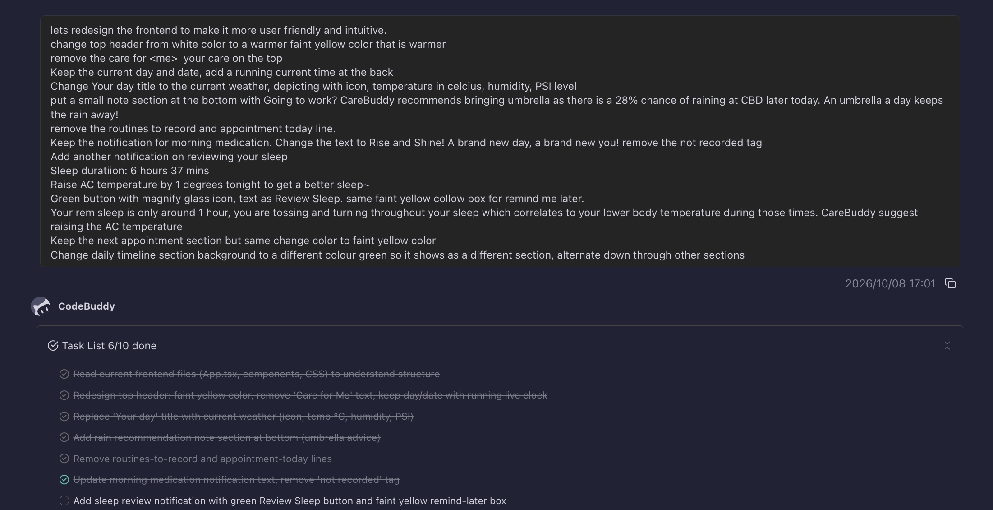
CodeBuddy: frontend redesign
Detailed interface requirements and CodeBuddy’s implementation task list
Historical UI iteration and development-tool usage
38
Notes:
The screenshot documents an early UI redesign request and implementation task list. Some requested design and illustrative health content differ from the current website. It is evidence of CodeBuddy use, not a clinical guidance source or proof that every displayed task completed.
Original screenshot preserved without cropping or editing.
Source: care-buddy-submission-2026-10-09/output/codebuddy-evidence/01-codebuddy-ui-redesign.png
Context: care-buddy-submission-2026-10-09/output/codebuddy-evidence/README.txt

Slide 39
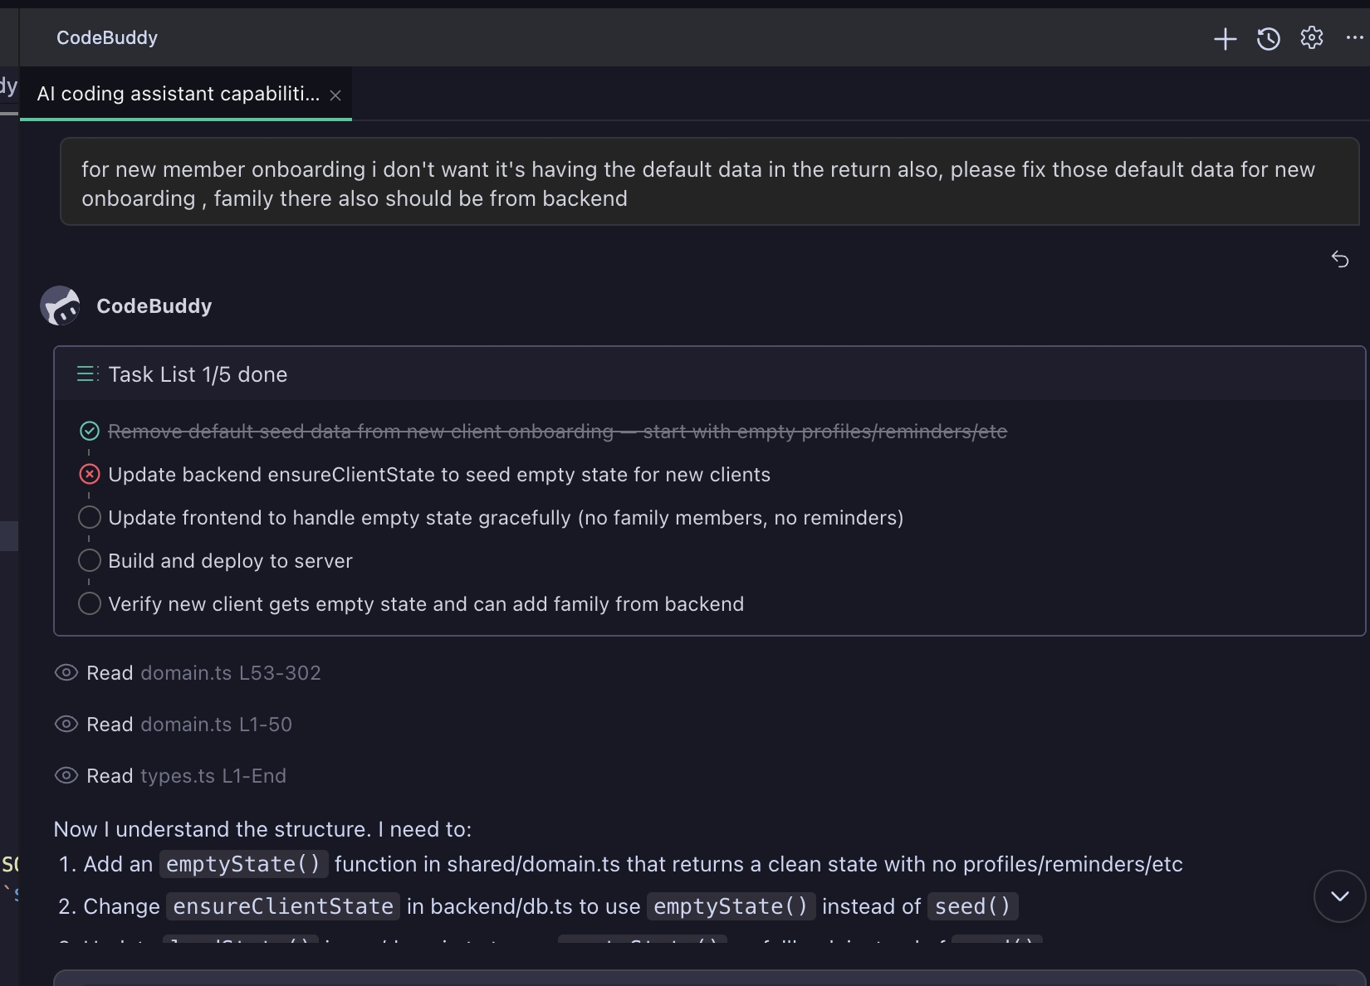
CodeBuddy: backend onboarding
Source-file reading and a plan for onboarding and family state
Development request and investigation, with work in progress
39
Notes:
The screenshot documents a backend onboarding/family-state request, source reading and a task plan. The displayed progress is incomplete. This is development-tool evidence, not proof that every requested task completed successfully.
Original screenshot preserved without cropping or editing.
Source: care-buddy-submission-2026-10-09/output/codebuddy-evidence/02-codebuddy-backend-onboarding.jpg
Context: care-buddy-submission-2026-10-09/output/codebuddy-evidence/README.txt

Slide 40
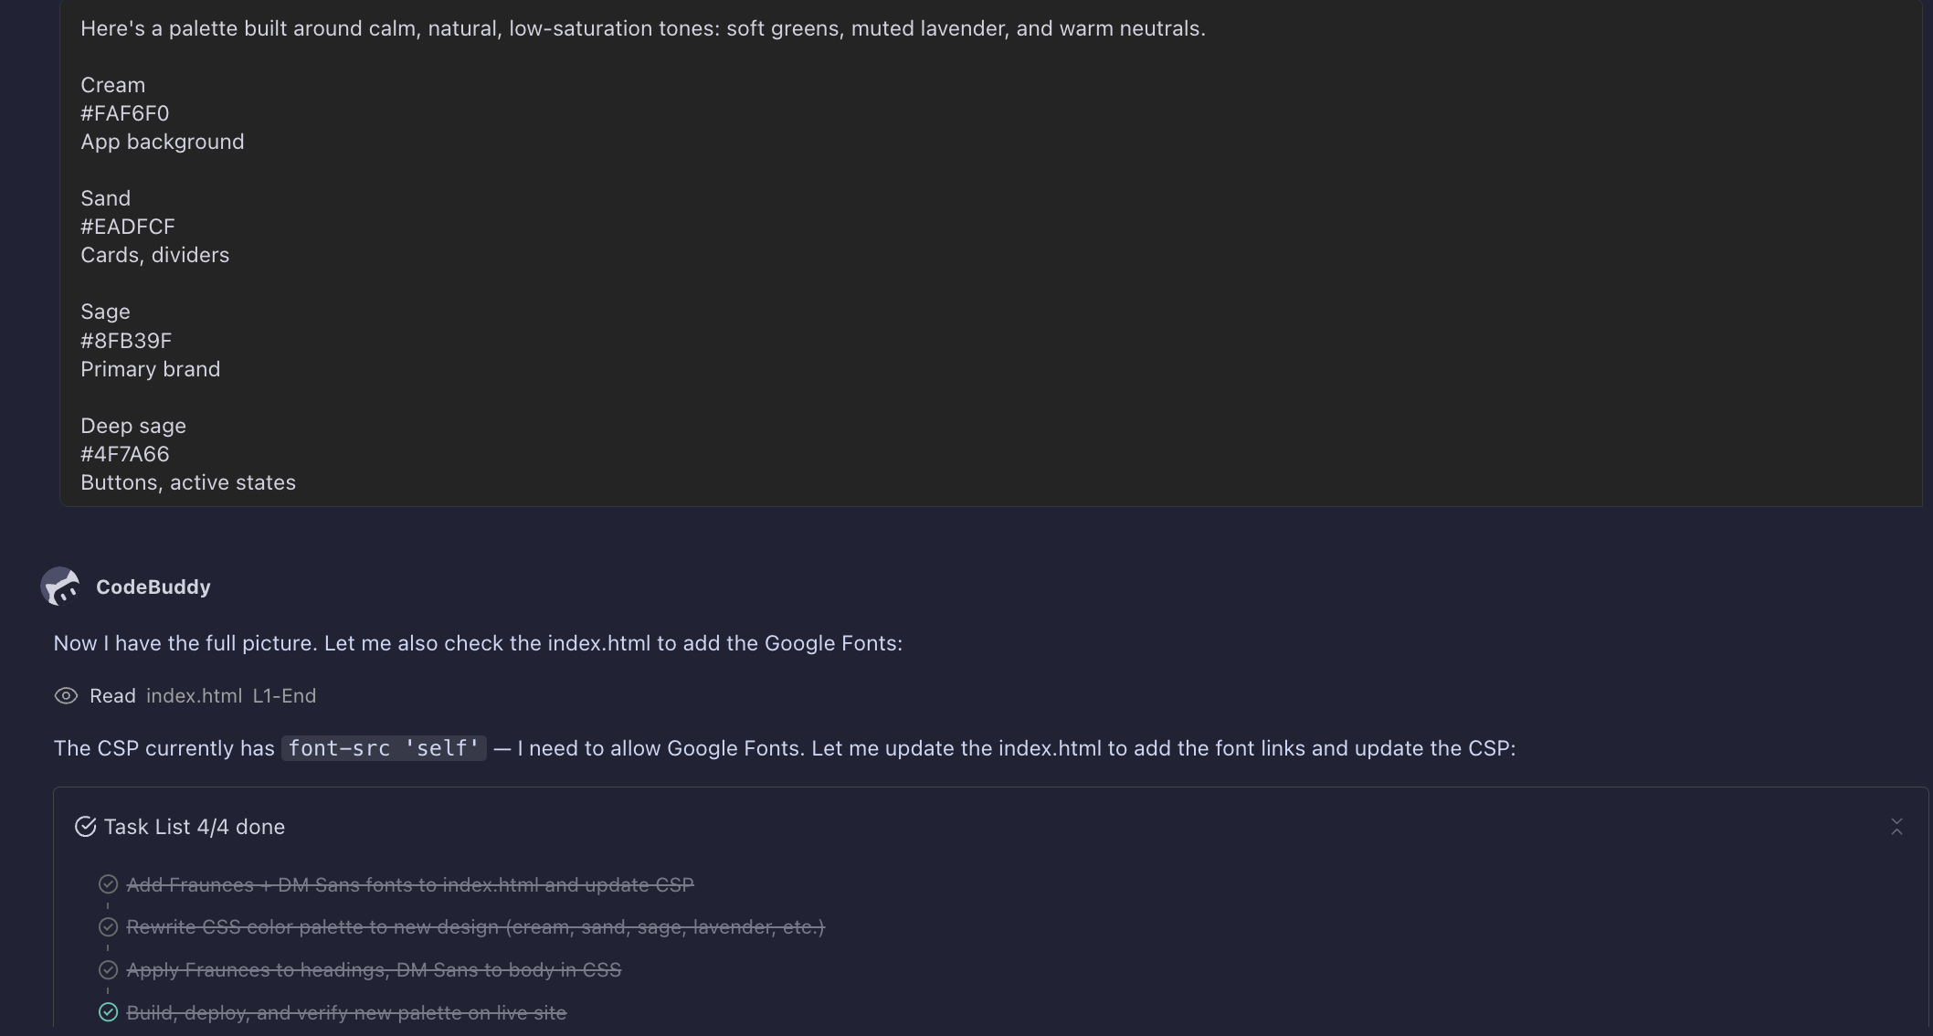
CodeBuddy: brand and typography
The supplied palette and CodeBuddy’s completed font and colour task list
Brand implementation evidence from the development workflow
40
Notes:
The screenshot documents the supplied colour palette, CodeBuddy reading index.html and a completed font/palette task list. It records a historical development iteration. Current product behaviour is described separately in the submission pack.
Original screenshot preserved without cropping or editing.
Source: care-buddy-submission-2026-10-09/output/codebuddy-evidence/03-codebuddy-brand-fonts.png
Context: care-buddy-submission-2026-10-09/output/codebuddy-evidence/README.txt

Slide 41
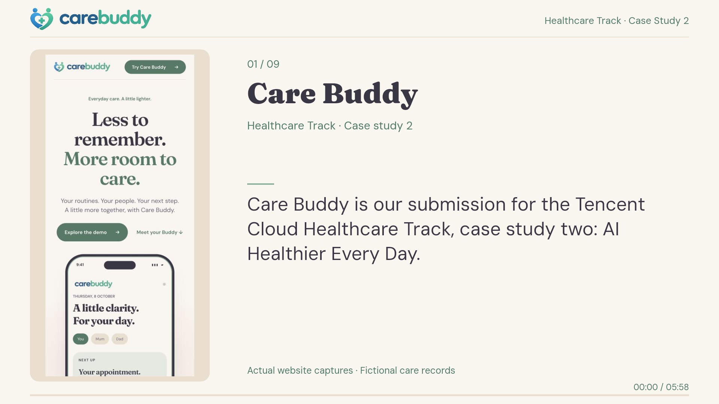
CareBuddy demo video
Mobile walkthrough, 5 min 58 sec
Click the video in Slide Show to play
Open hosted video
41
Notes:
CareBuddy submission mobile walkthrough. Duration 5:57.73 (approximately 5:58), H.264 video with AAC instrumental audio, 1920 × 1080, 15 fps. Embedded original MP4, with its original poster.
The walkthrough uses actual mobile production-site captures from 9 October 2026, including a saved TokenHub reminder update and a GP navigation response. Family, benefit, appointment and reading data shown in this demo are fictional or illustrative.
Original file: care-buddy-submission-2026-10-09/output/Care-Buddy-Mobile-Demo.mp4
Hosted playback: https://carebuddy.life/submissions/carebuddy-2026/
Source description: care-buddy-submission-2026-10-09/output/README.txt
The video has captions and instrumental audio, with no spoken narration.

Slide 42
SECURITY & PRIVACY
Security for production
Proposed controls for a dependable service handling personal care data
Encryption
Data segregation
TLS 1.2+ for data in transit.
Verify tenant and care-circle scope for
AES-256 for databases, files and backups.
records, files, jobs and AI context.
Manage and rotate keys through KMS.
Separate production from demo and test data.
Access and secrets
Monitoring and recovery
Verified sign-in and minimum necessary access.
Log access and changes without care content.
MFA for privileged operators.
Rate-limit APIs and detect unusual activity.
Keep AI keys and credentials on the server.
Test encrypted restores and incident response.
Proposed production design. Implementation and verification are required before deployment with real patient data.
42
Notes:
Proposed production security design, not a certification or a claim that all listed controls currently run in the demo.
The submission reference describes HTTPS/Nginx, server-held TokenHub credentials, domain validation, profile permission checks and scoped revocable assistant credentials. The no-login browser namespace is not verified human authentication. SQLite is a prototype store on one server.
Proposed baseline: TLS 1.2 or newer on browser/API, database and service connections, with certificate verification. Use AES-256 encryption at rest for care databases, files and backups. Select managed database encryption and encrypted volumes as appropriate to the final service. Use KMS-controlled keys, restricted key access, rotation and recovery procedures; avoid keys in application data stores or source code. Encryption at rest does not replace access checks.
Tencent COS supports server-side encryption and KMS-managed keys. Its availability does not mean CareBuddy has enabled it. https://www.tencentcloud.com/document/product/436/18145
Verify tenant_id and care_circle_id server-side on every access, storage object, background job and AI context. Use enforced database isolation where supported, with tests for cross-tenant access. Separate production, test and demo environments and credentials. MFA applies to operators, along with least privilege and controlled support access. Record audit metadata rather than sensitive care payloads.
Operational readiness includes dependency patching, API rate limits, detection and incident response, protected backups and restoration exercises.
Current implementation context: Care-Buddy-Architecture-Healthcare.pptx and Project-Description.txt in the 9 October 2026 submission pack, reference commit 63f19f6e291159b01338a56eaed2fb7edbf98ee6.
PDPC guidance: https://www.pdpc.gov.sg/-/media/Files/PDPC/PDF-Files/Other-Guides/guidetosecuringpersonaldatainelectronicmedium0903178d4749c8844062038829ff0000d98b0f.pdf

Slide 43
SECURITY & PRIVACY
Privacy and consent
Proposed controls give people a clear choice over their care information
Sharing by choice
Minimal AI context
Choose who can view or manage each circle.
Send only authorised information needed
Revoke sharing and assistant connections.
for the task. Remove unnecessary identifiers.
Keep sponsor reporting separate from records.
Review provider retention and data-use terms.
Purpose and retention
External handoffs
Explain how care data supports the service.
Ask before sending data to teleconsult partners.
Define retention and deletion rules.
Assess storage and processing locations.
Provide a process for access and correction.
Agree breach handling and provider contracts.
Proposed production privacy design. Consent, retention policies and provider terms require implementation and review.
43
Notes:
Proposed production privacy design. Do not claim PDPA compliance, clinical certification or consent-verified patient sharing from this slide.
The person whose care information is involved should have a clear explanation of purposes, access choices and sharing with caregivers, employers/insurers, AI providers or teleconsult providers. Family membership and sponsor membership alone must not grant personal-record access. Use an auditable consent record, accessible withdrawal and revocation. Sponsors should receive agreed aggregate reporting unless a person separately authorises particular access.
Minimise data sent to AI and assistant integrations, remove unnecessary direct identifiers and restrict the context to the authorised care circle and purpose. The prototype’s conversational context and health-reading alert evaluator are separate. Review AI processing locations, retention and training-use terms before deployment.
Define a purpose-based retention schedule, secure deletion including backup expiry, and access/correction request handling. Retention periods depend on service responsibilities and applicable requirements; no arbitrary fixed period is promised.
Current GP navigation opens a WhiteCoat link without transmitting care payloads. Any future transfer of chat, readings or identity needs an agreed interface, clear consent and provider contracts. Hosting in Singapore does not establish that every model provider processes data there. Assess cross-border transfers and responsibilities.
Source: Singapore Personal Data Protection Act 2012, consent, purpose, access/correction, protection, retention, transfer and breach provisions. https://sso.agc.gov.sg/Act/PDPA2012?segment=mnc
PDPC guide to securing personal data in electronic medium: https://www.pdpc.gov.sg/-/media/Files/PDPC/PDF-Files/Other-Guides/guidetosecuringpersonaldatainelectronicmedium0903178d4749c8844062038829ff0000d98b0f.pdf
Prototype context: 9 October 2026 submission Project-Description.txt and architecture slides.

Slide 44
THE FOUNDING TEAM
Meet the founders
The hands-on team behind CareBuddy
Alex Lew
Shao Quan Chew
Yau Boon Tan
Product and AI
Architecture and security
Technology and delivery
AI in everyday use
A personal reason to build
Full demo in under a day
Explores AI deeply and turns
Builds and manages the
Built the whole CareBuddy
emerging models into tools
infrastructure behind CareBuddy.
demo in less than a day.
he uses every day.
Owns architecture and security,
Leads a technology team
Built multilayer agents on
with a focus on dependable
of more than 20 people
VPS infrastructure, controlled
operations.
in his day job.
through Telegram and SMS.
A cancer survivor who knows
Brings broad coding fluency
Brings product judgement
the burden of daily care and
and a deep understanding
to model choice and
believes deeply in the product.
of the systems he builds.
agent orchestration.
Founder backgrounds supplied by the team
44
Notes:
Founder profiles based on the user’s supplied descriptions, 9 October 2026.
Alex Lew: product and AI expertise, extensive hands-on experimentation with AI, multiple layers of agents running on VPS infrastructure and controlled through Telegram or SMS for daily work.
Shao Quan Chew: architecture and security expert who builds and manages the infrastructure. Cancer survivor and strong believer in CareBuddy.
Yau Boon Tan: built the whole demo in less than a day, leads a technology team of more than 20 in his day job, broad programming expertise and deep understanding of the systems he builds.
The profiles rephrase the supplied information. No unsupported comparison with every engineer, universal fluency in every coding language, awards or employment titles is asserted.

Slide 45
PARTNERSHIP OPPORTUNITIES
WhiteCoat teleconsultation partnership
A proposed route from everyday care to professional medical advice
CareBuddy | WhiteCoat | CareBuddy follow-through
Offers a teleconsultation route when a user seeks medical advice. Helps the user prepare for a conversation with a doctor. | Provides the consultation through its own clinical service. The doctor assesses suitability and determines clinical care. | Helps organise the next routine using the doctor’s instructions. Any future data handoff needs explicit consent and agreement.
Partnership outlook
The team has high confidence in securing a WhiteCoat deal.
Commercial terms and integration scope remain to be agreed.
Current demo
Opens a WhiteCoat GP link. Partner booking and data transfer are proposed next steps.
Proposed partnership. WhiteCoat agreement is pending. The existing redirect does not book a consultation or send care records.
45
Notes:
Proposed WhiteCoat teleconsultation partnership. The user reports high confidence in securing a deal. This is the team’s outlook, not an executed agreement, confirmed commercial terms or a signed partner commitment.
CareBuddy would offer a route to WhiteCoat when a user seeks professional medical advice. WhiteCoat remains responsible for consultation suitability and clinical decisions through its own service. CareBuddy can support preparation and organisation of clinician instructions without independently prescribing or changing medication.
The submitted prototype already opens https://link.whitecoat.com.sg/dXEf/nnq8g6r9 for GP navigation. It does not book an appointment or send conversation/reading payloads through that link. A future booking interface or information handoff requires a commercial and technical agreement, explicit user consent, access controls and defined clinical/data responsibilities. No fee, revenue share, exclusivity or availability guarantee is assumed.
WhiteCoat’s published FAQ describes video consultations with Singapore-registered doctors, with the doctor assessing whether teleconsultation is suitable and advising appropriate follow-up. https://whitecoat.global/sg/faq.html
Prototype source: care-buddy-submission-2026-10-09/output/Project-Description.txt and Care-Buddy-Architecture-Healthcare.pptx.

Slide 46
COMMERCIAL & PILOT PLAN
CareBuddy’s differentiation
A shared care workflow with reminders in the tools people already use
Existing tool | Documented strengths | CareBuddy’s intended role
Medisafe | Medication management and caregiver reminders | Shared routine and appointment context with care reminders in an AI assistant
Google Health with Fitbit devices | Wearable health metrics and AI coaching with Premium | Family coordination and follow-through Connected device feeds are planned
Claude | Conversation and actions through connected tools | Scoped care context, validated changes and reminders through host scheduling
CareBuddy’s positioning centres on the family care workflow
Positioning hypothesis. Capabilities overlap across products. Production identity and partner integrations remain proposed.
46
Notes:
POSITIONING HYPOTHESIS. This compares documented starting points and CareBuddy's intended role. It is not an exhaustive feature audit or a claim that competitors lack family sharing, reminders, AI or medical records. In particular, Medisafe already offers caregiver support, and Google Health has health records and AI coaching. CareBuddy's proposed differentiation is an integrated family coordination workflow with care-specific context, validated actions and reminders through a personal assistant. Validate this positioning with caregiver interviews and hands-on comparisons.
Medisafe official caregiver guide supports medication management, dependent profiles and caregiver missed-dose reminders: https://help-center.medisafe.com/en/articles/11793638-caregiver-guide-how-to-use-medisafe-to-manage-a-family-member-s-medications
Google Health official feature map supports Fitbit-linked health metrics and Gemini-based coaching with Premium, with availability depending on device and plan: https://support.google.com/product-documentation/answer/17081467?hl=en
Claude official connector guide supports retrieving data and taking actions through connected services: https://support.claude.com/en/articles/11176164-use-connectors-to-extend-claude-s-capabilities
Sources checked 9 October 2026. CareBuddy source: supplied Care-Buddy-Architecture-Healthcare.pptx and Project-Description.txt, submission reference commit 63f19f6e291159b01338a56eaed2fb7edbf98ee6. The demo supports selected profile context, typed validated commands, transaction receipts and scoped revocable notification exports. Host scheduling must be enabled separately. Verified identity, consent-based sharing, live device feeds and integrated teleconsult booking remain production work.

Slide 47
COMMERCIAL & PILOT PLAN
Business model and unit economics
Proposed sponsor funding, with an illustrative cost budget per funded care circle
S$120
S$10 monthly revenue
Direct delivery budget per funded circle
per care circle per year
Monthly cost budget | S$
AI usage | 0.75
Hosting, storage and jobs | 0.75
Participant support | 1.50
Total direct delivery | 3.00
Initial payer
An employer, insurer or pilot sponsor
funds family access to a shared care plan.
Self-pay option to test
S$7
70%
Families can fund their own circle.
Clinical consultation fees sit outside this plan.
Monthly contribution
Contribution margin
Illustrative commercial assumptions. Contribution excludes acquisition and corporate overheads. Validate price and delivery costs in the pilot.
47
Notes:
PROPOSED BUSINESS MODEL AND COST BUDGET, not observed revenue, a supplier quote or a forecast. The existing market and GTM appendix assumes S$120 per care circle per year, or S$10 per month. A sponsor funds family access. Employers and insurers are proposed later channels after pilot validation, and self-pay is an option to test. Proposed CareBuddy subscription pricing excludes clinical services. WhiteCoat's commercial terms and consultation charging arrangements require agreement.
Illustrative monthly operating budget per funded care circle: AI usage S$0.75, allocated hosting/storage/background jobs S$0.75, participant support S$1.50. Sum = S$3.00 direct delivery cost. These are planning budgets selected for commercial testing, not measured current costs or Tencent prices. Track actual model usage, hosting allocation and support hours during the pilot. A small initial cohort may exceed this budget because of minimum platform costs and onboarding effort. Sponsor-funded credits should not hide the full steady-state service cost.
S$10.00 revenue minus S$3.00 direct delivery cost = S$7.00 monthly contribution. Contribution margin = 7 / 10 = 70%. This excludes acquisition/sales costs, corporate overheads, product development, taxes and any clinical-service cost. It is not net profit. Monthly revenue here is the annual subscription divided by 12, not a statement about billing cadence. Measure both cost per funded circle and cost per active circle.
The pilot should test the S$120 annual offer, actual support effort and a signed sponsor extension. Inputs remain hypotheses until measured. Existing reference: CareBuddy-Launch-Pilot-Evidence-v3.pptx, slides 24, 26 and 29.

Slide 48
COMMERCIAL & PILOT PLAN
Pilot evidence and success measures
Three personal accounts today. Proposed pilot: 100 circles over 12 weeks
Current evidence
Pilot measure | Proposed goal | Measurement
Activation | At least 80% | First routine and member invited within 7 days of enrolment
Week-8 activity | At least 50% | One confirmed care action during the eighth usage week
Routine follow-through | Establish baseline | Completed due actions / due actions User-reported routine completion
Caregiver engagement | Establish baseline | 2 active authorised members in a circle, plus caregiver feedback
Willingness to pay | 1 paid extension | A signed sponsor extension Test the S$120 annual price
Delivery cost | S$3/month budget | Full delivery cost per funded circle AI, hosting and support included
Mick Chew
Daily medicines
and specialist reviews
Ken Sim
Exercise routines
and Claude reminders
Seb Tan
Caregiver visibility
and Fitbit alerts
Personal accounts are qualitative evidence. Targets are proposed. Activation and week-8 activity use all enrolled circles as the denominator.
48
Notes:
CURRENT QUALITATIVE EVIDENCE: the user supplied three named pilot-user accounts from Mick Chew, Ken Sim and Seb Tan, and explicitly asked to retain them as supplied. Those complete anecdotes remain verbatim on slides 30–32. These accounts do not establish the total pilot sample, measured retention, clinical effectiveness or a percentage improvement. No measured cohort dataset was supplied. Seb's Fitbit account is a personal account supplied by the team and is separate from the technical submission demo snapshot.
PROPOSED SCORECARD for the existing 100-care-circle, 12-week Singapore feasibility pilot. Activation: at least 80% of all enrolled circles create a first routine and invite an authorised member within 7 days. Week-8 activity: at least 50% of all enrolled circles perform one confirmed care action during the eighth usage week. A circle is the unit of analysis, with members de-duplicated. These targets are unchanged from slides 26 and 29. The programme's weeks 3–10 form the eight usage weeks.
Routine follow-through: establish a baseline using completed due routine actions divided by due routine actions within an agreed observation window. These are user-recorded actions, not independently verified medication adherence. Caregiver engagement: measure circles with at least two authorised members each performing a recorded care action within the observation week, alongside qualitative caregiver feedback. Do not set an unsupported benchmark before collecting the baseline.
Commercial gate: one signed sponsor extension for a next cohort, with willingness-to-pay discussions around the illustrative S$120 annual plan. Direct delivery cost budget: S$3.00 per funded circle per month from slide 47. Measure actual AI usage, full hosting allocation and participant support, including the economic cost of credits. Keep cost per active circle as a separate reported measure.
All numerical goals are proposals, not current results. Recruitment and participant use depend on production identity/access controls, partner agreements, informed consent and the relevant evaluation approvals.

Slide 49
COMMERCIAL & PILOT PLAN
One family’s care journey
An illustrative day for an adult child helping Dad manage his care plan
01
02
03
04
Morning
Midday
Evening
When advice is needed
Today’s care plan
A reminder in Claude
A shared care view
A route to WhiteCoat
Dad follows his medicine plan.
Host scheduling enables Claude
The family reviews care actions
CareBuddy opens WhiteCoat.
CareBuddy shows what is due.
to remind the family member
in Dad’s selected care circle.
A doctor assesses suitability.
Clinical instructions stay fixed.
about an exercise routine.
Access follows the selected role.
Booking integration needs
partner agreement.
Family follow-through
After a consultation, the family can organise agreed follow-up steps
while preserving the doctor’s clinical instructions.
Illustrative intended-use scenario. Verified consent/access and integrated teleconsult booking require production work and partner agreement.
49
Notes:
ILLUSTRATIVE INTENDED-USE SCENARIO, not an additional pilot testimonial or a measured before/after result. The family is fictional. The story combines existing routine and medication surfaces, assistant notification exports, selected care-circle viewing and a GP link with the proposed production experience.
Morning: the existing prescribed medication instructions remain fixed. CareBuddy supports organisation and user-recorded care actions, not medication prescribing or dosing changes. Midday: the personal assistant uses the scoped CareBuddy notification export only after the user enables host scheduling. Notification acknowledgement does not mark the underlying routine complete. Evening: the selected care profile and view/manage permission govern the demo's actions. Production use requires verified identity and consent-based circle access. The story makes no live-wearable-feed claim.
When medical advice is needed, the current demo opens a WhiteCoat GP page without booking or sending a care payload. WhiteCoat's doctor assesses teleconsult suitability. A commercial referral arrangement, integrated booking, data handoff and follow-through workflow remain proposed and need partner agreement and participant consent.
Source: supplied 9 October 2026 submission architecture and project description, reference commit 63f19f6e291159b01338a56eaed2fb7edbf98ee6. WhiteCoat official FAQ: https://whitecoat.global/sg/faq.html. This is a proposed user journey, not clinical guidance or an emergency-monitoring workflow.

Slide 50
COMMERCIAL & PILOT PLAN
Partner requests and the next 90 days
Proposed commitments for a 100-circle Singapore pilot, starting from partner kickoff
Tencent
NTU
WhiteCoat
One architecture and security review.
One research lead for caregiver co-design
One service owner for the referral journey.
A 12-week cloud and TokenHub support
and feasibility evaluation.
Agree referral, consent and booking scope.
package for the agreed pilot budget.
Help recruit under an agreed protocol.
Sign a pilot collaboration agreement.
Potential value to the partner
Potential value to the partner
Potential value to the partner
A consented reference case with
Caregiver usability and implementation
A proposed source of consultation referrals
measured cloud usage and service costs.
findings, with agreed publication rights.
and a family follow-through workflow.
By day 30
Agree partner roles, budget and the evaluation protocol.
By day 60
Verify identity, consent and tenant access. Complete readiness review.
By day 90
Begin cohort onboarding when agreements and readiness gates are met.
Proposed requests and timeline. Partner commitments are pending. Recruitment depends on readiness, consent and relevant study approvals.
50
Notes:
CONCRETE PROPOSED PARTNER REQUESTS. No commitments, credits, appointments or agreements are confirmed by this slide. The team has expressed high confidence in obtaining a WhiteCoat collaboration, with scope and commercial terms still to be agreed.
Tencent: request one architecture/security workshop and an agreed cloud/TokenHub support package for the 12-week, 100-circle feasibility pilot. Define workloads, budget ceiling, full economic service cost, technical owner and review milestones during scoping. Offer a reference case using measured usage and delivery costs only with participant and partner consent. No cash or credit amount is invented.
NTU: request one research lead to co-design the caregiver experience and feasibility evaluation and support recruitment under an agreed protocol. Clarify data access, ethics approval where applicable, participant withdrawal, IP and publication rights. The 100 circles are a proposed cohort, not an enrolled group or a power calculation.
WhiteCoat: request one named service owner, an agreed referral/consent process, a decision on booking/data handoff scope and a signed pilot collaboration agreement. Potential value includes referrals and support for families organising doctor-directed follow-up. The current demo only opens a GP link and does not book or transfer care data. There is no guaranteed consultation volume.
PROPOSED 90-DAY PLAN starts from a partner kickoff, not from today's date or a committed launch date. Day 30: partner roles, budget and evaluation protocol. Day 60: verified identity, consent, tenant access and operational readiness review, including the security/privacy controls in the production appendix. Day 90: begin onboarding only after agreements, readiness gates, informed consent and the relevant evaluation approvals. Research approval timing may require a later start. The 12-week participant programme is separate and follows this preparation, as described on slide 29.
CareBuddy's contribution: product delivery, secure operation, onboarding/support and complete cost/incident measurement. Partner fit context and prior sources: https://www.tencentcloud.com/partners ; https://www.ntu.edu.sg/arise/home ; https://www.ntu.edu.sg/pcfm ; https://whitecoat.global/sg/faq.html.

