Slide 1

Care
Buddy
From the WhiteCoat Innovation Team
Less to remember.
More room
to care.
HEALTHCARE · LONG-TERM SELF-CARE
Tencent Cloud AI CAN DO IT Hackathon Singapore 2026
Alex Lew · Shao Quan Chew · Yau Boon Tan
01
Notes:
CareBuddy-Launch.pdf, page 1

Slide 2

THE WORLD AROUND US
AI everywhere.
Life at
full speed.
More messages. More screens.
More competing for our attention.
02
Notes:
CareBuddy-Launch.pdf, page 2

Slide 3

THE CARE GAP
Care can slip
through
a busy day.
Our routines. Our health.
The people we mean to check on.
03
Notes:
CareBuddy-Launch.pdf, page 3

Slide 4

INTRODUCING
Your everyday
health buddy.
A little more attention to your health.
A little more care for the people you love.
HEALTHCARE · LONG-TERM SELF-CARE
04
Notes:
CareBuddy-Launch.pdf, page 4

Slide 5
A DELIBERATE FOCUS
Care has its
own space.
01
Daily routines & medication
02
Dental & screening reminders
03
Sleep & health information
04
Health chat & your care circle
Designed around everyday health
and the people you care for.
Product vision
05
Notes:
CareBuddy-Launch.pdf, page 5

Slide 6
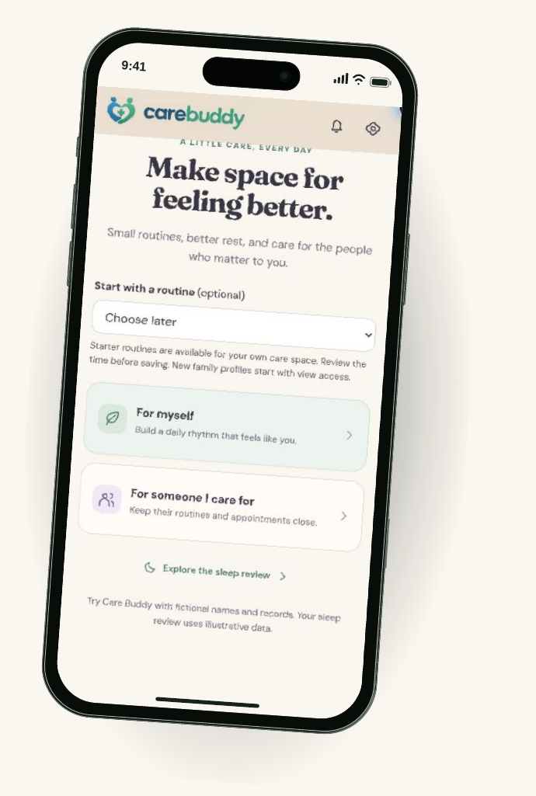
THE PROTOTYPE, UP CLOSE
Start with
your care.
For yourself.
For someone you care for.
Choose a routine.
Make room for a small first step.
Mobile prototype walkthrough · Fictional data
06
Notes:
CareBuddy-Launch.pdf, page 6

Slide 7
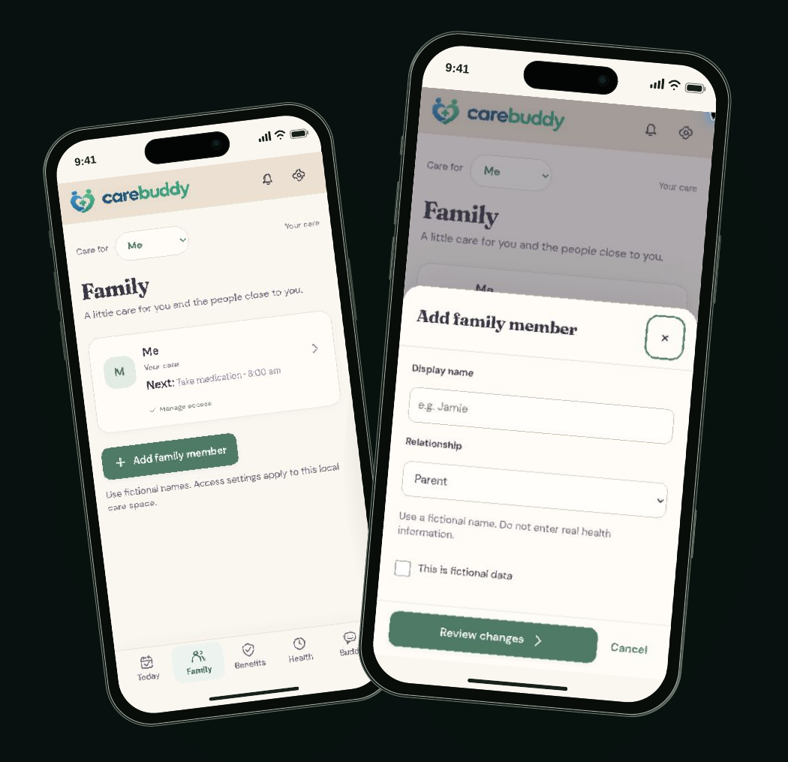
YOUR CARE CIRCLE
Your people.
In view.
Keep a loved one’s routines
and appointments close.
A personal care space,
with permission-aware access
as the intended model.
Mobile prototype walkthrough · Fictional profiles; production sharing to be validated
07
Notes:
CareBuddy-Launch.pdf, page 7

Slide 8
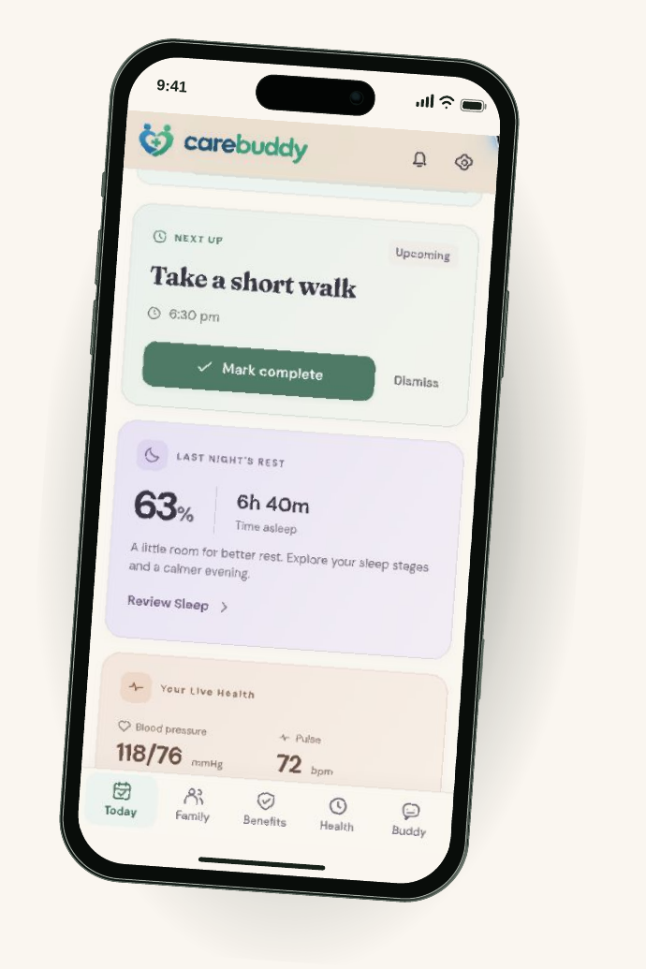
Your day.
A little lighter.
One place to see the next care task
and keep everyday routines in view.
Routines
Rest
Readings
Mobile prototype walkthrough · Fictional data
08
Notes:
CareBuddy-Launch.pdf, page 8

Slide 9
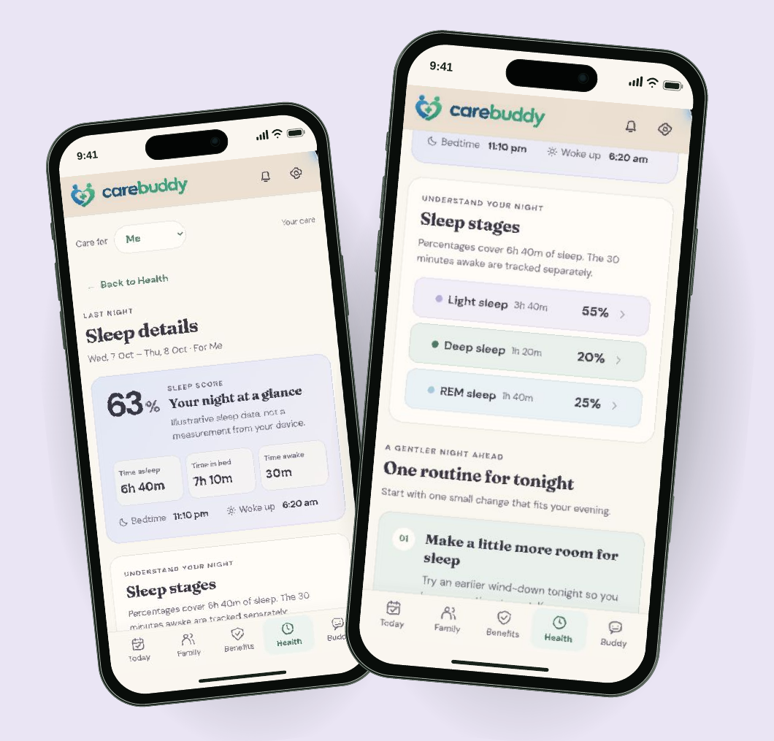
SLEEP
Make room
for a
better night.
Review rest.
Choose a wind-down routine.
Illustrative sleep data.
Wearable connection is planned.
Mobile prototype walkthrough · Sleep is not measured from a device
09
Notes:
CareBuddy-Launch.pdf, page 9

Slide 10
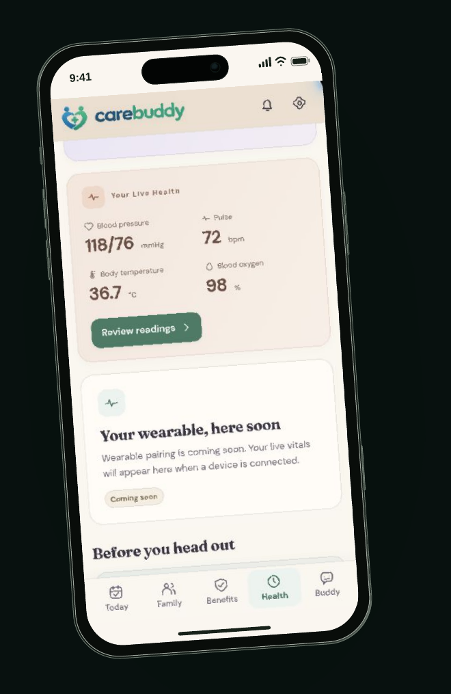
HEALTH INFORMATION
Your health,
at a glance.
Rest, routines and recorded readings.
A place to notice what deserves attention.
Mobile prototype walkthrough · Illustrative readings; no live wearable data
10
Notes:
CareBuddy-Launch.pdf, page 10

Slide 11
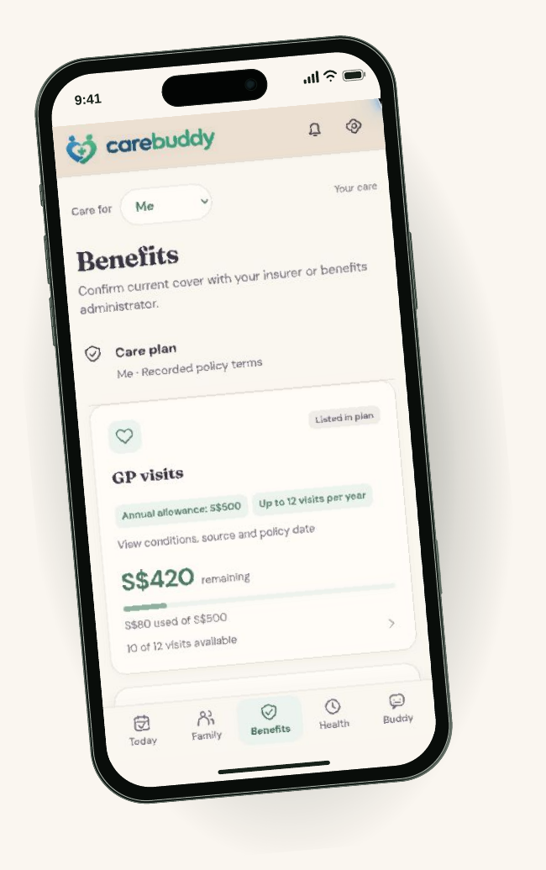
BENEFITS
Keep the details
close.
Bring important plan notes
into your care space.
Confirm cover with the insurer.
Less searching.
More clarity.
Mobile prototype walkthrough · Plan notes, not a live insurance check
11
Notes:
CareBuddy-Launch.pdf, page 11

Slide 12
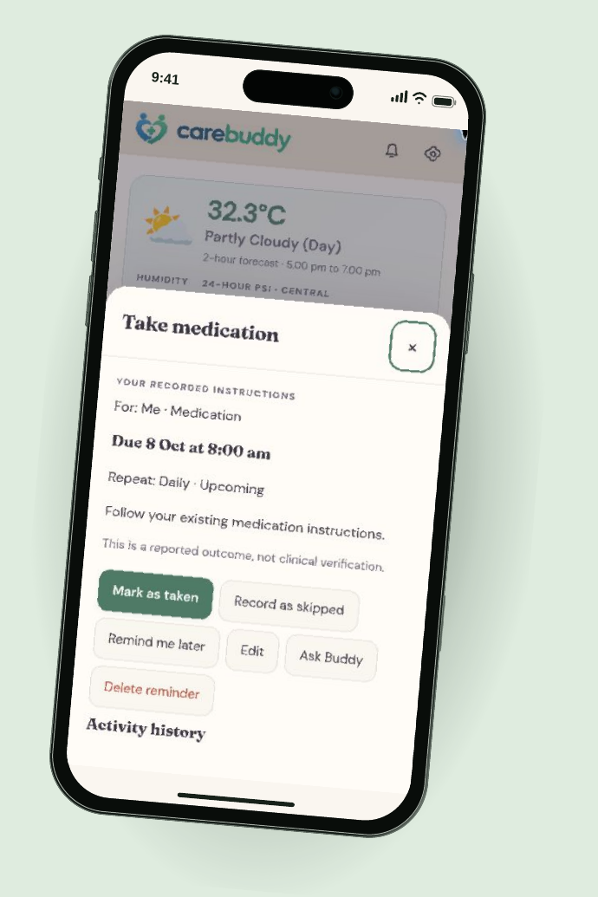
ROUTINES & MEDICATION
A small nudge.
A clear
next step.
See what’s due.
Mark it taken, skipped or later.
Follow existing medication instructions.
Responses are self-reported.
Mobile prototype walkthrough · In-app reminder; push delivery is not live
12
Notes:
CareBuddy-Launch.pdf, page 12

Slide 13
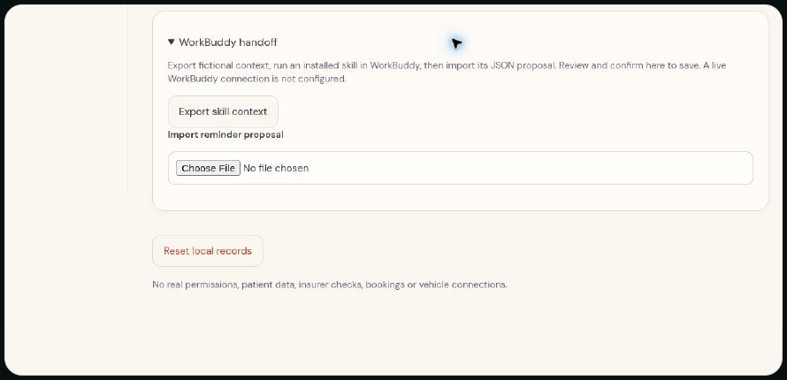
CARE, WHERE YOU ALREADY ARE
A reminder beyond
the care app.
“Remind me to drink water
while I’m working.”
CareBuddy plugin concept
Codex experience planned
Current prototype: manual WorkBuddy handoff.
Export context, import a proposal, review before saving.
Concept + actual prototype handoff · No live WorkBuddy connection or background push
13
Notes:
CareBuddy-Launch.pdf, page 13

Slide 14
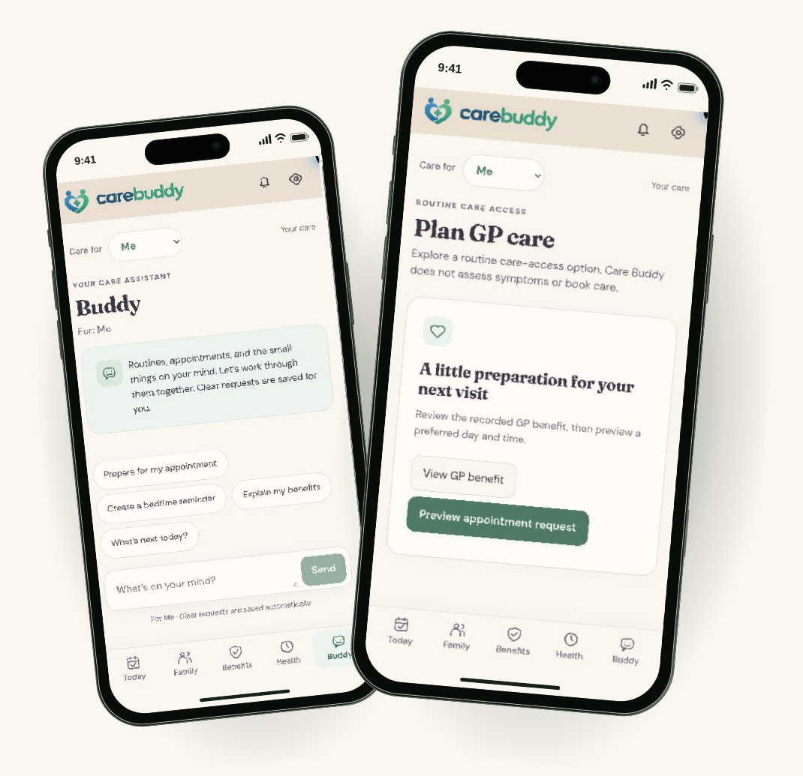
BUDDY & CARE ACCESS
Talk through
the next step.
Routines and appointment
preparation today.
WhiteCoat teleconsult connection
is a next step.
Mobile prototype walkthrough · GP planning only; no verified WhiteCoat redirect or booking
14
Notes:
CareBuddy-Launch.pdf, page 14

Slide 15

KEEPING CARE IN VIEW
Notice.
Remember.
Follow through.
Make the next care step easier
to see, discuss and remember.
Intended value · Clinical outcomes have not been evaluated
15
Notes:
CareBuddy-Launch.pdf, page 15

Slide 16
TEAM ARCHITECTURE
Built around
Tencent.
TENCENT CLOUD · INTENDED APPLICATION BOUNDARY
USER DEVICE
CareBuddy
CareBuddy services
Tencent TokenHub
→
Identity, care records
→
Model inference
Care circle · Routines · Health
and action validation
for Buddy
views
Built with CodeBuddy
Review before execution
External care providers
Development workflow
AI proposals pass application checks
Separate boundary; explicit handoff
Team-stated Tencent stack. Service-level deployment and data-flow evidence still need verification.
16
Notes:
CareBuddy-Launch.pdf, page 16

Slide 17
TRUST BY DESIGN
Care needs
Permissioned care
clear boundaries.
Family visibility should follow explicit access choices.
Visible actions
Let people review consequential proposals before saving or sharing.
Clinical limits
Support routines and preparation. Refer clinical decisions to
qualified care.
THE TRADE-OFF
Less silent
automation.
More human control.
Production design requirements · Validation remains ahead
17
Notes:
CareBuddy-Launch.pdf, page 17

Slide 18
WHAT COMES NEXT
01
Benefits, connected
More ways
Insurance information and clearer benefit guidance
to care.
02
A more useful day
Relevant news, weather and timely routines
03
Care within reach
Doctor discovery and WhiteCoat teleconsult access
04
CareBuddy, alongside you
A plugin experience, including hydration prompts in Codex
Roadmap · Integrations and clinical workflows are not live
18
Notes:
CareBuddy-Launch.pdf, page 18

Slide 19

Less to remember.
More room to care.
carebuddy.life ↗
Alex Lew · Shao Quan Chew · Yau Boon Tan
Tencent Cloud AI CAN DO IT Hackathon Singapore 2026
19
Notes:
CareBuddy-Launch.pdf, page 19
https://carebuddy.life/

Slide 20
PROTOTYPE SCOPE
What the demo
shows today.
Visible in the prototype
Onboarding and fictional family profiles
Daily routines and medication actions
Illustrative sleep and health views
Benefit notes and Buddy entry screen
GP appointment planning
Manual WorkBuddy context handoff
Still ahead
Verified sign-up and authentication
Connected wearable measurements
Live insurance eligibility checks
Push notifications and background sync
Live WorkBuddy or Codex connection
WhiteCoat redirect and teleconsult booking
Screens are captured from carebuddy.life. Fictional records and illustrative flows are used throughout the demo.
Observed 8 October 2026
20
Notes:
CareBuddy-Launch.pdf, page 20

Slide 21
REFERENCES & DEMONSTRATION
See it for yourself.
01
CareBuddy product & brand ↗
Current slogan, visual identity and public prototype.
02
CareBuddy demo ↗
Original screens: Today, Family, Health, Sleep, Benefits, Buddy and Settings.
03
Tencent TokenHub ↗
Architecture names are supplied by the team; deployment evidence is separate.
Product screenshots captured 8 October 2026. Team: Alex Lew, Shao Quan Chew and Yau Boon Tan.
Human imagery is illustrative. Additional source detail and presenter notes are included with the HTML source.
21
Notes:
CareBuddy-Launch.pdf, page 21
https://carebuddy.life/
https://carebuddy.life/today
https://intl.cloud.tencent.com/document/product/1300/78933?lang=en

