Slide 1

Care
Buddy
From the WhiteCoat Innovation Team
Less to remember.
More room
to care.
HEALTHCARE · LONG-TERM SELF-CARE
Tencent Cloud AI CAN DO IT Hackathon Singapore 2026
Alex Lew · Shao Quan Chew · Yau Boon Tan
01
Notes:
CareBuddy-Launch.pdf, page 1

Slide 2

THE WORLD AROUND US
AI everywhere.
Life at
full speed.
More messages. More screens.
More competing for our attention.
02
Notes:
CareBuddy-Launch.pdf, page 2

Slide 3

THE CARE GAP
Care can slip
through
a busy day.
Our routines. Our health.
The people we mean to check on.
03
Notes:
CareBuddy-Launch.pdf, page 3

Slide 4

INTRODUCING
Your everyday
health buddy.
A little more attention to your health.
A little more care for the people you love.
HEALTHCARE · LONG-TERM SELF-CARE
04
Notes:
CareBuddy-Launch.pdf, page 4

Slide 5
A DELIBERATE FOCUS
Care has its
own space.
01
Daily routines & medication
02
Dental & screening reminders
03
Sleep & health information
04
Health chat & your care circle
Designed around everyday health
and the people you care for.
Product vision
05
Notes:
CareBuddy-Launch.pdf, page 5

Slide 6
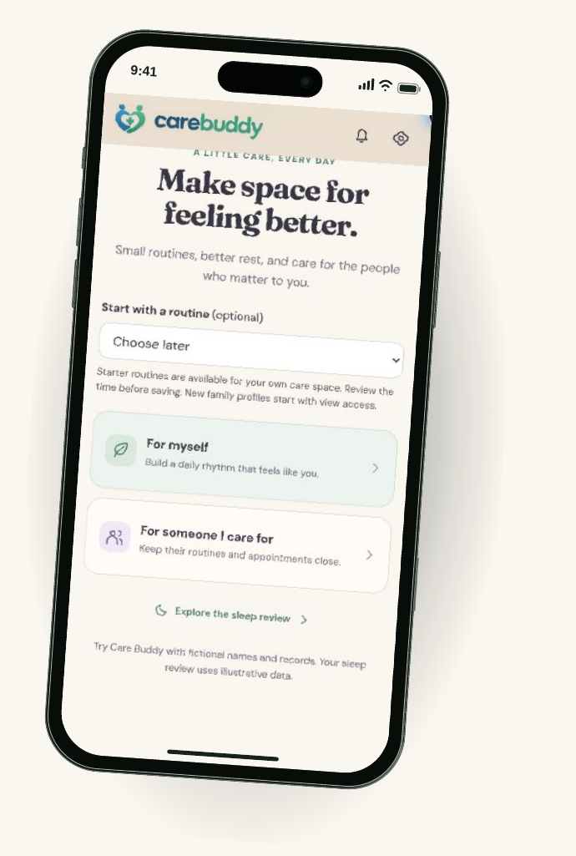
THE PROTOTYPE, UP CLOSE
Start with
your care.
For yourself.
For someone you care for.
Choose a routine.
Make room for a small first step.
Mobile prototype walkthrough · Fictional data
06
Notes:
CareBuddy-Launch.pdf, page 6

Slide 7
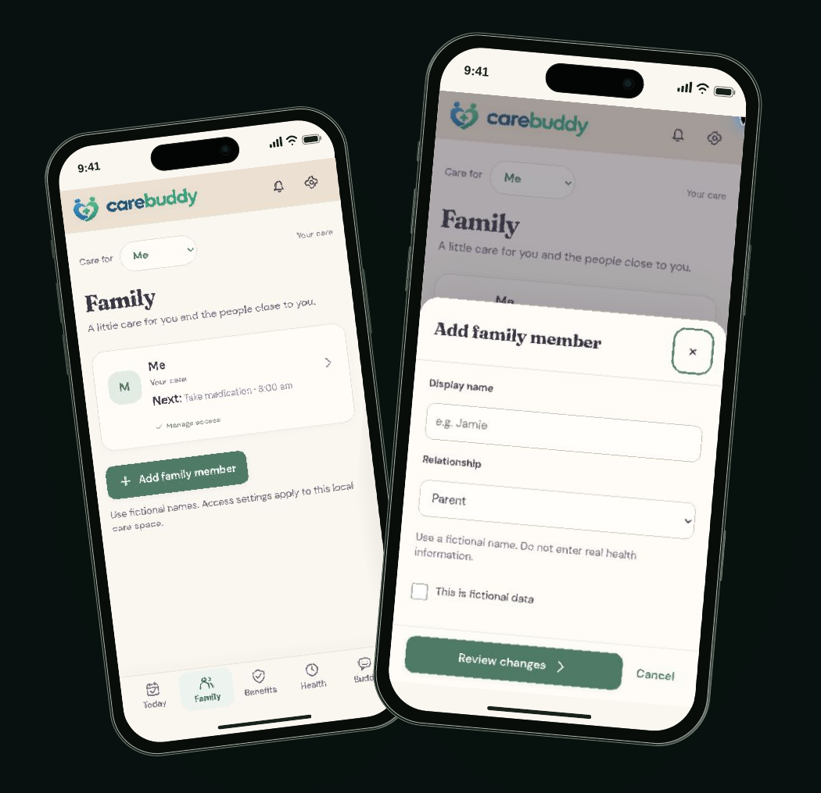
YOUR CARE CIRCLE
Your people.
In view.
Keep a loved one’s routines
and appointments close.
A personal care space,
with permission-aware access
as the intended model.
Mobile prototype walkthrough · Fictional profiles; production sharing to be validated
07
Notes:
CareBuddy-Launch.pdf, page 7

Slide 8
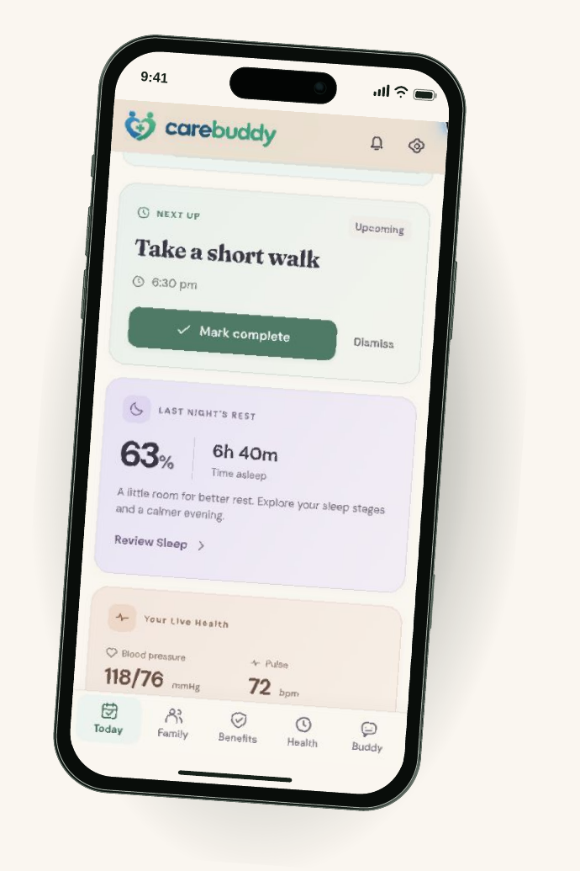
Your day.
A little lighter.
One place to see the next care task
and keep everyday routines in view.
Routines
Rest
Readings
Mobile prototype walkthrough · Fictional data
08
Notes:
CareBuddy-Launch.pdf, page 8

Slide 9
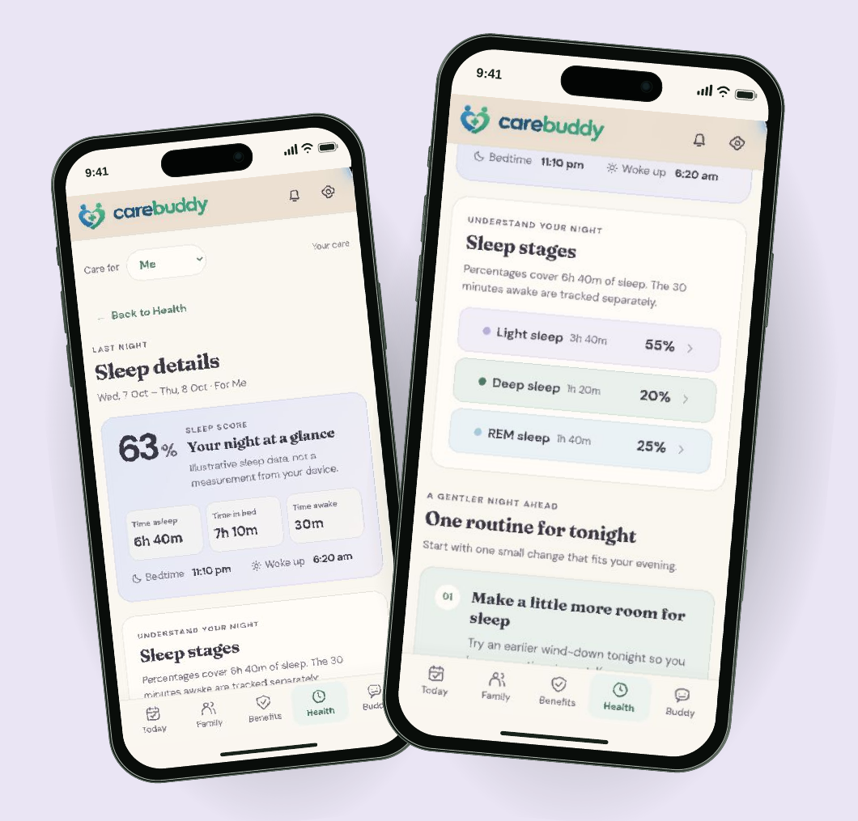
SLEEP
Make room
for a
better night.
Review rest.
Choose a wind-down routine.
Illustrative sleep data.
Wearable connection is planned.
Mobile prototype walkthrough · Sleep is not measured from a device
09
Notes:
CareBuddy-Launch.pdf, page 9

Slide 10
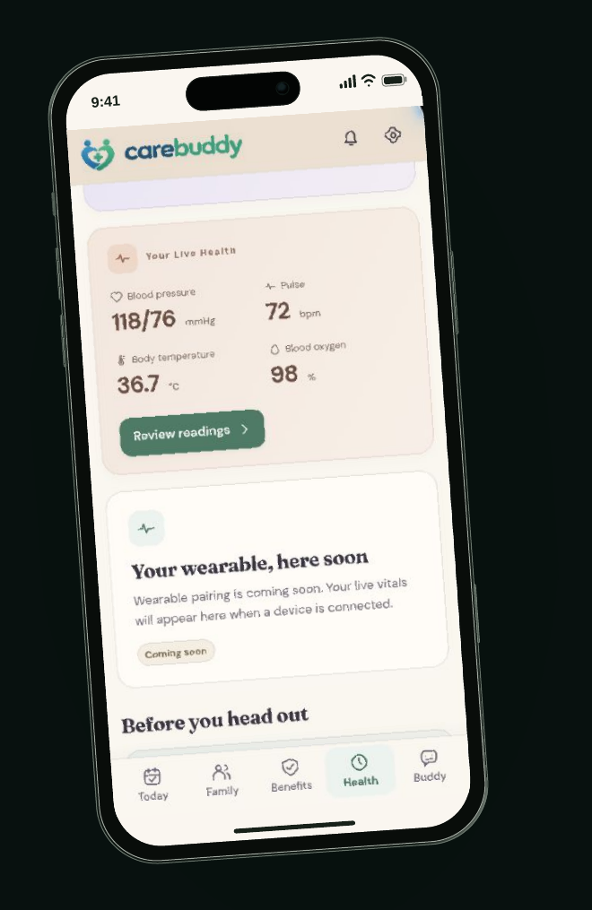
HEALTH INFORMATION
Your health,
at a glance.
Rest, routines and recorded readings.
A place to notice what deserves attention.
Mobile prototype walkthrough · Illustrative readings; no live wearable data
10
Notes:
CareBuddy-Launch.pdf, page 10

Slide 11
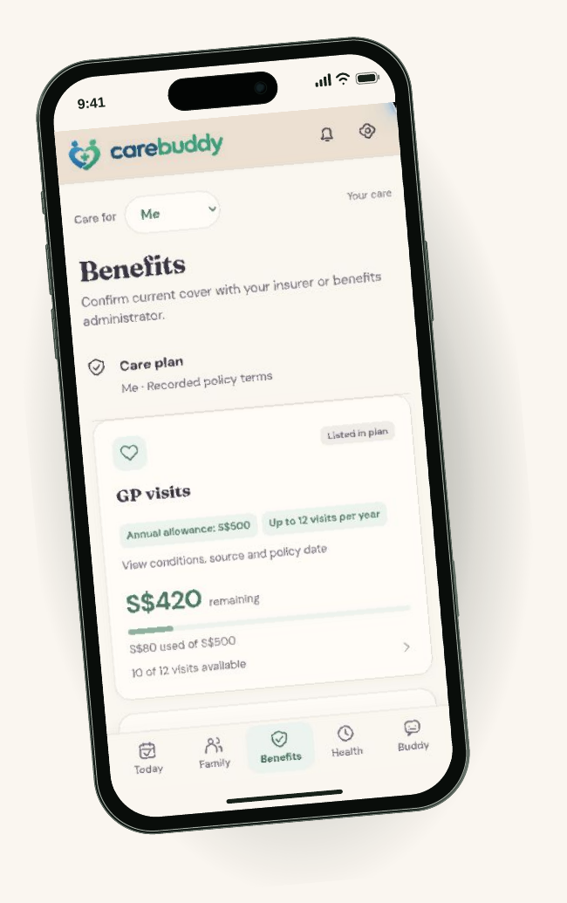
BENEFITS
Keep the details
close.
Bring important plan notes
into your care space.
Confirm cover with the insurer.
Less searching.
More clarity.
Mobile prototype walkthrough · Plan notes, not a live insurance check
11
Notes:
CareBuddy-Launch.pdf, page 11

Slide 12
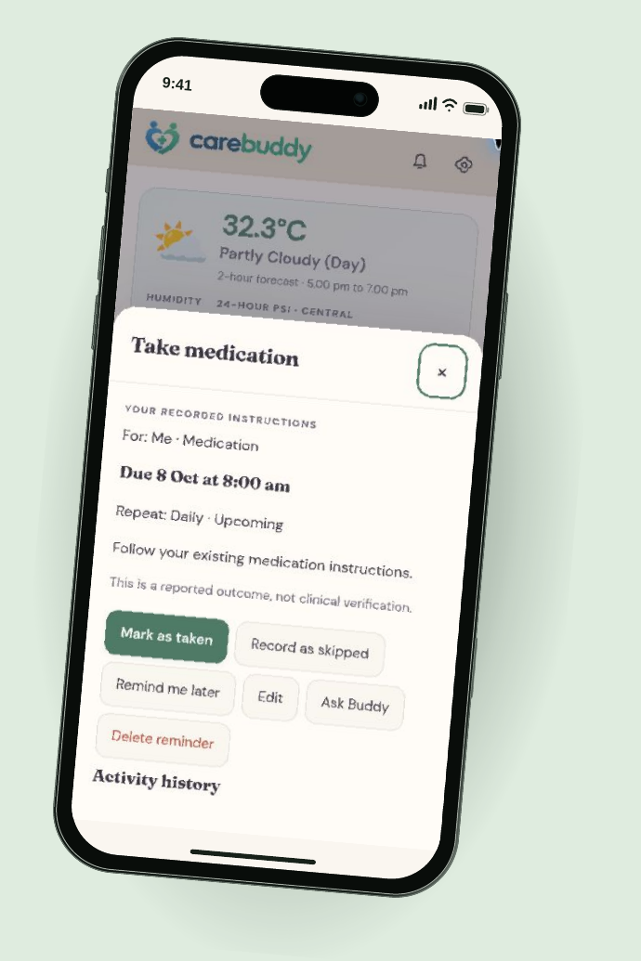
ROUTINES & MEDICATION
A small nudge.
A clear
next step.
See what’s due.
Mark it taken, skipped or later.
Follow existing medication instructions.
Responses are self-reported.
Mobile prototype walkthrough · In-app reminder; push delivery is not live
12
Notes:
CareBuddy-Launch.pdf, page 12

Slide 13
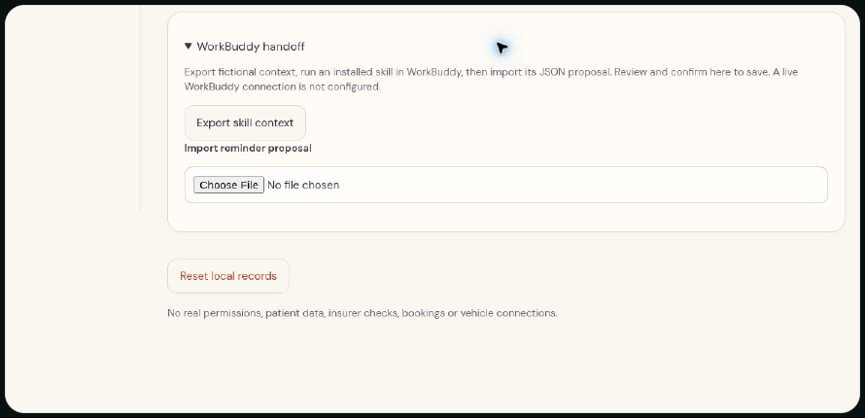
CARE, WHERE YOU ALREADY ARE
A reminder beyond
the care app.
“Remind me to drink water
while I’m working.”
CareBuddy plugin concept
Codex experience planned
Current prototype: manual WorkBuddy handoff.
Export context, import a proposal, review before saving.
Concept + actual prototype handoff · No live WorkBuddy connection or background push
13
Notes:
CareBuddy-Launch.pdf, page 13

Slide 14
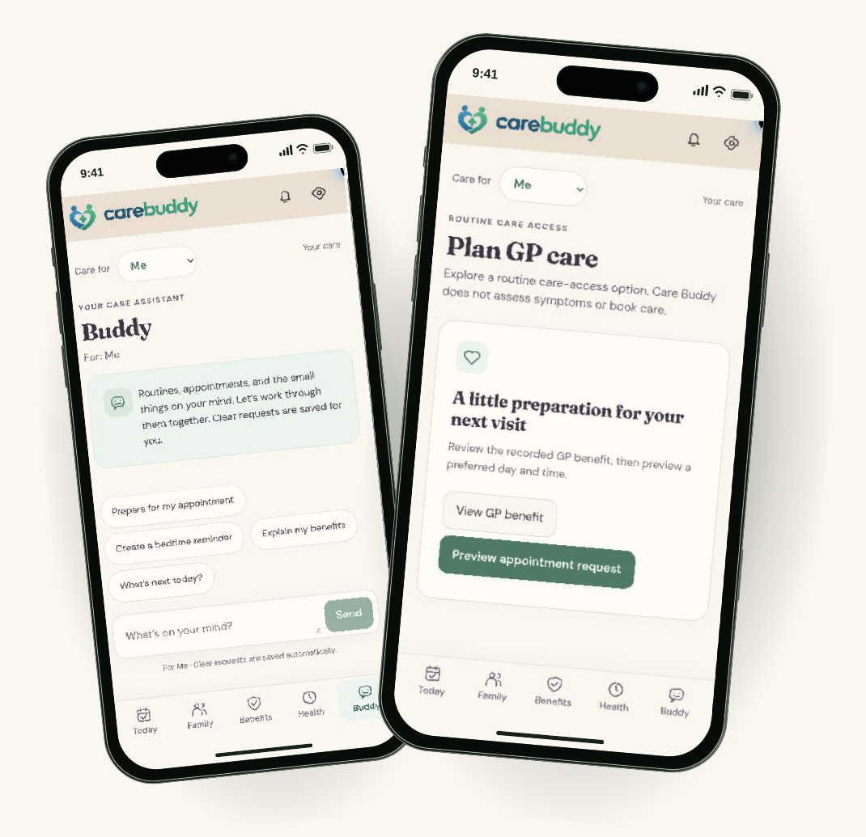
BUDDY & CARE ACCESS
Talk through
the next step.
Routines and appointment
preparation today.
WhiteCoat teleconsult connection
is a next step.
Mobile prototype walkthrough · GP planning only; no verified WhiteCoat redirect or booking
14
Notes:
CareBuddy-Launch.pdf, page 14

Slide 15

KEEPING CARE IN VIEW
Notice.
Remember.
Follow through.
Make the next care step easier
to see, discuss and remember.
Intended value · Clinical outcomes have not been evaluated
15
Notes:
CareBuddy-Launch.pdf, page 15

Slide 16
TEAM ARCHITECTURE
Built around
Tencent.
TENCENT CLOUD · INTENDED APPLICATION BOUNDARY
USER DEVICE
CareBuddy
CareBuddy services
Tencent TokenHub
→
Identity, care records
→
Model inference
Care circle · Routines · Health
and action validation
for Buddy
views
Built with CodeBuddy
Review before execution
External care providers
Development workflow
AI proposals pass application checks
Separate boundary; explicit handoff
Team-stated Tencent stack. Service-level deployment and data-flow evidence still need verification.
16
Notes:
CareBuddy-Launch.pdf, page 16

Slide 17
TRUST BY DESIGN
Care needs
Permissioned care
clear boundaries.
Family visibility should follow explicit access choices.
Visible actions
Let people review consequential proposals before saving or sharing.
Clinical limits
Support routines and preparation. Refer clinical decisions to
qualified care.
THE TRADE-OFF
Less silent
automation.
More human control.
Production design requirements · Validation remains ahead
17
Notes:
CareBuddy-Launch.pdf, page 17

Slide 18
WHAT COMES NEXT
01
Benefits, connected
More ways
Insurance information and clearer benefit guidance
to care.
02
A more useful day
Relevant news, weather and timely routines
03
Care within reach
Doctor discovery and WhiteCoat teleconsult access
04
CareBuddy, alongside you
A plugin experience, including hydration prompts in Codex
Roadmap · Integrations and clinical workflows are not live
18
Notes:
CareBuddy-Launch.pdf, page 18

Slide 19

Less to remember.
More room to care.
carebuddy.life ↗
Alex Lew · Shao Quan Chew · Yau Boon Tan
Tencent Cloud AI CAN DO IT Hackathon Singapore 2026
19
Notes:
CareBuddy-Launch.pdf, page 19
https://carebuddy.life/

Slide 20
PROTOTYPE SCOPE
What the demo
shows today.
Visible in the prototype
Onboarding and fictional family profiles
Daily routines and medication actions
Illustrative sleep and health views
Benefit notes and Buddy entry screen
GP appointment planning
Manual WorkBuddy context handoff
Still ahead
Verified sign-up and authentication
Connected wearable measurements
Live insurance eligibility checks
Push notifications and background sync
Live WorkBuddy or Codex connection
WhiteCoat redirect and teleconsult booking
Screens are captured from carebuddy.life. Fictional records and illustrative flows are used throughout the demo.
Observed 8 October 2026
20
Notes:
CareBuddy-Launch.pdf, page 20

Slide 21
REFERENCES & DEMONSTRATION
See it for yourself.
01
CareBuddy product & brand ↗
Current slogan, visual identity and public prototype.
02
CareBuddy demo ↗
Original screens: Today, Family, Health, Sleep, Benefits, Buddy and Settings.
03
Tencent TokenHub ↗
Architecture names are supplied by the team; deployment evidence is separate.
Product screenshots captured 8 October 2026. Team: Alex Lew, Shao Quan Chew and Yau Boon Tan.
Human imagery is illustrative. Additional source detail and presenter notes are included with the HTML source.
21
Notes:
CareBuddy-Launch.pdf, page 21
https://carebuddy.life/
https://carebuddy.life/today
https://intl.cloud.tencent.com/document/product/1300/78933?lang=en

Slide 22
STRATEGY & PRODUCTION APPENDIX
High availability architecture
Proposed Tencent Cloud deployment in Singapore
SINGAPORE REGION · SAME VPC, TWO AVAILABILITY ZONES
SINGAPORE ZONE 1
Stateless API
Tencent TokenHub
Replica + worker
External model inference
CareBuddy PWA
WAF + regional CLB
Managed SQL
Family & caregivers
Healthy replicas only
SINGAPORE ZONE 2
Primary, standby
Timeout + circuit breaker
Across zones
Stateless API
Manual actions still work
Replica + worker
Review model data-processing
locations before the pilot
Durable outbox + retries · encrypted backups · probes & alerts
Targets to validate
99.9% core availability · restore ≤30 min · data loss ≤15 min
Regional disaster recovery needs a separate approved location and recovery plan.
Proposed design; deployment choices and failover/restore drills still required. Source: Tencent Cloud Regions and Zones.
22
Notes:
PROPOSED PRODUCTION ARCHITECTURE, not a claim about current deployment.
Stateless Express APIs run on separate CVM instances across Singapore Zone 1 and Zone 2; a regional CLB removes unhealthy replicas. Select a managed SQL configuration with primary/standby across zones and validate service/zone availability with Tencent. Durable outbox, idempotent workers, bounded retries, encrypted backups, health probes and an on-call runbook are proposed controls. Database connections must handle failover.
AI failures must not block manual routines, appointments or records. Only selected, authorised circle context may be sent to TokenHub; model provider processing locations/terms require review. The AI request is illustrated from one replica; both replicas use the same bounded adapter.
99.9% is a proposed monthly end-to-end SLO for core care flows, excluding external AI inference. It allows about 43.2 minutes of unavailability in a 30-day month. RTO ≤30 minutes and RPO ≤15 minutes are proposed backup/restore drill targets, not measured guarantees. Same-region availability does not cover a region-wide outage; separate DR design is needed.
Source: Tencent Cloud, Regions and Zones, last updated 18 September 2026. Supports cross-zone VPC isolation and regional CLB routing. https://www.tencentcloud.com/document/product/213/6091
Current prototype context: local docs/tokenhub.md (7 October 2026); account authentication and server CRUD migration remain separate.

Slide 23
STRATEGY & PRODUCTION APPENDIX
Multi-tenancy
One platform; organisation boundaries and consent within each care circle
TENANT = ORGANISATION OR DIRECT FAMILY ACCOUNT
Access within a circle
Partner A
Partner B
Direct family
The family owner grants view or edit rights.
Care circles A1, A2
Care circles B1, B2
Private care circle
Sponsor access follows explicit consent.
Isolation across tenants
Validate tenant and circle scope on every
Shared application + access policy
query, object path, job and AI request.
Verified identity → tenant membership → circle permission
Operations at scale
Separate quotas, audit logs and billing.
Test denied access across tenant boundaries.
Tenant-scoped records, files and AI context
Enterprise option
tenant_id + care_circle_id on every operation
Offer a dedicated database when contracts
require stronger physical separation.
Proposed model; production identity, consent enforcement and server-side tenant storage remain implementation work.
23
Notes:
PROPOSED MULTI-TENANT MODEL.
A tenant is an organisation-sponsored account or a direct family account. Care circles have separate membership and consent grants within the tenant. A person can belong to multiple tenants, but the active tenant and circle must be explicitly authorised by the server. Organisation membership alone does not grant access to personal health records. Sponsor reporting should use agreed aggregate metrics unless a person explicitly grants specific access.
Every database operation must include verified tenant_id and care_circle_id scope. Use composite identifiers/constraints, tenant-scoped storage paths, scoped queue payloads and scoped AI retrieval. Reject missing or mismatched scope. Use database-enforced isolation where supported by the selected engine; do not assume MySQL provides native row-level security. A dedicated database is an optional enterprise tier.
Negative tests must attempt access using another tenant's identifiers, revoked circle roles, stale invitations and background jobs with mismatched scope. Tenant quotas and metering prevent one organisation from exhausting shared capacity.
Source context: CareBuddy-Launch.pdf, pages 6–14 and 20; local docs/tokenhub.md, dated 7 October 2026, describes selected-profile AI context and confirmation requirements but says authentication and server CRUD migration are separate. This slide proposes the production design, not implemented isolation.

Slide 24
STRATEGY & PRODUCTION APPENDIX
Singapore TAM, SAM & SOM
Illustrative annual revenue potential at S$120 per care circle
TAM · Total market | SAM · Initial segment | SOM · Year-3 scenario
S$178.8m | S$53.6m | S$0.60m
1.49m care circles | 447,000 care circles | 5,000 funded care circles
All resident households Upper bound, before need or adoption | Assumed 30% of households Have a need and can use the service | Target through partner distribution About 1.1% of modelled SAM
1.49m × S$120 per year | 1.49m × 30% × S$120 per year | 5 partners × 5,000 eligible circles × 20% funded conversion × S$120 per year
Assumptions: one circle per household; S$10/month; 30% SAM eligibility; partner reach and conversion are unvalidated.
TAM and SAM are potential revenue, not current spend. SOM is a target scenario, not a forecast.
Demographic base: 1.49m resident households in 2025, SingStat Population Trends 2026. All commercial inputs are assumptions.
24
Notes:
SINGAPORE-FIRST BOTTOM-UP MARKET MODEL.
Observed input: 1.49 million Singapore resident households in 2025, as reported in Population Trends 2026 (published 25 September 2026). No claim is made that every household needs or will pay for CareBuddy.
Assumptions: one revenue-bearing care circle per household and S$10 per month (S$120 annually). A sponsor may pay on behalf of the family. TAM = 1,490,000 × 120 = S$178,800,000 annually, a theoretical upper bound for Singapore.
SAM eligibility is an explicit, unvalidated scenario assumption of 30% of households with a coordination need and ability to use the service. It is NOT an observed count of households with elderly members. SAM = 1,490,000 × 0.30 = 447,000 circles; annual potential = S$53,640,000 (rounded on slide to S$53.6m). Validate this eligibility share with research before using it as a forecast.
SOM is a year-3 distribution scenario: 5 partners × 5,000 unique eligible households each × 20% funded/paid conversion = 5,000 funded circles. De-duplicate households across partners. 5,000 × S$120 = S$600,000 annual recurring revenue at year-3 steady state, about 1.12% of SAM. Partner counts, reach, conversion and price are unvalidated, not current traction. Regional markets are excluded.
Sensitivity: at S$5/month all revenue values halve; at S$15/month they increase by 50%. At 20%/40% SAM eligibility, SAM becomes 298,000/596,000 circles, or S$35.76m/S$71.52m at the base price.
Source: Singapore Department of Statistics, Population Trends 2026, Households and Housing. https://www.singstat.gov.sg/publication-resources/population-trends-2026

Slide 25
STRATEGY & PRODUCTION APPENDIX
SWOT analysis
Prototype strengths, production gaps and the conditions for adoption
Strengths Working mobile care-circle prototype Confirmable actions with scoped AI context Clear routine and coordination use case | Weaknesses Production identity and tenant storage pending Retention and willingness to pay untested Clinical and wearable integrations limited
Opportunities Singapore’s ageing population Caregiver pilots via community or clinical partners Tencent Cloud and NTU collaboration potential | Threats Trusted care platforms and existing reminder tools Low repeat use or limited digital confidence Trust failures and AI/provider cost dependence
Near-term priority
Validate repeat use and a paying sponsor while closing identity and tenant-isolation gaps.
Strategic assessment; no clinical outcome, adoption or partner commitment is claimed. Prototype context: 7–8 October 2026.
25
Notes:
SWOT is an assessment, not a statistical ranking or established competitive analysis.
Strengths are grounded in CareBuddy-Launch.pdf and local docs/tokenhub.md, dated 7 October 2026, which records a real TokenHub completion and confirmable domain-validated proposals. Weaknesses reflect the documented absence of production authentication/server CRUD and the original deck's limited wearable/clinical integration scope. No commercial retention, willingness-to-pay or clinical outcome data was supplied.
Opportunities are hypotheses for caregiver-led care coordination, community/clinical pilots and potential Tencent/NTU collaboration. Singapore resident population ageing is supported by SingStat: 19.5% aged 65+ in 2026, from 12.4% in 2016. https://www.singstat.gov.sg/publication-resources/population-trends-2026
Threats are plausible adoption and execution risks: existing care/reminder alternatives, repeat-use difficulty, trust failures and external AI/provider economics. They do not assert competitor market shares.
Priority: establish production identity/tenant controls, then test repeat use, support costs and paid sponsor demand before deeper clinical integration or regional expansion.

Slide 26
STRATEGY & PRODUCTION APPENDIX
Go-to-market strategy
Singapore caregiver pilots first; sponsor-funded distribution after validation
Months 0–3 | Months 4–6 | Months 7–12
Caregiver pilot | Paid cohort | Partner rollout
100 circles through one community or clinical partner | Pilot sponsor, then employers with caregiver benefits | Employer or insurer distribution; regional partner discovery later
Daily routines and shared tasks Guided onboarding and support | Annual sponsor plan: S$120/circle Test pricing and service levels | Repeatable onboarding and support Expand integrations when needed
Gate: ≥80% activation in 7 days ≥50% active in usage week 8 | Gate: signed paid extension Manageable cost per active circle | Gate: 2–3 paying partners Repeatable retention and economics
Business model hypothesis: partners fund care circles; family access is included.
The timeline starts after production readiness. All milestones and pricing are proposed targets.
Proposed GTM plan. Clinical effectiveness, acquisition cost and willingness to pay need evidence from the pilot.
26
Notes:
PROPOSED GO-TO-MARKET PLAN, with time measured from a production-ready pilot start rather than a committed calendar launch.
Initial user: an adult caregiver coordinating a family member's routines and appointments. Initial value proposition: fewer coordination gaps and a clearer daily task view; do not claim diagnosis, clinical triage or proven health outcomes. Recruit an initial cohort through an agreed community or clinical partner; no such partner commitment is claimed.
Activation definition: a circle creates a first routine and invites another authorised member within 7 days. The proposed activation target is ≥80% of enrolled circles. Weekly active at week 8 means at least one confirmed routine/care action during that week; denominator is all enrolled circles, with a proposed target of ≥50%. Targets are unvalidated. Capture qualitative caregiver feedback and onboarding barriers.
Business-model hypothesis: a sponsor pays S$120/circle/year, including family access. Validate price, support effort, AI unit costs and sponsor procurement cycle before a paid extension. A signed paid cohort, positive contribution after direct costs and sustained repeat use are gates to expansion.
In months 7–12, aim for 2–3 paying partners and repeatable onboarding. The market slide's five-partner SOM is a later year-3 scenario. Regional discovery starts after Singapore evidence; no regional revenue is included in this deck.
Source context: CareBuddy-Launch.pdf, especially pages 12–14 and 18–20. The channel priorities and commercial targets on this slide are strategic proposals, not external factual claims.

Slide 27
PARTNERSHIP OPPORTUNITIES
Tencent
01
Cloud architecture & pilot support
Review availability and data boundaries.
partnership
Request cloud support for a defined pilot
budget, with a deployment and recovery review.
opportunities
02
AI quality & cost
Compare models on caregiver tasks and language
Production readiness and distribution
coverage. Track latency, cost and confirmed
for a Singapore care-coordination pilot.
actions before increasing usage.
Potential value to Tencent: a reference
03
Commercial distribution
workload for cloud and AI services.
Explore Development Partner eligibility and
Initial ask
introductions to suitable channels. Publish a
A technical workshop and a defined
reference case only with participant consent.
cloud/model support package.
Proposed collaboration; participation, support and programme eligibility are subject to agreement. Sources in speaker notes.
27
Notes:
PROPOSED TENCENT COLLABORATION, not an existing or committed partnership.
The first opportunity is a Tencent Cloud architecture workshop covering a Singapore deployment, multi-zone failover, data boundaries and AI model processing. Request pilot credits/support only against an agreed budget; this deck does not assume credits have been awarded or guaranteed.
The second is an evaluation of TokenHub models on caregiver coordination tasks and supported languages, with latency, per-circle cost and confirmation/error behaviour measured. Existing local docs/tokenhub.md, dated 7 October 2026, report a real completion via TokenHub; this does not establish a commercial partnership.
The third is to explore the Development Partner route and introductions to channels relevant to Singapore caregivers. Tencent's published partner programme lists Development Partners for software/SaaS built on Tencent Cloud. Eligibility and any joint marketing or distribution must be agreed. Regional/WeChat distribution could be assessed later after Singapore evidence; no access to Tencent users or guaranteed reach is claimed.
Potential reciprocal value: a consented reference workload demonstrating care-coordination demand for cloud and AI services. Any case study would require organisational agreement and participant consent; do not publish identifiable care information.
Sources: Tencent Cloud Partner Ecosystem Program. https://www.tencentcloud.com/partners
Tencent Cloud Regions and Zones. https://www.tencentcloud.com/document/product/213/6091
CareBuddy local docs/tokenhub.md (7 October 2026).

Slide 28
PARTNERSHIP OPPORTUNITIES
NTU
01
ARISE: ageing & caregiver design
Co-design with caregivers and older adults.
partnership
Evaluate ease of use and weekly engagement;
explore a fit with health-coaching work.
opportunities
02
LKCMedicine: evaluation design
Seek Primary Care & Family Medicine input
Nanyang Technological University
on content and evaluation design. Measure
Caregiver research and commercial validation.
feasibility before testing clinical outcomes.
Potential value: a platform for applied
03
NTUitive: commercial validation
ageing and implementation research.
Explore venture-building advice, pricing
Initial ask
validation and partner introductions, subject
A joint scoping session with an ageing
to programme eligibility and agreed IP terms.
research lead and a venture adviser.
Proposed collaboration; participation, support and programme eligibility are subject to agreement. Sources in speaker notes.
28
Notes:
PROPOSED NTU COLLABORATION. NTU means Nanyang Technological University, confirmed by the user. No NTU participation, research approval, patient recruitment access or funding is claimed.
ARISE (Ageing Research Institute for Society and Education) describes gerontechnology and health coaching among its focus areas. This makes caregiver/older-adult co-design and behavioural usability work a plausible opportunity; the specific CareBuddy project is a proposal. https://www.ntu.edu.sg/arise/home
LKCMedicine's Primary Care & Family Medicine programme describes co-developing interventions and research with GPs/community and its SPARK primary-care research network. Seek content/evaluation input and a feasibility protocol; do not imply clinical efficacy or guaranteed clinic access. https://www.ntu.edu.sg/pcfm
NTU Innovation and Entrepreneurship's Startup Pathway lists NTUitive venture-building guidance and support for field work on problem/market/business-model fit. Commercial advice, eligibility, partner introductions and IP ownership/publication rights require agreement. No grant eligibility or award is assumed. https://www.ntu.edu.sg/innovates/startup-pathway
An evaluation involving research participants requires an agreed protocol, appropriate institutional ethics review where applicable, and informed consent before recruitment. The initial aim is feasibility/usability and caregiver task coordination. Clinical outcome claims would require a separate, adequately designed study.

Slide 29
TENCENT + NTU + CAREBUDDY
Joint pilot proposal
100 care circles · 12 weeks · Singapore
Weeks 1–2 | Co-design, consent and onboarding
Weeks 3–10 | Caregiver use with weekly feedback
Weeks 11–12 | Evaluate use, cost and paid extension
Proposed success measures
80%
Activate within 7 days
First routine + member invited
50%
Weekly active in usage week 8
At least one confirmed care action
Both measures use all enrolled circles as the denominator.
Tencent | NTU | CareBuddy
Architecture and model review Defined pilot support request | Co-design and feasibility study Ethics/research oversight as needed | Product, onboarding and support Metering and incident response
Continue if repeat use and delivery cost support a funded next cohort.
Proposed pilot; starts after production identity/access controls, partner agreement, participant consent and relevant study approvals.
29
Notes:
PROPOSED JOINT PILOT, contingent on Tencent/NTU agreement. 100 care circles are an illustrative initial cohort size, not a recruited cohort or a statistical power calculation. The 12-week participant programme starts only after production identity, consent/access controls, tenant storage and an agreed evaluation protocol are ready. Institutional ethics approval is required where the project is research and applicable; this schedule does not include approval lead time.
Weeks 1–2: caregiver/older-adult co-design feedback, consent and supported onboarding. Weeks 3–10: eight weeks of ordinary coordination use and weekly qualitative feedback. Weeks 11–12: evaluate engagement, usability, support effort, AI/hosting costs and sponsor willingness to fund a next cohort.
Activation target: at least 80 of 100 enrolled circles create a first routine and invite another authorised member within 7 days. Week-8 activity target: at least 50 of 100 enrolled circles perform one confirmed care action during the eighth usage week (calendar weeks 3–10 are the eight usage weeks). Measure active use at circle level, de-duplicate members and do not treat self-reported actions as verified medication adherence.
Proposed roles: Tencent supplies architecture/model evaluation advice and considers a defined support request; NTU collaborates on co-design and feasibility/evaluation oversight; CareBuddy builds and operates the product, handles participant support and tracks costs/incidents. The study protocol must define roles, data access, ownership, publication rights and withdrawal procedures.
Decision gate: sufficient sustained use, manageable direct delivery costs and a credible funded next cohort. No clinical-effectiveness claim is proposed for this feasibility pilot.
Institutional fit sources: https://www.ntu.edu.sg/arise/home ; https://www.ntu.edu.sg/pcfm ; https://www.tencentcloud.com/partners .

