Slide 1

LIBRARY IDEAS
BY SUVAM PAUL

Slide 2
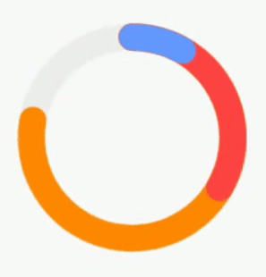
Canvas
The library is used to achieve features like custom underline on a Text view. Moreover, it can also be used to implement shapes like Rectangle, Rounded Rectangle, Paths, Circles and other Drawable shapes.

Slide 3
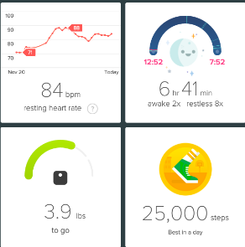
Activity Tracker
This need some kind of tool to track the daily activities of a person and other important parameters. Nowadays, fitness trackers have especially become very important.
The library would enable several kind of trackers which would help the user track his/her daily activities with much more ease and accuracy.

Slide 4

Image Loading Library
The library helps to avoid high memory consumption caused by loading multiple images at the same time. Improper implementation can cause memory overflow issues. It minimizes memory usage to give a better user experience.

Slide 5
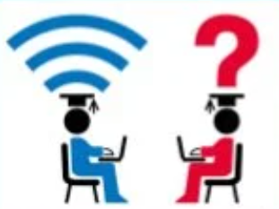
Networking Library
Nowadays, almost every mobile app needs some sort of network communication to perform some type of functions.
When fetching data from APIs that return large amount of data, we need to optimize the different threads and device resources appropriately.
So the Networking library would be responsible for handling the optimization.

Slide 6
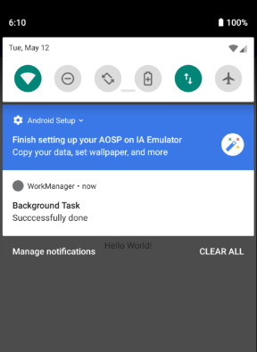
Background Work Manager
Some applications require the system to run even if the app is closed
This library is helpful in background processing to run background tasks in an effective manner. We can enqueue our background work without opening the app to work (even in case of restarting the device).

