Slide 1
EEG-Based Emotion Recognition
By Group 7:
Suvam Paul (2019EE10536)
Shubham (2019EE10529)
Dyuti Bharadwaj (2019EE10475)
Sarang Dev (2019EE10519)

Slide 2
Outline of the presentation
Introduction
Motivation
Data Description
Feature Selection
Wavelet Packet Decomposition (WPD)
Data Models
Performance Comparison
Conclusion

Slide 3
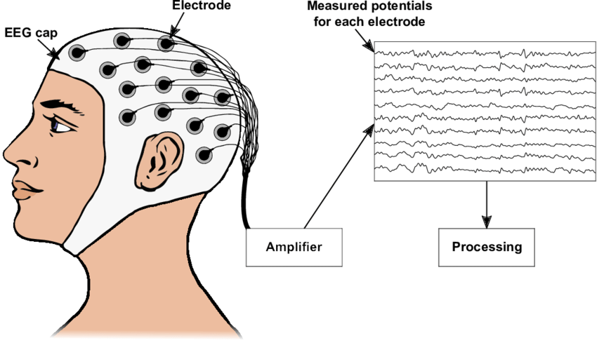
Introduction
In this work, a new emotion recognition model using wavelet packet energy features using electroencephalography (EEG) data has been presented.

Slide 4
Motivation
Emotions are reflected in the form of physical and physiological changes in humans.
The physical signals such as facial expression and speech can be controlled to conceal the true emotions.
We utilized the methodology of emotion recognition for motor intention detection.
Emotion recognition systems with high accuracy give opportunities to study real world applications such as mental state and fatigue monitoring.

Slide 5
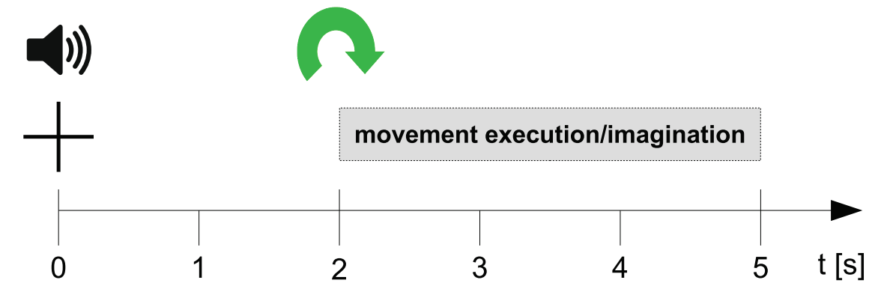
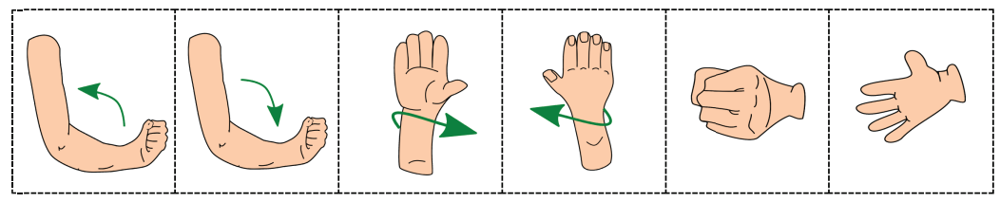
Data Description
The data set comprises of GDF files for each trial(total: 42) and run(total: 10).
The EEG was measured from 61 channels covering frontal, central, parietal and temporal areas using active electrodes.
Sampling frequency = 512Hz
6 movement classes + 1 rest position

Slide 6
Feature Selection/Extraction
Feature: Wavelet packet energy of the sub-bands
Features were extracted corresponding to four EEG frequency sub-bands
Delta: 0-4Hz
Theta: 4-8Hz
Alpha: 8-13Hz
Beta: 13-20Hz
Wavelet packet decomposition(depth-6) was used.

Slide 7
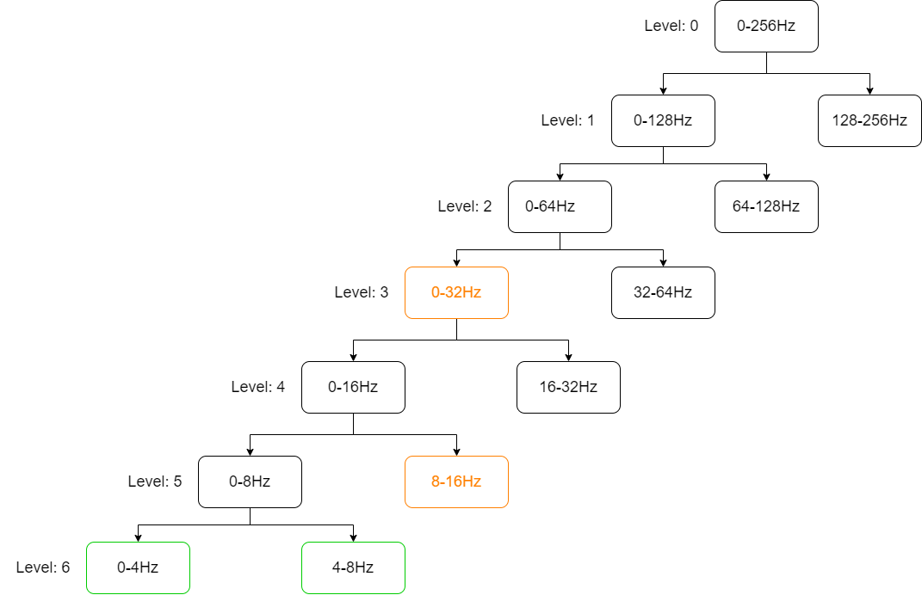
Wavelet Packet Decomposition (WPD)
WPD decomposes both high and low frequencies into two subspaces and generates a balances binary tree structure.
Delta: 0-4Hz
Theta: 4-8Hz
Alpha: 8-13Hz
Beta: 13-20Hz

Slide 8
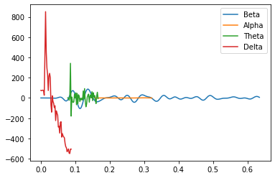
Sample extracted data signal( 1Channel, 1 Trial) for representational purpose
Magnitude
Time

Slide 9
Data Models
Performance of following three models is compared:
1-D CNN: Kernel slides along one dimension, so it’s used mostly for time series data.
LSTM: A type of RNN, also used for sequential learning, has memory cells to store previous values.
CNN – LSTM: Hybrid model developed by combining the convolutional neural network (CNN) with the long short-term memory (LSTM).

Slide 10
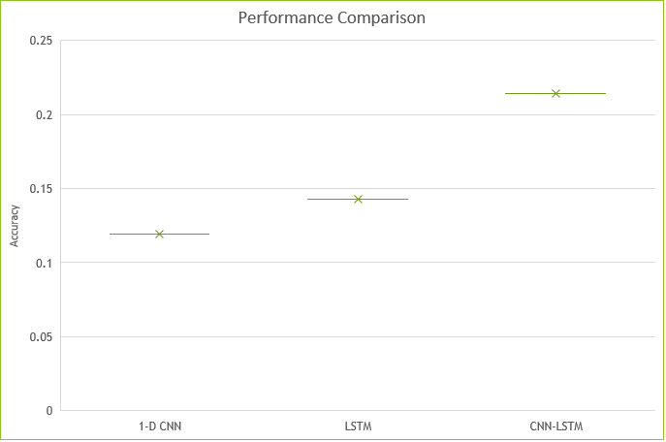
Performance Comparison

Slide 11
Conclusion
Among the three classifiers used, double layered CNN-LSTM is found to perform the best as compared to other two methods.
The classification accuracy can be improved by changing the EEG time segment.
The data is insufficient to train the current deep learning architecture (60 trials per class), hence we need to modify the architecture of the learning models.

