Slide 1
Raising Cybersecurity Awareness: Using Gamification and AI Nudging Supported by Cyber Law.
Name of Authors : 1. Piyush A. Gandhi (Author),
2. Asawari P. Shinde (Co-Author).
Year & Department Name : Third Year, Computer Engineering.
Institute Name : Trinity Polytechnic, Pune (1734) - MSBTE.
Guide Name : Rahul D. Dhongade.

Slide 2
INTRODUCTION
Rising Threat: Phishing attacks via malicious links remain one of the top cybercrimes globally and in India (APWG & CERT-In 2024–2025 reports).
India Context: High mobile usage + rapid growth in WhatsApp, Telegram, UPI fraud → millions at risk daily.
Awareness Gap: Traditional methods (posters, videos, workshops) are passive → low engagement & poor long-term retention.
Power of Gamification: Serious games proven to improve knowledge through interaction between system & User.

Slide 3
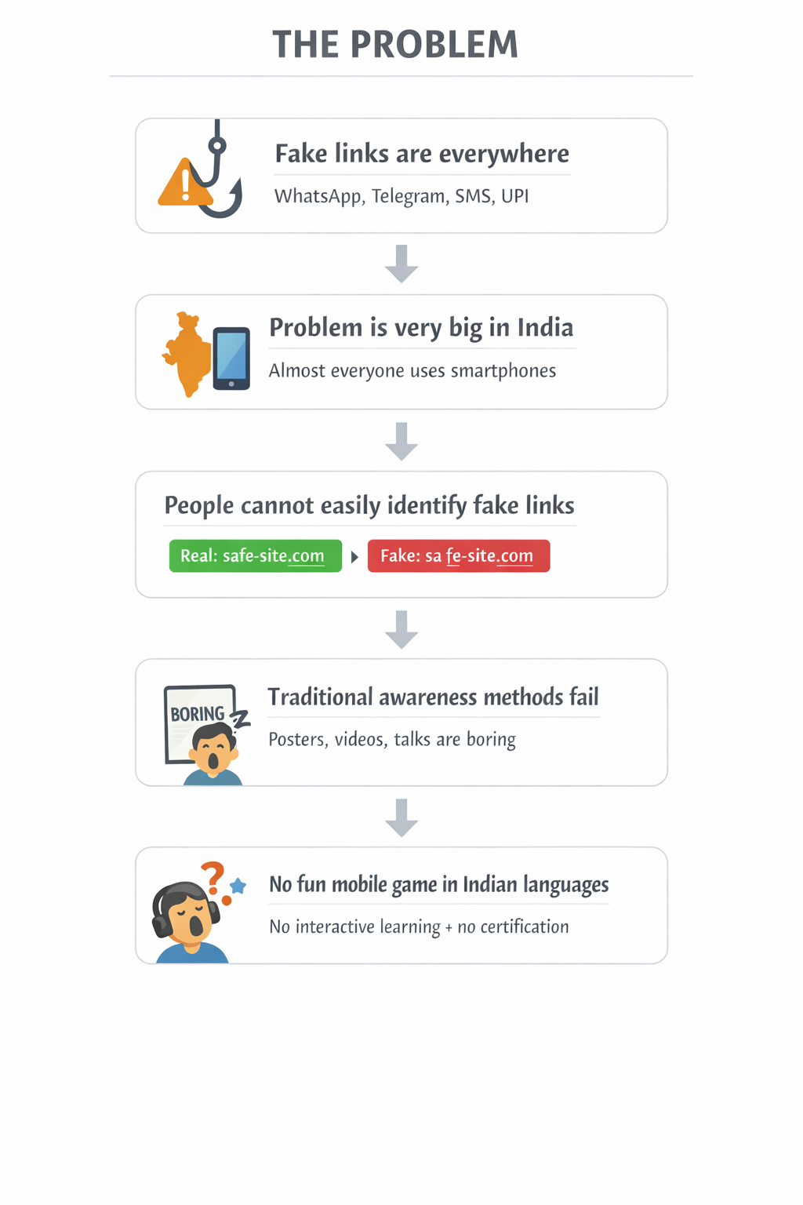
PROBLEM STATEMENT

Slide 4
EXISTING SYSTEM
Majority of users fail to detect sophisticated phishing URLs (typosquatting, homoglyphs, fake subdomains, encoded URLs, shortened links).
Low cybersecurity literacy among non-technical Indian users.
Existing tools are mostly English-only, passive, and lack India-specific context (UPI, regional apps).

Slide 5
PROPOSED SYSTEM
100 levels + 20-question final quiz.
3 lives per level, streak scoring, badges.
Rule-based fake link generation. (for ex: grnail.com = m)
Multilingual UI (13 Indian languages).
Secure quiz mode (anti-exit, anti-screenshot).
Digital certificate (PDF/JPG + QR verification).
Indian focus: I4C, 1930 helpline, cybercrime.gov.in, CERT-In, regional language support.

Slide 6
LITERATURE SURVEY
Author (Year) | Domain / Focus | Methodology / Techniques | Key Contributions | Remarks / Limitations
Sheng et al. (2010) | Phishing education via games | Game-based training (Anti-Phishing Phil), user study | First widely cited serious game for phishing; improved recognition rates by ~40% in short term | Web-based prototype, English-only, no mobile version, short-term retention only
Kumaraguru et al. (2007) | Phishing susceptibility & interventions | User studies, training materials, embedded training | Showed that embedded training (in-context warnings) outperforms mass training | Focused on email phishing; no mobile or link-specific focus; dated dataset
Alkhushayni & Lee (2025) | Multilingual / low-resource sentiment analysis | Translation augmentation + SVM / pre-trained models | Improved cross-lingual generalization for low-resource languages (including some Indian languages) | Primarily sentiment analysis (not phishing); e-commerce focus; no gamification
Mao et al. (2024) | General phishing & social engineering survey | Systematic review (PRISMA), 200+ papers | Broad categorization of phishing techniques, datasets, and countermeasures; identifies gaps | Review paper; no original implementation; limited focus on user education games
CERT-In / MeitY (2024–2025) | India-specific cybercrime & phishing trends | Annual reports, helpline data (1930), UPI fraud analysis | Documents massive rise in WhatsApp/Telegram phishing in India; recommends awareness campaigns | Official report; no technical/game-based solution; passive awareness only
Chaithra et al. (2025) | Financial phishing & sentiment in news | Instruction-tuned LLMs + RAG + Reinforcement Learning | Improved detection of financial phishing in news/articles; supports real-time decision making | Finance/news domain only; no user-facing game or training component

Slide 7
OBJECTIVES
To design and develop an interactive mobile game that effectively trains users to detect phishing and malicious links in real-world scenarios.
To implement a realistic fake link generation system using a rule-based mutation algorithm tailored for Indian social media and messaging platforms.
To prominently promote Indian cyber helplines (e.g., I4C 1930) and resources within the app to encourage immediate action in real incidents.
To evaluate the game’s effectiveness in improving phishing detection skills through simulated training and user feedback in an Indian context.

Slide 8
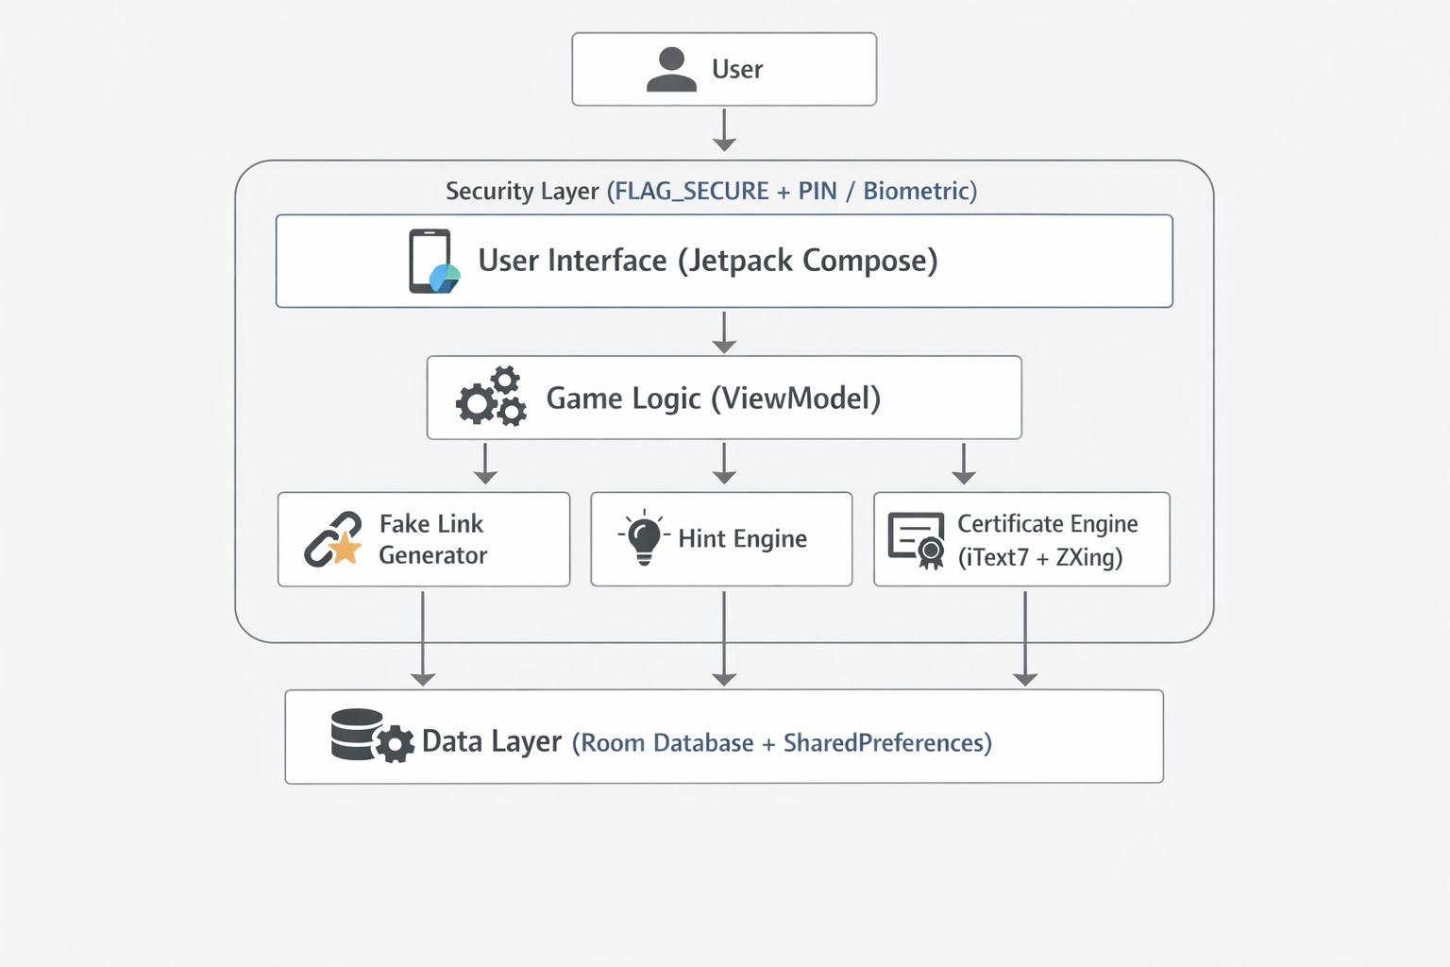
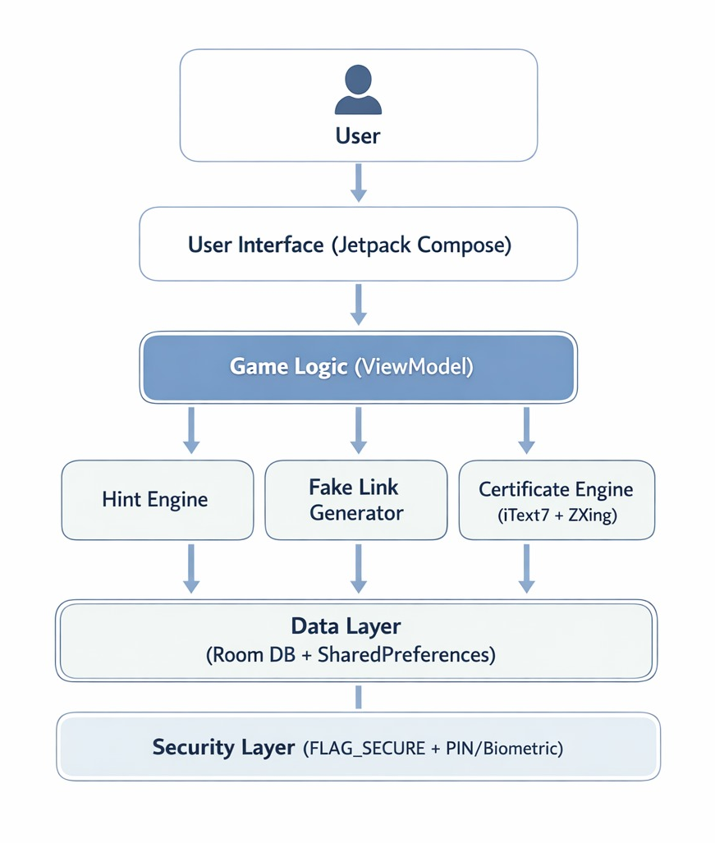
SYSTEM ARCHITECTURE

Slide 9
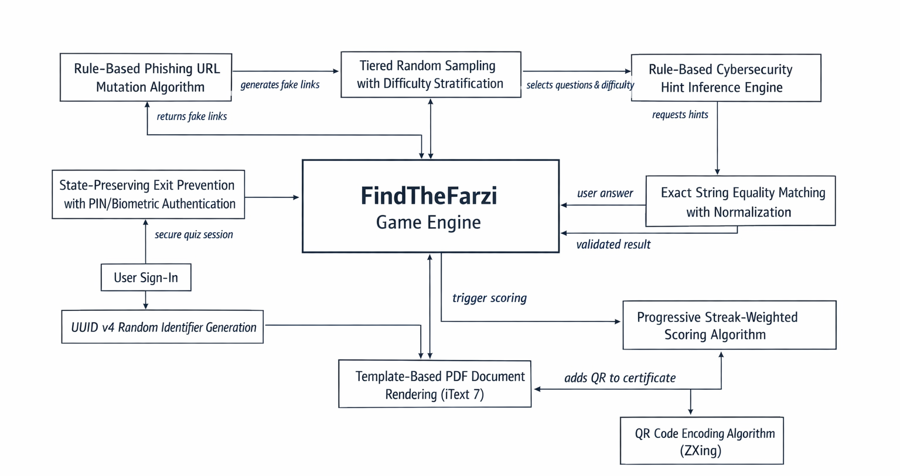
METHODOLOGY
Player ID

Slide 10
FUTURE SCOPE
iOS version (SwiftUI / Flutter).
Multiplayer / friend challenge mode.
On-device ML for real-time link analysis.
Integration with CERT-In / I4C threat feeds.
AR mode (scan real QR codes).
Voice-guided hints in regional languages.
Global leaderboard & social sharing.

Slide 11
CONCLUSION
Effective Gamification: FindTheFarzi transforms complex phishing detection into an engaging, repeatable mobile game, significantly improving user retention and skill acquisition compared to traditional awareness methods.
India-Centric Innovation: With multilingual support (13 languages), realistic rule-based fake link generation, and prominent promotion of I4C 1930 helpline, the app addresses the unique needs of Indian smartphone users.
Secure & Verifiable Impact: Strong anti-cheat mechanisms, verifiable digital certification with QR code, and safe simulation environment position FindTheFarzi as a credible tool with potential to reduce phishing vulnerability at scale.

Slide 12
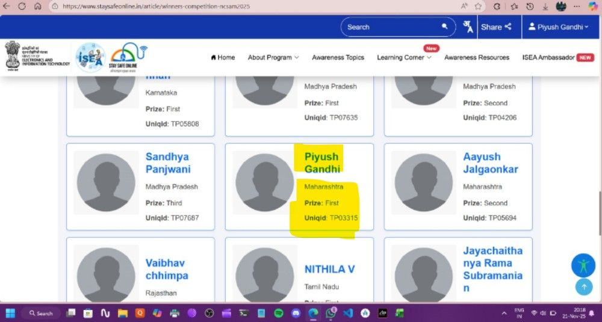
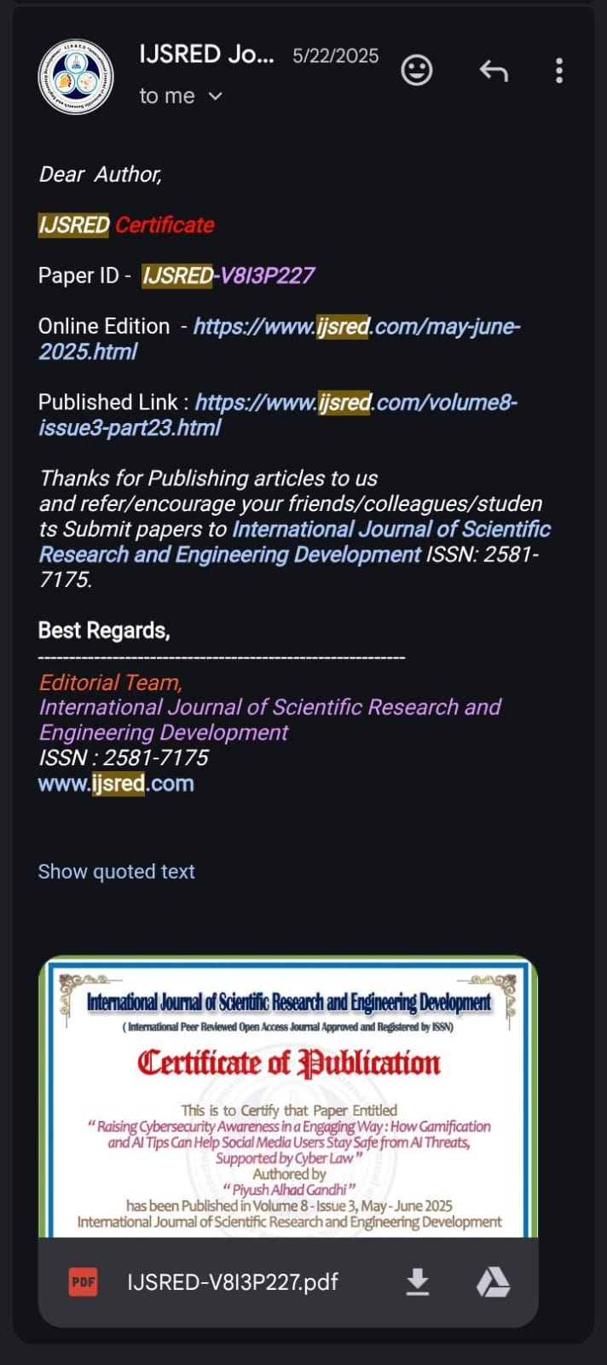
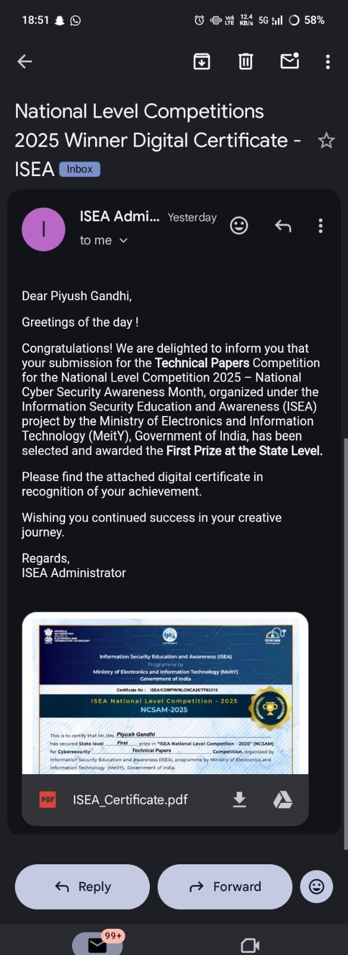
THANK YOU.
1. Paper ID - IJSRED-V813P227
2. Online Edition - LINK
3. Published Link - LINK

