Slide 1
ASL To Text Classification
By : Saurabh Chauhan & Jeevan Aher

Slide 2
Agenda
Introduction
Project Overview
Model used : VideoMAE
Internal Architecture of VideoMAE
Challenges faced & solution
Conclusion

Slide 3
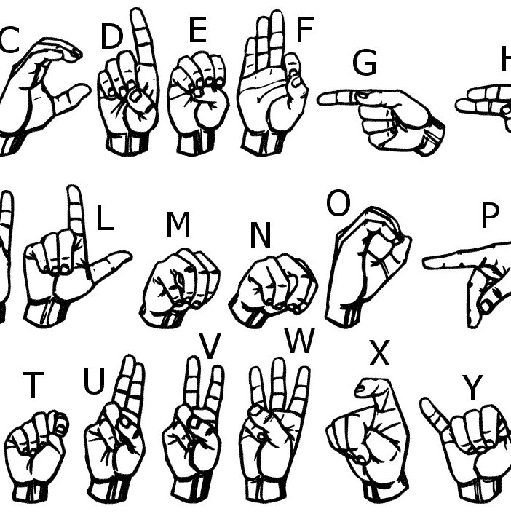
American Sign Language (ASL) to text conversion. Goal: Classify hand signs into corresponding text. Application: Helps bridge communication gaps.

Slide 4
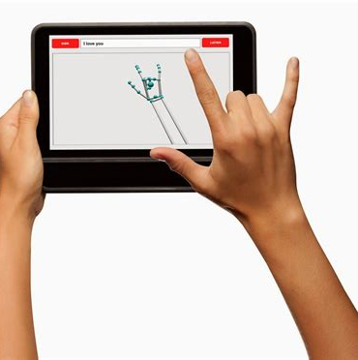
Project Overview
Input: Video of person performing ASL signs.
Model: Fine-tuned VideoMAE.
Output: Predicted text label of sign.

Slide 5
Model Used - VideoMAE
Masked Autoencoding Approach
Learns video features by reconstructing masked patches.
Requires no labeled data for pretraining (self-supervised learning).
High Masking Ratio
Around 90% of input video patches are masked.
Forces the model to learn strong spatial and temporal representations.
Vision Transformer (ViT) Backbone
Adapts ViT for videos by processing spatiotemporal patches.
Captures both appearance (spatial) and motion (temporal) information.
Handles Short and Long Videos
Effective temporal modeling allows it to deal with both short clips (like ASL signs) and longer videos.

Slide 6
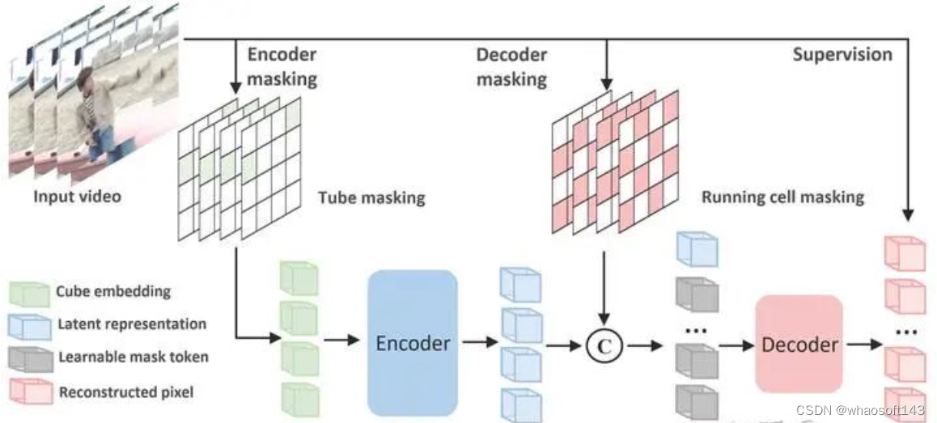
Internal Architecture of VideoMAE

Slide 7
Challenges Faced & Solution
Real-time camera feed inference attempted.
Issue: Model caused lag due to high resource demands.
Local system was not powerful enough.
Instead of real-time:
Recorded video used.
Extract frames from recorded video.
Process video to 16 frames using Universal Temporal Subsampling.

Slide 8
Conclusion
Fine-tuned VideoMAE successfully on ASL dataset.
Managed challenges with innovative preprocessing.
High accuracy achieved.
Future Work:
- Optimize for real-time inference.

Slide 9
Thank you
Saurabh Chauhan & Jeevan Aher
schau57@uis.edu
jaher5@uis.edu

