Slide 1
Introduce My Project – Rabbit Emp
Whitedodo https://github.com/whitedodo/rabbitEmp/
This article has been to using the font “Nanum gotic”

Slide 2
Content of Tables
1. Introduce
2. UML Design
3. Data Structure
4. Demonstration of work
5. Questions and answers

Slide 3
1. Introduce
Subject | Rabbit Emp(직원 관리 프로그램)
Goal | 직원 추가, 삭제, 조회를 할 수 있는 시스템 구현
Using the program | C++(mingw GCC)

Slide 4
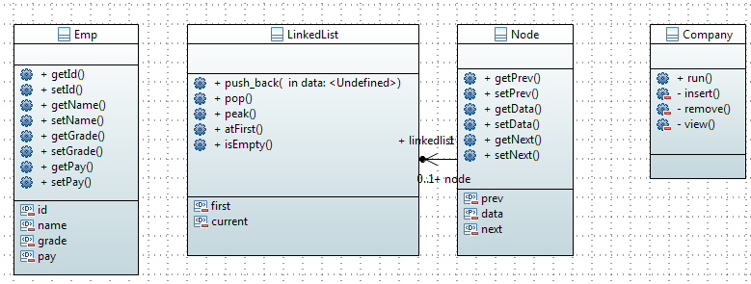
2. UML Design

Slide 5
3. Data Structure
Linked List
data | next
data | next
data | next
 | NULL
• Modified the existing structure and added the prev node.
data | prev | next
data | prev | next
data | prev | next

Slide 6
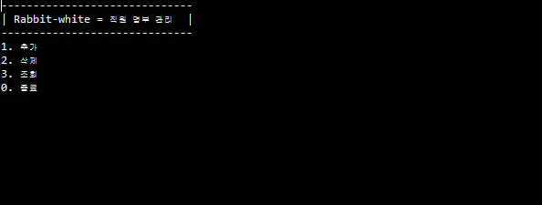
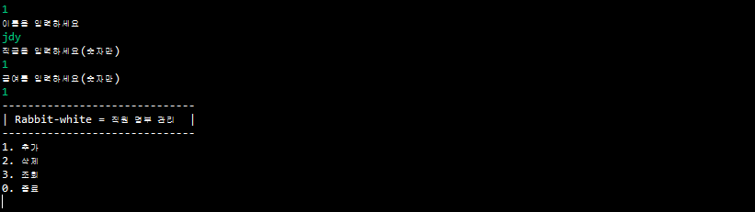
4. Demonstration of work
1. Main
2. Function: Add

Slide 7
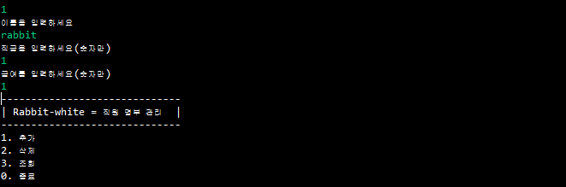
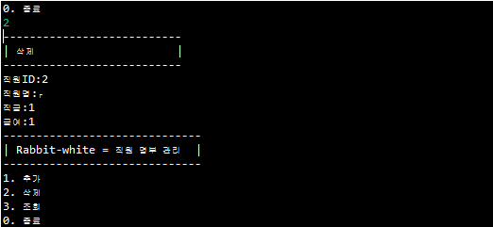
4. Demonstration of work
3. Function: Add
4. Function: Delete

Slide 8
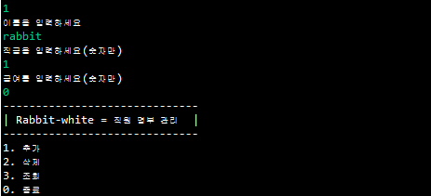
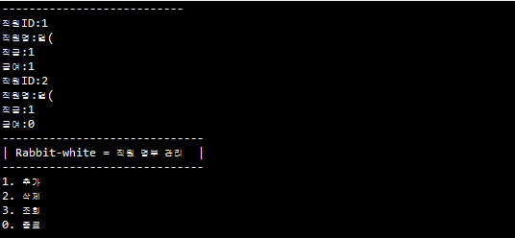
4. Demonstration of work
5. Function: Add
6. Function: Search

Slide 9
5. Question And Answer

