Slide 1

Azure Key Vault & API Management
Robert Meyer
FULLSTACK-DEVELOPER
@roeb

Slide 2
Secure your Serverless Services
Best Practices:
Require HTTPS
Use Function Keys and never anonymous Functions
Authorization with OpenID/OAuth
Restrict CORS
Disable Remote Debugging
Managed Identities
Managing Secrets
Azure API Management Services

Slide 3


What we look at
Azure API Management Services
Azure Key Vault

Slide 4
Azure Key Vault: What it is
Solve the following problems:
Secrets Management
Key Management
Certificate Management
Features:
Centralize application secrets
Monitor access and use
Simplified administration of application secrets

Slide 5
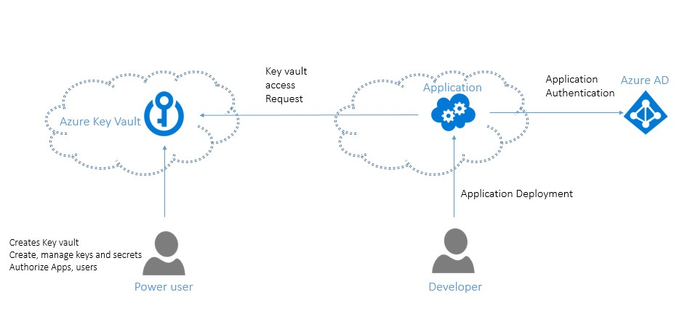
Azure Key Vault: How it works

Slide 6
Azure Key Vault: What it costs
 | Standard | Premium
Secrets operations | €0.026/10,000 transactions | €0.026/10,000 transactions
Certificate operations | Renewals—€2.530 per renewal request. All other operations—€0.026/10,000 transactions | Renewals—€2.530 per renewal request. All other operations—€0.026/10,000 transactions
Standard: Supports only Software Protected Keys and does not support
HSM Protected Keys.
Premium: Supports both software and HSM protected keys

Slide 7
API Management: What it is
Accept API calls and route them to your backends
Verifies API Keys, JWT Tokens and certificates
Enforces usage quotas and rate limits.
Logs call metadata for analytics purposes.
Manage Versioning of your APIs

Slide 8
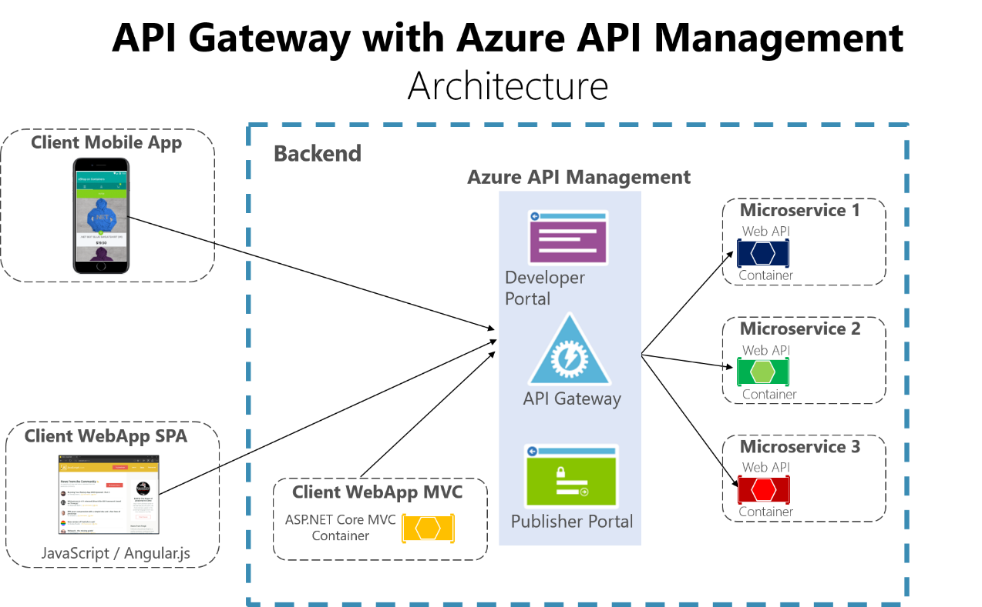
API Management: How it works

Slide 9
API Management: Tiers & Costs
Multiple Tiers available:
Consumption: Lightweight and serverless version of API Management service
Developer: Non-production use cases and evaluations
Basic: Entry-level production use cases
Standard: Medium-volume production use cases
Premium: High-volume or enterprise production use cases
Costs:
Consumption: €2.95155 per million calls (1M calls free)
Plans: €0.06 - €3.23 /hour

Slide 10

API Management & Key Vault: Demo
Explain Azure Key Vault & API Management in Azure Portal
Use Azure Key Vault with a Azure Function

Slide 11
API Management & KeyVault: Exercise
Secure your Azure Functions with Azure KeyVaults & API Management
In the last exercises you successfully built a solution based on Microsoft Azure Serverless Services. However, sensitive information is stored directly in the AppSettings of the functions and can therefore be viewed by everyone.
The goal in this exercise is to protect sensitive data and to provide it only to authorized persons & applications. We will realize this with the help of the Azure KeyVault. We will also look at how you can protect and control your Azure functions with HTTP triggers using the Azure API Management.
Link: [INSER GITHUB LINK HERE]

