Slide 1
IoT protocols and Simulation Framework
- Rahul Jadhav
LWIG-WG, IETF106, Singapore

Slide 2
What is this about?
Experience-sharing
  Untrustworthy results
    Protocols not realistic
    IEEE papers give unrealistic data
  Experiments done in limited scope
    Difficult for fellow-researchers to try different settings
  Comparative analysis is difficult
My context
  Multihop mesh routing protocols
  Bigger networks (1K nodes, 16 hops), AMI scenario

Slide 3
What we want?
Requirements
  Benchmarking performance
  Reproducible data
  Data under realistic network conditions
  Data with real-world IoT network stacks
  Interop tests
  Shareable scenario config

Slide 4
Realistic models are necessary
Especially for wireless constrained networks
  Asymmetric links
  Impact of channel access
  Inteference and collision patterns
Performance data is important to be measured with realistic wireless modelling
  Best is to use hardware, but it may not be possible!

Slide 5
So, Yet another framework!
Cooja
  Very easy to use, good visualization, integrates contiki
  Supports Hardware Emulation!
  But not realistic: path loss and propagation models
  Cannot scale: to hundreds of nodes
NS3/Omnet++
  Realistic models
  But difficult to integrate with real-world stacks
  What about NS3-TapBridge?
Hardware Testbeds
  Indriya, FIT/IOT-Lab
  Practical data but limited scale
  Difficult to debug, limited runtimes

Slide 6
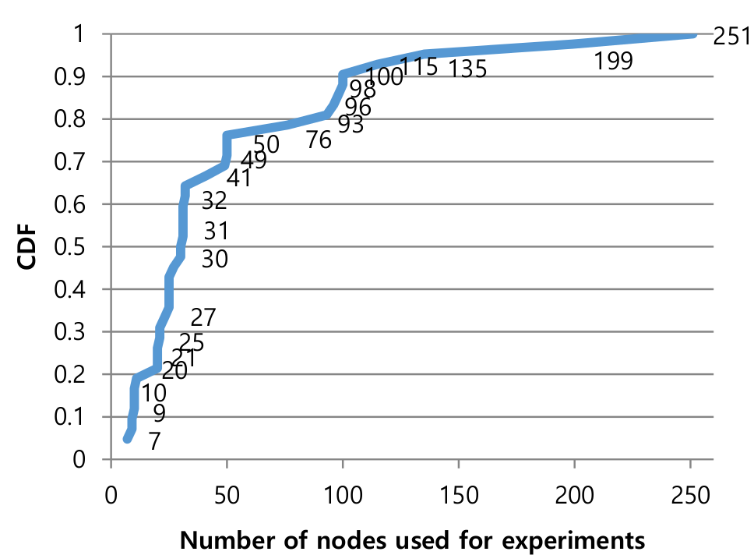
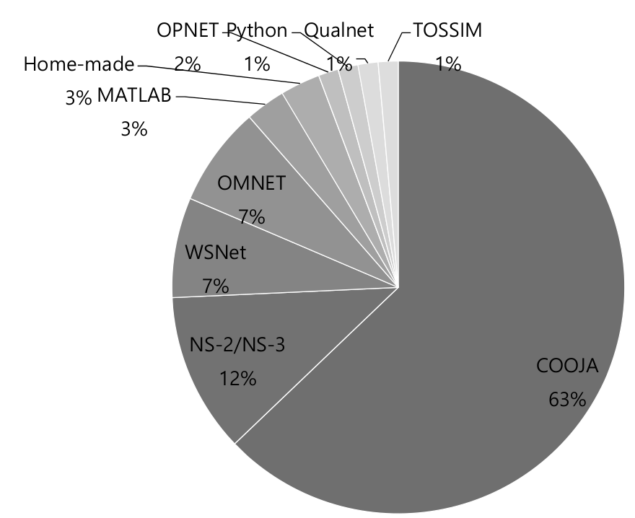
Realistic Simulation Frameworks are difficult to use
< 40% experiments used hardware nodes and in that 80% used less than 60 nodes
Cooja is the dominant tool!
Ref: Challenging the IPv6 Routing Protocol for Low-Power and Lossy Networks (RPL): A Survey, Hyung-Sin Kim et.al.

Slide 7
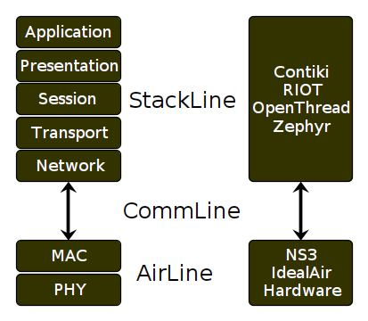
Introducing Whitefield
Started during IETF96
Design Goals
  Integrate proven wireless models with real-world stacks
  Scalable to thousands of nodes
  Can migrate to hardware using the same setup
  Cloneable setup
Stacklines supported
    Contiki, RIOT
    OpenThread (support in progress)
AirLine support
  NS3
  IdealAir (in progress)

Slide 8
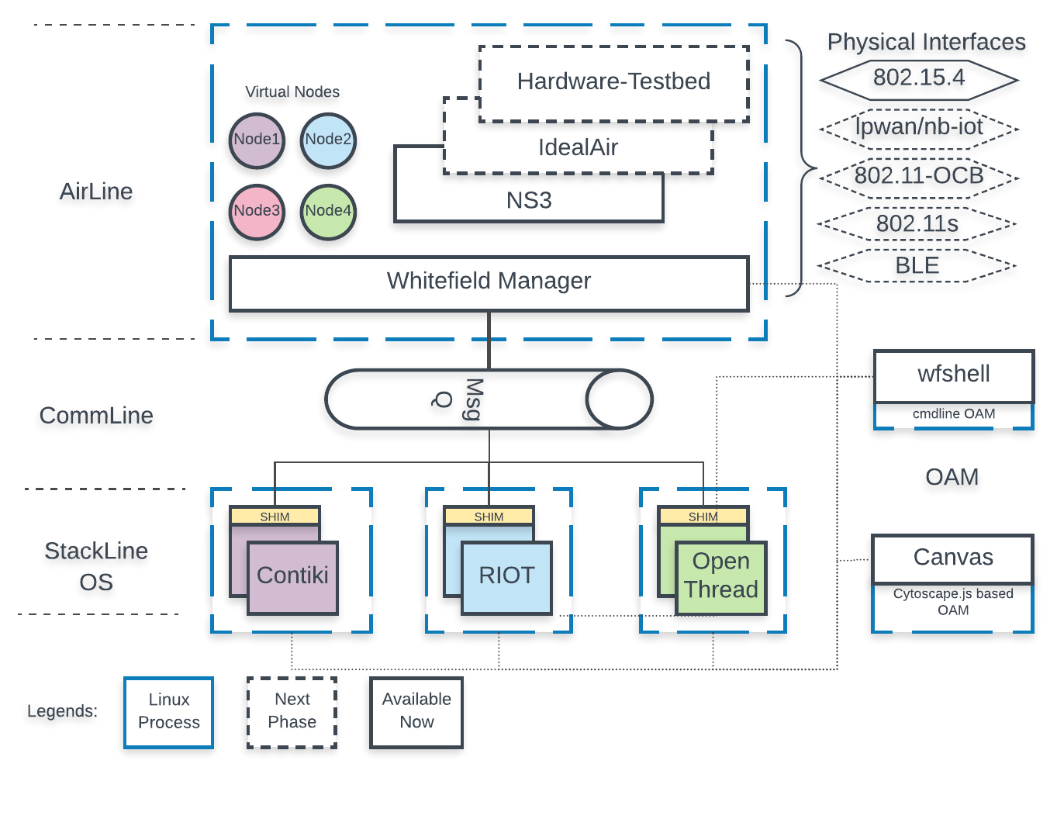
High Level Design
Contiki/RIOT/OpenThread have been added with Whitefield platform support (in whitefield org repo)
Every StackLine node is a Linux process
Mapping of StackLine node to virtual AirLine node
Whitefield orchestrates the AirLine and StackLine processes
AirLine, StackLine, CommLine decoupled
CommLine currently uses abstract unix domain sockets
Every node is identified by a unique ID
Max 60K nodes possible
Common OAM/Visualization

Slide 9
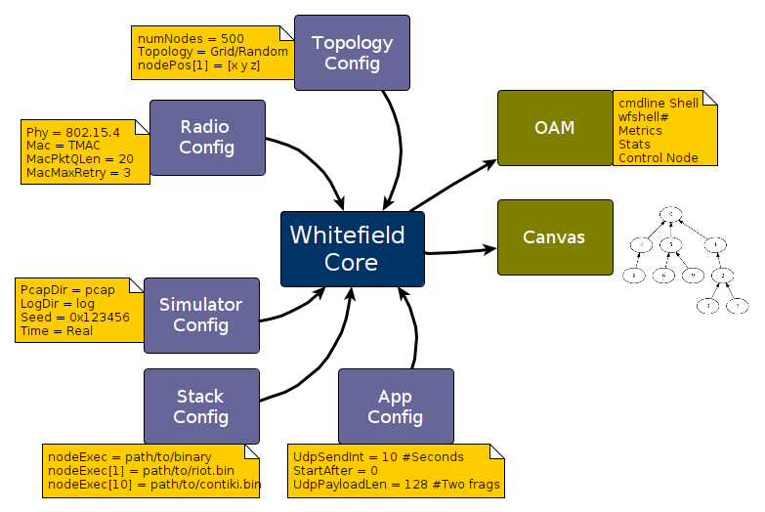

Slide 10
Case-Study-1
draft-ietf-roll-rpl-observations
  For the first time we could test interop between RIOT and Contiki at scale
    RPL DAO aggregation not handled in Contiki
    Reported RPL DAO fragmentation issue on RIOT ML (ref)
    Essentially could not interop at scale
  Network convergence time for 300 Contiki nodes
    With Cooja was <20s
    With Whitefield it was 1-2mins with very high variation depending on app-traffic
    With hardware we found similar convergence time
      We actually had 300 node hw setup!
    Control Overhead was very different

Slide 11
Case-Study-2
draft-ietf-roll-efficient-npdao
  Impact of optimized invalidation on overall network performance
  Numbers drastically vary from Cooja
    Numbers with Cooja are actually very good, but misleading

Slide 12
More Case-Studies
draft-ietf-lwig-nbr-mgmt-policy
  Impact of neighbor cache policy on the stability of the network
draft-ietf-6lo-minimal-fragment
  Impact of 802.15.4 single channel operation on fragment forwarding
Detailed setup config, observations and raw data is present on the Whitefield-framework github

Slide 13

Other work in the context
IoTBench
  “A community effort to better evaluate and compare low-power wireless network”
  Provides excellent conceptual framework
  Enlists tools and testbeds in the context
Whitefield will use the recommendations
  Organizing the suites, metrics, configuration
  Use of profiles for ease of management

Slide 14


https://github.com/whitefield-framework/whitefield
Future Extensions: https://trello.com/b/9bdugZxX/project-whitefield
Questions: rahul.ietf@gmail.com

