Slide 1
TSM
Mortgage Servicing Intelligence
A pilot proposal for First American
Live exception intelligence across the loan lifecycle — from war room triage to executive decision, in one relay chain.
TSM Consultz LLC
Confidential — prepared for pilot discussion

Slide 2
THE PROBLEM
Exceptions get found late — after they've already cost money
1
2
3
Fragmented visibility
Delayed escalation
No cost-of-inaction math
Loan-level exceptions, SLA breaches, and exposure sit in separate systems — nobody sees the full pipeline risk at once.
Issues surface at month-end review instead of the moment they cross a threshold, so the response window is already gone.
Teams can't compare "act now" vs. "do nothing" in dollar terms, so prioritization defaults to whoever complains loudest.
Result: avoidable rework, missed SLAs, and pipeline value that isn't managed — it's discovered.

Slide 3
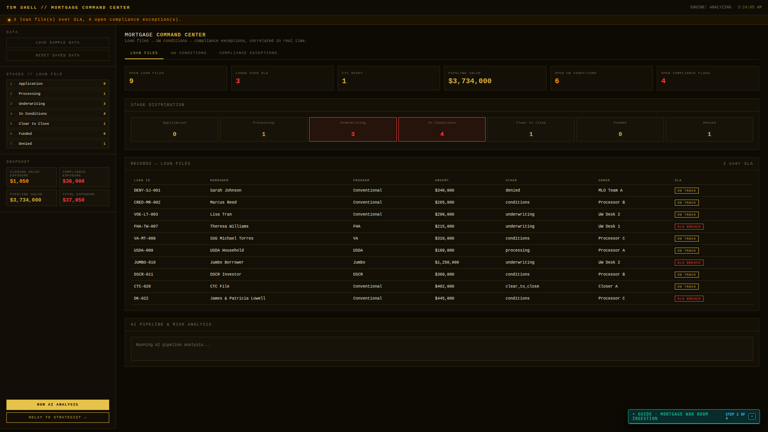
THE SOLUTION
One relay chain: War Room → Strategist → Executive Portal
War Room ingests loan-level data in real time and flags SLA breaches and exposure the moment they occur.
Strategist layer runs AI-driven prioritization — ranking exceptions by dollar impact, not just age or channel.
Executive Portal rolls everything into pipeline-level KPIs so leadership sees risk without digging into case files.
Mortgage War Room — live loan-level exceptions

Slide 4
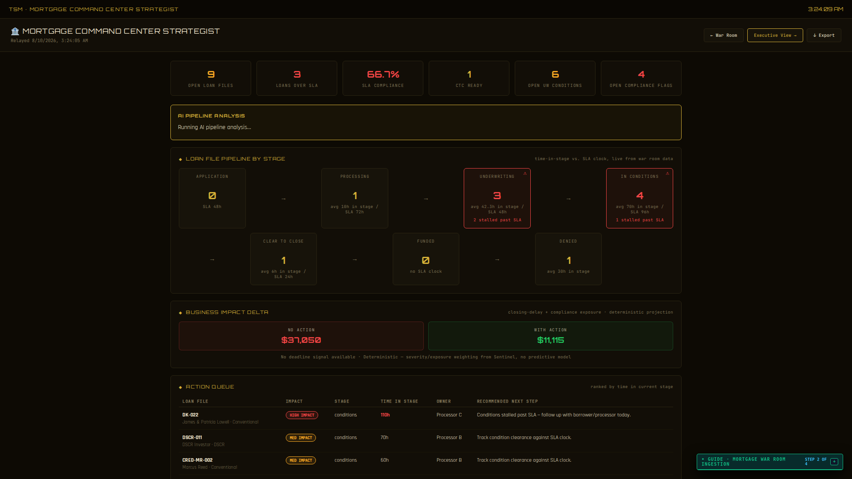
IN ACTION
The AI quantifies the cost of doing nothing
NO ACTION TAKEN
$37,050
Projected impact if this exception queue is left unworked
WITH TSM ACTION
$11,115
Same queue, worked in priority order by the strategist AI
Strategist — AI summary with prioritized action queue
That's a 70% reduction in exposure on this queue alone — from prioritization, not headcount.

Slide 5
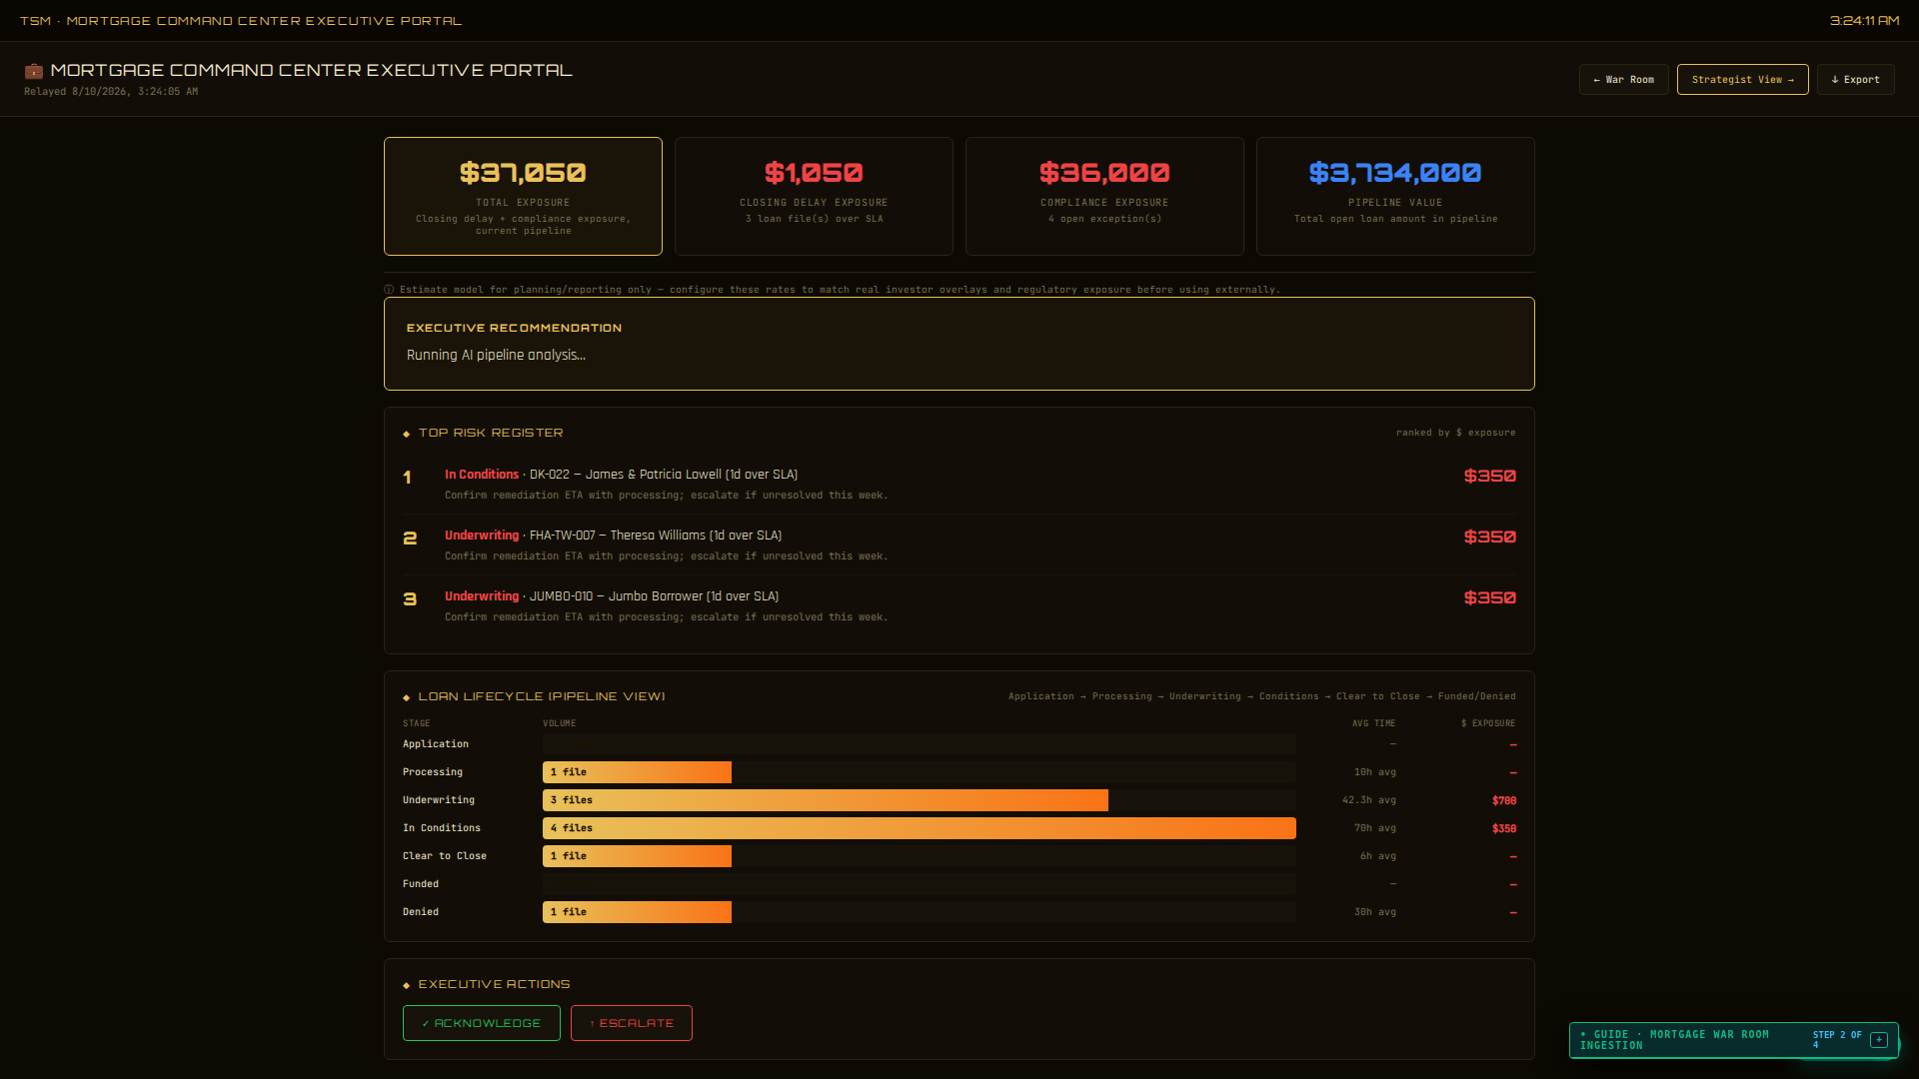
IN ACTION
Leadership sees pipeline risk at a glance
Executive Portal — live pipeline value $3,734,000, exposure and SLA breach flags rolled up in real time

Slide 6
COMING IN LIVE DEMO
Sentinel Center: continuous monitoring, live
LIVE DEMO SLOT
Sentinel Center runs on the live, Groq-backed deployment rather than static sample data —
we'll pull this screen up in real time during the walkthrough rather than show a static capture here.
Real-time queue health
Anomaly detection on AI outputs
Cross-vertical correlation
We'd rather show this working live than paste in a mockup that isn't real.

Slide 7
PILOT STRUCTURE
A phased pilot, priced to prove value first
PHASE 1 — PILOT
PHASE 2 — SCALE
$4,500
Tiered + 21%
flat, per month
branch-tiered base, plus shared-savings kicker
Full War Room → Strategist → Executive Portal chain live on your mortgage data
Branch-tiered monthly base as footprint expands beyond the pilot
No shared-savings kicker during the pilot window
21% shared-savings kicker on verified exposure reduction
Success measured against agreed SLA and exposure-reduction targets
Kicker capped at 2× the monthly base — no open-ended upside risk

Slide 8
NEXT STEPS
Let's put this in front of a real branch queue
1
Scope a pilot branch
Pick one branch or queue to connect first — real loan-level data, not a demo dataset.
2
Live Sentinel walkthrough
See the Groq-backed monitoring layer running against live data, not a screenshot.
3
Kick off Phase 1
30-day flat-fee pilot, measured against agreed SLA and exposure-reduction targets.
TSM Consultz LLC
app.tsmatter.com

