Slide 1
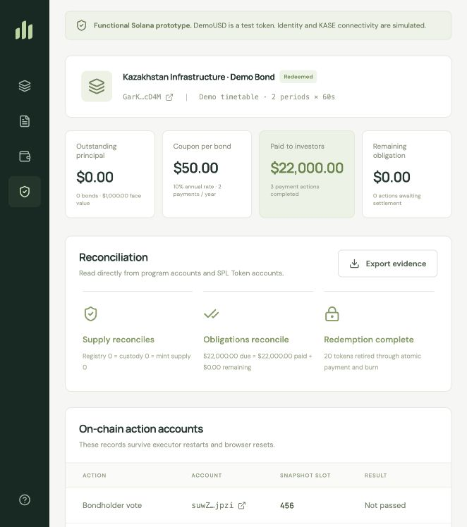
BONDOPS
Corporate actions
for tokenized bonds
Solana prototype for record dates, coupon settlement,
atomic redemption and bondholder voting
KASE × Superteam Kazakhstan
Colosseum Side Track
Notes:
BondOps pitch deck. Product screenshot from the working local Solana prototype.

Slide 2
THE OPERATING GAP
A token is only the beginning of a bond lifecycle
Bond issuers must determine rights, calculate money due and prove every outcome after issuance.
Without a controlled record
Without durable settlement state
Without atomic redemption
A transfer near the cutoff can make the eligible holder unclear.
Retries and interrupted batches can lead to inconsistent records or duplicated work.
Principal payment and bond retirement can become separate operational events.
BondOps keeps the entitlement, payment and retirement state in Solana program accounts.
BONDOPS | KASE × SUPERTEAM KAZAKHSTAN
02
Notes:
The challenge is servicing after token issuance. BondOps focuses on the action lifecycle rather than initial token creation.

Slide 3
END-TO-END FLOW
Four on-chain stages cover the bond lifecycle
The issuer queues actions before their record dates. The program controls the sequence and preserves the resulting state.
1
2
3
4
Issue
Record date
Settle
Redeem
Create the SPL bond mint and controlled holder registry.
Freeze transfers at the cutoff and snapshot eligible balances.
Fund the action vault and pay each immutable entitlement.
Pay principal and burn the matching bond tokens atomically.
Additional action included: snapshot-weighted bondholder voting with a 50% quorum and strict majority.
BONDOPS | KASE × SUPERTEAM KAZAKHSTAN
03
Notes:
The prototype includes the three required scenarios: coupon payment, bond redemption and voting as an additional corporate action.

Slide 4
RECORD DATE
The program protects ownership at the contractual cutoff
A late executor cannot alter historical entitlement ownership by taking a snapshot after transfers have happened.
Before cutoff
Record date
Snapshot
Settlement
Transfers are allowed
Transfers freeze
Balances and amounts become immutable
Each holder receives the recorded amount
Example: a seller who transfers after the snapshot keeps that coupon entitlement. The buyer receives rights from the next eligible record date.
BONDOPS | KASE × SUPERTEAM KAZAKHSTAN
04
Notes:
The record-date snapshot determines the entire coupon entitlement in this prototype. It does not calculate accrued interest split pro rata at a trade date.

Slide 5
SETTLEMENT
Funding and payment stay traceable and resumable
A separate token vault supports each action. The program requires full funding before the first beneficiary payment.
Fund
Issuer deposits the entire obligation into the action vault
Pay
Program transfers the exact snapshot amount and writes a paid flag
Resume
A new executor skips paid entries and continues the interrupted batch
Result: every action account preserves entitlement quantities, amounts, paid status and settlement timestamps.
BONDOPS | KASE × SUPERTEAM KAZAKHSTAN
05
Notes:
The chain demo includes a partial coupon settlement, a reload, a resumed batch and a duplicate-payment rejection.

Slide 6
VERIFIED OUTCOME
Maturity closes the instrument with reconciled on-chain records
Each redemption entry transfers principal, reduces the registry position and burns the same bond quantity in one transaction.
$22,000
20
0
DemoUSD paid to investors
Bond tokens retired
Outstanding supply after redemption
The audit screen reconciles registry quantity, custody balance, bond mint supply and every action obligation.
BONDOPS | KASE × SUPERTEAM KAZAKHSTAN
06
Notes:
These final demo results are captured in docs/evidence/browser-audit.json. The program was executed on local Solana validator with real SPL Token CPIs.

Slide 7
READY FOR THE KASE SIDE TRACK
What the judges can verify
1
Working source
github.com/whitehercig/bondops
2
Three required flows
Coupon payment, redemption and voting
3
Technical explanation
Architecture, snapshots, formulas and settlement boundary
4
Demo proof
Audit view, transaction records and exported evidence
Record the 3–4 minute walk-through from docs/DEMO_SCRIPT.md
and attach its hosted link in the Colosseum form.
BondOps
Notes:
Close with source repository, demo video and clear implemented versus simulated boundary. Do not claim a public deployment unless the video shows it.

