Slide 1
Deep Neural Networks
Janghun Jo Geonung Kim
Computer Graphics Lab.

Slide 2

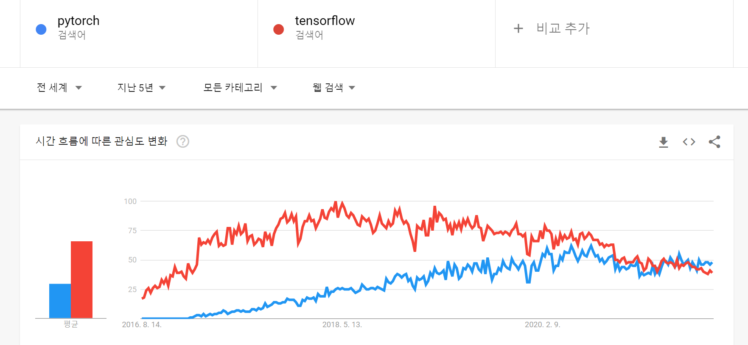
Pytorch
Deep Learning Library
Open Source
Primarily developed by Facebook’s AI
From September 2016
Neural Network 학습에 필요한 전반적인 기능을 제공

Slide 3
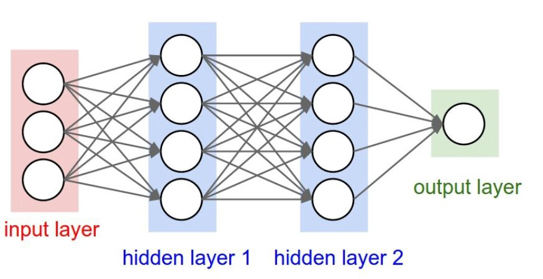
Model Training
Load dataset
Training
Inference
Loss
Gradient
Update

Slide 4
Model Training
Load dataset
Training
Inference
Loss
Gradient
Update
Loss
정답

Slide 5

Model Training
Load dataset
Training
Inference
Loss
Gradient
Update
Loss
정답
Backpropagation

Slide 6

Model Training
Load dataset
Training
Inference
Loss
Gradient
Update
Loss
정답

Slide 7
Convolutional Neural Networks

Slide 8
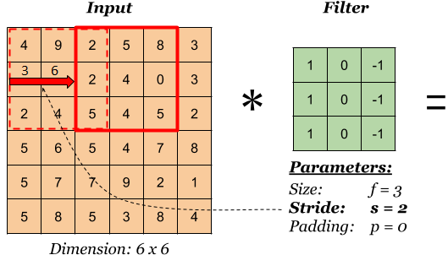
Convolutional Neural Network (CNN)
CNN Diagram GIF
https://towardsdatascience.com/a-comprehensive-guide-to-convolutional-neural-networks-the-eli5-way-3bd2b1164a53
Filter values를 최적화 과정을 통해서 찾음 (+ bias)
Input과 Output의 Dimension이 다를 수 있음
Padding과 Stride를 통해서 조절
Padding GIF
https://towardsdatascience.com/covolutional-neural-network-cb0883dd6529
[ Stride ]

