Slide 1
AWX Python VENVs as Code
A simple scalable solution for managing python virtual environments within AWX.

Slide 2
What is Ansible
Ansible is a radically simple IT automation engine that automates cloud provisioning, configuration management, application deployment, intra-service orchestration, and many other IT needs.
Designed for multi-tier deployments since day one, Ansible models your IT infrastructure by describing how all of your systems inter-relate, rather than just managing one system at a time.

Slide 3
What is AWX
AWX is an open source web application that provides a user interface, REST API, and task engine for Ansible. It's the open source version of the Ansible Tower. The AWX allows you to manage Ansible playbooks, inventories, and schedule jobs to run using the web interface.

Slide 4
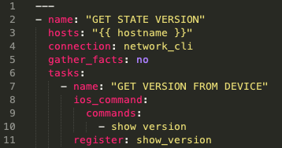
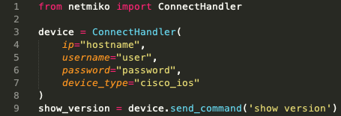
Ansible Compared to Python

Slide 5
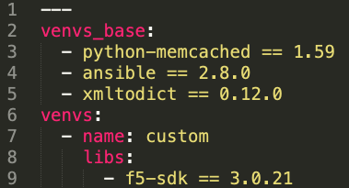
Virtual Environment Definition

Slide 6
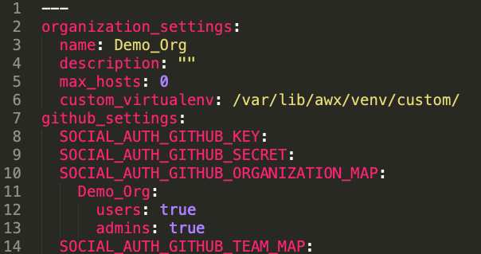
Deployment Configuration Sample

Slide 7
Repositories
Playbook Repo
https://github.com/whitej6/Demo_Repo
AWX Deployment Repo
https://github.com/whitej6/meetup_demo

