Slide 1
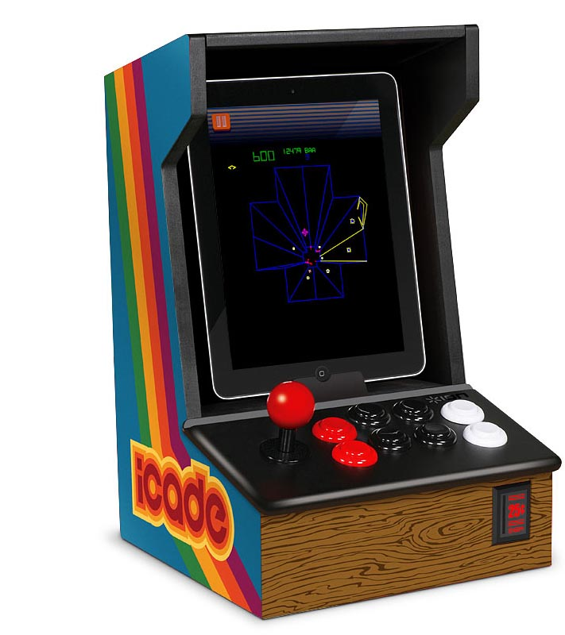
Retro Paradise
By: Lawrence Murillo
Darin McDonald
Jacob White
This Photo by Unknown Author is licensed under CC BY-SA-NC

Slide 2
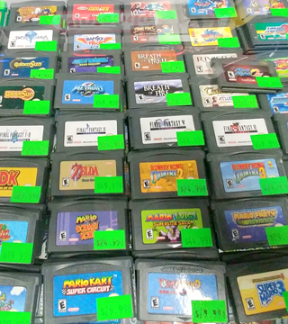
Objective
Are objectives, to make it easier for gamers to buy & sell retro games and console, online or in our store, with people who specialize and know the market to give them the best prize.
This Photo by Unknown Author is licensed under CC BY-NC-ND

Slide 3
Tech Involved
Java – Netbeans
Java FX for the GUI
SQLite/MariaDb

Slide 4
User Stories
As a customer
I want an online catalog
So I can browse store products
As an Admin
I want a database
So I can add products and check stock

Slide 5
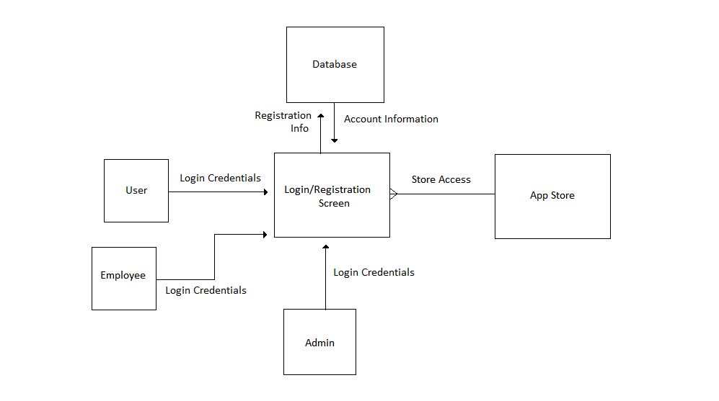
Context Diagram

Slide 6
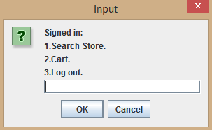
Demo

Slide 7
Questions?

