Slide 1
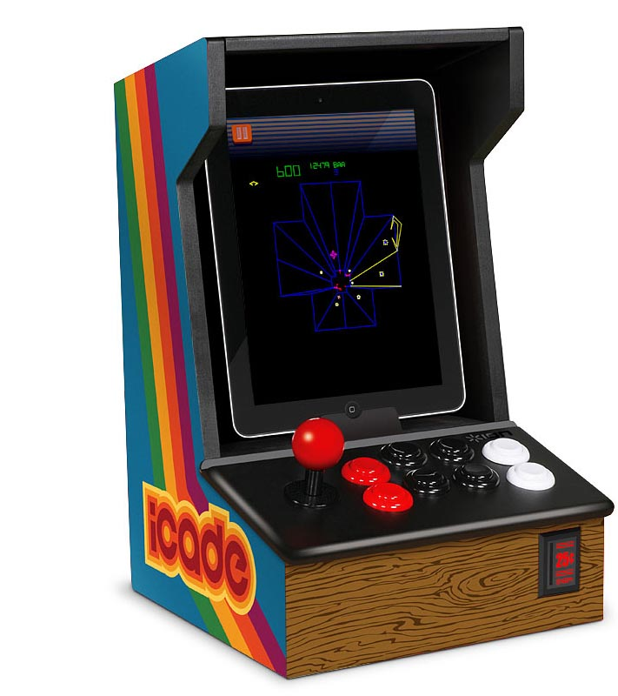
Retro Paradise
By: Lawrence Murillo
Darin McDonald
Jacob White
This Photo by Unknown Author is licensed under CC BY-SA-NC

Slide 2
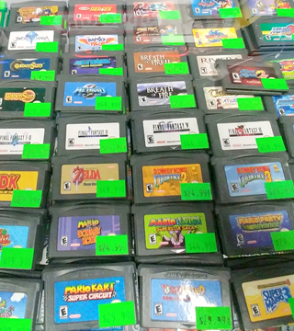
Objective
Are objectives, to make it easier for gamers to buy & sell retro games and console, online or in our store, with people who specialize and know the market to give them the best prize.
This Photo by Unknown Author is licensed under CC BY-NC-ND

Slide 3
Tech Involved
Java – Netbeans
Java FX for the GUI
SQLite or MariaDb

Slide 4
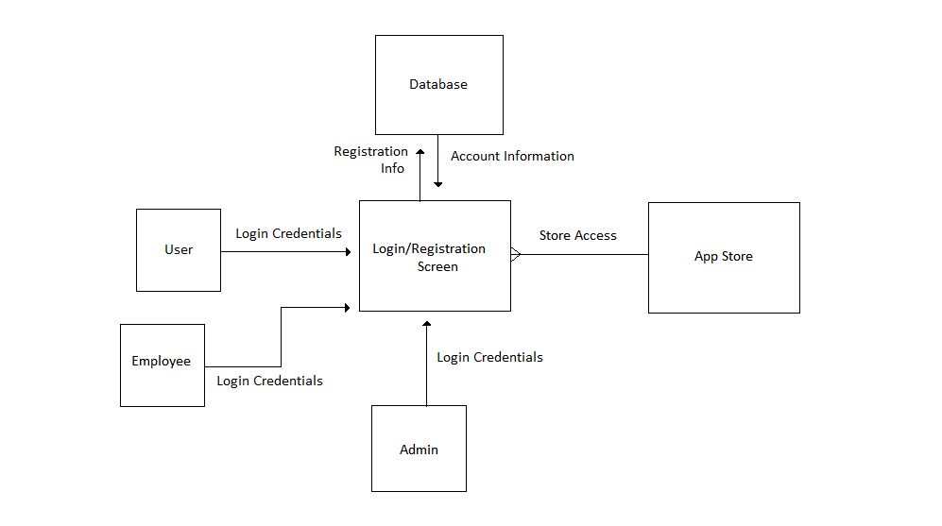
Context Diagram

Slide 5
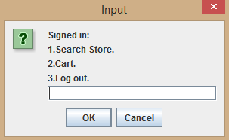
Demo

Slide 6
Questions?

