Slide 1





Milano Water Project
Rainbird ESPs
Flow Sensor
P001C
Sensor
Irrigation
S001D
Linux Server
(RPI 4)
MQTT BROKER
PyRainbird
Process
P001D
MQTT
Pressure
S001C
Flow Sensor
Monitor
Irrigation
Process
I001D
Monitor
Process
Blynk
water
Process
Sensor
Tank
S002D
MonitorMQTT
Tank Floats
S002C
Monitor
Tank
Process
Water Level
T001D
Flow Sensor
Sensor
House
S003D
Alert
Process
Blynk
Alert
Process
Pressure
S003C
Monitor
House
Process
H001D
Current SensorX4
Sensor
Wells
S005D
Log
Process
Pressure Sw
Septic Alert
S005C
Monitor
Wells
Process
W001D
Flow Sensor
Sensor
Well3
S006D
Blynk
Log
Process
Pressure
Telegraf
Process
S006C
influxDB
Monitor
Well3
Process
W002D
*future
Legend:
*future
MQTT – Data
MQTT – Command
Digital
Analog
Blynk Cloud

Slide 2
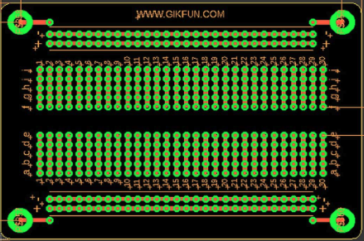

Analog Input Board I2C
12V
A3. A2. A1. A0
A3. A2. A1. A0
SDA
SCL
Vin GND
Vin GND
5V
A0 – Well #1
A1 – Well #2
A2 – Well #3
A3 – Irrigation
A0 – Irrig Pressure
A1 – House Pressure
A2 – Tank Depth Sensor
A3 – Unused

Slide 3

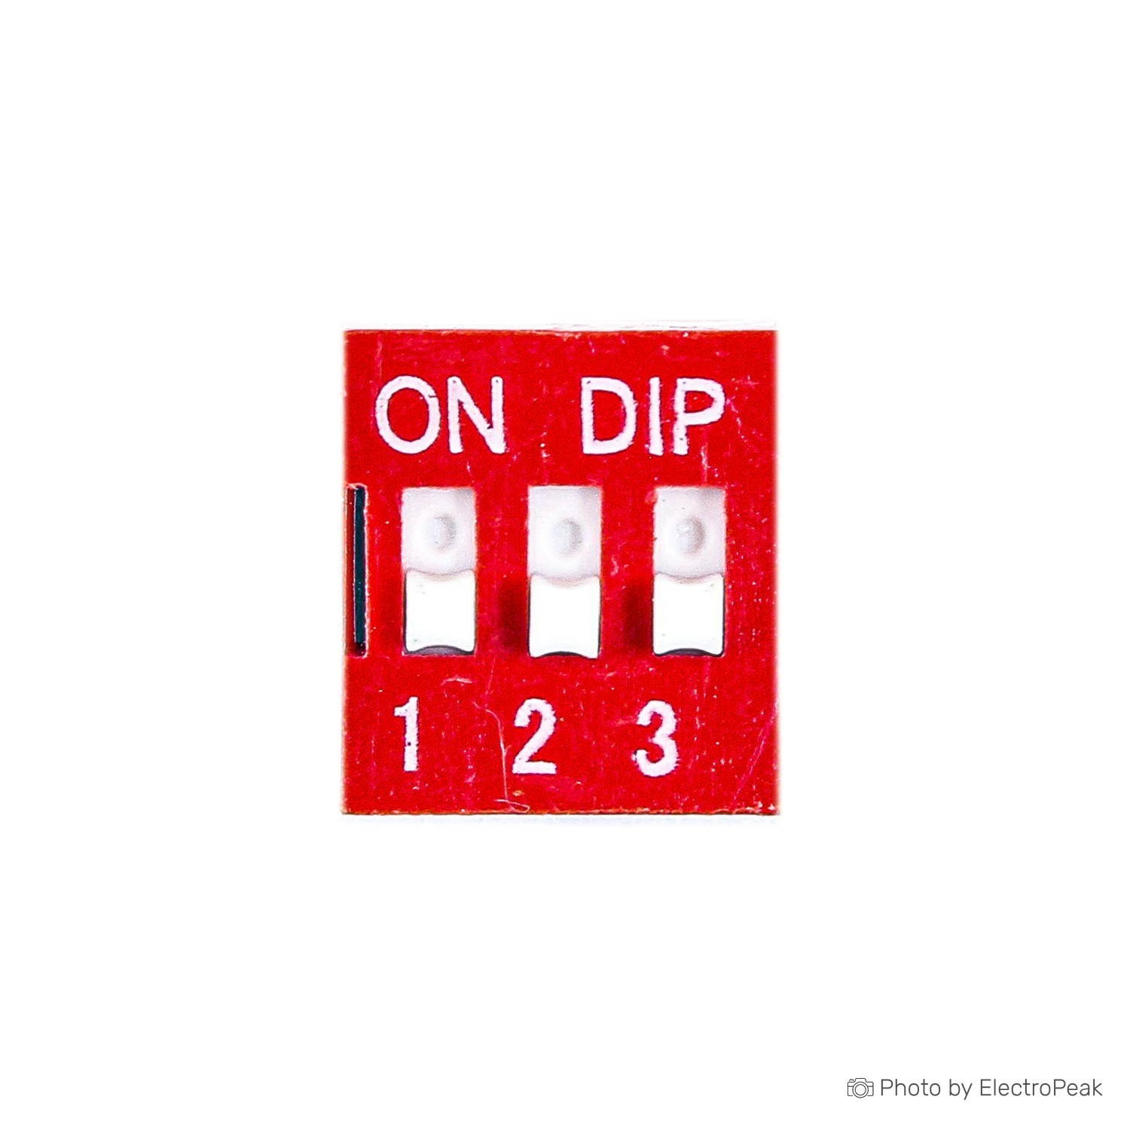

15 – Unused
14 – Disc #1
N/C
GND
14 – Disc #1
12 – Config #1
13 – FlowSensor
15 - Unused
02 - TempSens
00 - Unused
Basic I/O Board I2C
Temp, Flow, ADC
03 – Config #2
01 – Unused
16 – Disc #3 (no PUP)
05 – Disc #2
04 – Config #3
14 – Disc #1
12 – Config #1
13 – Flow Sensor
A0
+3.3V
R1 1k
Gnd
R2 2.2K
Gnd
Temp Sensor
Flow Sensor
Analog +v
+5V

Slide 4
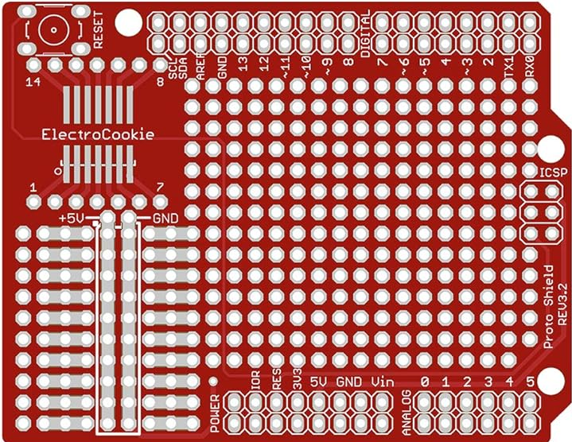
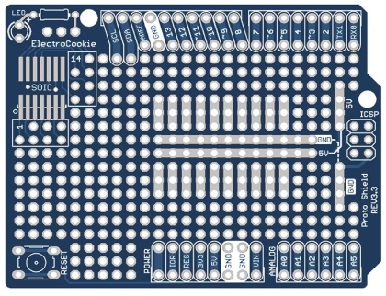
Basic I/O Board I2C
Temp, Flow, ADC
Temp Sensor
Flow Sensor
Analog +v
R1 1k
R2 2.2K
A0
+3.3V
+5V
GND

