Slide 1
Security in Automobiles: Vulnerability and Protection (OBD-II Access Control)
Master Thesis. Michiel Willems, 25/04/18

Slide 2
Outline
Introduction
OBD-II Access Control
Paper: Security, Vulnerability and Protection of Vehicular On-board Diagnostics
Introduction
Proposed Security Solutions
Current Thesis Status
Planning next two months

Slide 3
Introduction

Slide 4
Introduction
Automobile hacking has become one of the major concerns for software security today:
Over 100M lines of code deployed over more than 70 ECU’s.
Networking protocols (e.g. CAN).
Increasing connectability (Bluetooth, Wifi, etc).
Lee Pike, Jamey Sharp, Mark Tullsen, Patrick C. Hickey and James Bielman. 2015.
Securing the automobile: A comprehensive approach.
Dan Klinedinst, Christopher King. 2016
On Board Diagnostics: Risks and Vulnerabilities of the Connected Vehicle

Slide 5
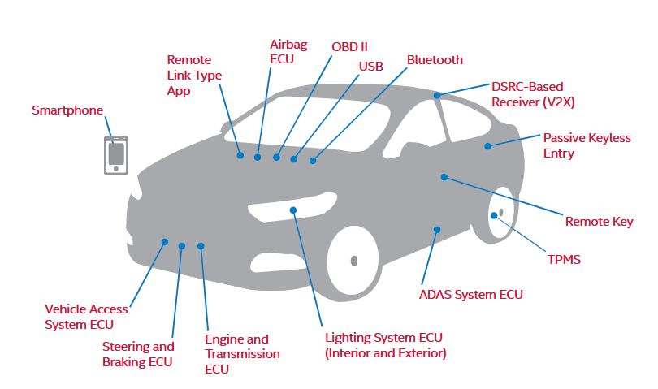
Introduction

Slide 6
Introduction

Slide 7
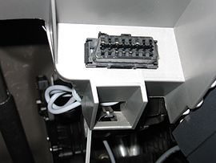
Introduction
On Board Diagnostics Protocol.
Help Technicians Diagnose and Repair Complex Problems
Allows access to vehicle subsystems via connector.
Introduces parameter ID’s (PID) to request data from ECU’s.
PID manufacturer and model specific.
Works with multiple signalling protocols, but CAN mostly used.
https://en.wikipedia.org/wiki/On-board_diagnostics
Allen Lyons, California Air Resources Board , On-Board Diagnostics (OBD) Program Overview, 2015 .

Slide 8


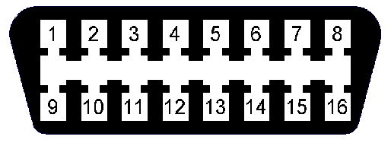
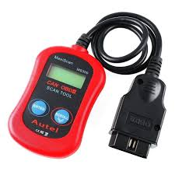
OBD-II
Vehicle Network

Slide 9
Security Issues
No source address => No certainty about origin.
Broadcast nature => Information Disclosure.
Prioritized ID’s => Denial of Service.
No support for encryption or authentication.
’CAN, by design, offers no protection from manipulation’
(Miller, 2013), (Koscher, 2010)

Slide 10
Threat Model
Physical Access to OBD-II DLC.
Ability to inject arbitrary packets.
Able to exploit vulnerabilities in ECU software.
Vehicle Network

Slide 11
OBD-II Access Control

Slide 12
Introduction
Thesis Subject: Role Based Access Control.
Every role determines what kind of access is permitted.
For example:
Repair shop => Read diagnostics information only.
Official dealership => Diagnostics + ability to fix/test faulty ECU’s.
Police => Check integrity of vehicle network.

Slide 13

Introduction
Central Gateway
Private Key
Public Key
Vehicle Network

Slide 14
Introduction
Challenges:
PKI infrastructure.
Authentication protocol (challenge response).
Permissions table.
Secure private key API.

Slide 15
Security, Vulnerability and Protection of Vehicular On-board Diagnostics
Aastha Yadav, Gaurav Bose, Radhika Bhange, Karan Kapoor, N.Ch.S.N Iyengar, Ronnie D. Caytiles
VIT University.Vellore-632014, Tamilnadu, India, Hannam University, Korea

Slide 16
Paper - Introduction
Outline:
Introduction
Motivation
Background Research
Points Entry
On-Board Diagnostic (OBD)-II Port
OBD-II Port Security Threats
Security Solution
Conclusion

Slide 17
Paper - Introduction
Outline:
Introduction
Motivation
Background Research
Points Entry
On-Board Diagnostic (OBD)-II Port
OBD-II Port Security Threats
Security Solution
Conclusion

Slide 18
Security, Vulnerability and Protection of Vehicular On-board Diagnostics
Aastha Yadav, Gaurav Bose, Radhika Bhange, Karan Kapoor, N.Ch.S.N Iyengar, Ronnie D. Caytiles
VIT University.Vellore-632014, Tamilnadu, India, Hannam University, Korea
Proposed Security Solutions

Slide 19
Security Solutions – Seed Key Algorithm
Implement security at ECU level.
Every ECU holds a secret key.
Algorithm:
Tester sends a PID to the ECU.
ECU sends a seed value to the Tester.
Both ECU and Tester calculate response from seed and secret key.
Tester sends response to ECU where it is verified.

Slide 20
Security Solutions – Seed Key Algorithm
Security Issues:
Same secret key shared.
Secret key stored in unprotected memory.
Algorithms are proprietary and Confidential (Security through Obscurity).
Seed values often too short ( 10 min to crack 16 bit seed ).
K. Koscher, A. Czeskis, F. Roesner, S. Patel, T. Kohno, S. Checkoway, D. McCoy, B. Kantor, D.Anderson and H.a.o. Shacham,
"Experimental security analysis of a modern automobile", Security and Privacy (SP), 2010 IEEE Symposium on, (2010).

Slide 21
Security Solutions – Two Way Authentication
Extends Seed-Key Algorithm.
Introduce device that allows client (owner of car) to control access to the OBD-II port.
Device can be a pager, cell phone, smartphone app, bluetooth, etc.
Device allows client to receive and send acknowledgments.

Slide 22
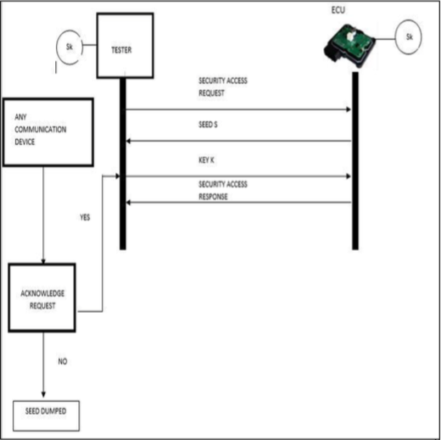
Security Solutions – Two Way Authentication

Slide 23
Security Solutions – Timer Method
Extends Two-Way authentication method.
Introduces 2 things:
Timer started once seed is received, if it runs out the client is notified.
Client needs to enter code when completing acknowledgement.
Timer should prevent brute force attacks.

Slide 24
Paper – My Issues
Solution assumes official tester device.
Custom tester software could use revealed secret keys.
Custom tester software would bypass two-way authentication.
Implementation uses small key and seed sizes.
Demo uses 5 bit seeds and keys.
ECU is implemented only virtually (no CAN).

Slide 25
Current Thesis Status

Slide 26
Current Thesis Status
2 DVK90CAN1 AVR development boards (AT90CAN128).
Gateway:
Holds public keys & permissions table.
Tester:
Implements private key API.
Authenticate & send OBD-II messages.

Slide 27
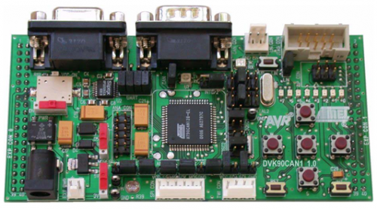
Current Thesis Status
Authentication Request.
Remote CAN frame
With Specific ID
Tester
Gateway

Slide 28
Current Thesis Status
Challenge
2 CAN Frames
128 bit Challenge
Tester
Gateway

Slide 29
Current Thesis Status
Key Attestation
8 CAN frames
512 bit Signature of Challenge
Tester
Gateway

Slide 30
Current Thesis Status
Elliptic Curve Digital Signature Algorithm.
Key Size:
Security level is Key Size / 2 (smaller key than normal DSA).
According to NSA 256 bit key sufficient (128-bit security level) .
Signature Size:
Security level is Signature size / 4.
A signature of size 512 bit will be sufficient (128-bit security level).
https://en.wikipedia.org/wiki/Key_size#cite_note-19
https://en.wikipedia.org/wiki/Elliptic_Curve_Digital_Signature_Algorithm

Slide 31
Current Thesis Status
Authentication Request.
Remote CAN frame
Acknowledgment
Tester
Gateway

Slide 32
Current Thesis Status
Send OBD-II message
OBD-II message
Tester
Gateway

Slide 33
Current Thesis Status
Former protocol is for sending 1 OBD-II message.
If multiple messages are to be sent shared secret is established:
Elliptic Curve Diffie-Hellman
Shared secret used as new symmetric key.
Every OBD-II message followed by MAC of message using shared symmetric key.
Periodically new symmetric key established.

Slide 34
Current Thesis Status
Current Implementation:
Relevant Microcontroller functions explored.
2 AVR boards can send and receive CAN messages.
Serial link between board and pc (for demo).
Elliptic Curve Library (micro-ecc) imported and tested (Key Storage).
https://github.com/kmackay/micro-ecc

Slide 35
Planning next 2 months

Slide 36
Planning
Implementation:
Finish Authentication + ECDH protocol.
Build permissions table.
Tester private key API.
represents online API for interacting with private keys.
This API should be secure!
Testing.

Slide 37
Planning
Writing:
Finishing touches: Literary Review, Background (CAN & OBD-II), Contributions, Introduction and Abstract.
OBD-II Access control (explanation of implemented protocol).
Formulation and interpretation of test results.
Conclusion.

Slide 38
Questions?

Slide 39
OBD-II
On Board Diagnostics Protocol.
Help Technicians Diagnose and Repair Complex Problems
Allows access to vehicle subsystems via connector.
Introduces parameter ID’s (PID) to request data from ECU’s.
PID manufacturer and model specific.
Works with multiple signalling protocols, but CAN mostly used.
https://en.wikipedia.org/wiki/On-board_diagnostics

Slide 40
OBD-II
Vehicle Network

Slide 41
OBD-II
OBD-II
Data Link Connector
Vehicle Network

Slide 42
OBD-II
Diagnostic
Scan Tool
Vehicle Network

Slide 43
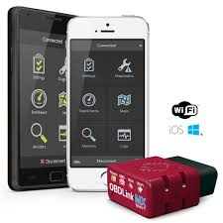
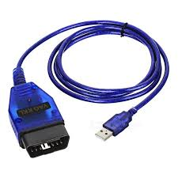
OBD-II
Scan Tools.

Slide 44
OBD-II
CAN Bus
Vehicle Network

Slide 45
CAN
Controller Area Network.
Bus allowing communications between ECU’s inside the vehicle.
Message Based Protocol (Frame).
Carrier Sense Multiple Access with Collision Avoidance (CSMA/CA).
Not only communications protocol implemented in vehicles (cf LIN, MOST) but most common.
https://en.wikipedia.org/wiki/CAN_bus

Slide 46
OBD-II
Vehicle Network

Slide 47
Security Issues

Slide 48
Security Issues
No source address => No certainty about origin.
Broadcast nature => Information Disclosure.
Prioritized ID’s => Denial of Service.
No support for encryption or authentication.
’CAN, by design, offers no protection from manipulation’
(Miller, 2013), (Koscher, 2010)

Slide 49
Security Issues
Potential hacking results.
Vehicle Theft.
Changing Emission information (“Dieselgate”).
Reduce odometer value.
Change recorded data after crash.
…
EXTREMETECH, „Hack the diagnostics connector, steal yourself a BMW in 3 minutes
Stephanie Bayer, Thomas Enderle, Dennis Kengo Oka , Marko Wolf .
Security Crash Test – Practical Security Evaluations of Automotive Onboard IT Components

Slide 50
Threat Model
Physical Access to OBD-II DLC.
Ability to inject arbitrary packets.
Able to exploit vulnerabilities in ECU software.
Enable wireless connectivity.
Vehicle Network

Slide 51
Proposed Solution: OBD-II Role Based Access Control

Slide 52
Solution
Proposed solution: Role Based Access Control.
Every role determines what kind of access is permitted.
For example:
Repair shop => Read diagnostics information only.
Official dealership => Diagnostics + ability to fix/test faulty ECU’s.
Police => Check integrity of vehicle network.

Slide 53
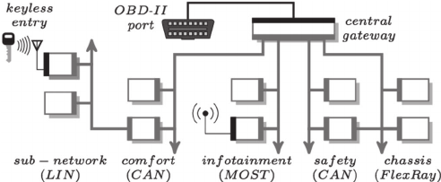
Solution
Central gateway (CGW).
Acts as router for all subnetworks + gate for all incoming data.
Perfect place to implement access control solution.

Slide 54
Solution
Central Gateway
Private Key
Public Key
Vehicle Network

Slide 55
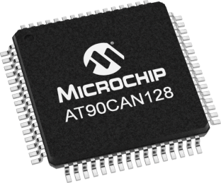
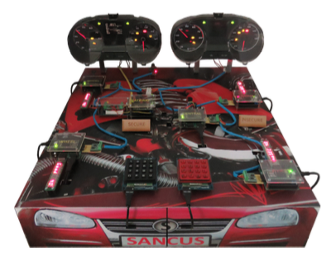
Solution
Implementation:
Microcontroller with CAN controller (AT90CAN128).
CAN Transceiver.
OBD-II connector.
Demo:
CAN testbench designed at KuLeuven for testing VulCAN.
Jo Van Bulck, Jan Tobias Mühlberg, and Frank Piessens
December 2017

Slide 56
Planning Next Three Months

Slide 57
Planning
December:
Get Familiar with Microcontroller software development.
Write December paper/poster.
January & February:
Implement a simple CAN compliant device.
Start Implementing rudimentary access control.

Slide 58
Questions? Notes: - Timing.

Slide 59
Timing difficulties.
Major Challenges!: Key infrastructure, Key size, …
No Slowing Down!!!

Slide 60
CAN Protocol

Slide 61
CAN
Controller Area Network.
Bus allowing communications between ECU’s inside the vehicle.
Message Based Protocol.
Carrier Sense Multiple Access with Collision Avoidance (CSMA/CA).
Not only communications protocol implemented in vehicles (cf LIN, MOST) but most common.

Slide 62
CAN Frame
Name | SOF | ID | RTR | IDE | r0 | DLC | Data | CRC | CRCd | ACK | EOF
No. Bits | 1 | 11 | 1 | 1 | 1 | 4 | 64 | 15 | 1 | 2 | 7
Identity Field
Used to identify each ECU in the vehicle.
Also specifies a priority (Lowest ID = highest priority).
Bitwise contention resolution (1 = Recessive & 0 = Dominant).

Slide 63
CAN Bitwise Contention Resolution
1 | 1 | 0 | 1 | 0 | 0 | 1 | 1 | 0 | 1 | 0
0 | 0 | 1 | 0 | 1 | 0 | 1 | 1 | 0 | 1 | 0
Node 1
Node 3
0 | 1 | 0 | 1 | 1 | 1 | 1 | 1 | 0 | 0 | 1
0 | 0 | 0 | 1 | 0 | 0 | 0 | 0 | 1 | 1 | 0
Node 2
Node 4
Value Transmitted: 0

Slide 64
CAN Bitwise Contention Resolution
1 | 1 | 0 | 1 | 0 | 0 | 1 | 1 | 0 | 1 | 0
0 | 0 | 1 | 0 | 1 | 0 | 1 | 1 | 0 | 1 | 0
Node 1
Node 3
0 | 1 | 0 | 1 | 1 | 1 | 1 | 1 | 0 | 0 | 1
0 | 0 | 0 | 1 | 0 | 0 | 0 | 0 | 1 | 1 | 0
Node 2
Node 4
Value Transmitted: 0

Slide 65
CAN Bitwise Contention Resolution
1 | 1 | 0 | 1 | 0 | 0 | 1 | 1 | 0 | 1 | 0
0 | 0 | 1 | 0 | 1 | 0 | 1 | 1 | 0 | 1 | 0
Node 1
Node 3
0 | 1 | 0 | 1 | 1 | 1 | 1 | 1 | 0 | 0 | 1
0 | 0 | 0 | 1 | 0 | 0 | 0 | 0 | 1 | 1 | 0
Node 2
Node 4
Value Transmitted: 0

Slide 66
CAN Bitwise Contention Resolution
1 | 1 | 0 | 1 | 0 | 0 | 1 | 1 | 0 | 1 | 0
0 | 0 | 1 | 0 | 1 | 0 | 1 | 1 | 0 | 1 | 0
Node 1
Node 3
0 | 1 | 0 | 1 | 1 | 1 | 1 | 1 | 0 | 0 | 1
0 | 0 | 0 | 1 | 0 | 0 | 0 | 0 | 1 | 1 | 0
Node 2
Node 4
Value Transmitted: 1

Slide 67
CAN Frame
Name | SOF | ID | RTR | IDE | r0 | DLC | Data | CRC | CRCd | ACK | EOF
No. Bits | 1 | 11 | 1 | 1 | 1 | 4 | 64 | 15 | 1 | 2 | 7
Data Field
Carries the payload.
Length is 64 so only 8 bytes of data in each message.

Slide 68
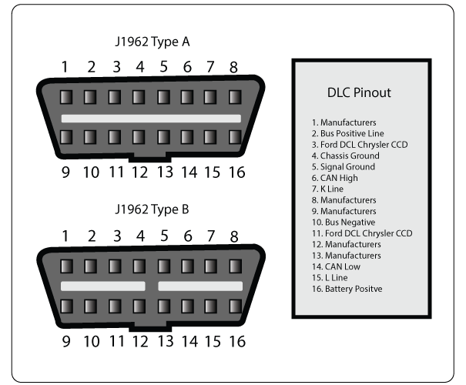
OBD-II

Slide 69
OBD-II
Parameter ID’s (PID)
Codes to request data from a vehicle.
Typical Use (with scan tool connected to DLC):
Technician enters PID on the scan tool.
PID is sent to the CAN bus (accessed via the DLC).
Some ECU recognises the PID and reports the corresponding value on the bus.
Scan tool reads response and displays it to the technician.

Slide 70
Security Issues
Potential hacking results (safety critical).
Driver Distractions (wipers etc.).
Engine shutoff.
Steering changes.
…

Slide 71
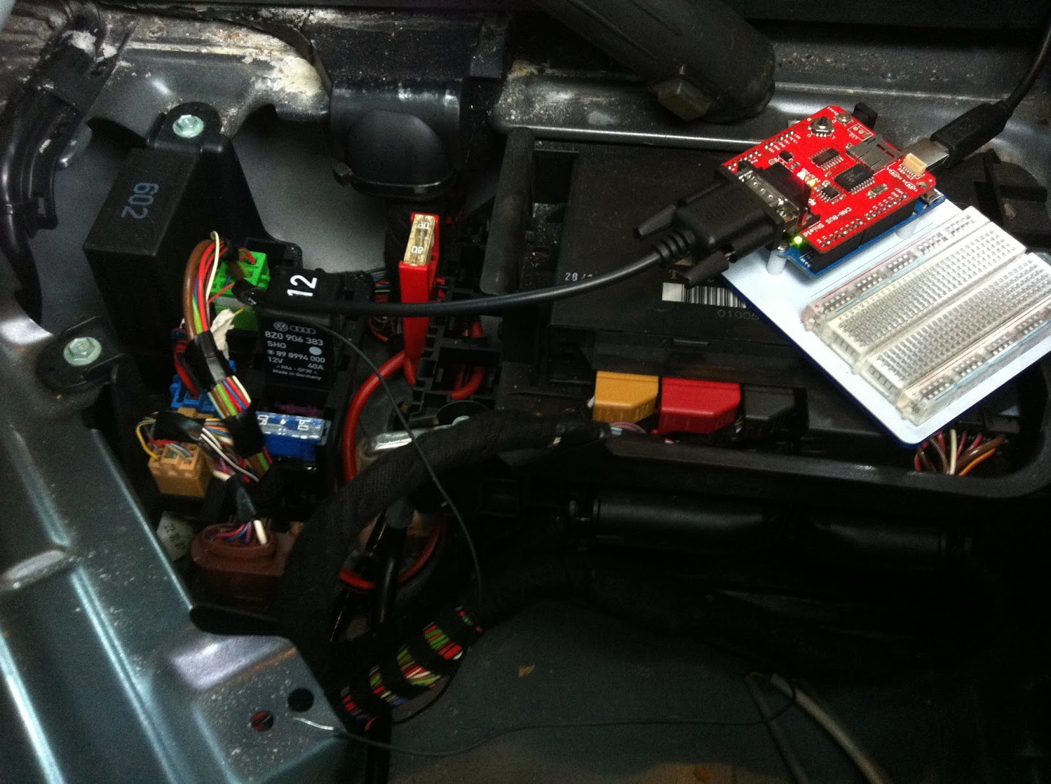
Physical Access
Impossible to completely deny physical access.
Solutions rely on reducing potential harm of unauthorized access:
Seed-key mechanism
Two-way authentication between ECU’s.
Timer method.
Intrusion detection system.
Honeypot.
VulCAN.

Slide 72

Bluetooth
Standard Bluetooth security not sufficient.
Large protocol stack, so susceptible to multiple attacks:
Cipher attacks, Bluejacking, Backdoor attack, etc.
Solutions should apply to the Bluetooth implementation used inside the vehicle.

Slide 73
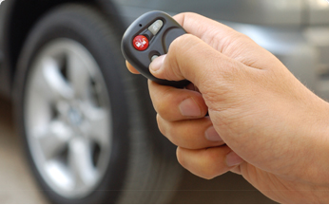
Remote Keyless Entry
Most cars today use RF-based remote keyless entry (RKE)
radio transmitter sends encrypted data containing identifying information.
The ECU can determine if the key is valid and lock, unlock, and start the vehicle

Slide 74
Tire Pressure Monitoring System
Each tire has pressure sensor.
Transmits real time data to an ECU.
Radio signal can be blocked/mimicked.
Solution: ?

Slide 75
Distributed Software

Slide 76
Secure Software & Systems

