Slide 1
Security in Automobiles: Vulnerability and Protection (OBD-II Access Control)
Master Thesis. Michiel Willems, 06/12/17

Slide 2
Outline
Introduction
Background
OBD-II Protocol
CAN Protocol
Security Issues
OBD-II Access Control
Planning next three months

Slide 3
Introduction

Slide 4
Introduction
Modern vehicle is a “Computer on Wheels”.
Over 100M lines of code deployed over as many as 70 ECU’s.
Networking protocols to facilitate internal communications (e.g. CAN).
Increasing connectability (Bluetooth, Wifi, etc).
Lee Pike, Jamey Sharp, Mark Tullsen, Patrick C. Hickey and James Bielman. 2015.
Securing the automobile: A comprehensive approach.
Dan Klinedinst, Christopher King. 2016
On Board Diagnostics: Risks and Vulnerabilities of the Connected Vehicle

Slide 5
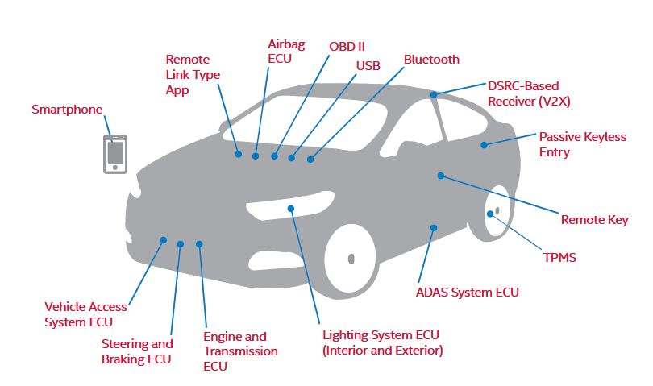
Introduction
Aastha Yadav, Gaurav Bose, Radhika Bhange, Karan Kapoor, N.Ch.S.N Iyengar, Ronnie D. Caytiles. 2016.
Security, Vulnerability and Protection of Vehicular On-board Diagnostics

Slide 6
Introduction
Goal of thesis: Securing the OBD-II port by implementing some kind of access control mechanism.
More Precisely:
Role Based Access Control.

Slide 7
OBD-II Protocol

Slide 8
OBD-II
On Board Diagnostics Protocol.
Allows access to vehicle subsystems via data link connector.
Introduces parameter ID’s (PID) to request data from ECU’s.
PID specifications are manufacturer and model specific.
Works with multiple signalling protocols, but CAN mostly used.
https://en.wikipedia.org/wiki/On-board_diagnostics

Slide 9


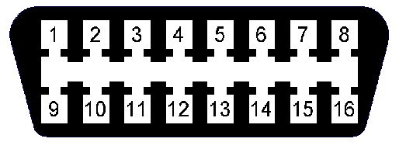
OBD-II
Vehicle Network

Slide 10
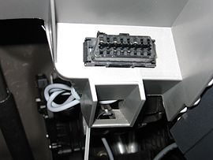
OBD-II
OBD-II
Data Link Connector
Vehicle Network

Slide 11
OBD-II
Diagnostic
Scan Tool
Vehicle Network

Slide 12
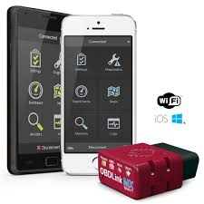
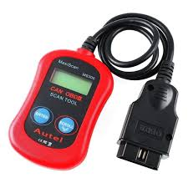
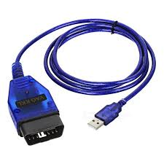
OBD-II
Scan Tools.

Slide 13
OBD-II
CAN Bus
Vehicle Network

Slide 14
CAN
Controller Area Network.
Bus allowing communications between ECU’s inside the vehicle.
Message Based Protocol (Frame).
Carrier Sense Multiple Access with Collision Avoidance (CSMA/CA).
Not only communications protocol implemented in vehicles (cf LIN, MOST) but most common.
https://en.wikipedia.org/wiki/CAN_bus

Slide 15
OBD-II
Vehicle Network

Slide 16
Security Issues

Slide 17
Security Issues
No source address => No certainty about origin.
Broadcast nature => Information Disclosure.
Prioritized ID’s => Denial of Service.
No support for encryption or authentication.
’CAN, by design, offers no protection from manipulation’
(Miller, 2013), (Koscher, 2010)

Slide 18
Security Issues
Potential hacking results.
Vehicle Theft.
Changing Emission information (“Dieselgate”).
Reduce odometer value.
Change recorded data after crash.
…
EXTREMETECH, „Hack the diagnostics connector, steal yourself a BMW in 3 minutes
Stephanie Bayer, Thomas Enderle, Dennis Kengo Oka , Marko Wolf .
Security Crash Test – Practical Security Evaluations of Automotive Onboard IT Components

Slide 19
Threat Model
Physical Access to OBD-II DLC.
Ability to inject arbitrary packets.
Able to exploit vulnerabilities in ECU software.
Enable wireless connectivity.
Vehicle Network

Slide 20
Proposed Solution: OBD-II Role Based Access Control

Slide 21
Solution
Proposed solution: Role Based Access Control.
Every role determines what kind of access is permitted.
For example:
Repair shop => Read diagnostics information only.
Official dealership => Diagnostics + ability to fix/test faulty ECU’s.
Police => Check integrity of vehicle network.

Slide 22
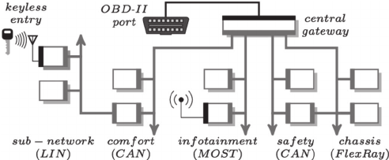
Solution
Central gateway (CGW).
Acts as router for all subnetworks + gate for all incoming data.
Perfect place to implement access control solution.

Slide 23

Solution
Central Gateway
Private Key
Public Key
Vehicle Network

Slide 24
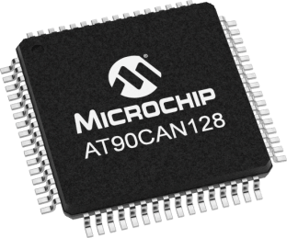
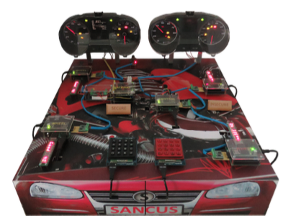
Solution
Implementation:
Microcontroller with CAN controller (AT90CAN128).
CAN Transceiver.
OBD-II connector.
Demo:
CAN testbench designed at KuLeuven for testing VulCAN.
Jo Van Bulck, Jan Tobias Mühlberg, and Frank Piessens
December 2017

Slide 25
Planning Next Three Months

Slide 26
Planning
December:
Get Familiar with Microcontroller software development.
Write December paper/poster.
January & February:
Implement a simple CAN compliant device.
Start Implementing rudimentary access control.

Slide 27
Questions? Notes: - Timing.

Slide 28
Timing difficulties.
Major Challenges!: Key infrastructure, Key size, …
No Slowing Down!!!

Slide 29
CAN Protocol

Slide 30
CAN
Controller Area Network.
Bus allowing communications between ECU’s inside the vehicle.
Message Based Protocol.
Carrier Sense Multiple Access with Collision Avoidance (CSMA/CA).
Not only communications protocol implemented in vehicles (cf LIN, MOST) but most common.

Slide 31
CAN Frame
Name | SOF | ID | RTR | IDE | r0 | DLC | Data | CRC | CRCd | ACK | EOF
No. Bits | 1 | 11 | 1 | 1 | 1 | 4 | 64 | 15 | 1 | 2 | 7
Identity Field
Used to identify each ECU in the vehicle.
Also specifies a priority (Lowest ID = highest priority).
Bitwise contention resolution (1 = Recessive & 0 = Dominant).

Slide 32
CAN Bitwise Contention Resolution
1 | 1 | 0 | 1 | 0 | 0 | 1 | 1 | 0 | 1 | 0
0 | 0 | 1 | 0 | 1 | 0 | 1 | 1 | 0 | 1 | 0
Node 1
Node 3
0 | 1 | 0 | 1 | 1 | 1 | 1 | 1 | 0 | 0 | 1
0 | 0 | 0 | 1 | 0 | 0 | 0 | 0 | 1 | 1 | 0
Node 2
Node 4
Value Transmitted: 0

Slide 33
CAN Bitwise Contention Resolution
1 | 1 | 0 | 1 | 0 | 0 | 1 | 1 | 0 | 1 | 0
0 | 0 | 1 | 0 | 1 | 0 | 1 | 1 | 0 | 1 | 0
Node 1
Node 3
0 | 1 | 0 | 1 | 1 | 1 | 1 | 1 | 0 | 0 | 1
0 | 0 | 0 | 1 | 0 | 0 | 0 | 0 | 1 | 1 | 0
Node 2
Node 4
Value Transmitted: 0

Slide 34
CAN Bitwise Contention Resolution
1 | 1 | 0 | 1 | 0 | 0 | 1 | 1 | 0 | 1 | 0
0 | 0 | 1 | 0 | 1 | 0 | 1 | 1 | 0 | 1 | 0
Node 1
Node 3
0 | 1 | 0 | 1 | 1 | 1 | 1 | 1 | 0 | 0 | 1
0 | 0 | 0 | 1 | 0 | 0 | 0 | 0 | 1 | 1 | 0
Node 2
Node 4
Value Transmitted: 0

Slide 35
CAN Bitwise Contention Resolution
1 | 1 | 0 | 1 | 0 | 0 | 1 | 1 | 0 | 1 | 0
0 | 0 | 1 | 0 | 1 | 0 | 1 | 1 | 0 | 1 | 0
Node 1
Node 3
0 | 1 | 0 | 1 | 1 | 1 | 1 | 1 | 0 | 0 | 1
0 | 0 | 0 | 1 | 0 | 0 | 0 | 0 | 1 | 1 | 0
Node 2
Node 4
Value Transmitted: 1

Slide 36
CAN Frame
Name | SOF | ID | RTR | IDE | r0 | DLC | Data | CRC | CRCd | ACK | EOF
No. Bits | 1 | 11 | 1 | 1 | 1 | 4 | 64 | 15 | 1 | 2 | 7
Data Field
Carries the payload.
Length is 64 so only 8 bytes of data in each message.

Slide 37
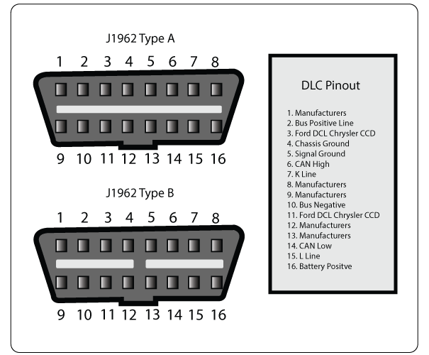
OBD-II

Slide 38
OBD-II
Parameter ID’s (PID)
Codes to request data from a vehicle.
Typical Use (with scan tool connected to DLC):
Technician enters PID on the scan tool.
PID is sent to the CAN bus (accessed via the DLC).
Some ECU recognises the PID and reports the corresponding value on the bus.
Scan tool reads response and displays it to the technician.

Slide 39
Security Issues
Potential hacking results (safety critical).
Driver Distractions (wipers etc.).
Engine shutoff.
Steering changes.
…

Slide 40
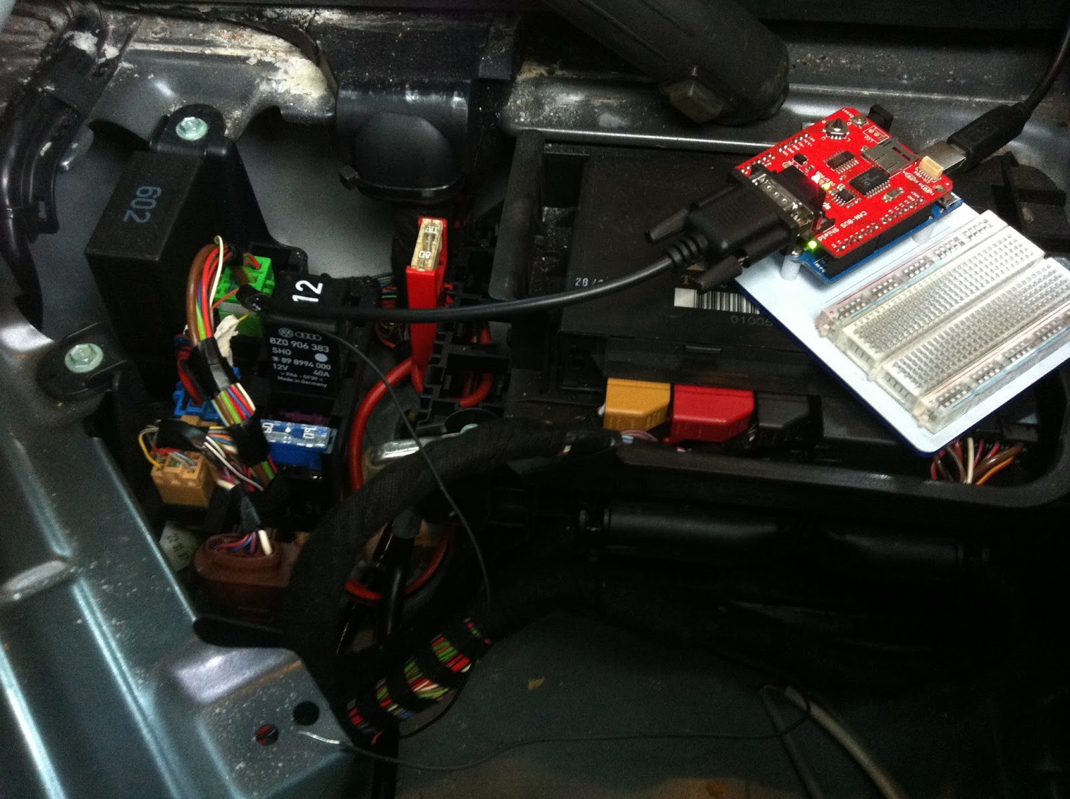
Physical Access
Impossible to completely deny physical access.
Solutions rely on reducing potential harm of unauthorized access:
Seed-key mechanism
Two-way authentication between ECU’s.
Timer method.
Intrusion detection system.
Honeypot.
VulCAN.

Slide 41

Bluetooth
Standard Bluetooth security not sufficient.
Large protocol stack, so susceptible to multiple attacks:
Cipher attacks, Bluejacking, Backdoor attack, etc.
Solutions should apply to the Bluetooth implementation used inside the vehicle.

Slide 42
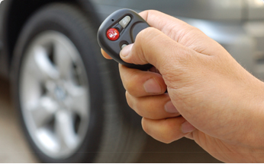
Remote Keyless Entry
Most cars today use RF-based remote keyless entry (RKE)
radio transmitter sends encrypted data containing identifying information.
The ECU can determine if the key is valid and lock, unlock, and start the vehicle

Slide 43
Tire Pressure Monitoring System
Each tire has pressure sensor.
Transmits real time data to an ECU.
Radio signal can be blocked/mimicked.
Solution: ?

Slide 44
Distributed Software

Slide 45
Secure Software & Systems

