Slide 1

第1节
数据处理之查询

Slide 2
目 标
通过本章学习，您将可以:
基本的SELECT语句
过滤和排序数据
多表查询
单行函数
分组函数

Slide 3
1—基本 SELECT 语句
SELECT *|{[DISTINCT] column|expression [alias],...}
FROM table;
SELECT 标识选择哪些列。
FROM 标识从哪个表中选择。
Notes:
Basic SELECT Statement
In its simplest form, a SELECT statement must include the following:
A SELECT clause, which specifies the columns to be displayed
A FROM clause, which specifies the table containing the columns listed in the SELECT clause
In the syntax:
SELECT is a list of one or more columns
* selects all columns
DISTINCT suppresses duplicates
column|expression selects the named column or the expression
alias gives selected columns different headings
FROM table specifies the table containing the columns
Note: Throughout this course, the words keyword, clause, and statement are used as follows:
A keyword refers to an individual SQL element. For example, SELECT and FROM are keywords.
A clause is a part of a SQL statement. For example, SELECT employee_id, last_name, ... is a clause.
A statement is a combination of two or more clauses. For example, SELECT * FROM employees is a SQL statement.

Slide 4
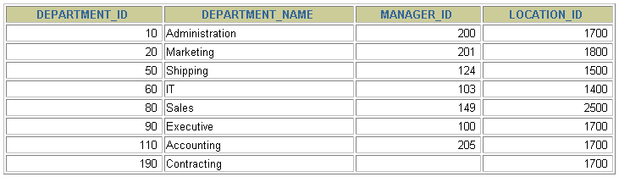
选择全部列
SELECT *
FROM departments;
Notes:
Selecting All Columns of All Rows
You can display all columns of data in a table by following the SELECT keyword with an asterisk (*). In the example on the slide, the department table contains four columns: DEPARTMENT_ID, DEPARTMENT_NAME, MANAGER_ID, and LOCATION_ID. The table contains seven rows, one for each department.
You can also display all columns in the table by listing all the columns after the SELECT keyword. For example, the following SQL statement, like the example on the slide, displays all columns and all rows of the DEPARTMENTS table:
SELECT department_id, department_name, manager_id, location_id
FROM departments;
Instructor Note
Let the students know that details of all the tables are given in Appendix B.

Slide 5
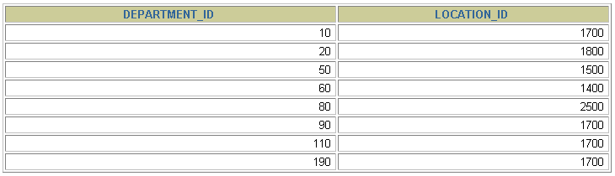
选择特定的列
SELECT department_id, location_id
FROM departments;
Notes:
Selecting Specific Columns of All Rows
You can use the SELECT statement to display specific columns of the table by specifying the column names, separated by commas. The example on the slide displays all the department numbers and location numbers from the DEPARTMENTS table.
In the SELECT clause, specify the columns that you want, in the order in which you want them to appear in the output. For example, to display location before department number going from left to right, you use the following statement:
SELECT location_id, department_id
FROM departments;
Instructor Note
You can also select from pseudocolumns. A pseudocolumn behaves like a table column but is not actually stored in the table. You cannot insert or delete values of the pseudocolumns. Some available pseudocolumns are CURRVAL, NEXTVAL, LEVEL, ROWID, and ROWNUM.
…

Slide 6
注 意
SQL 语言大小写不敏感。
SQL 可以写在一行或者多行
关键字不能被缩写也不能分行
各子句一般要分行写。
使用缩进提高语句的可读性。
Notes:
Writing SQL Statements
Using the following simple rules and guidelines, you can construct valid statements that are both easy to read and easy to edit:
• SQL statements are not case sensitive, unless indicated.
SQL statements can be entered on one or many lines.
• Keywords cannot be split across lines or abbreviated.
Clauses are usually placed on separate lines for readability and ease of editing.
• Indents should be used to make code more readable.
Keywords typically are entered in uppercase; all other words, such as table names and columns, are entered in lowercase.
Executing SQL Statements
Using iSQL*Plus, click the Execute button to run the command or commands in the editing
window.
Instructor Note
Although not required in iSQL*Plus, placing a semicolon (;) at the end of the last clause is recommended. Other environments, such as PL/SQL programs, require that the end of each statement contains a semicolon.

Slide 7
列的别名
列的别名:
重命名一个列。
便于计算。
紧跟列名，也可以在列名和别名之间加入关键字‘AS’，别名使用双引号，以便在别名中包含空格或特殊的字符并区分大小写。
Notes:
Column Aliases
When displaying the result of a query, iSQL*Plus normally uses the name of the selected column as the column heading. This heading may not be descriptive and hence may be difficult to understand. You can change a column heading by using a column alias.
Specify the alias after the column in the SELECT list using a space as a separator. By default, alias headings appear in uppercase. If the alias contains spaces or special characters (such as # or $), or is case sensitive, enclose the alias in double quotation marks (" ").
Instructor Note
Within a SQL statement, a column alias can be used in both the SELECT clause and the ORDER BY clause. You cannot use column aliases in the WHERE clause. Both alias features comply with the ANSI SQL 92 standard.
Demo: 1_alias.sql
Purpose: To illustrate the use of aliases in expressions.

Slide 8


使用别名
SELECT last_name AS name, commission_pct comm
FROM employees;
…
SELECT last_name "Name", salary*12 "Annual Salary"
FROM employees;
…
Notes:
Column Aliases (continued)
The first example displays the names and the commission percentages of all the employees. Notice that the optional AS keyword has been used before the column alias name. The result of the query is the same whether the AS keyword is used or not. Also notice that the SQL statement has the column aliases, name and comm, in lowercase, whereas the result of the query displays the column headings in uppercase. As mentioned in a previous slide, column headings appear in uppercase by default.
The second example displays the last names and annual salaries of all the employees. Because Annual Salary contain a space, it has been enclosed in double quotation marks. Notice that the column heading in the output is exactly the same as the column alias.
Instructor Note
Point out the optional AS keyword in the first example and the double quotation marks in the second example. Also show that the aliases always appear in uppercase, unless enclosed within double quotation marks.

Slide 9
字符串
日期和字符只能在单引号中出现。
每当返回一行时，字符串被输出一次。
Notes:
Literal Character Strings
A literal is a character, a number, or a date that is included in the SELECT list and that is not a column name or a column alias. It is printed for each row returned. Literal strings of free-format text can be included in the query result and are treated the same as a column in the SELECT list.
Date and character literals must be enclosed within single quotation marks (' '); number literals need not.

Slide 10
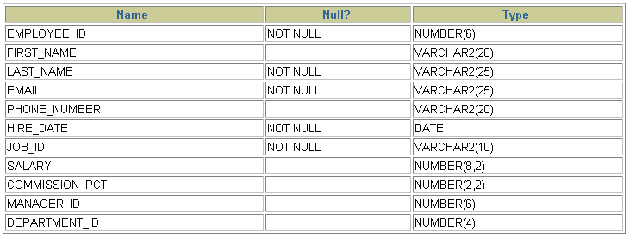
显示表结构
使用 DESCRIBE 命令，表示表结构
DESC[RIBE] tablename
DESCRIBE employees

Slide 11
2—过滤和排序数据

Slide 12
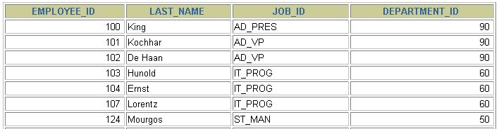

在查询中过滤行
EMPLOYEES
…
返回在 90号部门工作的所有员工的信息

Slide 13
过滤
使用WHERE 子句，将不满足条件的行过滤掉。
WHERE 子句紧随 FROM 子句。
SELECT *|{[DISTINCT] column|expression [alias],...}
FROM table
[WHERE condition(s)];
Notes:
Limiting the Rows Selected
You can restrict the rows returned from the query by using the WHERE clause. A WHERE clause contains a condition that must be met, and it directly follows the FROM clause. If the condition is true, the row meeting the condition is returned.
In the syntax:
WHERE restricts the query to rows that meet a condition
condition is composed of column names, expressions, constants, and a comparison operator
The WHERE clause can compare values in columns, literal values, arithmetic expressions, or functions. It consists of three elements:
Column name
Comparison condition
Column name, constant, or list of values

Slide 14

WHERE 子句
SELECT employee_id, last_name, job_id, department_id
FROM employees
WHERE department_id = 90 ;
Notes:
Using the WHERE Clause
In the example, the SELECT statement retrieves the name, job ID, and department number of all employees whose job ID is SA_REP.
Note that the job title SA_REP has been specified in uppercase to ensure that it matches the job ID column in the EMPLOYEES table. Character strings are case sensitive.

Slide 15
比较运算
操作符
=
>
>=
<
<=
<>
含义
等于 (不是 ==)
大于
大于、等于
小于
小于、等于
不等于 (也可以是 !=)
赋值使用 := 符号
Notes:
Comparison Conditions
Comparison conditions are used in conditions that compare one expression to another value or expression. They are used in the WHERE clause in the following format:
Syntax
... WHERE expr operator value
For Example
... WHERE hire_date='01-JAN-95'
... WHERE salary>=6000
... WHERE last_name='Smith'
An alias cannot be used in the WHERE clause.
Note: The symbol != and ^= can also represent the not equal to condition.

Slide 16

比较运算
SELECT last_name, salary
FROM employees
WHERE salary <= 3000;
Notes:
Using the Comparison Conditions
In the example, the SELECT statement retrieves the last name and salary from the EMPLOYEES table, where the employee salary is less than or equal to 3000. Note that there is an explicit value supplied to the WHERE clause. The explicit value of 3000 is compared to the salary value in the SALARY column of the EMPLOYEES table.

Slide 17
其它比较运算
操作符
BETWEEN ...AND...
IN(set)
LIKE
IS NULL
含义
在两个值之间 (包含边界)
等于值列表中的一个
模糊查询
空值

Slide 18
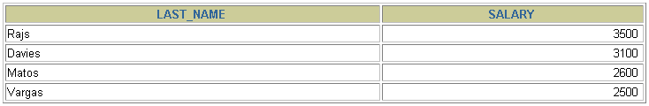
BETWEEN
使用 BETWEEN 运算来显示在一个区间内的值
SELECT last_name, salary
FROM employees
WHERE salary BETWEEN 2500 AND 3500;
Lower limit
Upper limit
Notes:
The BETWEEN Condition
You can display rows based on a range of values using the BETWEEN range condition. The range that you specify contains a lower limit and an upper limit.
The SELECT statement on the slide returns rows from the EMPLOYEES table for any employee whose salary is between $2,500 and $3,500.
Values specified with the BETWEEN condition are inclusive. You must specify the lower limit first.
Instructor Note
Emphasize that the values specified with the BETWEEN operator in the example are inclusive. Explain that BETWEEN … AND … is actually translated by Oracle server to a pair of AND conditions: (a >= lower limit) AND (a <= higher limit). So using BETWEEN … AND … has no performance benefits, and it is used for logical simplicity.
Demo: 2_betw.sql
Purpose: To illustrate using the BETWEEN operator.

Slide 19
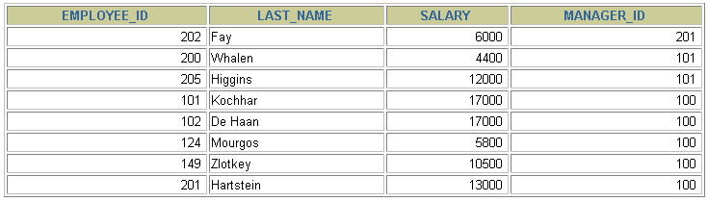
IN
使用 IN运算显示列表中的值。
SELECT employee_id, last_name, salary, manager_id
FROM employees
WHERE manager_id IN (100, 101, 201);
Notes:
The IN Condition
To test for values in a specified set of values, use the IN condition. The IN condition is also known as the membership condition.
The slide example displays employee numbers, last names, salaries, and manager’s employee numbers for all the employees whose manager’s employee number is 100, 101, or 201.
The IN condition can be used with any data type. The following example returns a row from the EMPLOYEES table for any employee whose last name is included in the list of names in the WHERE clause:
SELECT employee_id, manager_id, department_id
FROM employees
WHERE last_name IN ('Hartstein', 'Vargas');
If characters or dates are used in the list, they must be enclosed in single quotation marks ('').
Instructor Note
Explain that IN ( ... ) is actually translated by Oracle server to a set of OR conditions: a = value1 OR a = value2 OR a = value3. So using IN ( ... ) has no performance benefits, and it is used for logical simplicity.
Demo: 2_in.sql
Purpose: To illustrate using the IN operator.

Slide 20
LIKE
使用 LIKE 运算选择类似的值
选择条件可以包含字符或数字:
% 代表零个或多个字符(任意个字符)。
_ 代表一个字符。
SELECT first_name
FROM employees
WHERE first_name LIKE 'S%';
Notes:
The LIKE Condition
You may not always know the exact value to search for. You can select rows that match a character pattern by using the LIKE condition. The character pattern-matching operation is referred to as a wildcard search. Two symbols can be used to construct the search string.
The SELECT statement on the slide returns the employee first name from the EMPLOYEES table for any employee whose first name begins with an S. Note the uppercase S. Names beginning with an s are not returned.
The LIKE condition can be used as a shortcut for some BETWEEN comparisons. The following example displays the last names and hire dates of all employees who joined between January 1995 and December 1995:
SELECT last_name, hire_date
FROM employees
WHERE hire_date LIKE '%95';

Slide 21

LIKE
‘%’和‘-’可以同时使用。
SELECT last_name
FROM employees
WHERE last_name LIKE '_o%';
Notes:
Combining Wildcard Characters
The % and _ symbols can be used in any combination with literal characters. The example on the slide displays the names of all employees whose last names have an o as the second character.
The ESCAPE Option
When you need to have an exact match for the actual % and _ characters, use the ESCAPE option. This option specifies what the escape character is. If you want to search for strings that contain ‘SA_’, you can use the following SQL statement:
SELECT employee_id, last_name, job_id
FROM employees
WHERE job_id LIKE '%SA\_%' ESCAPE '\';
The ESCAPE option identifies the backslash (\) as the escape character. In the pattern, the escape character precedes the underscore (_). This causes the Oracle Server to interpret the underscore literally.

Slide 22
ESCAPE
回避特殊符号的：使用转义符。例如：将[%]转为[$%]、[_]转为[$_]，然后再加上[ESCAPE ‘$’] 即可。
SELECT job_id
FROM jobs
WHERE job_id LIKE ‘IT\_%‘;
如果使用\表示转义，要省略escape。如果不是\，则要加上escape。
SELECT job_id
FROM jobs
WHERE job_id LIKE ‘IT$_%‘ escape ‘$‘;

Slide 23
NULL
使用 IS (NOT) NULL 判断空值。
SELECT last_name, manager_id
FROM employees
WHERE manager_id IS NULL;
Notes:
The NULL Conditions
The NULL conditions include the IS NULL condition and the IS NOT NULL condition.
The IS NULL condition tests for nulls. A null value means the value is unavailable, unassigned, unknown, or inapplicable. Therefore, you cannot test with = because a null cannot be equal or unequal to any value. The slide example retrieves the last names and managers of all employees who do not have a manager.
For another example, to display last name, job ID, and commission for all employees who are NOT entitled to get a commission, use the following SQL statement:
SELECT last_name, job_id, commission_pct
FROM employees
WHERE commission_pct IS NULL;
…

Slide 24
逻辑运算
操作符
AND OR
NOT
含义
逻辑并
逻辑或
逻辑否
Notes:
Logical Conditions
A logical condition combines the result of two component conditions to produce a single result based on them or inverts the result of a single condition. A row is returned only if the overall result of the condition is true. Three logical operators are available in SQL:
AND
OR
NOT
All the examples so far have specified only one condition in the WHERE clause. You can use several conditions in one WHERE clause using the AND and OR operators.

Slide 25

AND
AND 要求并的关系为真。
SELECT employee_id, last_name, job_id, salary
FROM employees
WHERE salary >=10000
AND job_id LIKE '%MAN%';
Notes:
The AND Operator
In the example, both conditions must be true for any record to be selected. Therefore, only employees who have a job title that contains the string MAN and earn $10,000 or more are selected.
All character searches are case sensitive. No rows are returned if MAN is not in uppercase. Character strings must be enclosed in quotation marks.
AND Truth Table
The following table shows the results of combining two expressions with AND:
Instructor Note
Demo: 2_and.sql
Purpose: To illustrate using the AND operator.

Slide 26
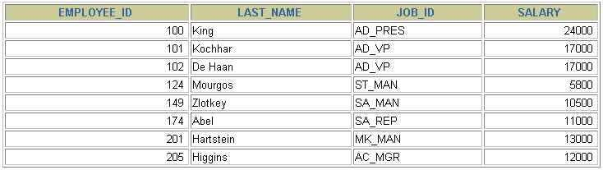
OR
OR 要求或关系为真。
SELECT employee_id, last_name, job_id, salary
FROM employees
WHERE salary >= 10000
OR job_id LIKE '%MAN%';
Notes:
The OR Operator
In the example, either condition can be true for any record to be selected. Therefore, any employee who has a job ID containing MAN or earns $10,000 or more is selected.
The OR Truth Table
The following table shows the results of combining two expressions with OR:
Instructor Note
Demo: 2_or.sql
Purpose: To illustrate using the OR operator.

Slide 27
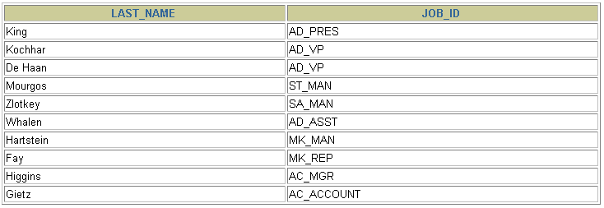
NOT
SELECT last_name, job_id
FROM employees
WHERE job_id
NOT IN ('IT_PROG', 'ST_CLERK', 'SA_REP');
Notes:
The NOT Operator
The slide example displays the last name and job ID of all employees whose job ID is not IT_PROG, ST_CLERK, or SA_REP.
The NOT Truth Table
The following table shows the result of applying the NOT operator to a condition:
Note: The NOT operator can also be used with other SQL operators, such as BETWEEN, LIKE, and NULL.
... WHERE job_id NOT IN ('AC_ACCOUNT', 'AD_VP')
... WHERE salary NOT BETWEEN 10000 AND 15000
... WHERE last_name NOT LIKE '%A%'
... WHERE commission_pct IS NOT NULL

Slide 28
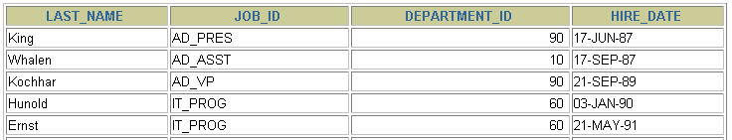
ORDER BY子句
使用 ORDER BY 子句排序
ASC（ascend）: 升序
DESC（descend）: 降序
ORDER BY 子句在SELECT语句的结尾。
SELECT last_name, job_id, department_id, hire_date
FROM employees
ORDER BY hire_date ;
…
Notes:
The ORDER BY Clause
The order of rows returned in a query result is undefined. The ORDER BY clause can be used to sort the rows. If you use the ORDER BY clause, it must be the last clause of the SQL statement. You can specify an expression, or an alias, or column position as the sort condition.
Syntax
SELECT expr
FROM table
[WHERE condition(s)]
[ORDER BY {column, expr} [ASC|DESC]];
In the syntax:
ORDER BY specifies the order in which the retrieved rows are displayed
ASC orders the rows in ascending order (this is the default order)
DESC orders the rows in descending order
If the ORDER BY clause is not used, the sort order is undefined, and the Oracle server may not fetch rows in the same order for the same query twice. Use the ORDER BY clause to display the rows in a specific order.
Instructor Note
Let the students know that the ORDER BY clause is executed last in query execution. It is placed last unless the FOR UPDATE clause is used.

Slide 29
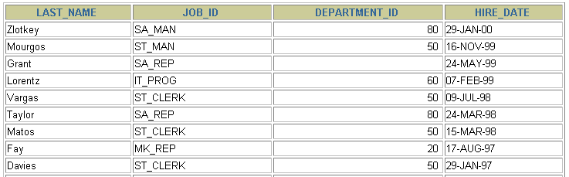
降序排序
SELECT last_name, job_id, department_id, hire_date
FROM employees
ORDER BY hire_date DESC ;
…
Notes:
Default Ordering of Data
The default sort order is ascending:
Numeric values are displayed with the lowest values first—for example, 1–999.
Date values are displayed with the earliest value first—for example, 01-JAN-92 before 01-JAN-95.
Character values are displayed in alphabetical order—for example, A first and Z last.
Null values are displayed last for ascending sequences and first for descending sequences.
Reversing the Default Order
To reverse the order in which rows are displayed, specify the DESC keyword after the column name in the ORDER BY clause. The slide example sorts the result by the most recently hired employee.
Instructor Note
Let the students know that you can also sort by a column number in the SELECT list. The following example sorts the output in the descending order by salary:
SELECT last_name, salary
FROM employees
ORDER BY 2 DESC;

Slide 30
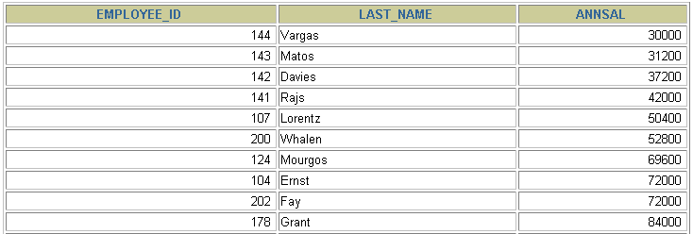
按别名排序
SELECT employee_id, last_name, salary*12 annsal
FROM employees
ORDER BY annsal;
…
Notes:
Sorting by Column Aliases
You can use a column alias in the ORDER BY clause. The slide example sorts the data by annual salary.
Instructor Note
Internally, the order of execution for a SELECT statement is as follows:
FROM clause
WHERE clause
SELECT clause
ORDER BY clause

Slide 31
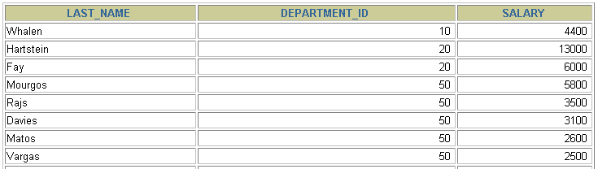
多个列排序
按照ORDER BY 列表的顺序排序。
可以使用不在SELECT 列表中的列排序。
SELECT last_name, department_id, salary
FROM employees
ORDER BY department_id, salary DESC;
…
Notes:
Sorting by Multiple Columns
You can sort query results by more than one column. The sort limit is the number of columns in the given table.
In the ORDER BY clause, specify the columns, and separate the column names using commas. If you want to reverse the order of a column, specify DESC after its name. You can also order by columns that are not included in the SELECT clause.
Example
Display the last names and salaries of all employees. Order the result by department number, and then in descending order by salary.
SELECT last_name, salary
FROM employees
ORDER BY department_id, salary DESC;
Instructor Note
Show that the DEPARTMENT_ID column is sorted in ascending order and the SALARY column in descending order.

Slide 32
3 — 多表查询

Slide 33

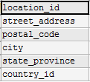
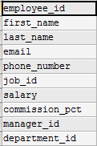
EMPLOYEES表
DEPARTMENTS表
LOCATIONS表

Slide 34

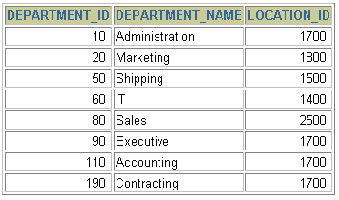



从多个表中获取数据
EMPLOYEES
DEPARTMENTS
…
…
Notes:
Data from Multiple Tables
Sometimes you need to use data from more than one table. In the slide example, the report displays data from two separate tables.
Employee IDs exist in the EMPLOYEES table.
Department IDs exist in both the EMPLOYEES and DEPARTMENTS tables.
Location IDs exist in the DEPARTMENTS table.
To produce the report, you need to link the EMPLOYEES and DEPARTMENTS tables and access data from both of them.

Slide 35
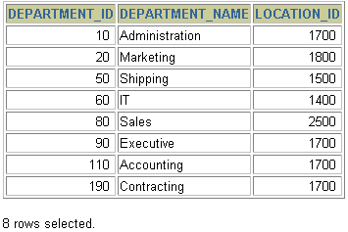
select last_name, department_name
from employees, departments
演示笛卡尔集的错误情况：
select count(employee_id) from employees;
假设输出107行
select count(department_id)from departments;
假设输出27行
select 107*27 from dual;

Slide 36
笛卡尔集
笛卡尔集会在下面条件下产生:
省略连接条件
连接条件无效
所有表中的所有行互相连接
为了避免笛卡尔集， 可以在 WHERE 加入有效的连接条件。
Notes:
Cartesian Products
When a join condition is invalid or omitted completely, the result is a Cartesian product, in which all combinations of rows are displayed. All rows in the first table are joined to all rows in the second table.
A Cartesian product tends to generate a large number of rows, and the result is rarely useful. You should always include a valid join condition in a WHERE clause, unless you have a specific need to combine all rows from all tables.
Cartesian products are useful for some tests when you need to generate a large number of rows to simulate a reasonable amount of data.

Slide 37
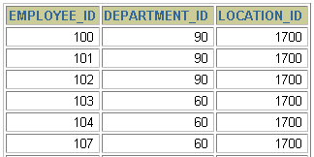
笛卡尔集
EMPLOYEES (20行)
DEPARTMENTS (8行)
…
笛卡尔集: 20x8=160行
…
Notes:
Cartesian Products (continued)
A Cartesian product is generated if a join condition is omitted. The example on the slide displays employee last name and department name from the EMPLOYEES and DEPARTMENTS tables. Because no WHERE clause has been specified, all rows (20 rows) from the EMPLOYEES table are joined with all rows (8 rows) in the DEPARTMENTS table, thereby generating 160 rows in the output.
SELECT last_name, department_name dept_name
FROM employees, departments;
Instructor Note
Demo: 4_cart.sql
Purpose: To illustrate executing a Cartesian product
…

Slide 38
Mysql 连接
使用连接在多个表中查询数据。
在 WHERE 子句中写入连接条件。
在表中有相同列时，在列名之前加上表名前缀
SELECT table1.column, table2.column
FROM table1, table2
WHERE table1.column1 = table2.column2;
Notes:
Defining Joins
When data from more than one table in the database is required, a join condition is used. Rows in one table can be joined to rows in another table according to common values existing in corresponding columns, that is, usually primary and foreign key columns.
To display data from two or more related tables, write a simple join condition in the WHERE clause.
In the syntax:
table1.column denotes the table and column from which data is retrieved
table1.column1 = is the condition that joins (or relates) the tables together table2.column2
Guidelines
When writing a SELECT statement that joins tables, precede the column name with the table name for clarity and to enhance database access.
If the same column name appears in more than one table, the column name must be prefixed with the table name.
To join n tables together, you need a minimum of n-1 join conditions. For example, to join four tables, a minimum of three joins is required. This rule may not apply if your table has a concatenated primary key, in which case more than one column is required to uniquely identify each row.
For more information, see Oracle9i SQL Reference, “SELECT.”

Slide 39
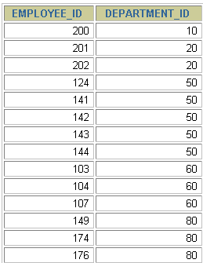
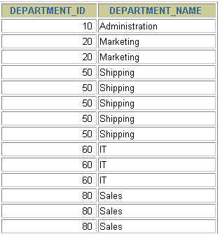
等值连接
EMPLOYEES
DEPARTMENTS
…
…
外键
主键
：唯一、非空
Notes:
Equijoins
To determine an employee’s department name, you compare the value in the DEPARTMENT_ID column in the EMPLOYEES table with the DEPARTMENT_ID values in the DEPARTMENTS table. The relationship between the EMPLOYEES and DEPARTMENTS tables is an equijoin—that is, values in the DEPARTMENT_ID column on both tables must be equal. Frequently, this type of join involves primary and foreign key complements.
Note: Equijoins are also called simple joins or inner joins.
Instructor Note
Explain the use of a decision matrix for simplifying writing joins. For example, if you want to display the name and department number of all the employees who are in the same department as Goyal, you can start by making the following decision tree:
Columns to Display Originating Table Condition
last_name employees last_name='Goyal'
department_name departments employees.department_id =
departments.department_id
Now the SQL statement can be easily formulated by looking at the decision matrix. The first column gives the column list in the SELECT statement, the second column gives the tables for the FROM clause, and the third column gives the condition for the WHERE clause.

Slide 40
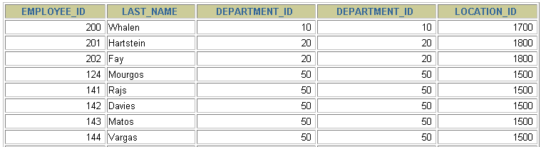
等值连接
SELECT employees.employee_id, employees.last_name,
employees.department_id, departments.department_id,
departments.location_id
FROM employees, departments
WHERE employees.department_id = departments.department_id;
…
Notes:
Retrieving Records with Equijoins
In the slide example:
The SELECT clause specifies the column names to retrieve:
employee last name, employee number, and department number, which are columns in the EMPLOYEES table
department number, department name, and location ID, which are columns in the DEPARTMENTS table
The FROM clause specifies the two tables that the database must access:
EMPLOYEES table
DEPARTMENTS table
The WHERE clause specifies how the tables are to be joined:
EMPLOYEES.DEPARTMENT_ID = DEPARTMENTS.DEPARTMENT_ID
Because the DEPARTMENT_ID column is common to both tables, it must be prefixed by the table name to avoid ambiguity.

Slide 41
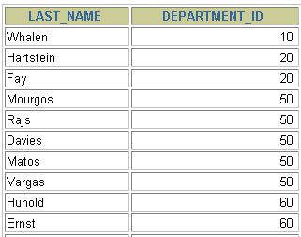
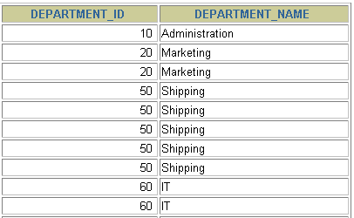
多个连接条件与 AND 操作符
EMPLOYEES
DEPARTMENTS
…
…
Notes:
Additional Search Conditions
In addition to the join, you may have criteria for your WHERE clause to restrict the rows under consideration for one or more tables in the join. For example, to display employee Matos' department number and department name, you need an additional condition in the WHERE clause.
SELECT last_name, employees.department_id,
department_name
FROM employees, departments
WHERE employees.department_id = departments.department_id
AND last_name = 'Matos';

Slide 42
区分重复的列名
使用表名前缀在多个表中区分相同的列。
在不同表中具有相同列名的列可以用表的别名加以区分。
Notes:
Qualifying Ambiguous Column Names
You need to qualify the names of the columns in the WHERE clause with the table name to avoid ambiguity. Without the table prefixes, the DEPARTMENT_ID column could be from either the DEPARTMENTS table or the EMPLOYEES table. It is necessary to add the table prefix to execute your query.
If there are no common column names between the two tables, there is no need to qualify the columns. However, using the table prefix improves performance, because you tell the Oracle Server exactly where to find the columns.
The requirement to qualify ambiguous column names is also applicable to columns that may be ambiguous in other clauses, such as the SELECT clause or the ORDER BY clause.
Instructor Note
Demo: 4_loc.sql
Purpose: To illustrate a SELECT clause with no aliases.

Slide 43
表的别名
使用别名可以简化查询。
使用表名前缀可以提高执行效率。
SELECT e.employee_id, e.last_name, e.department_id,
d.department_id, d.location_id
FROM employees e , departments d
WHERE e.department_id = d.department_id;
Notes:
Table Aliases
Qualifying column names with table names can be very time consuming, particularly if table names are lengthy. You can use table aliases instead of table names. Just as a column alias gives a column another name, a table alias gives a table another name. Table aliases help to keep SQL code smaller, therefore using less memory.
Notice how table aliases are identified in the FROM clause in the example. The table name is specified in full, followed by a space and then the table alias. The EMPLOYEES table has been given an alias of e, and the DEPARTMENTS table has an alias of d.
Guidelines
Table aliases can be up to 30 characters in length, but shorter is better.
If a table alias is used for a particular table name in the FROM clause, then that table alias must be substituted for the table name throughout the SELECT statement.
Table aliases should be meaningful.
The table alias is valid only for the current SELECT statement.

Slide 44
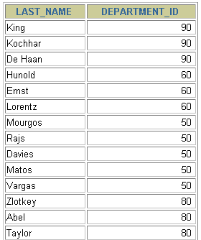
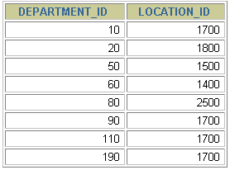
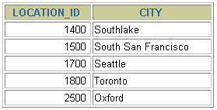
连接多个表
EMPLOYEES
DEPARTMENTS
LOCATIONS
…
连接 n个表,至少需要 n-1个连接条件。 例如：连接三个表，至少需要两个连接条件。
练习：查询出公司员工的 last_name, department_name, city
Notes:
Additional Search Conditions
Sometimes you may need to join more than two tables. For example, to display the last name, the department name, and the city for each employee, you have to join the EMPLOYEES, DEPARTMENTS, and LOCATIONS tables.
SELECT e.last_name, d.department_name, l.city
FROM employees e, departments d, locations l
WHERE e.department_id = d.department_id
AND d.location_id = l.location_id;
…

Slide 45
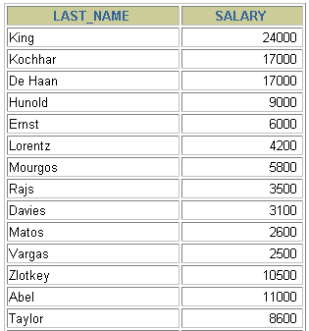
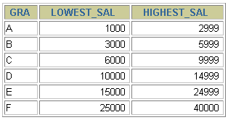
非等值连接
EMPLOYEES
JOB_GRADES
EMPLOYEES表中的列工资
应在JOB_GRADES表中的最高
工资与最低工资之间
…
Notes:
Non-Equijoins
A non-equijoin is a join condition containing something other than an equality operator.
The relationship between the EMPLOYEES table and the JOB_GRADES table has an example of a non-equijoin. A relationship between the two tables is that the SALARY column in the EMPLOYEES table must be between the values in the LOWEST_SALARY and HIGHEST_SALARY columns of the JOB_GRADES table. The relationship is obtained using an operator other than equals (=).

Slide 46
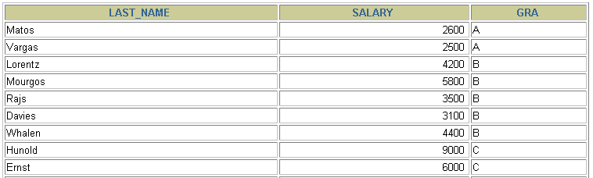
非等值连接
SELECT e.last_name, e.salary, j.grade_level
FROM employees e, job_grades j
WHERE e.salary
BETWEEN j.lowest_sal AND j.highest_sal;
…
Notes:
Non-Equijoins (continued)
The slide example creates a non-equijoin to evaluate an employee’s salary grade. The salary must be between any pair of the low and high salary ranges.
It is important to note that all employees appear exactly once when this query is executed. No employee is repeated in the list. There are two reasons for this:
None of the rows in the job grade table contain grades that overlap. That is, the salary value for an employee can lie only between the low salary and high salary values of one of the rows in the salary grade table.
All of the employees’ salaries lie within the limits provided by the job grade table. That is, no employee earns less than the lowest value contained in the LOWEST_SAL column or more than the highest value contained in the HIGHEST_SAL column.
Note: Other conditions, such as <= and >= can be used, but BETWEEN is the simplest. Remember to specify the low value first and the high value last when using BETWEEN.
Table aliases have been specified in the slide example for performance reasons, not because of possible ambiguity.
Instructor Note
Explain that BETWEEN … AND … is actually translated by the Oracle server to a pair of AND conditions (a >= lower limit) and (a <= higher limit) and IN ( … ) is translated by the Oracle server to a set of OR conditions (a = value1 OR a = value2 OR a = value3 ). So using BETWEEN … AND … , IN(…) has no performance benefits; the benefit is logical simplicity.

Slide 47
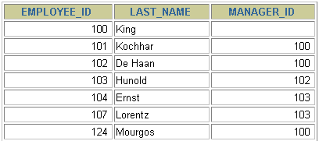
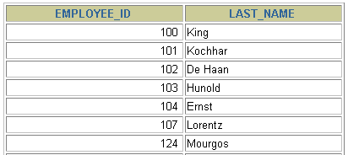
自连接
EMPLOYEES (WORKER)
EMPLOYEES (MANAGER)
…
…
WORKER 表中的MANAGER_ID 和 MANAGER 表中的EMPLOYEE_ID相等
练习：查询出 last_name 为 ‘Chen’ 的员工的 manager 的信息
Notes:
Joining a Table to Itself
Sometimes you need to join a table to itself. To find the name of each employee’s manager, you need to join the EMPLOYEES table to itself, or perform a self join. For example, to find the name of Whalen’s manager, you need to:
Find Whalen in the EMPLOYEES table by looking at the LAST_NAME column.
Find the manager number for Whalen by looking at the MANAGER_ID column. Whalen’s manager number is 101.
Find the name of the manager with EMPLOYEE_ID 101 by looking at the LAST_NAME column. Kochhar’s employee number is 101, so Kochhar is Whalen’s manager.
In this process, you look in the table twice. The first time you look in the table to find Whalen in the LAST_NAME column and MANAGER_ID value of 101. The second time you look in the EMPLOYEE_ID column to find 101 and the LAST_NAME column to find Kochhar.
Instructor Note
Show the data from the EMPLOYEES table and point out how each manager is also an employee.

Slide 48
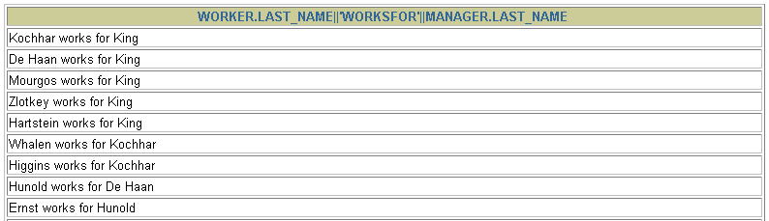
自连接
题目：查询employees表，返回“Xxx works for Xxx”
SELECT CONCAT(worker.last_name ,' works for '
, manager.last_name)
FROM employees worker, employees manager
WHERE worker.manager_id = manager.employee_id ;
…
Notes:
Joining a Table to Itself (continued)
The slide example joins the EMPLOYEES table to itself. To simulate two tables in the FROM clause, there are two aliases, namely w and m, for the same table, EMPLOYEES.
In this example, the WHERE clause contains the join that means “where a worker’s manager number matches the employee number for the manager.”
Instructor Note
Point out the following to the students:
The column heading in the result of the query on the slide seems meaningless. A meaningful column alias should have been used instead.
There are only 19 rows in the output, but there are 20 rows in the EMPLOYEES table. This occurs because employee King, who is the president, does not have a manager.

Slide 49
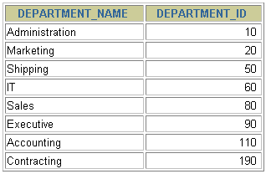
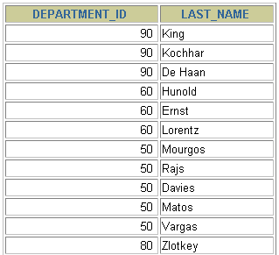
外连接
DEPARTMENTS
EMPLOYEES
…
190号部门没有员工
Notes:
Returning Records with No Direct Match with Outer Joins
If a row does not satisfy a join condition, the row will not appear in the query result. For example, in the equijoin condition of EMPLOYEES and DEPARTMENTS tables, employee Grant does not appear because there is no department ID recorded for her in the EMPLOYEES table. Instead of seeing 20 employees in the result set, you see 19 records.
SELECT e.last_name, e.department_id, d.department_name
FROM employees e, departments d
WHERE e.department_id = d.department_id;输出106行，而本身是有107行的。（在非等值连接演示了）现在想把不满足的也显示出来，叫外连接。
…

Slide 50
内连接和外连接(1)
内连接: 合并具有同一列的两个以上的表的行, 结果集中不包含一个表与另一个表不匹配的行
外连接: 两个表在连接过程中除了返回满足连接条件的行以外还返回左（或右）表中不满足条件的行 ，这种连接称为左（或右） 外连接。没有匹配的行时, 结果表中相应的列为空(NULL).

Slide 51
SQL99：使用ON 子句创建连接
自然连接中是以具有相同名字的列为连接条件的。
可以使用 ON 子句指定额外的连接条件。
这个连接条件是与其它条件分开的。
ON 子句使语句具有更高的易读性。
Notes:
如：
Select last_name,department_name
From employees e join departments d
On e.department_id = d.department_id;
The ON Condition
Use the ON clause to specify a join condition. This lets you specify join conditions separate from any search or filter conditions in the WHERE clause.

Slide 52
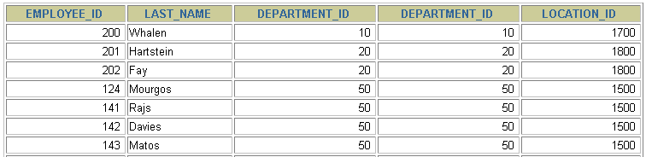
ON 子句
SELECT e.employee_id, e.last_name, e.department_id,
d.department_id, d.location_id
FROM employees e JOIN departments d
ON (e.department_id = d.department_id);
…
Notes:
Creating Joins with the ON Clause
The ON clause can also be used as follows to join columns that have different names:
SELECT e.last_name emp, m.last_name mgr
FROM employees e JOIN employees m
ON (e.manager_id = m.employee_id);
The preceding example is a selfjoin of the EMPLOYEE table to itself, based on the EMPLOYEE_ID and MANAGER_ID columns.
…

Slide 53
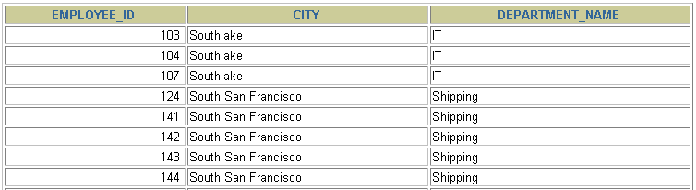
使用 ON 子句创建多表连接
SELECT employee_id, city, department_name
FROM employees e
JOIN departments d
ON d.department_id = e.department_id
JOIN locations l
ON d.location_id = l.location_id;
…
Notes:
Three-Way Joins
A three-way join is a join of three tables. In SQL: 1999 compliant syntax, joins are performed from left to right so the first join to be performed is EMPLOYEES JOIN DEPARTMENTS. The first join condition can reference columns in EMPLOYEES and DEPARTMENTS but cannot reference columns in LOCATIONS. The second join condition can reference columns from all three tables.
This can also be written as a three-way equijoin:
SELECT employee_id, city, department_name
FROM employees, departments, locations
WHERE employees.department_id = departments.department_id
AND departments.location_id = locations.location_id;
Instructor Note
The example shown can also be accomplished with the USING clause:
SELECT e.employee_id, l.city, d.department_name
FROM employees e
JOIN departments d
USING (department_id)
JOIN locations l
USING (location_id);

Slide 54

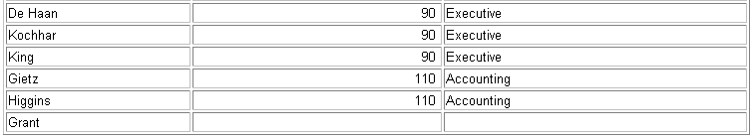
左外连接
SELECT e.last_name, e.department_id, d.department_name
FROM employees e
LEFT OUTER JOIN departments d
ON (e.department_id = d.department_id) ;
…
Notes:
Example of LEFT OUTER JOIN
This query retrieves all rows in the EMPLOYEES table, which is the left table even if there is no match in the DEPARTMENTS table.
This query was completed in earlier releases as follows:
SELECT e.last_name, e.department_id, d.department_name
FROM employees e, departments d
WHERE d.department_id (+) = e.department_id;

Slide 55
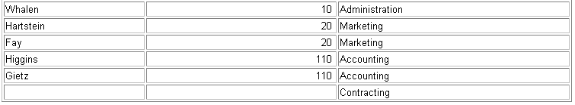
右外连接
SELECT e.last_name, e.department_id, d.department_name
FROM employees e
RIGHT OUTER JOIN departments d
ON (e.department_id = d.department_id) ;
…
Notes:
Example of RIGHT OUTER JOIN
This query retrieves all rows in the DEPARTMENTS table, which is the right table even if there is no match in the EMPLOYEES table.
This query was completed in earlier releases as follows:
SELECT e.last_name, e.department_id, d.department_name
FROM employees e, departments d
WHERE d.department_id = e.department_id (+);

Slide 56
4 — 单行函数

Slide 57
SQL 函数
输入
函 数
输出
参数1
函数执行
参数2
结 果
参数n
y = f(x1,…,xn)
Notes:
SQL Functions
Functions are a very powerful feature of SQL and can be used to do the following:
Perform calculations on data
Modify individual data items
Manipulate output for groups of rows
Format dates and numbers for display
Convert column data types
SQL functions sometimes take arguments and always return a value.
Note: Most of the functions described in this lesson are specific to Oracle’s version of SQL.
Instructor Note
This lesson does not discuss all functions in great detail. It presents the most common functions with a brief explanation of them.

Slide 58
两种 SQL 函数
函 数
单行函数
多行函数
Notes:
SQL Functions (continued)
There are two distinct types of functions:
Single-row functions
Multiple-row functions
Single-Row Functions
These functions operate on single rows only and return one result per row. There are different types of single-row functions. This lesson covers the following ones:
Character
Number
Date
Conversion
Multiple-Row Functions
Functions can manipulate groups of rows to give one result per group of rows. These functions are known as group functions. This is covered in a later lesson.
For more information, see Oracle9i SQL Reference for the complete list of available functions and their syntax.

Slide 59
单行函数
单行函数:
操作数据对象
接受参数返回一个结果
只对一行进行变换
每行返回一个结果
可以嵌套
参数可以是一列或一个值
function_name [(arg1, arg2,...)]
Notes:
Single-Row Functions
Single-row functions are used to manipulate data items. They accept one or more arguments and return one value for each row returned by the query. An argument can be one of the following:
User-supplied constant
Variable value
Column name
Expression
Features of single-row functions include:
Acting on each row returned in the query
Returning one result per row
Possibly returning a data value of a different type than that referenced
Possibly expecting one or more arguments
Can be used in SELECT, WHERE, and ORDER BY clauses; can be nested
In the syntax:
function_name is the name of the function.
arg1, arg2 is any argument to be used by the function. This can be represented by a column name or expression.

Slide 60
字符函数
字符函数
大小写控制函数
字符控制函数
LOWER
UPPER
CONCAT
SUBSTR
LENGTH
INSTR
LPAD | RPAD
TRIM
REPLACE

Slide 61
大小写控制函数
这类函数改变字符的大小写。
函数
结果
LOWER('SQL Course')
UPPER('SQL Course')
sql course
SQL COURSE
Notes:
Case Manipulation Functions
LOWER, UPPER, and INITCAP are the three case-conversion functions.
LOWER: Converts mixed case or uppercase character strings to lowercase
UPPER: Converts mixed case or lowercase character strings to uppercase
INITCAP: Converts the first letter of each word to uppercase and remaining letters to lowercase
SELECT 'The job id for '||UPPER(last_name)||' is '
||LOWER(job_id) AS "EMPLOYEE DETAILS"
FROM employees;
…

Slide 62
字符控制函数
这类函数控制字符:
函数
结果
CONCAT('Hello', 'World')
SUBSTR('HelloWorld',1,5)
LENGTH('HelloWorld')
INSTR('HelloWorld', 'W')
LPAD(salary,10,'*')
RPAD(salary, 10, '*')
TRIM('H' FROM 'HelloWorld')
REPLACE('abcd','b','m')
HelloWorld
Hello
10
6
*****24000
24000*****
elloWorld
amcd
Notes:
Character Manipulation Functions
CONCAT, SUBSTR, LENGTH, INSTR, LPAD, RPAD, and TRIM are the character manipulation functions covered in this lesson.
CONCAT: Joins values together (You are limited to using two parameters with CONCAT.)
SUBSTR: Extracts a string of determined length
LENGTH: Shows the length of a string as a numeric value
INSTR: Finds numeric position of a named character
LPAD: Pads the character value right-justified
RPAD: Pads the character value left-justified
TRIM: Trims heading or trailing characters (or both) from a character string (If trim_character or trim_source is a character literal, you must enclose it in single quotes.)
Instructor Note
Be sure to point out RPAD to the students, because this function is needed in a practice exercise. Also, TRIM, which was a new function in Oracle8i, does the job of both the LTRIM and the RTRIM functions.

Slide 63
数字函数
ROUND: 四舍五入
ROUND(45.926, 2) 45.93
TRUNCATE: 截断
TRUNCATE(45.926) 45
MOD: 求余
MOD(1600, 300) 100
Notes:
Number Functions
Number functions accept numeric input and return numeric values. This section describes some of the number functions.
Note: This list contains only some of the available number functions.
For more information, see Oracle9i SQL Reference, “Number Functions.”

Slide 64
日期函数
函数NOW() 返回:
日期
时间
Notes:
The SYSDATE Function
SYSDATE is a date function that returns the current database server date and time. You can use SYSDATE just as you would use any other column name. For example, you can display the current date by selecting SYSDATE from a table. It is customary to select SYSDATE from a dummy table called DUAL.
Example
Display the current date using the DUAL table.
SELECT SYSDATE
FROM DUAL;

Slide 65
通用函数
SELECT employee_id,12 * salary * (1 + IFNULL(commission_pct,0))
FROM employees;
Notes:
The SYSDATE Function
SYSDATE is a date function that returns the current database server date and time. You can use SYSDATE just as you would use any other column name. For example, you can display the current date by selecting SYSDATE from a table. It is customary to select SYSDATE from a dummy table called DUAL.
Example
Display the current date using the DUAL table.
SELECT SYSDATE
FROM DUAL;

Slide 66
条件表达式
在 SQL 语句中使用IF-THEN-ELSE 逻辑
使用方法:
CASE 表达式
Notes:
Conditional Expressions
Two methods used to implement conditional processing (IF-THEN-ELSE logic) within a SQL statement are the CASE expression and the DECODE function.
Note: The CASE expression is new in the Oracle9i Server release. The CASE expression complies with ANSI SQL; DECODE is specific to Oracle syntax.

Slide 67
CASE 表达式
在需要使用 IF-THEN-ELSE 逻辑时:
CASE expr WHEN comparison_expr1 THEN return_expr1
[WHEN comparison_expr2 THEN return_expr2
WHEN comparison_exprn THEN return_exprn
ELSE else_expr]
END
练习：查询部门号为 10, 20, 30 的员工信息, 若部门号为 10, 则打印其工资的 1.1 倍, 20 号部门, 则打印其工资的 1.2 倍, 30 号部门打印其工资的 1.3 倍数
Notes:
The CASE Expression
CASE expressions let you use IF-THEN-ELSE logic in SQL statements without having to invoke procedures.
In a simple CASE expression, Oracle searches for the first WHEN ... THEN pair for which expr is equal to comparison_expr and returns return_expr. If none of the WHEN ... THEN pairs meet this condition, and an ELSE clause exists, then Oracle returns else_expr. Otherwise, Oracle returns null. You cannot specify the literal NULL for all the return_exprs and the else_expr.
All of the expressions ( expr, comparison_expr, and return_expr) must be of the same data type, which can be CHAR, VARCHAR2, NCHAR, or NVARCHAR2.
Instructor Note
There is also a searched CASE expression. Oracle searches from left to right until it finds an occurrence of a condition that is true, and then returns return_expr. If no condition is found to be true, and an ELSE clause exists, Oracle returns else_expr. Otherwise Oracle returns null. For more information, see Oracle9i SQL Reference, “Expressions.”

Slide 68
CASE 表达式
下面是使用case表达式的一个例子：
SELECT last_name, job_id, salary,
CASE job_id WHEN 'IT_PROG' THEN 1.10*salary
WHEN 'ST_CLERK' THEN 1.15*salary
WHEN 'SA_REP' THEN 1.20*salary
ELSE salary END "REVISED_SALARY"
FROM employees;
…
…
Notes:
Using the CASE Expression
In the preceding SQL statement, the value of JOB_ID is decoded. If JOB_ID is IT_PROG, the salary increase is 10%; if JOB_ID is ST_CLERK, the salary increase is 15%; if JOB_ID is SA_REP, the salary increase is 20%. For all other job roles, there is no increase in salary.
The same statement can be written with the DECODE function.

Slide 69
5 — 分组函数

Slide 70
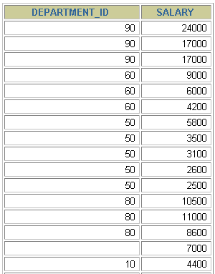

什么是分组函数
分组函数作用于一组数据，并对一组数据返回一个值。
EMPLOYEES
表 EMPLOYEES
中的工资最大值
…
Notes:
Group Functions
Unlike single-row functions, group functions operate on sets of rows to give one result per group. These sets may be the whole table or the table split into groups.

Slide 71
组函数类型
AVG()
SUM()
MAX()
MIN()
COUNT()

Slide 72
组函数语法
SELECT [column,] group_function(column), ...
FROM table
[WHERE condition]
[GROUP BY column]
[ORDER BY column];
Notes:
Guidelines for Using Group Functions
DISTINCT makes the function consider only nonduplicate values; ALL makes it consider every value including duplicates. The default is ALL and therefore does not need to be specified.
The data types for the functions with an expr argument may be CHAR, VARCHAR2, NUMBER, or DATE.
All group functions ignore null values. To substitute a value for null values, use the NVL, NVL2, or COALESCE functions.
The Oracle server implicitly sorts the result set in ascending order when using a GROUP BY clause. To override this default ordering, DESC can be used in an ORDER BY clause.
Instructor Note
Stress the use of DISTINCT and group functions ignoring null values. ALL is the default and is very rarely specified.

Slide 73
AVG（平均值）和 SUM （合计）函数
可以对数值型数据使用AVG 和 SUM 函数。
SELECT AVG(salary), MAX(salary),
MIN(salary), SUM(salary)
FROM employees
WHERE job_id LIKE '%REP%';
Notes:
Group Functions
You can use AVG, SUM, MIN, and MAX functions against columns that can store numeric data. The example on the slide displays the average, highest, lowest, and sum of monthly salaries for all sales representatives.

Slide 74
MIN（最小值）和 MAX（最大值）函数
可以对任意数据类型的数据使用 MIN 和 MAX 函数。
SELECT MIN(hire_date), MAX(hire_date)
FROM employees;
Notes:
Group Functions (continued)
You can use the MAX and MIN functions for any data type. The slide example displays the most junior and most senior employee.
The following example displays the employee last name that is first and the employee last name that is the last in an alphabetized list of all employees.
SELECT MIN(last_name), MAX(last_name)
FROM employees;
Note: AVG, SUM, VARIANCE, and STDDEV functions can be used only with numeric data types.

Slide 75
COUNT（计数）函数
COUNT(*) 返回表中记录总数,适用于任意数据类型。
SELECT COUNT(*)
FROM employees
WHERE department_id = 50;
Notes:
The COUNT Function
The COUNT function has three formats:
COUNT(*)
COUNT(expr)
COUNT(DISTINCT expr)
COUNT(*) returns the number of rows in a table that satisfy the criteria of the SELECT statement, including duplicate rows and rows containing null values in any of the columns. If a WHERE clause is included in the SELECT statement, COUNT(*) returns the number of rows that satisfies the condition in the WHERE clause.
In contrast, COUNT(expr) returns the number of non-null values in the column identified by expr.
COUNT(DISTINCT expr) returns the number of unique, non-null values in the column identified by expr.
The slide example displays the number of employees in department 50.
Instructor Note
Demo: 5_count1.sql, 5_count2.sql
Purpose: To illustrate using the COUNT(*) and COUNT(expr) functions

Slide 76
COUNT（计数）函数
COUNT(expr) 返回expr不为空的记录总数。
SELECT COUNT(commission_pct)
FROM employees
WHERE department_id = 50;
Notes:
The COUNT Function (continued)
The slide example displays the number of employees in department 80 who can earn a commission.
Example
Display the number of department values in the EMPLOYEES table.
SELECT COUNT(department_id)
FROM employees;

Slide 77
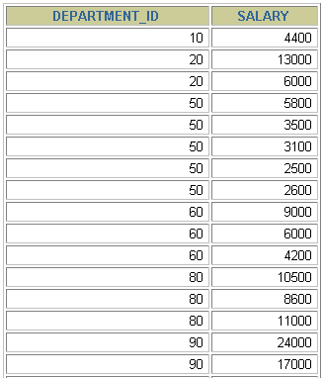
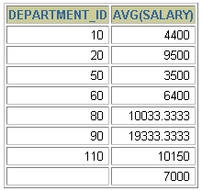
分组数据
EMPLOYEES
4400
9500
3500
求出
EMPLOYEES 表中各
部门的
平均工资
6400
10033
…
Notes:
Groups of Data
Until now, all group functions have treated the table as one large group of information. At times, you need to divide the table of information into smaller groups. This can be done by using the GROUP BY clause.

Slide 78
分组数据: GROUP BY 子句语法
可以使用GROUP BY子句将表中的数据分成若干组
SELECT column, group_function(column)
FROM table
[WHERE condition]
[GROUP BY group_by_expression]
[ORDER BY column];
明确：WHERE一定放在FROM后面
Notes:
The GROUP BY Clause
You can use the GROUP BY clause to divide the rows in a table into groups. You can then use the group functions to return summary information for each group.
In the syntax:
group_by_expression specifies columns whose values determine the basis for grouping rows
Guidelines
If you include a group function in a SELECT clause, you cannot select individual results as well, unless the individual column appears in the GROUP BY clause. You receive an error message if you fail to include the column list in the GROUP BY clause.
Using a WHERE clause, you can exclude rows before dividing them into groups.
You must include the columns in the GROUP BY clause.
You cannot use a column alias in the GROUP BY clause.
By default, rows are sorted by ascending order of the columns included in the GROUP BY list. You can override this by using the ORDER BY clause.

Slide 79
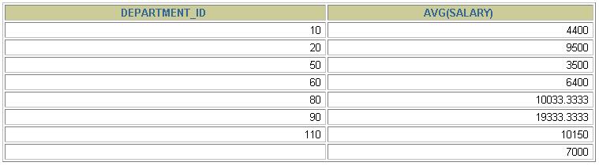
GROUP BY 子句
在SELECT 列表中所有未包含在组函数中的列都应该包含
在 GROUP BY 子句中。
SELECT department_id, AVG(salary)
FROM employees
GROUP BY department_id ;
Notes:
The GROUP BY Clause (continued)
When using the GROUP BY clause, make sure that all columns in the SELECT list that are not group functions are included in the GROUP BY clause. The example on the slide displays the department number and the average salary for each department. Here is how this SELECT statement, containing a GROUP BY clause, is evaluated:
The SELECT clause specifies the columns to be retrieved:
Department number column in the EMPLOYEES table
The average of all the salaries in the group you specified in the GROUP BY clause
The FROM clause specifies the tables that the database must access: the EMPLOYEES table.
The WHERE clause specifies the rows to be retrieved. Since there is no WHERE clause, all rows are retrieved by default.
The GROUP BY clause specifies how the rows should be grouped. The rows are being grouped by department number, so the AVG function that is being applied to the salary column will calculate the average salary for each department.
Instructor Note
Group results are sorted implicitly, on the grouping column. You can use ORDER BY to specify a different sort order, remembering to use only group functions, or the grouping column.

Slide 80
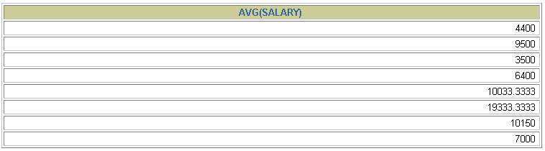
GROUP BY 子句
包含在 GROUP BY 子句中的列不必包含在SELECT 列表中
SELECT AVG(salary)
FROM employees
GROUP BY department_id ;
Notes:
The GROUP BY Clause (continued)
The GROUP BY column does not have to be in the SELECT clause. For example, the SELECT statement on the slide displays the average salaries for each department without displaying the respective department numbers. Without the department numbers, however, the results do not look meaningful.
You can use the group function in the ORDER BY clause.
SELECT department_id, AVG(salary)
FROM employees
GROUP BY department_id
ORDER BY AVG(salary);
Instructor Note
Demonstrate the query with and without the DEPARTMENT_ID column in the SELECT statement.
…

Slide 81
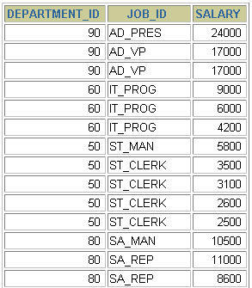
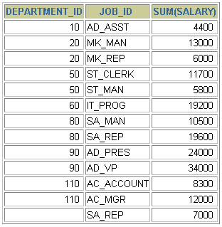

使用多个列分组
EMPLOYEES
使用多个列
进行分组
…
Notes:
Groups within Groups
Sometimes you need to see results for groups within groups. The slide shows a report that displays the total salary being paid to each job title, within each department.
The EMPLOYEES table is grouped first by department number and, within that grouping, by job title. For example, the four stock clerks in department 50 are grouped together and a single result (total salary) is produced for all stock clerks within the group.
Instructor Note
Demo: 5_order1.sql, 5_order2.sql
Purpose: To illustrate ordering columns that are grouped by DEPARTMENT_ID first and ordering columns that are grouped by JOB_ID first.

Slide 82
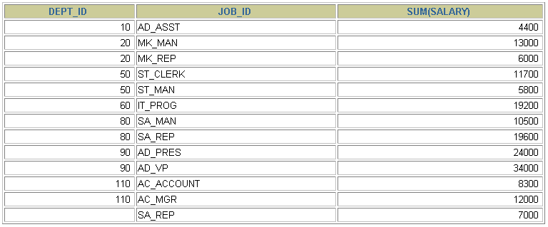
在GROUP BY子句中包含多个列
SELECT department_id dept_id, job_id, SUM(salary)
FROM employees
GROUP BY department_id, job_id ;
Notes:
Groups within Groups (continued)
You can return summary results for groups and subgroups by listing more than one GROUP BY column. You can determine the default sort order of the results by the order of the columns in the GROUP BY clause. Here is how the SELECT statement on the slide, containing a GROUP BY clause, is evaluated:
The SELECT clause specifies the column to be retrieved:
Department number in the EMPLOYEES table
Job ID in the EMPLOYEES table
The sum of all the salaries in the group that you specified in the GROUP BY clause
The FROM clause specifies the tables that the database must access: the EMPLOYEES table.
The GROUP BY clause specifies how you must group the rows:
First, the rows are grouped by department number.
Second, within the department number groups, the rows are grouped by job ID.
So the SUM function is being applied to the salary column for all job IDs within each department number group.

Slide 83
非法使用组函数
不能在 WHERE 子句中使用组函数。
可以在 HAVING 子句中使用组函数。
SELECT department_id, AVG(salary)
FROM employees
WHERE AVG(salary) > 8000
GROUP BY department_id;
WHERE AVG(salary) > 8000
*
ERROR at line 3:
ORA-00934: group function is not allowed here
WHERE 子句中不能使用组函数
Notes:
即：返回平均工资大于6000的department_id
Select department_id,avg(salary)
From employees
Group by department_id;
Having avg(salary)>6000;
Illegal Queries Using Group Functions (continued)
The WHERE clause cannot be used to restrict groups. The SELECT statement on the slide results in an error because it uses the WHERE clause to restrict the display of average salaries of those departments that have an average salary greater than $8,000.
You can correct the slide error by using the HAVING clause to restrict groups.
SELECT department_id, AVG(salary)
FROM employees
HAVING AVG(salary) > 8000
GROUP BY department_id;

Slide 84
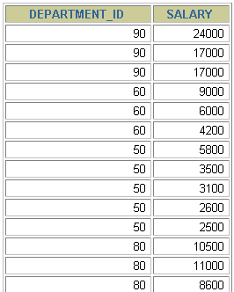
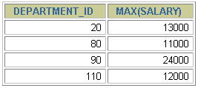

过滤分组
EMPLOYEES
部门最高工资
比 10000 高的
部门
…
Notes:
Restricting Group Results
In the same way that you use the WHERE clause to restrict the rows that you select, you use the HAVING clause to restrict groups. To find the maximum salary of each department, but show only the departments that have a maximum salary of more than $10,000, you need to do the following:
1. Find the average salary for each department by grouping by department number.
2. Restrict the groups to those departments with a maximum salary greater than $10,000.

Slide 85
过滤分组： HAVING 子句
使用 HAVING 过滤分组:
1. 行已经被分组。
2. 使用了组函数。
3. 满足HAVING 子句中条件的分组将被显示。
SELECT column, group_function
FROM table
[WHERE condition]
[GROUP BY group_by_expression]
[HAVING group_condition]
[ORDER BY column];
Notes:
The HAVING Clause
You use the HAVING clause to specify which groups are to be displayed, and thus, you further restrict the groups on the basis of aggregate information.
In the syntax:
group_condition restricts the groups of rows returned to those groups for which the specified condition is true
The Oracle server performs the following steps when you use the HAVING clause:
1. Rows are grouped.
2. The group function is applied to the group.
3. The groups that match the criteria in the HAVING clause are displayed.
The HAVING clause can precede the GROUP BY clause, but it is recommended that you place the GROUP BY clause first because that is more logical. Groups are formed and group functions are calculated before the HAVING clause is applied to the groups in the SELECT list.
Instructor Note
The Oracle server evaluates the clauses in the following order:
If the statement contains a WHERE clause, the server establishes the candidate rows.
The server identifies the groups specified in the GROUP BY clause.
The HAVING clause further restricts result groups that do not meet the group criteria in the HAVING clause.

Slide 86
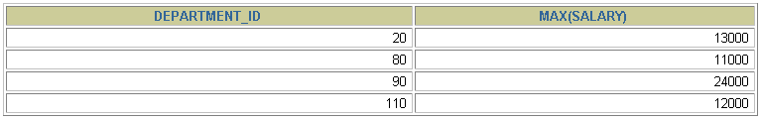
HAVING 子句
SELECT department_id, MAX(salary)
FROM employees
GROUP BY department_id
HAVING MAX(salary)>10000 ;
Notes:
The HAVING Clause (continued)
The slide example displays department numbers and maximum salaries for those departments whose maximum salary is greater than $10,000.
You can use the GROUP BY clause without using a group function in the SELECT list.
If you restrict rows based on the result of a group function, you must have a GROUP BY clause as well as the HAVING clause.
The following example displays the department numbers and average salaries for those departments whose maximum salary is greater than $10,000:
SELECT department_id, AVG(salary)
FROM employees
GROUP BY department_id
HAVING max(salary)>10000;

Slide 87


