Slide 1

第4节
数据处理之增删改

Slide 2
目 标
通过本章学习，您将可以:
使用 DML 语句
向表中插入数据
更新表中数据
从表中删除数据
Notes:
Lesson Aim
In this lesson, you learn how to insert rows into a table, update existing rows in a table, and delete existing rows from a table. You also learn how to control transactions with the COMMIT, SAVEPOINT, and ROLLBACK statements.

Slide 3
数据操纵语言
DML(Data Manipulation Language – 数据操纵语言) 可以在下列条件下执行:
向表中插入数据
修改现存数据
删除现存数据
事务是由完成若干项工作的DML语句组成的
Notes:
Data Manipulation Language
Data manipulation language (DML) is a core part of SQL. When you want to add, update, or delete data in the database, you execute a DML statement. A collection of DML statements that form a logical unit of work is called a transaction.
Consider a banking database. When a bank customer transfers money from a savings account to a checking account, the transaction might consist of three separate operations: decrease the savings account, increase the checking account, and record the transaction in the transaction journal. The Oracle server must guarantee that all three SQL statements are performed to maintain the accounts in proper balance. When something prevents one of the statements in the transaction from executing, the other statements of the transaction must be undone.
Instructor Note
DML statements can be issued directly in iSQL*Plus, performed automatically by tools such as Oracle Forms Services, or programmed with tools such as the 3GL precompilers.
Every table has INSERT, UPDATE, and DELETE privileges associated with it. These privileges are automatically granted to the creator of the table, but in general they must be explicitly granted to other users.
Starting with Oracle 7.2, you can place a subquery in the place of the table name in an UPDATE statement, essentially the same way you use a view.

Slide 4
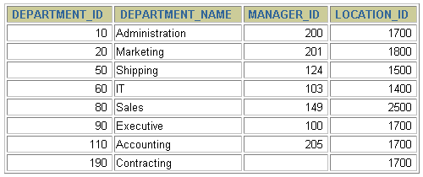
插入数据
新行
DEPARTMENTS
向 DEPARTMENTS
表中插入新的记录
Notes:
Adding a New Row to a Table
The slide graphic illustrates adding a new department to the DEPARTMENTS table.

Slide 5
INSERT 语句语法
使用 INSERT 语句向表中插入数据。
使用这种语法一次只能向表中插入一条数据。
INSERT INTO table [(column [, column...])]
VALUES (value [, value...]);
Notes:
Adding a New Row to a Table (continued)
You can add new rows to a table by issuing the INSERT statement.
In the syntax:
table is the name of the table
column is the name of the column in the table to populate
value is the corresponding value for the column
Note: This statement with the VALUES clause adds only one row at a time to a table.

Slide 6
插入数据
为每一列添加一个新值。
按列的默认顺序列出各个列的值。
在 INSERT 子句中随意列出列名和他们的值。
字符和日期型数据应包含在单引号中。
INSERT INTO departments(department_id, department_name,
manager_id, location_id)
VALUES (70, 'Pub', 100, 1700);
1 row created.
Notes:
Adding a New Row to a Table (continued)
Because you can insert a new row that contains values for each column, the column list is not required in the INSERT clause. However, if you do not use the column list, the values must be listed according to the default order of the columns in the table, and a value must be provided for each column.
DESCRIBE departments
For clarity, use the column list in the INSERT clause. Enclose character and date values within single quotation marks; it is not recommended to enclose numeric values within single quotation marks.
Number values should not be enclosed in single quotes, because implicit conversion may take place for numeric values assigned to NUMBER data type columns if single quotes are included.

Slide 7
向表中插入空值
隐式方式: 在列名表中省略该列的值。
INSERT INTO departments (department_id,
department_name )
VALUES (30, 'Purchasing');
1 row created.
显示方式: 在VALUES 子句中指定空值。
INSERT INTO departments
VALUES (100, 'Finance', NULL, NULL);
1 row created.
Notes:
Methods for Inserting Null Values
Be sure that you can use null values in the targeted column by verifying the Null? status with the iSQL*Plus DESCRIBE command.
The Oracle Server automatically enforces all data types, data ranges, and data integrity constraints. Any column that is not listed explicitly obtains a null value in the new row.
Common errors that can occur during user input:
Mandatory value missing for a NOT NULL column
Duplicate value violates uniqueness constraint
Foreign key constraint violated
CHECK constraint violated
Data type mismatch
Value too wide to fit in column

Slide 8
从其它表中拷贝数据
在 INSERT 语句中加入子查询。
不必书写 VALUES 子句。
子查询中的值列表应与 INSERT 子句中的列名对应
INSERT INTO emp2
SELECT *
FROM employees
WHERE department_id = 90;
3 rows created.
INSERT INTO sales_reps(id, name, salary, commission_pct)
SELECT employee_id, last_name, salary, commission_pct
FROM employees
WHERE job_id LIKE '%REP%';
4 rows created.
Notes:
Copying Rows from Another Table
You can use the INSERT statement to add rows to a table where the values are derived from existing tables. In place of the VALUES clause, you use a subquery.
Syntax
INSERT INTO table [ column (, column) ] subquery;
In the syntax:
table is the table name
column is the name of the column in the table to populate
subquery is the subquery that returns rows into the table
The number of columns and their data types in the column list of the INSERT clause must match the number of values and their data types in the subquery. To create a copy of the rows of a table, use SELECT * in the subquery.
INSERT INTO copy_emp
SELECT *
FROM employees;
For more information, see Oracle9i SQL Reference, “SELECT,” subqueries section.
Instructor Note
Please run the script 8_cretabs.sql to create the COPY_EMP and SALES_REPS tables before demonstrating the code examples. Do not get into too many details on copying rows from another table.

Slide 9
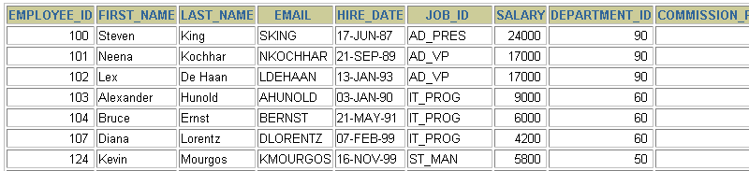
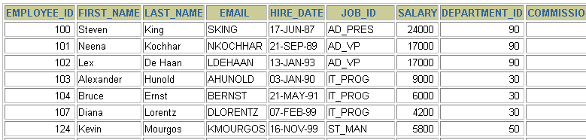
更新数据
EMPLOYEES
更新 EMPLOYEES 表
Notes:
Changing Data in a Table
The slide graphic illustrates changing the department number for employees in department 60 to department 30.

Slide 10
UPDATE 语句语法
使用 UPDATE 语句更新数据。
可以一次更新多条数据。
如果需要回滚数据，需要保证在DML前，进行设置：SET AUTOCOMMIT = FALSE;
UPDATE table
SET column = value [, column = value, ...]
[WHERE condition];
Notes:
Updating Rows
You can modify existing rows by using the UPDATE statement.
In the syntax:
table is the name of the table
column is the name of the column in the table to populate
value is the corresponding value or subquery for the column
condition identifies the rows to be updated and is composed of column names expressions, constants, subqueries, and comparison operators
Confirm the update operation by querying the table to display the updated rows.
For more information, see Oracle9i SQL Reference, “UPDATE.”
Note: In general, use the primary key to identify a single row. Using other columns can unexpectedly cause several rows to be updated. For example, identifying a single row in the EMPLOYEES table by name is dangerous, because more than one employee may have the same name.

Slide 11
更新数据
使用 WHERE 子句指定需要更新的数据。
如果省略 WHERE 子句，则表中的所有数据都将被更新。
UPDATE employees
SET department_id = 70
WHERE employee_id = 113;
1 row updated.
UPDATE copy_emp
SET department_id = 110;
22 rows updated.
Notes:
Updating Rows (continued)
The UPDATE statement modifies specific rows if the WHERE clause is specified. The slide example transfers employee 113 (Popp) to department 70.
If you omit the WHERE clause, all the rows in the table are modified.
SELECT last_name, department_id
FROM copy_emp;
Note: The COPY_EMP table has the same data as the EMPLOYEES table.
…

Slide 12
更新中的数据完整性错误
UPDATE employees
SET department_id = 55
WHERE department_id = 110;
错误代码： 1452
Cannot add or update a child row: a foreign key constraint fails (`myemployees`.`employees`, CONSTRAINT `dept_id_fk` FOREIGN KEY (`department_id`) REFERENCES `departments` (`department_id`))
不存在 55 号部门
另例：
update employees set manager_id = 299 where employee_id = 203;
Notes:
Integrity Constraint Error
If you attempt to update a record with a value that is tied to an integrity constraint, an error is returned.
In the example on the slide, department number 55 does not exist in the parent table, DEPARTMENTS, and so you receive the parent key violation ORA-02291.
Note: Integrity constraints ensure that the data adheres to a predefined set of rules. A subsequent lesson covers integrity constraints in greater depth.
Instructor Note
Explain integrity constraints, and review the concepts of primary key and foreign key.

Slide 13
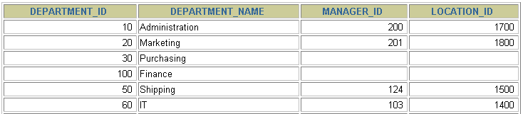
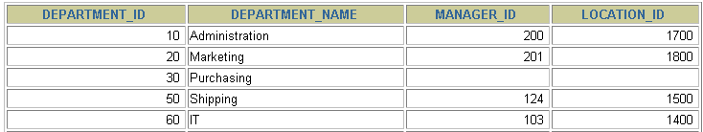
删除数据
DEPARTMENTS
从表DEPARTMENTS 中删除一条记录。
Notes:
Removing a Row from a Table
The slide graphic removes the Finance department from the DEPARTMENTS table (assuming that there are no constraints defined on the DEPARTMENTS table).
Instructor Note
After all the rows have been eliminated with the DELETE statement, only the data structure of the table remains. A more efficient method of emptying a table is with the TRUNCATE statement. You can use the TRUNCATE statement to quickly remove all rows from a table or cluster. Removing rows with the TRUNCATE statement is faster than removing them with the DELETE statement for the following reasons:
The TRUNCATE statement is a data definition language (DDL) statement and generates no rollback information. It is covered in a subsequent lesson.
Truncating a table does not fire the delete triggers of the table.
If the table is the parent of a referential integrity constraint, you cannot truncate the table. Disable the constraint before issuing the TRUNCATE statement.

Slide 14
DELETE 语句
使用 DELETE 语句从表中删除数据。
DELETE FROM table
[WHERE condition];
Notes:
Deleting Rows
You can remove existing rows by using the DELETE statement.
In the syntax:
table is the table name condition identifies the rows to be deleted and is composed of column names, expressions, constants, subqueries, and comparison operators
Note: If no rows are deleted, a message “0 rows deleted.” is returned:
For more information, see Oracle9i SQL Reference, “DELETE.”
Instructor Note
The DELETE statement does not ask for confirmation. However, the delete operation is not made permanent until the data transaction is committed. Therefore, you can undo the operation with the ROLLBACK statement if you make a mistake.

Slide 15
删除数据
使用 WHERE 子句删除指定的记录。
如果省略 WHERE 子句，则表中的全部数据将被删除
DELETE FROM departments
WHERE department_name = 'Finance';
1 row deleted.
DELETE FROM copy_emp;
22 rows deleted.
Notes:
Deleting Rows (continued)
You can delete specific rows by specifying the WHERE clause in the DELETE statement. The slide example deletes the Finance department from the DEPARTMENTS table. You can confirm the delete operation by displaying the deleted rows using the SELECT statement.
SELECT *
FROM departments
WHERE department_name = 'Finance';
no rows selected.
If you omit the WHERE clause, all rows in the table are deleted. The second example on the slide deletes all the rows from the COPY_EMP table, because no WHERE clause has been specified.
Example
Remove rows identified in the WHERE clause.
DELETE FROM employees
WHERE employee_id = 114;
1 row deleted.
DELETE FROM departments
WHERE department_id IN (30, 40);
2 rows deleted.

Slide 16
删除中的数据完整性错误
DELETE FROM departments
WHERE department_id = 60;
错误代码： 1451
Cannot delete or update a parent row: a foreign key constraint fails (`myemployees`.`employees`, CONSTRAINT `dept_id_fk` FOREIGN KEY (`department_id`) REFERENCES `departments` (`department_id`))
You cannot delete a row that contains a primary key that is used as a foreign key in another table.
Notes:
Integrity Constraint Error
If you attempt to delete a record with a value that is tied to an integrity constraint, an error is returned.
The example on the slide tries to delete department number 60 from the DEPARTMENTS table, but it results in an error because department number is used as a foreign key in the EMPLOYEES table. If the parent record that you attempt to delete has child records, then you receive the child record found violation ORA-02292.
The following statement works because there are no employees in department 70:
DELETE FROM departments
WHERE department_id = 70;
1 row deleted.
Instructor Note
If referential integrity constraints are in use, you may receive an Oracle server error message when you attempt to delete a row. However, if the referential integrity constraint contains the ON DELETE CASCADE option, then the selected row and its children are deleted from their respective tables.

Slide 17
数据库事务
事务：一组逻辑操作单元,使数据从一种状态变换到另一种状态。
数据库事务由以下的部分组成:
一个或多个DML 语句
一个 DDL(Data Definition Language – 数据定义语言) 语句
一个 DCL(Data Control Language – 数据控制语言) 语句
Notes:
Database Transactions
The Oracle server ensures data consistency based on transactions. Transactions give you more flexibility and control when changing data, and they ensure data consistency in the event of user process failure or system failure.
Transactions consist of DML statements that make up one consistent change to the data. For example, a transfer of funds between two accounts should include the debit to one account and the credit to another account in the same amount. Both actions should either fail or succeed together; the credit should not be committed without the debit.
Transaction Types

Slide 18
数据库事务
设置提交状态：SET AUTOCOMMIT = FALSE;
以第一个 DML 语句的执行作为开始
以下面的其中之一作为结束:
COMMIT 或 ROLLBACK 语句
DDL 语句（自动提交）
用户会话正常结束
系统异常终止
Notes:
When Does a Transaction Start and End?
A transaction begins when the first DML statement is encountered and ends when one of the following occurs:
A COMMIT or ROLLBACK statement is issued
A DDL statement, such as CREATE, is issued
A DCL statement is issued
The user exits iSQL*Plus
A machine fails or the system crashes
After one transaction ends, the next executable SQL statement automatically starts the next transaction.
A DDL statement or a DCL statement is automatically committed and therefore implicitly ends a transaction.
Instructor Note
Please run the script 8_cretest.sql to create the test table and insert data into the table.

Slide 19
COMMIT和ROLLBACK语句的优点
使用COMMIT 和 ROLLBACK语句,我们可以:
确保数据完整性。
数据改变被提交之前预览。
将逻辑上相关的操作分组。

Slide 20
总 结
通过本章学习, 您应学会如何使用DML语句改变数据和事务控制
语句
INSERT
UPDATE
DELETE
COMMIT
ROLLBACK
功能
插入
修正
删除
提交
回滚
Notes:
Summary
In this lesson, you should have learned how to manipulate data in the Oracle database by using the INSERT, UPDATE, and DELETE statements. Control data changes by using the COMMIT, SAVEPOINT, and ROLLBACK statements.
The Oracle server guarantees a consistent view of data at all times.
Locking can be implicit or explicit.

Slide 21


