Slide 1

HUST STUDENT MANAGEMENT SYSTEM
Vũ Ngọc Tùng – 20236058
Trần Chí Vũ – 20236060
Nguyễn Hoàng Tín – 20236055
Lê Hoàng Ánh Nguyệt – 20236050

Slide 2
PROBLEM
Hệ thống HUST Student Management System cho phép sinh viên đăng ký tài khoản, đăng ký/hủy lớp học, xem điểm, tra cứu thông tin học tập và tình trạng tốt nghiệp, cũng như thanh toán học phí một cách trực tuyến. Giảng viên có thể xem danh sách sinh viên, chấm điểm và cập nhật thông tin chuyên môn, trong khi quản trị viên (manager) có quyền tạo/sửa/xóa khóa học, lớp học, tài khoản người dùng, đồng thời mở hoặc đóng các đợt đăng ký theo học kỳ.

Slide 3
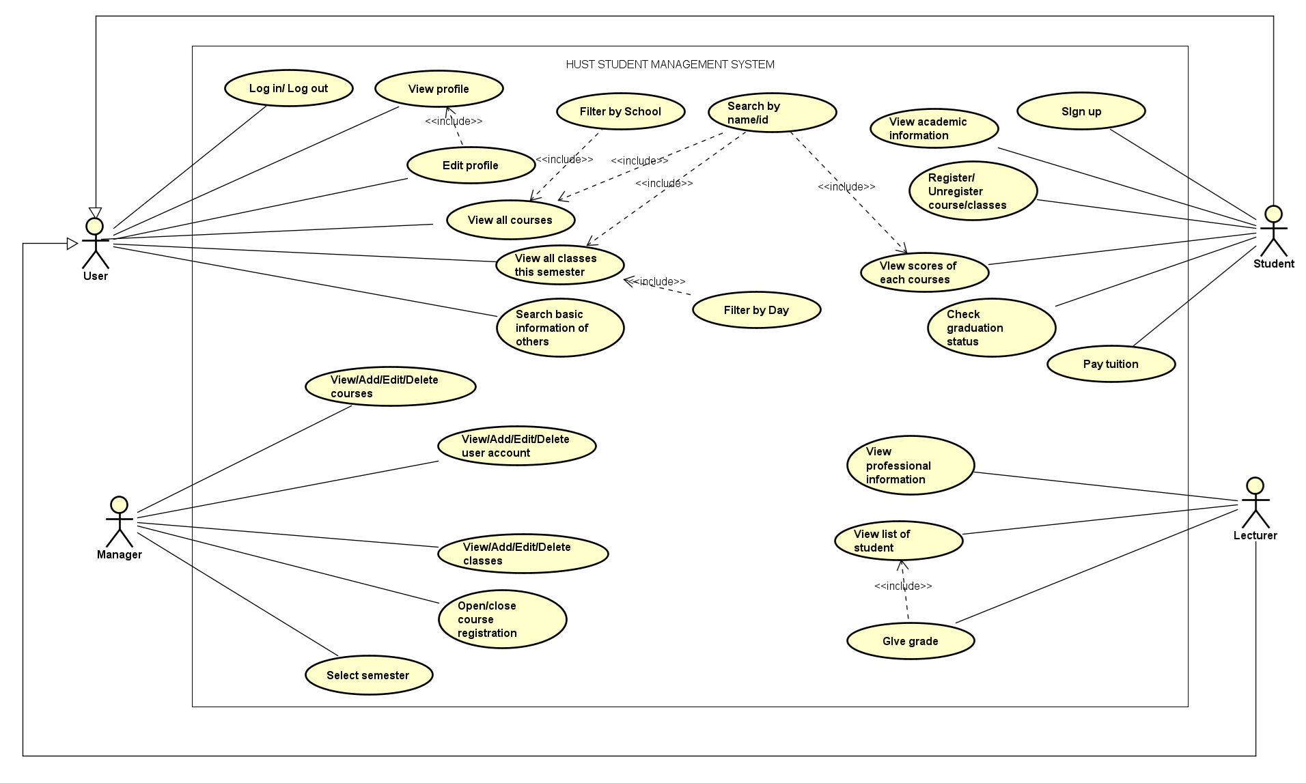
USE CASE DIAGRAM

Slide 4
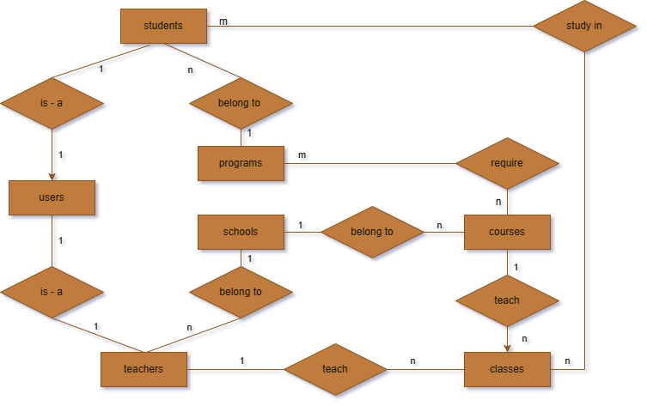
ER & RELATIONAL DIAGRAM

Slide 5
ER & RELATIONAL DIAGRAM
To convert ER Diagram to Relational Schema, we need to:
Create one table for each entities.
For 1-1 and 1-n relationship: Add foreign key in the "many" side referencing "one“.
For m-n relationship: Create junction table with foreign keys from both:
“Enrollments” table for Students m-n Classes.
“Program_requirements” table for Programs m-n Courses.

Slide 6
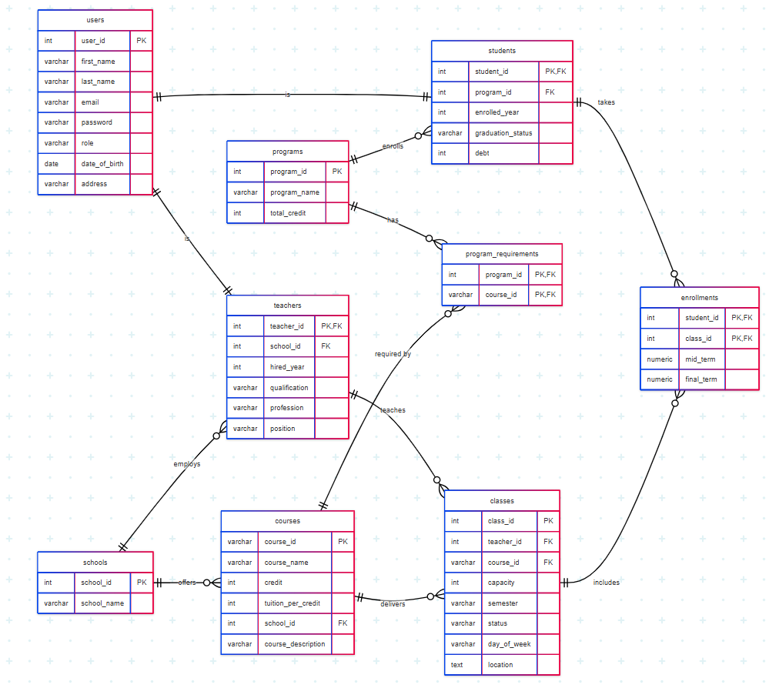
ER & RELATIONAL DIAGRAM

Slide 7
DATA TYPES (ENUMERATE)
CREATE TYPE public.class_status AS ENUM (
'open','closed');
CREATE TYPE public.day_of_week AS ENUM (
'Monday’, 'Tuesday’, 'Wednesday’,
'Thursday’, 'Friday’, 'Saturday');
CREATE TYPE public.graduation_status AS ENUM (
'graduated’, 'enrolled’, 'expelled’);
CREATE TYPE public."role" AS ENUM (
'student’, 'teacher');

Slide 8
TABLES
CREATE TABLE public.users (
user_id serial4 NOT NULL,
first_name varchar NOT NULL,
last_name varchar NOT NULL,
email varchar NULL,
"password" varchar NULL,
"role" public."role" NOT NULL,
date_of_birth date NULL,
address varchar NULL,
CONSTRAINT users_email_unique UNIQUE (email),
CONSTRAINT users_pkey PRIMARY KEY (user_id)
);
CREATE INDEX idx_users_email ON public.users USING btree (email);

Slide 9
TABLES
CREATE TABLE public.students (
student_id int4 NOT NULL,
program_id int4 NOT NULL,
enrolled_year int4 NOT NULL,
graduated public.graduation_status DEFAULT 'enrolled'::graduation_status NULL,
debt int4 DEFAULT 0 NULL,
CONSTRAINT students_pkey PRIMARY KEY (student_id),
CONSTRAINT students_program_id_programs_program_id_fk FOREIGN KEY (program_id) REFERENCES public.programs(program_id) ON DELETE CASCADE ON UPDATE CASCADE,
CONSTRAINT students_student_id_users_user_id_fk FOREIGN KEY (student_id) REFERENCES public.users(user_id) ON DELETE CASCADE ON UPDATE CASCADE);
CREATE INDEX idx_students_graduated ON public.students USING btree (graduated);
CREATE INDEX idx_students_program_id ON public.students USING btree (program_id);

Slide 10
TABLES
CREATE TABLE public.teachers (
teacher_id int4 NOT NULL,
school_id int4 NOT NULL,
hired_year int4 NULL,
qualification varchar NULL,
profession varchar NULL,
"position" varchar NULL,
CONSTRAINT teachers_pkey PRIMARY KEY (teacher_id),
CONSTRAINT teachers_school_id_schools_school_id_fk FOREIGN KEY (school_id) REFERENCES public.schools(school_id) ON DELETE CASCADE ON UPDATE CASCADE,
CONSTRAINT teachers_teacher_id_users_user_id_fk FOREIGN KEY (teacher_id) REFERENCES public.users(user_id) ON DELETE CASCADE ON UPDATE CASCADE);
CREATE INDEX idx_teachers_school_id ON public.teachers USING btree (school_id);

Slide 11
TABLES
CREATE TABLE public.classes (
class_id serial4 NOT NULL,
teacher_id int4 NULL,
course_id varchar(6) NOT NULL,
capacity int4 DEFAULT 0 NOT NULL,
semester varchar NOT NULL,
status public.class_status NOT NULL,
day_of_week public.day_of_week NOT NULL,
"location" text NOT NULL,
CONSTRAINT classes_pkey PRIMARY KEY (class_id),
CONSTRAINT classes_course_id_courses_course_id_fk FOREIGN KEY (course_id) REFERENCES public.courses(course_id) ON DELETE CASCADE ON UPDATE CASCADE,
CONSTRAINT classes_teacher_id_teachers_teacher_id_fk FOREIGN KEY (teacher_id) REFERENCES public.teachers(teacher_id) ON DELETE CASCADE ON UPDATE CASCADE);
CREATE INDEX idx_classes_course_id ON public.classes USING btree (course_id);
CREATE INDEX idx_classes_semester ON public.classes USING btree (semester);
CREATE INDEX idx_classes_teacher_id ON public.classes USING btree (teacher_id);

Slide 12
TABLES
CREATE TABLE public.courses (
course_id varchar(6) NOT NULL,
course_name varchar NOT NULL,
credit int4 NOT NULL,
tuition_per_credit int4 NOT NULL,
school_id int4 NOT NULL,
course_description varchar NULL,
CONSTRAINT courses_course_id_unique PRIMARY KEY (course_id),
CONSTRAINT courses_school_id_schools_school_id_fk FOREIGN KEY (school_id) REFERENCES public.schools(school_id) ON DELETE CASCADE ON UPDATE CASCADE
);
CREATE INDEX idx_courses_school_id ON public.courses USING btree (school_id);

Slide 13
TABLES
CREATE TABLE public.schools (
school_id serial4 NOT NULL,
school_name varchar NOT NULL,
CONSTRAINT schools_pkey PRIMARY KEY (school_id)
);
CREATE TABLE public.programs (
program_id serial4 NOT NULL,
program_name varchar NOT NULL,
total_credit int4 NOT NULL,
CONSTRAINT programs_pkey PRIMARY KEY (program_id)
);

Slide 14
TABLES
CREATE TABLE public.enrollments (
student_id int4 NOT NULL,
class_id int4 NOT NULL,
mid_term numeric(4, 2) NULL,
final_term numeric(4, 2) NULL,
CONSTRAINT check_final_term CHECK (((final_term IS NULL) OR ((final_term >= 0.00) AND (final_term <= 10.00)))),
CONSTRAINT check_mid_term CHECK (((mid_term IS NULL) OR ((mid_term >= 0.00) AND (mid_term <= 10.00)))),
CONSTRAINT unique_student_class UNIQUE (student_id, class_id),
CONSTRAINT enrollments_class_id_classes_class_id_fk FOREIGN KEY (class_id) REFERENCES public.classes(class_id) ON DELETE CASCADE ON UPDATE CASCADE,
CONSTRAINT enrollments_student_id_students_student_id_fk FOREIGN KEY (student_id) REFERENCES public.students(student_id) ON DELETE CASCADE ON UPDATE CASCADE
);
CREATE INDEX idx_enrollments_class_id ON public.enrollments USING btree (class_id);
CREATE INDEX idx_enrollments_student_id ON public.enrollments USING btree (student_id);

Slide 15
TABLES
CREATE TABLE public.program_requirements (
program_id int4 NOT NULL,
course_id varchar(6) NOT NULL,
CONSTRAINT program_course_unique UNIQUE (program_id, course_id),
CONSTRAINT program_requirements_course_id_fkey FOREIGN KEY (course_id) REFERENCES public.courses(course_id),
CONSTRAINT program_requirements_program_id_fkey FOREIGN KEY (program_id) REFERENCES public.programs(program_id)
);
CREATE INDEX idx_program_requirements_course_id ON public.program_requirements USING btree (course_id);
CREATE INDEX idx_program_requirements_program_id ON public.program_requirements USING btree (program_id);
CREATE TABLE public.configs (
current_semester varchar(255) NULL,
next_semester varchar(255) NULL,
class_reg_status bool NULL
);

Slide 16
VIEWS
CREATE OR REPLACE VIEW public.classes_view
AS SELECT c.*
count(e.student_id) AS enrolled_count
FROM classes c
LEFT JOIN enrollments e ON e.class_id = c.class_id
GROUP BY c.class_id;
CREATE OR REPLACE VIEW public.enrollments_view
AS SELECT e.*
calculate_result(mid_term, final_term) AS result,
calculate_pass_status(mid_term, final_term) AS pass
FROM enrollments e;

Slide 17
VIEWS
CREATE OR REPLACE VIEW public.students_view
AS SELECT s.*,
calculate_student_warning_level(student_id) AS warning_level,
calculate_accumulated_credit(student_id) AS accumulated_credit,
calculate_cpa(student_id) AS cpa
FROM students s;

Slide 18
TRIGGERS
create trigger trg_adjust_student_debt after
insert or delete or update on
public.enrollments for each row execute function adjust_student_debt()
CREATE OR REPLACE FUNCTION public.adjust_student_debt()
RETURNS trigger
LANGUAGE plpgsql
AS $function$
BEGIN
IF (TG_OP = 'INSERT') THEN
UPDATE students
SET debt = debt + new_debt
WHERE student_id = NEW.student_id;

Slide 19
TRIGGERS
create trigger trg_adjust_student_debt after
insert or delete or update on
public.enrollments for each row execute function adjust_student_debt()
CREATE OR REPLACE FUNCTION public.adjust_student_debt()
RETURNS trigger
LANGUAGE plpgsql
AS $function$
BEGIN
ELSIF (TG_OP = 'DELETE') THEN
UPDATE students
SET debt = debt - old_debt
WHERE student_id = OLD.student_id;

Slide 20
TRIGGERS
create trigger trg_adjust_student_debt after
insert or delete or update on
public.enrollments for each row execute function adjust_student_debt()
CREATE OR REPLACE FUNCTION public.adjust_student_debt()
RETURNS trigger
LANGUAGE plpgsql
AS $function$
BEGIN
ELSIF (TG_OP = 'UPDATE') THEN
UPDATE students
SET debt = debt - old_debt + new_debt
WHERE student_id = NEW.student_id;
END IF;
END IF;
RETURN NULL;
END;$function$;

Slide 21
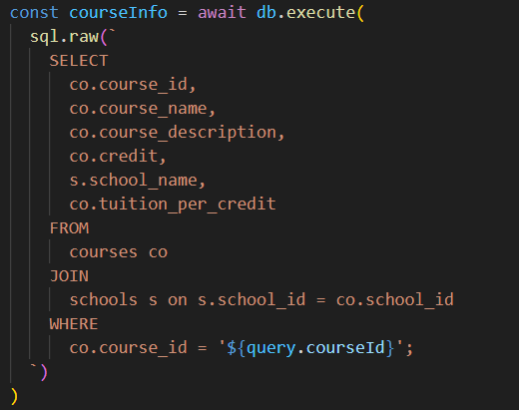
STORED PROCEDURE & APIs
The system uses basic REST APIs which include GET, POST, PUT and DELETE methods.
GET methods are used to fetch data:

Slide 22
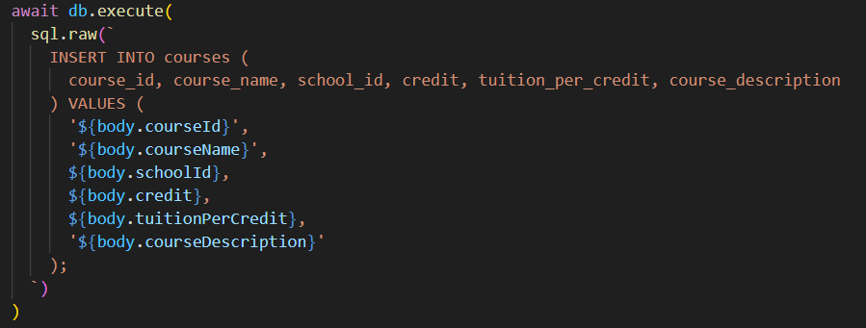
STORED PROCEDURE & APIs
The system uses basic REST APIs which include GET, POST, PUT and DELETE methods.
POST methods are used to add new data:

Slide 23
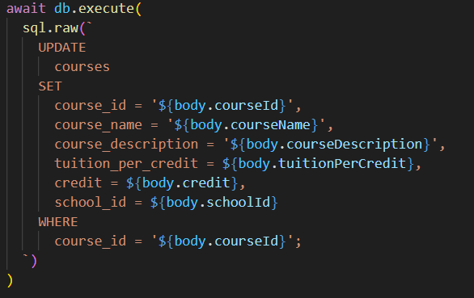
STORED PROCEDURE & APIs
The system uses basic REST APIs which include GET, POST, PUT and DELETE methods.
PUT methods are used to modify data:

Slide 24
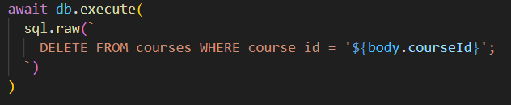
STORED PROCEDURE & APIs
The system uses basic REST APIs which include GET, POST, PUT and DELETE methods.
DELETE methods are used to delete data:

Slide 25
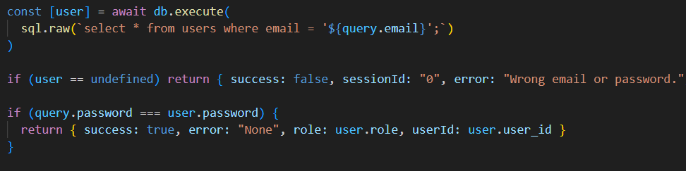
STORED PROCEDURE & APIs
Other APIs: Login API

Slide 26
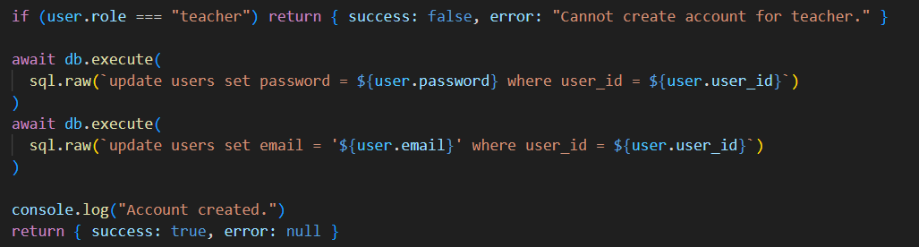
STORED PROCEDURE & APIs
Other APIs: Register API

Slide 27
STORED PROCEDURE & APIs
Other APIs: Check graduation status, which returns Boolean.
CREATE OR REPLACE FUNCTION public.fn_check_graduation_status(p_student_id integer)
RETURNS boolean
LANGUAGE plpgsql
AS $function$
DECLARE
v_program_id INT;
v_completed_course INT;
v_total_course INT;
v_completed_credit INT;
v_total_credit INT;

Slide 28
STORED PROCEDURE & APIs
Other APIs: Check graduation status, which returns Boolean.
CREATE OR REPLACE FUNCTION public.fn_check_graduation_status(p_student_id integer)
RETURNS boolean
BEGIN
-- Get the student's program ID
SELECT program_id INTO v_program_id FROM students_view WHERE student_id = p_student_id;
-- Count distinct completed courses that are part of program requirements
SELECT COUNT(DISTINCT c.course_id) INTO v_completed_course
FROM enrollments_view e
JOIN classes c … WHERE e.student_id = p_student_id … AND e.pass = TRUE;

Slide 29
STORED PROCEDURE & APIs
Other APIs: Check graduation status, which returns Boolean.
CREATE OR REPLACE FUNCTION public.fn_check_graduation_status(p_student_id integer)
RETURNS boolean
BEGIN
-- Get total required courses in the program
SELECT COUNT(course_id) INTO v_total_course FROM program_requirements
WHERE program_id = v_program_id;
-- Get total completed credits, avoiding duplicate course_ids
SELECT accumulated_credit INTO v_completed_credit FROM students_view
WHERE student_id = p_student_id;
-- Get the required total credit for the program
SELECT total_credit INTO v_total_credit FROM programs
WHERE program_id = v_program_id;

Slide 30
STORED PROCEDURE & APIs
Other APIs: Check graduation status, which returns Boolean.
CREATE OR REPLACE FUNCTION public.fn_check_graduation_status(p_student_id integer)
RETURNS boolean
BEGIN
-- Return graduation status
RETURN v_completed_course >= v_total_course
AND v_completed_credit >= v_total_credit;
END;
$function$
;

Slide 31
STORED PROCEDURE & APIs
Stored Procedure: Class registration for student
CREATE OR REPLACE PROCEDURE public.sp_enroll_student_in_class(IN p_student_id integer, IN p_class_id integer)
LANGUAGE plpgsql
AS $procedure$
DECLARE v_eligible BOOLEAN;
BEGIN
-- Check for eligibility
v_eligible := check_enrollment_eligibility(p_student_id, p_class_id);
IF NOT v_eligible THEN
RAISE EXCEPTION 'Student does not meet enrollment requirements for this class';
END IF;

Slide 32
STORED PROCEDURE & APIs
Stored Procedure: Class registration for student
CREATE OR REPLACE PROCEDURE public.sp_enroll_student_in_class(IN p_student_id integer, IN p_class_id integer)
LANGUAGE plpgsql
AS $procedure$
DECLARE v_eligible BOOLEAN;
BEGIN
-- Start a transaction for data integrity
BEGIN
-- Add an entry into enrollments
INSERT INTO enrollments (student_id, class_id, mid_term, final_term)
VALUES (p_student_id, p_class_id, NULL, NULL);
EXCEPTION
WHEN OTHERS THEN RAISE EXCEPTION 'Enrollment failed: %', SQLERRM;
END;
END;$procedure$;

Slide 33
THANK YOU !

Slide 34
FUNCTIONS

