Slide 1
Prediction of COVID-19 cases
By using machine learning
Alan McCabe
Atul Bhingarde
Chad Davis
Ganga Thota
Siraj Mohammed
Notes:
Presented by Chad

Slide 2
The Story
Presenting an predictive model, that would help for preparedness and accommodate response, using machine learning techniques on top COVID-19 outbreak data, all around the world.
Today we face a great challenge in our lives the likes of which we’ve never seen.
A pandemic has hit the entire world.
In order to better understand how different areas are affected, we display data for different countries of the world.
To keep it relative in each country, the counts are listed as occurrences per million.
We also wanted to see the relationship between GDP per capita (spending power) and hospital beds (access to healthcare).
Notes:
Presented by Chad

Slide 3
The TechStack
Data Source
Our World in Data - https://ourworldindata.org/
MongoDB
Python/PyMongo/Flask
Bootstrap/jQuery
Plotly
SKLearn/matplotlib
(Linear/Nonlinear) / Ridge RegressionsSingle/multiple, dynamic traces
Notes:
Presented by Ganga

Slide 4
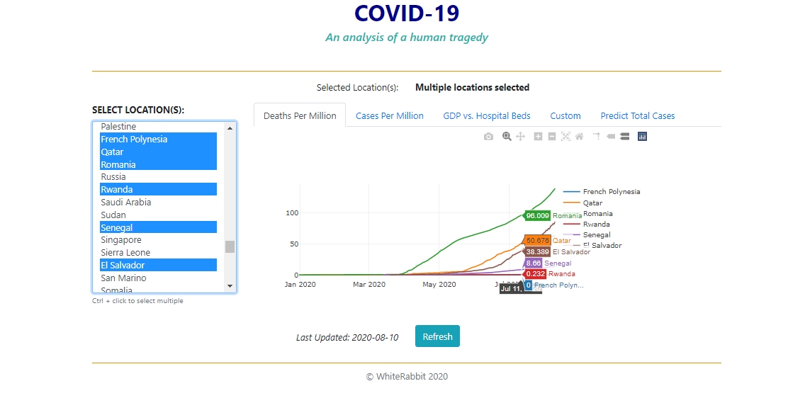
Deaths Per Million
Notes:
Presented by Atul

Slide 5
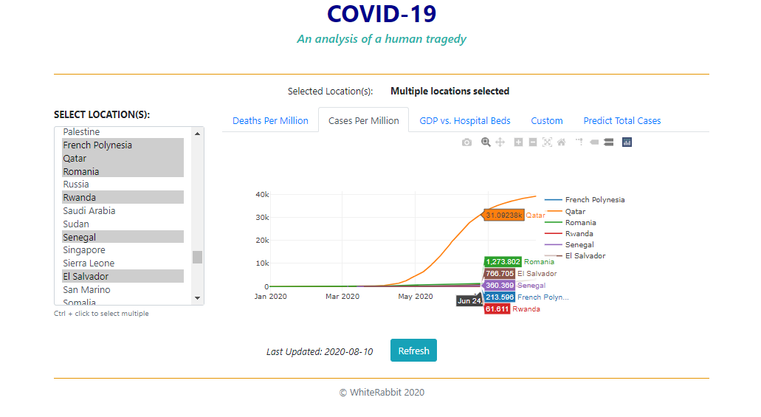
Cases Per Million
Notes:
Presented by Atul

Slide 6
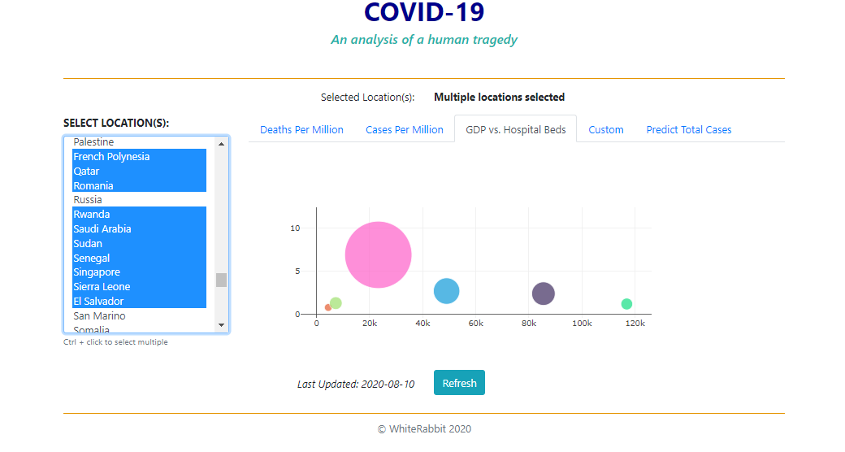
GDP vs. Hospital Beds
Notes:
Presented by Atul

Slide 7
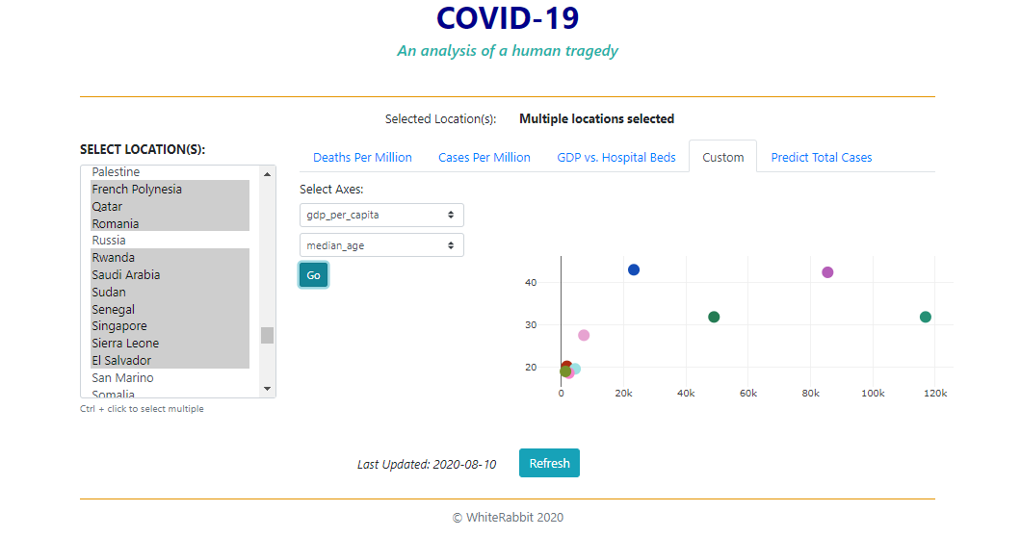
Custom axes selected from list

Slide 8
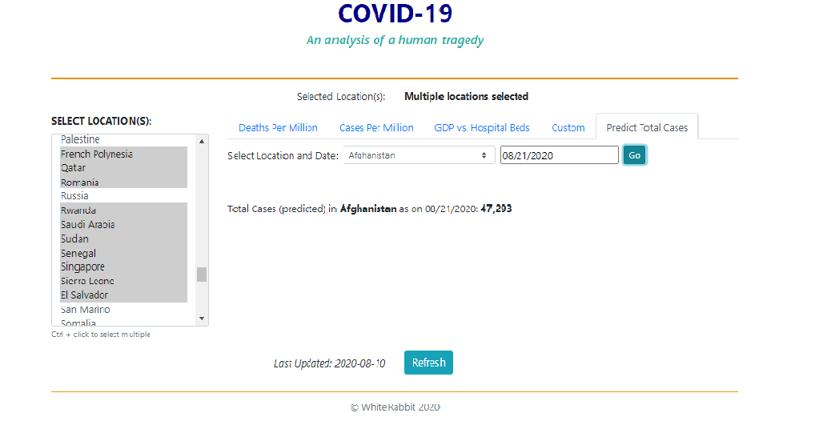
Predicting cases using machine learning

Slide 9
Live Demo
Notes:
Presented by Siraj

Slide 10
Conclusion
The details that are changing because of the outbreak and conditions, they can be predicted using mathematical models, taking out the heuristics and judgment.
Countries seem to be affected more than others.
Higher spending power (GDP per capita) is not an indicator of better access to healthcare.
More hospital beds does not guarantee lower death rate.
Notes:
Presented by Alan

Slide 11
Questions?
Notes:
Presented by Alan

